Slide 1
FNSF Blanket Testing Mission and Strategy Summary of previous workshops
Conclusions Derived Primarily from Previous FNST Workshop, August 12-14, 2008

Slide 2
A Breeding Blanket should be installed as the “BASE” Blanket on a FNSF from the beginning
A functioning breeding blanket will be needed to breed tritium during DT operation, no practical or affordable external source is available
Switching from non-breeding to breeding blanket involves complexity and long downtime, especially if coolant changes from water to helium
The actual wall conditions and materials used during the DT testing phase – e.g. high temperature and ferritic steel, should also be used during the HH/DD early operation phase in order to:
correctly optimize the plasma performance and
obtain actual information on plasma-blanket interactions early
Such information is needed for safety/licensing/availability of the DT phase
There is no non-breeding blanket for which there is more confidence than a breeding blanket (all involve risks, all will require development).
Using base breeding blanket will provide very important information essential to “reliability growth”, even during any initial HH and DD phases. This makes full utilization of the “expensive” neutrons by minimizing early life failures that are cheaper and faster to correct prior to DT operation
Note that ~ 20m² of testing area is required per concept. Two concepts need 40m² which is almost the net surface area available on the outboard of FNSF.

Slide 3
What Material Options Exist to Use For Base Breeding Blanket
FW and Structural Material: Ferritic Steel only option available by 2030
Austenitic steel is less suitable because of low thermal stress factor, high activation, and high swelling above 60 dpa. It does not extrapolate to reactor. No reasons found to think that austenitic steel reduces risk.
Primary Coolant should be Helium.
Most generically reactor relevant for ceramic breeder and dual coolant blanket options
Keep operating temperature of the ferritic structure above 300°C to minimize the impact of neutron-induced damage.
Only with this inert gas the potential for chemical reactions between the coolant and the beryllium or liquid metal breeders can be avoided

Slide 4
Base Breeding Blanket and Testing Strategy
The Two Breeding Blanket Concepts preferred by the US are:
The Dual Coolant Lithium Lead Concept (DCLL) with RAF/M steel and SiC FCI
The Helium Cooled Ceramic Breeder (HCCB) with RAF/M and Be-based multiplier
These concepts are relatively more mature and provide a more promising pathway toward attractiveness compared to other concepts.
These two concepts are recommended both for testing and for Base Breeding Blanket on FNSF
US can not test many concepts because the cost of R&D, design and analysis, and mockup testing for any given concept to qualify a test module for testing is large (~ $80 million). (Screening of many concepts is better done by the 7 international partners on ITER).
The concepts for the Base Breeding Blanket should be the same as those being tested, i.e. DCLL and HCCB, but run initially at reduced parameters/performance (e.g. more conservative temperatures)
Both port-based and base blanket can have “testing” missions
base blanket provide important data on failure modes/effects/rates and speed up the “reliability growth” phase which is very demanding and time consuming.
port-based blankets more highly instrumented and specialized for specific scientific experimental missions.

Slide 5
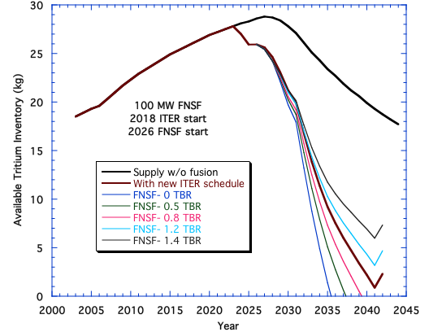
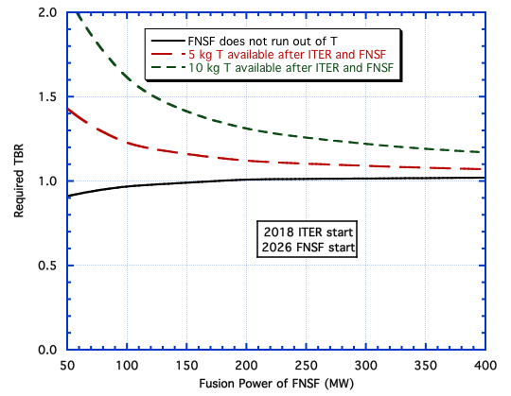
Tritium Breeding Requirement in Fusion Nuclear Science Facility (FNSF)
(Sawan/Abdou/Willms)
Almost all tritium supply will be used by ITER and FNSF has to be self-sufficient in tritium in addition to providing initial startup inventory for DEMO
Further delay in ITER and FNSF start increases required TBR in FNSF

Slide 6
FNSF Blanket Testing Mission and Strategy
Engineering Scaling
Engineering Scaling is a Process to Develop Meaningful Tests at Experimental Conditions and Parameters Less than those in a Reactor
Testing is for power plant Blanket. We need to see how the blanket behaves in power plant conditions.
If FNSF has significantly lower power density than power plant, we need to alter the test module to “Act-Alike” rather than “Look-Alike” power plant to preserve behavior
“Look-Alike” Test Modules Do Not Provide Meaningful Information Under Scaled-Down Conditions. “Act-Alike” Test Modules Are Necessary for the FNSF Port-base breeding blankets
- One exception is modules/sector to measure TBR- this needs “Look-Alike” with correct simulation of structure, etc.
The base breeding blanket can be Look-Alike and designed according to the FNSF parameters, but test modules must be designed as “Act-Alike”.

