Slide 1
US/Japan TITAN Collaboration Activities on
Tritium Studies in TITAN for Lead Lithium Eutectic Blankets
presented by:
Dia-Kai Sze
on behalf of TITAN Collaborators:
P. Calderoni - Idaho National Laboratory
S. Fukada - Kyushu University
Y. Hatano - Toyama University
S. Konishi - Kyoto University
K. Katyama- Kyushu University
N. Morley - UCLA
P. Sharpe - Idaho National Laboratory
T. Terai - University of Tokyo
Y. Yamamoto - Kyoto University

Slide 2
Outline
TITAN Objectives on Material Transport
Tritium Behavior in Lead Lithium Eutectic
Tritium Behavior in Plasma Facing and Structural Components

Slide 3
TITAN Objectives:
Integrated behavior of material in blanket systems
B

Slide 4
TITAN Objectives, continued:
Task 2-2: W/Structural Materials Interface
Permeation Experiments
Tungsten is main material to be investigated as PFM.
Other materials with more stable properties and existing irradiated materials may be also studied.
B
Tasks 1-1 and 2-1: Trapping effect in n-irradiated W
Retentionand Permeation experiments
Task 1-1: Effects of He and mixed materials
Plasma-driven retention experiments

Slide 5
TITAN Objectives, continued:
Task 1-2: -- Solubility of hydrogen isotopes in LLE
-- permeation between breeder, structure, and coolant
-- extraction of tritium from breeder
-- effect of Li concentration, impurities, corrosion products
B

Slide 6
TITAN Objectives, continued:
Task 1-3: --MHD flow behavior and characteristics, --Impact on Tritium, Thermal and Corrosion Transport, --Insulation effectiveness and pressure drop control
Flow experiments and CFD benchmarking
B

Slide 7
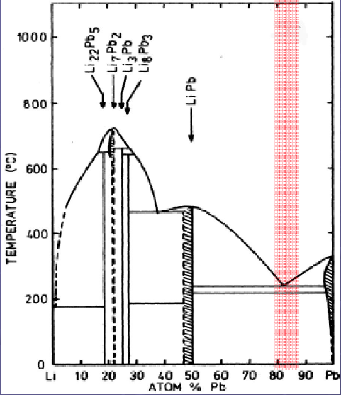
LLE Transport Property Knowledgebase
Collection of properties:
LLE Materials Standard Database (Bulk)
constitutive relations, thermodynamic properties, impurity characterization and behavior, chemical reactivity, H-isotope transport, and He bubble transport
LLE Materials Extended Database (MHD)
electric-magnetic properties, hydrodynamic correlations, and 2-phase dispersion correlations
General Design Parameters and Ranges on Interest
E and B fields - 0-1 kV/m, 0-15 T Neutron wall loading - 2.5 MW/m² Power density - ~1MW/m³ ⁶Li burnup - ~ 0.1 at.% / fpd / GW_{th} Temperature - 235˚C to 700˚C T pressure - 10 Pa to 10 kPa Flow velocity - ~ 1 mm/s to ~1 m/s
Near-eutectic Composition Sensitivities
LLE chemical activity governed by Li activity
Tritium solubility variation from mixture disproportioning in cool areas or aggregation
Mixture standards and impurity tolerances

Slide 8
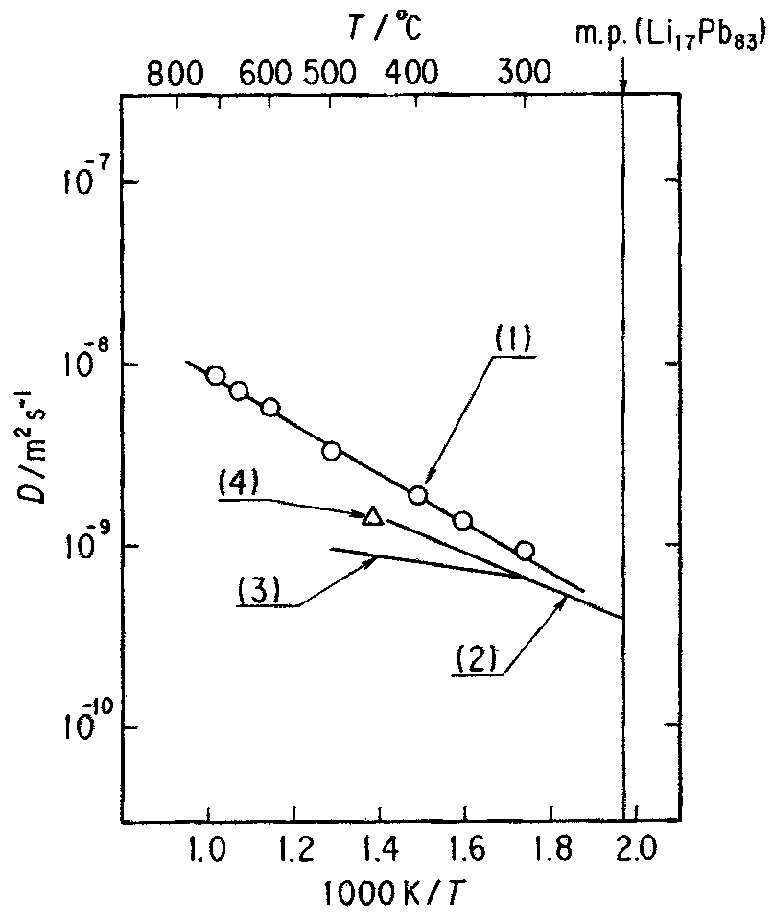
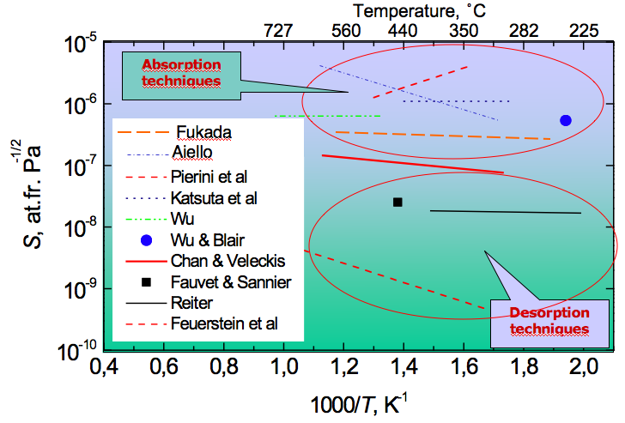
Tritium Transport Properties Variations
Diffusion Constant Variations:
Solubility Variations:
Moderate agreement - within an order of magnitude - from similar experiment arrangements. However sensitivity of D to mass transport correlations is needed for blanket system characterization.
No consensus on data range, nor even behavior at low partial pressure…
courtesy I. Ricapito, ENEA CR Brasimone

Slide 9
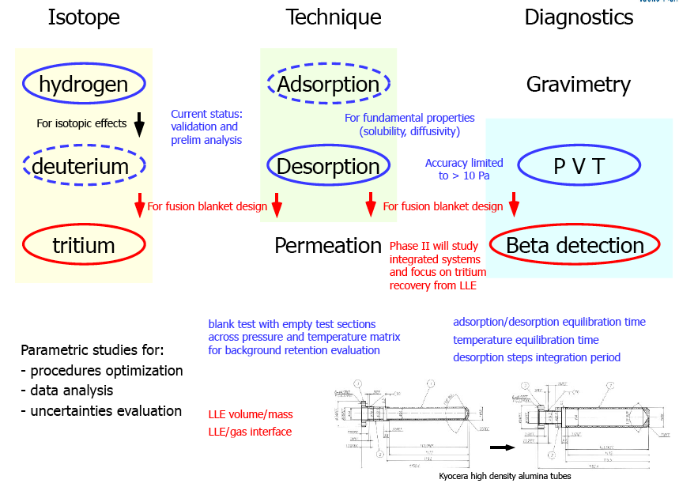
Experiment Approaches for Consideration

Slide 10
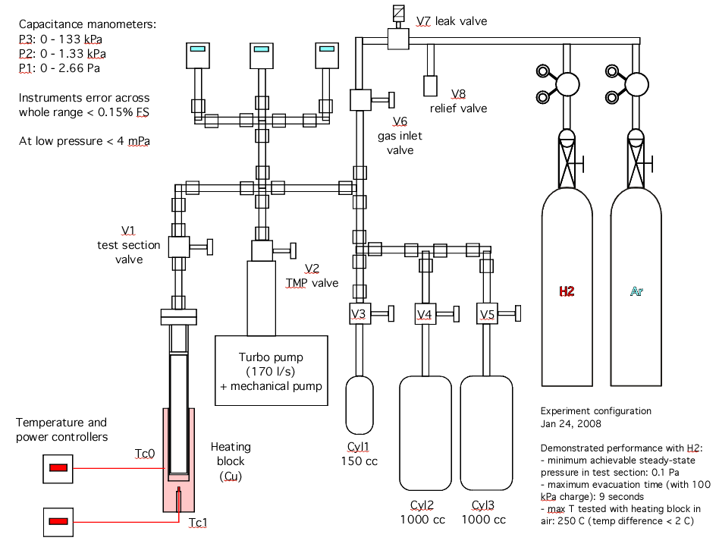
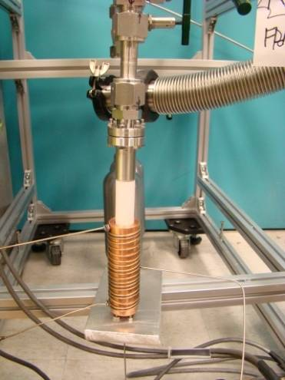
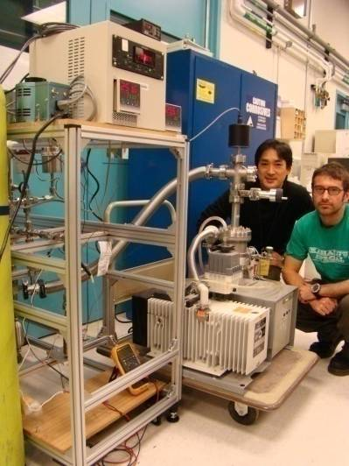
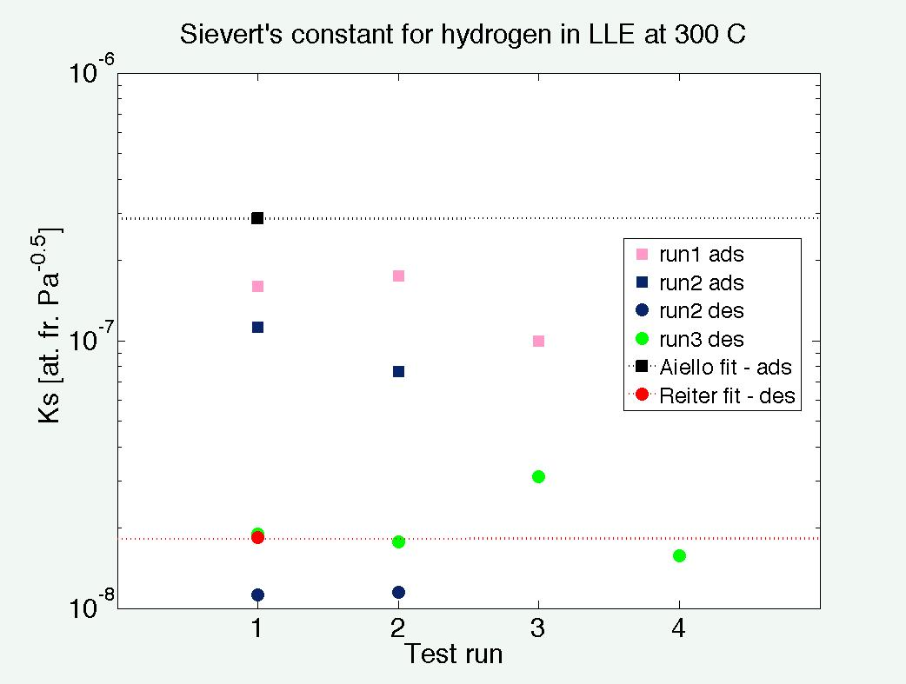
TITAN Task 1-2: Adsorption/desorption isotherm measurement system installed at INL STAR Facility

Slide 11
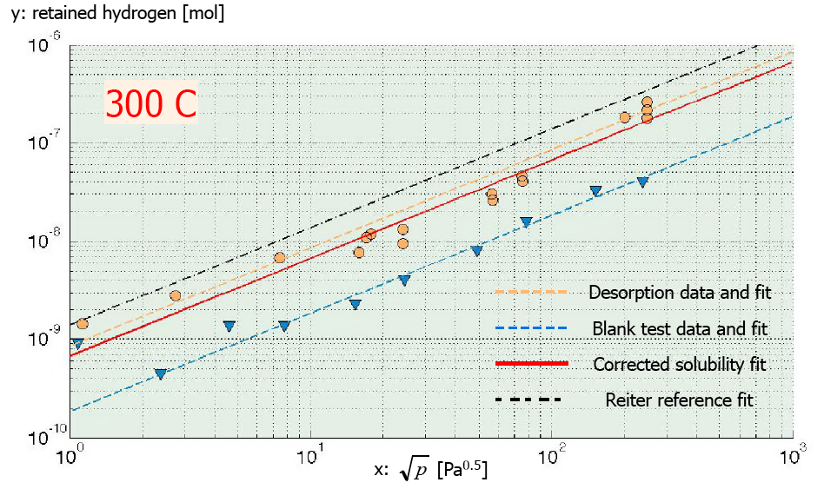
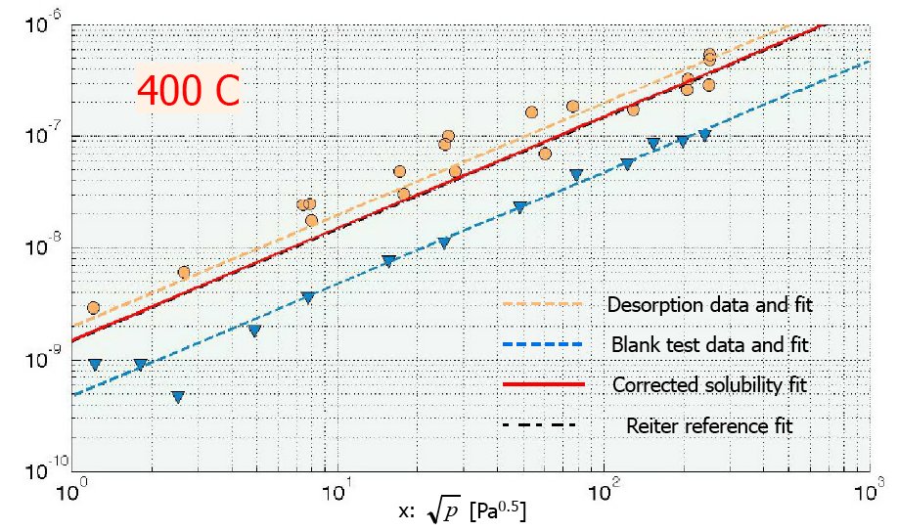
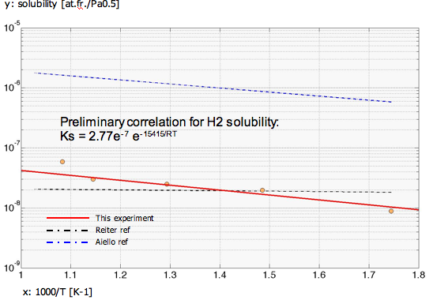
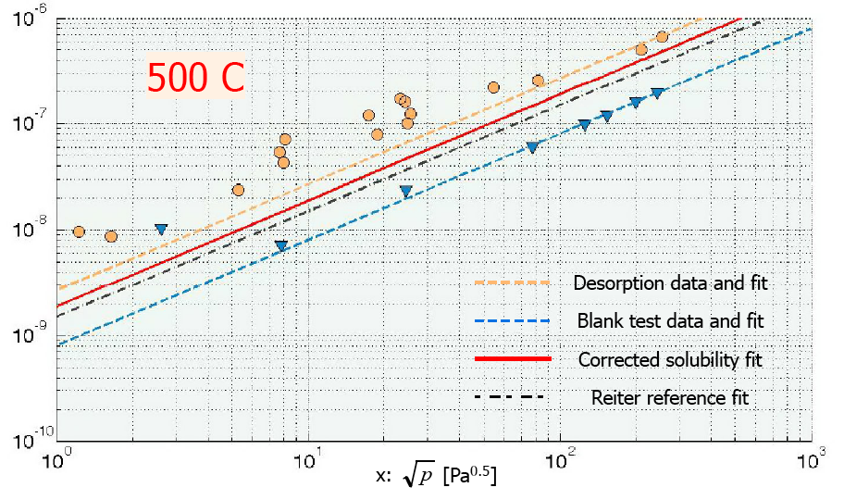
Preliminary LLE - Hydrogen Solubility Data

Slide 12
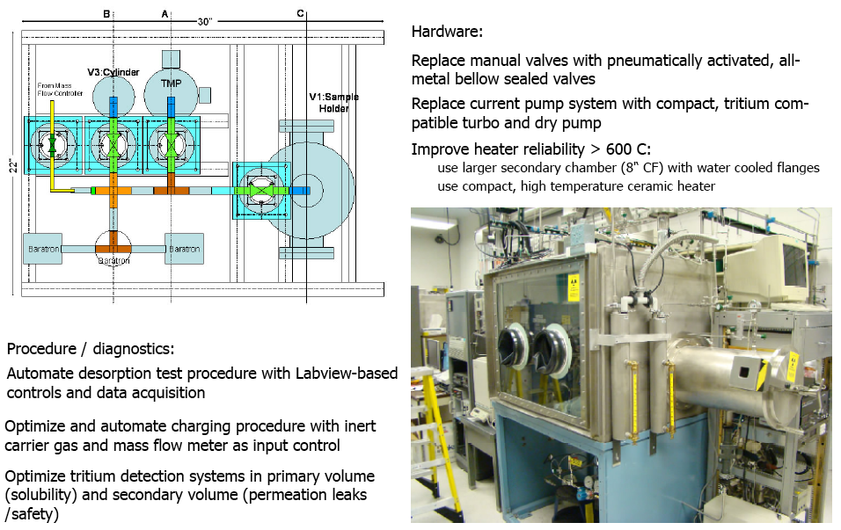
Experiment Upgrade for Testing with Tritium

Slide 13
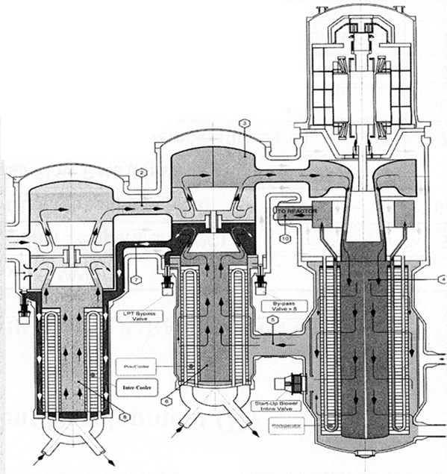
Task 1-2: Testing of Tritium Extraction Methods
Vacuum Permeator:
Concept is based on the Pd-Ag membrane applied to gas stream permeators; untested for use of refractory (Nb) with liquids
mass transport parameters at interface need K_{S} and D of T in LLE
Vacuum pump
Vacuum permeator
Usage issues (for DCLL):
Blanket
T2 outlet
Concentric pipes
Measurements of tritium mass transport coefficients in PbLi for turbulent flow in tubes are needed. This is a key parameter in assessing the viability vacuum permeators since the major resistance to extraction of the tritium is permeation of tritium through the PbLi.
Material compatibility measurements have not be made for PbLi and Nb, although, in general, refractory materials are thought to be compatible with PbLi based on tests up to 1000ºC
At high temperatures Nb will rapidly oxidize, requiring a very high vacuum during operation or a surface layer of Pd which is more oxide resistant. (requires housing the permeator in an inert gas environment)
PbLi (700 C)
PbLi (460 C)
Pressure boundary (90 C)
Closed Brayton Cycle
Power turbine
PbLi pump
Heat
Exchanger
Turbo-compressor
He outlet
He inlet
Inter-cooler
Pre-cooler
Recuperator

Slide 14
Task 1-2: Testing of Tritium Extraction Methods
Vacuum Permeator:
Concept is based on the Pd-Ag membrane applied to gas stream permeators; untested for use of refractory (Nb) with liquids
mass transport parameters at interface need K_{S} and D of T in LLE
Vacuum pump
Vacuum permeator
Concept to be tested (with tritium) via loop developed in TITAN collaboration and installed at INL
(3-4 year time period)
Usage issues (for DCLL):
Blanket
T2 outlet
Concentric pipes
Measurements of tritium mass transport coefficients in PbLi for turbulent flow in tubes are needed. This is a key parameter in assessing the viability vacuum permeators since the major resistance to extraction of the tritium is permeation of tritium through the PbLi.
Material compatibility measurements have not be made for PbLi and Nb, although, in general, refractory materials are thought to be compatible with PbLi based on tests up to 1000ºC
At high temperatures Nb will rapidly oxidize, requiring a very high vacuum during operation or a surface layer of Pd which is more oxide resistant. (requires housing the permeator in an inert gas environment)
PbLi (700 C)
PbLi (460 C)
Pressure boundary (90 C)
Closed Brayton Cycle
Power turbine
PbLi pump
Heat
Exchanger
Turbo-compressor
He outlet
He inlet
Inter-cooler
Pre-cooler
Recuperator

Slide 15
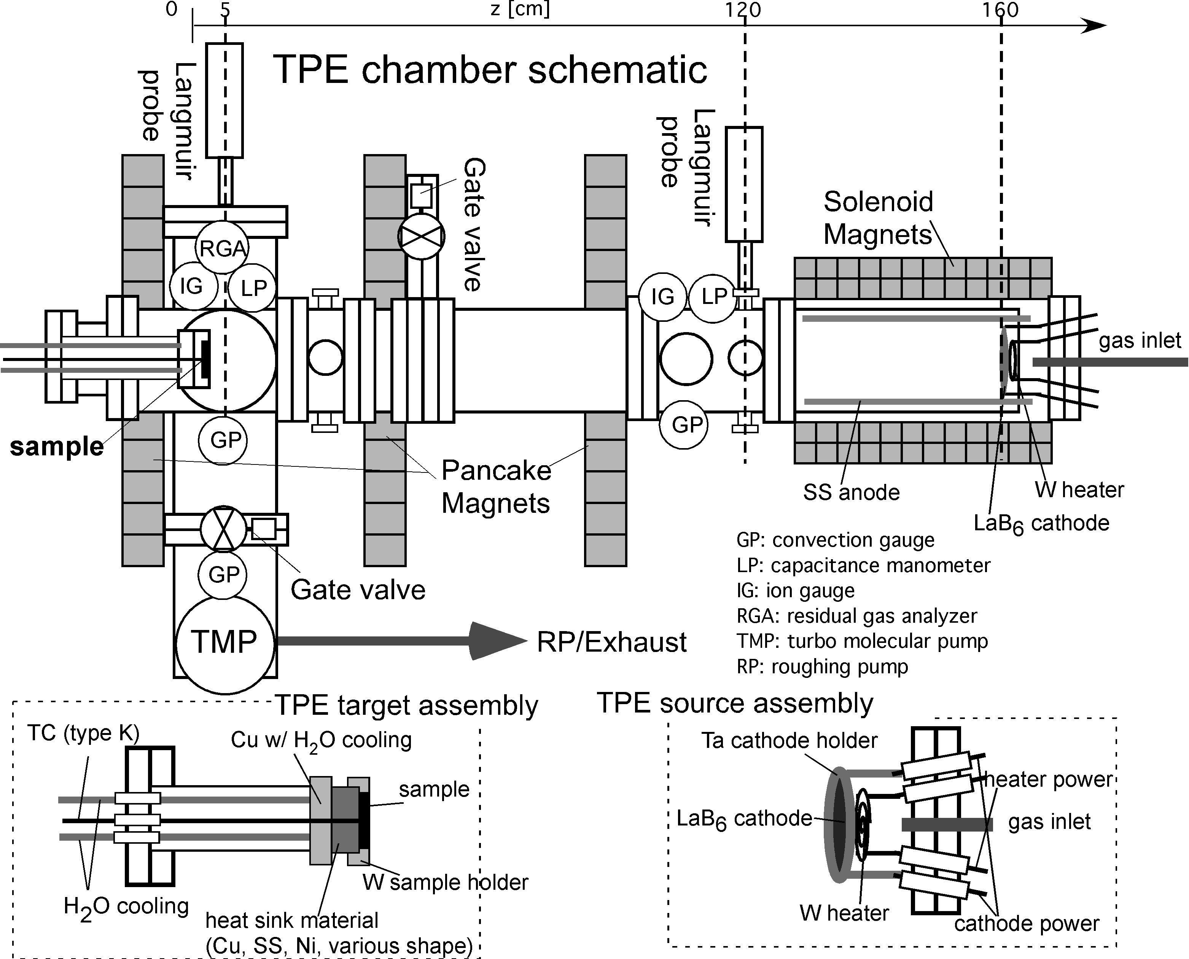
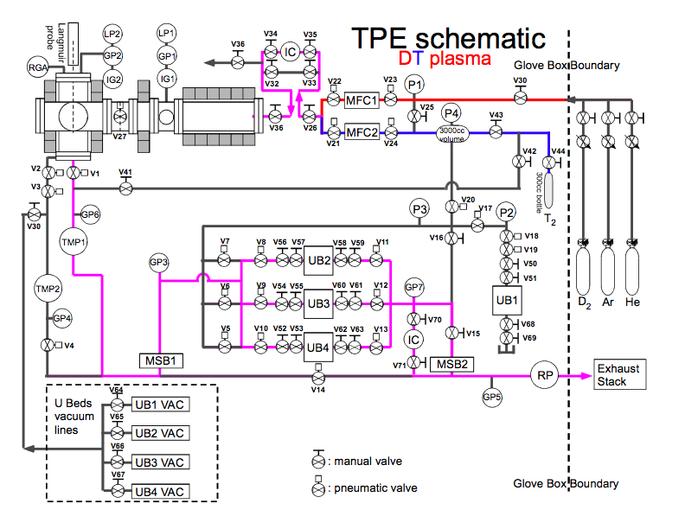
Task 1-1: Tritium Transport in PFC’s and Structural Materials
Role of TPE in fusion/PFC community:
“Tritium” behaviorin various PFCs
Tritium use (T inventory: 15000 Ci ~1.5g)
Handling of “neutron irradiated materials”
D/T retention in PFCs.
T permeation through PFCs
T surface/depth profiling in PFCs
Overview of the Tritium Plasma Experiment:
Linear type plasma
LaB₆ source and actively water-cooled target
Steady state plasma up to high fluence (~10²⁶ m⁻²)
High flux (~10²² m⁻²s⁻¹), surface temp. (300~1000K)
Tritium use: (0.1 ~ 3.0 %) T₂/D₂
Double enclosures for tritium use
Glovebox as a ventilation hood (first enclosure)
PermaCon box as a second enclosure
Ubeds as tritium getter

Slide 16
Tritium Plasma Experiment (TPE) capabilities
Diagnostics and collaborations
in-situ plasma diagnostics:
Langmuir probe (single probe, PMT)
Spectrometer (Ocean Optics HR-4000)
RGA (residual gas analyzer)
ex-situ PSI material diagnostics:
At site (INL - STAR)
TDS (thermal desorption spectroscopy)
IP (imaging plate analyzer)
Optical microscope
In town (INL – Idaho Research Center)
SEM (scanning electron microscope)
XPS (X-ray photoelectron spectroscopy)
AES (Auger electron spectroscopy)
University of Wisconsin, Madison: IBA (ion beam analysis)
ERD (elastics recoil detection)
NRA (nuclear reaction analysis)
Sandia National Laboratory, Livermore
LaserProfilometry for blister height/size
SEM/AES etc.
Plasma parameters:
n_{e}, T_{e}, V_{s}, V_{p}, p_{impurity}/p_{D2}, I_{Dα}, I_{D2}
PSI parameters:
D/T retention
D depth profile
T Surface/depth profile
Grain size
Element composition (depth profile)
Chemical states of element
Blister size/height
Use of tritium
Enhance the detection sensitivity significantly (by ion chamber or LSC)
Trace the surface profile easily (by IP)
Sensitivity: ~10⁻¹²= ppt (part per trillion)

Slide 17
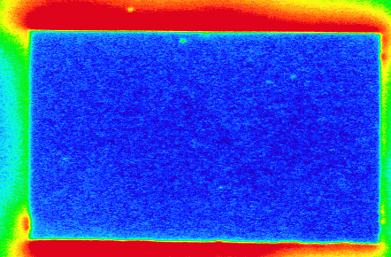
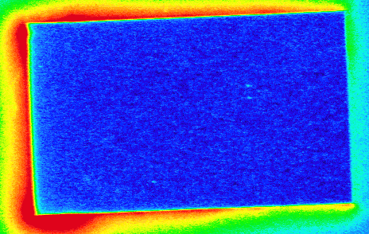
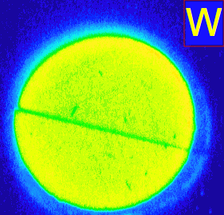
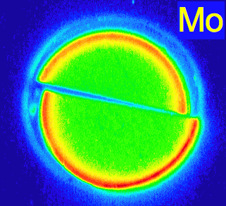
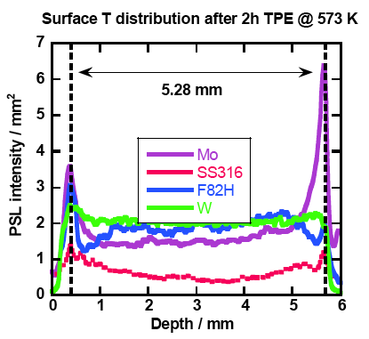
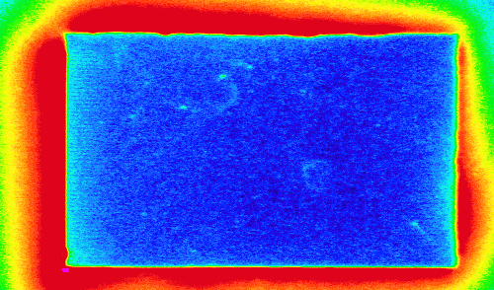
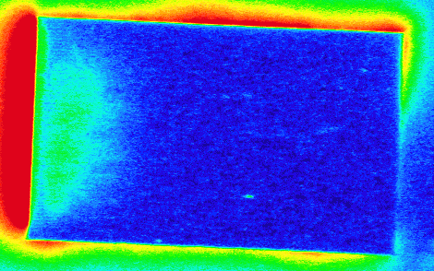
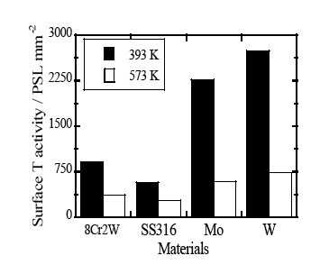
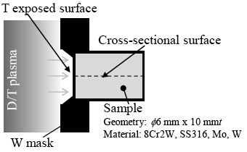
First result of tritium plasma campaign:
(0.1~0.2 %) T₂ /D₂ plasma on Mo and W (Preliminary results)
Front surface
Cross-sectional surface
393K
393K
573K
573K
Front surface
Cross-sectional surface
provided by Teppei Otsuka (Kyushu Univ.)
IP intensity ~ Relative T concentration
Difficult to quantify T concentration
Penetration (detection) depth depends on material/impurity/surface oxide etc..
Penetration depth: < 1 μm
Resolution: 25 μm/pixel

Slide 18
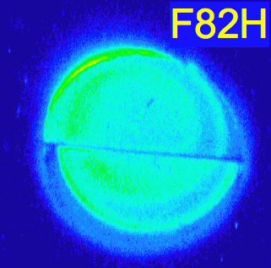
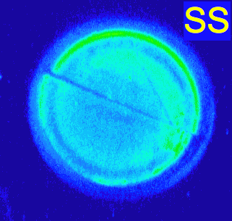
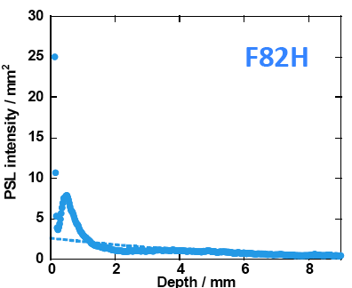
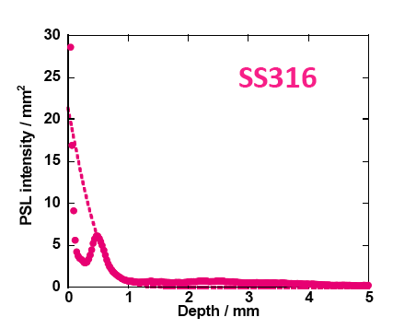
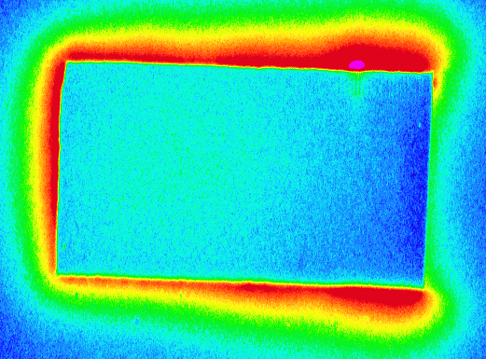
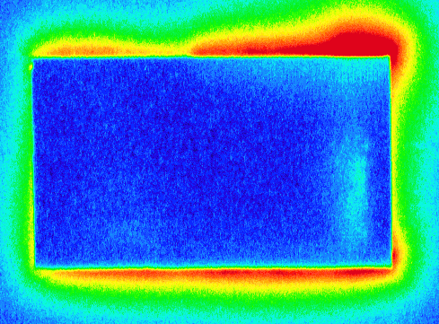
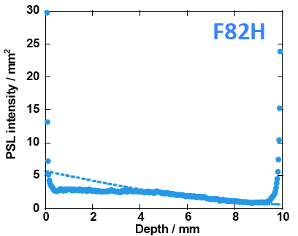
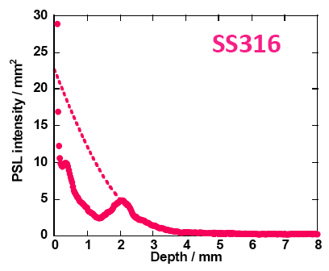
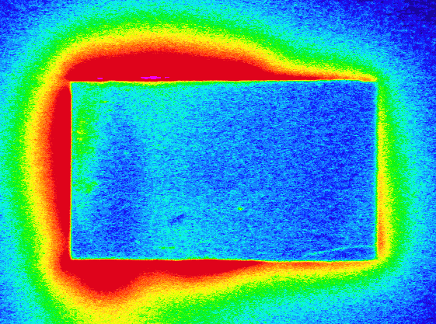
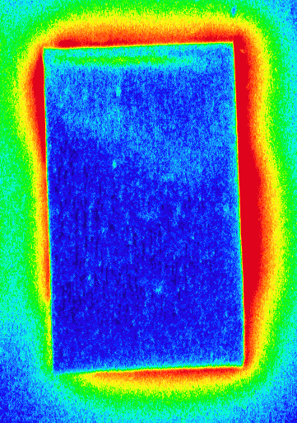
First result of tritium plasma campaign: (cont’d)
(0.1~0.2 %) T₂ /D₂ plasma on F82H and SS316 (Preliminary results)
Front surface
Cross-sectional surface
393K
393K
573K
573K
Front surface
Cross-sectional surface
provided by Teppei Otsuka (Kyushu Univ.)
IP intensity ~ Relative T concentration
Difficult to quantify T concentration
Penetration (detection) depth depends on material/impurity/surface oxide etc..
Penetration depth: < 1 μm
Resolution: 25 μm/pixel
Notes:
18

Slide 19
Deuterium retention in tungsten – a closer look
Thermal desorption spectroscopy (TDS) analysis in W D₂ plasma
Fluence dependence:
623K
Saturation of D retention at higher fluence at T_{samp}=623K ?
770 K peak (1.6~1.7eV trap: vacancy cluster) is responsible for higher retention
Blistering occurs at lower temperature (400~700K)
Very small retention with 920K peak (2.1eV trap: void)
Observation of the shift to higher peak (770 to 860K)
Might be the effect of cooling down after TPE exposure
Reference:
Venhaus et.al. ‘01 JNM
Notes:
19

Slide 20
Deuterium retention in tungsten and molybdenum (cont’d)
Future experiment plans of deuterium/tritium retention in high Z metal
D/T retention in Mo and W on higher fluence/multiple exposure etc..
Comparison of D and T behavior by dual mode TDS
T depth profile by cutting Mo and W in half (bulk depth profile ~mm)
Effects of He bubble as diffusion barrier
(T depth profile in bulk to see if He bubble prevents T permeation)
Thorough surface analysis (AES, XPS) in Mo and W
Low temperature peak in Mo might be due to oxide/impurity
D/T retention in single crystal tungsten
Comparisons of TDS, NRA, an IP
393K
Notes:
20

Slide 21
TITAN future experiment plans
Experiment plans for TITAN activities: task 1-1

Slide 22
TITAN future experiment plans (cont’d)

Slide 23
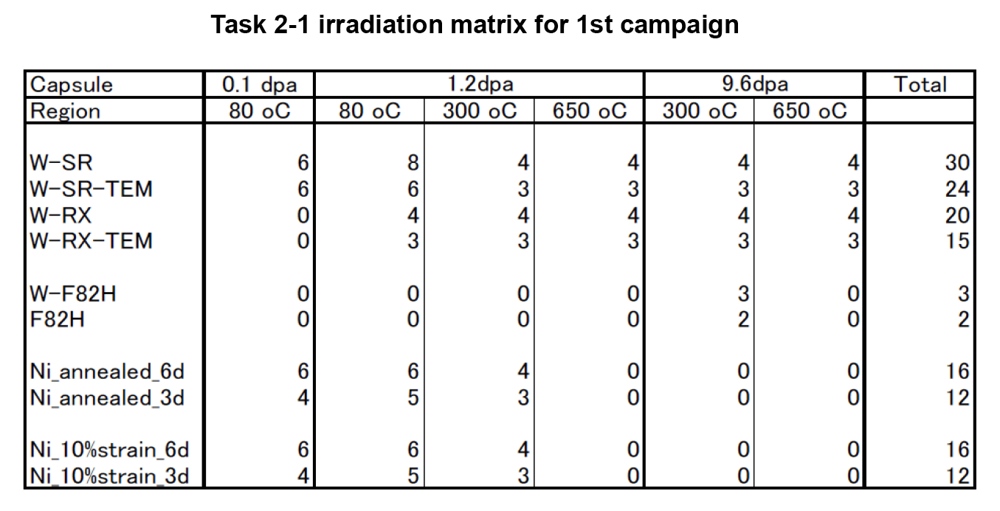
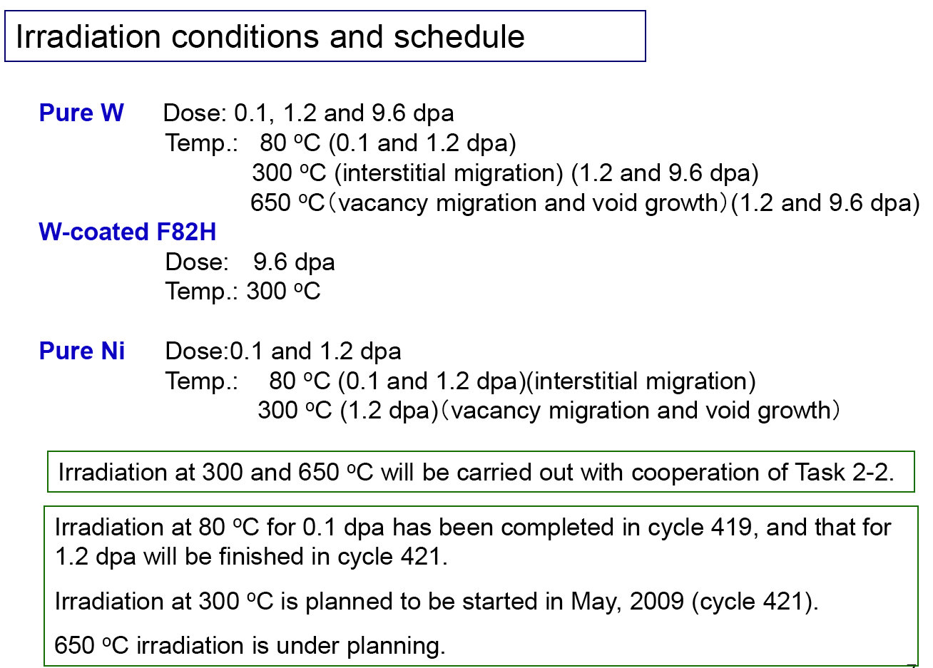
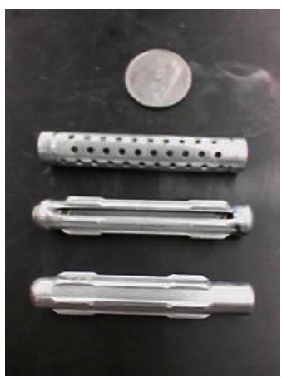
TITAN future experiment plans (cont’d)
Experiment plans for TITAN activities: task 2-1 Irradiation Synergies for Tritium

Slide 24
Summary
A number of tritium activities are occurring within the TITAN collaboration- several directly contribute to DCLL US-TBM R&D needs.
Program leverage is sufficient for now but the tasks would need to be accelerated if and when the US fully engages and commits to an ITER-TBM.

