Slide 1
Thermo-mechanical Analysis of a Prototypical SiC Foam-Based Flow Channel Insert
S. Sharafat, A. Aoyama, and N. Ghoniem
University of California, Los Angeles (UCLA)
Brian Williams,
Ultramet, Inc. Pacoima, California, 91331
FNST MEEETING AGENDA
August 18-20, 2009
Rice Room 6764
Boelter Hall, UCLA
shahrams@ucla.edu
brian.willimas.@ultramet.com

Slide 2
Introduction
Prototypes of FCI structures using “porous” CVD-SiC foam were fabricated
Mechanical, thermal, and electrical properties of SiC-foam core FCI materials are briefly reviewed
Thermo-mechanical performance tests and analysis of an FCI prototype were performed and will be presented

Slide 3
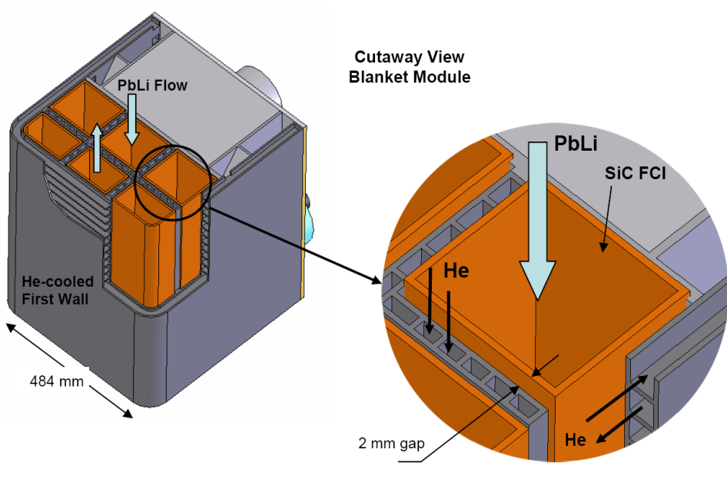
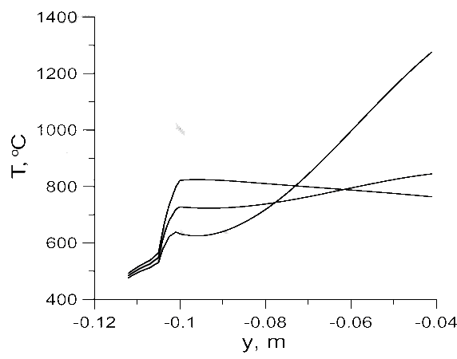
Introduction
U.S. ITER Dual Coolant Liquid Lead (DCLL) Test Blanket Module (TBM)
Flow Channel Insert (FCI) is a key feature that makes the DCLL concept attractive for DEMO and power reactors
FCI serves 2 important functions:
Thermally insulate Pb-Li (~700 ºC) from TBM structure (F82H, corr. T_{max} ~ 470 ºC)
Electrically insulate Pb-Li flow from steel structures.
Temperature Profile for Model DEMO Case
FS
FCI
Pb-Li
GAP
σ_{FCI} = 5 S/m
20 S/m
100 S/m

Slide 4
FCI Key Requirements
Minimize Impact on Tritium Breeding
Adequate thermal insulation
K_{th} = 2~5 W/m-K for US DCLL TBM
Adequate electrical insulation
σ_{el} = 5~100 S/m for US DCLL TBM
Compatibility with Pb-Li
Up to 470ºC for US DCLL TBM, >700ºC for DEMO
In a flow system with large temperature gradients
Leak Tight for Liquid Metal / disconnected porosity
Pb-Li must not “soak” into cracks or pores, must remain isolated in small pores even if cracked
Mechanical integrity
Primary and secondary stresses must not endanger integrity of FCI
Retain Requirements 1 – 5 during operation
Neutron irradiation in D-T phase ITER, and extended to DEMO
Developing flow conditions, temperature & field gradients
Repeated mechanical loading under VDE and disruption events

Slide 5
FCI Material Choice
Silicon Carbide (SiC) materials fulfill primary operational requirements of Flow Channel Inserts (FCIs)
A number of SiC-based FCI concepts are under development:
SiC/SiC Composites
CVI-SiC Closed Cell Syntactic Foam
CVI-SiC Open Cell Foam Core
Here we discuss Open Cell SiC-Foam Core FCI Prototypes, which were recently heat tested.
Thermo-mechanical performance tests of this FCI prototype will be discussed

Slide 6
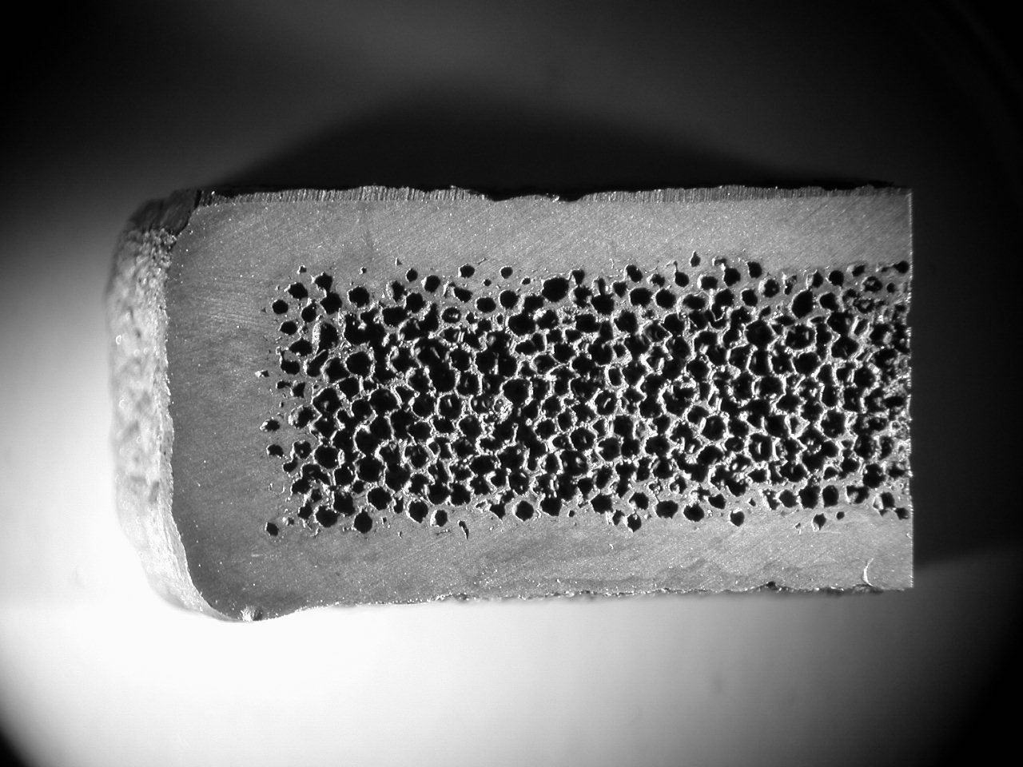
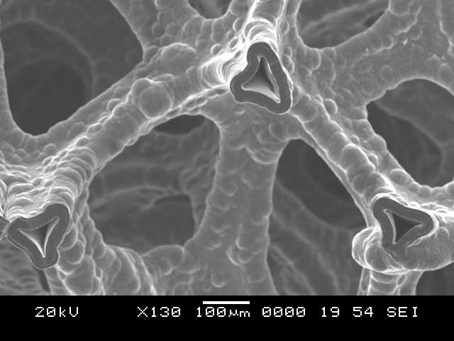
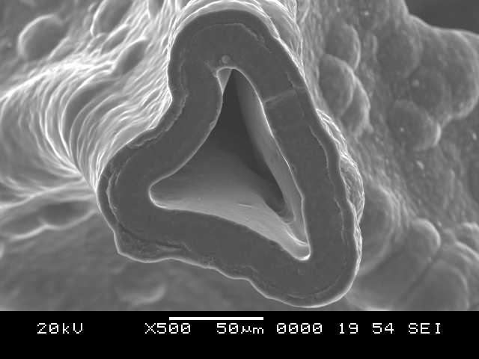
FCI: CVI-SiC Core Foam Wall
CVI-SiC foam is a thermally- and electrically low conducting “porous” structure
SiC foam density can be varied to promote desired mechanical and thermal properties
(1) CVD SiC and (2) SiC/SiC composite facesheet materials are being considered for the ID and OD of the FCI to increase structural integrity and to prevent PbLi ingress
PbLi ingress through potential face sheet defects is being minimized by filling the void space within the foam with ceramic Aerogel or ceramic microspheres
CVD-SiC
CVI-SiC-Foam
CVD-SiC
Cross-sectional photograph of 22% dense CVD SiC foam with 1.8 mm thick CVD SiC face-sheets (5X)
Removal of the ligament Carbon-core reduced electrical conductivity to < 0.2 S/m

Slide 7
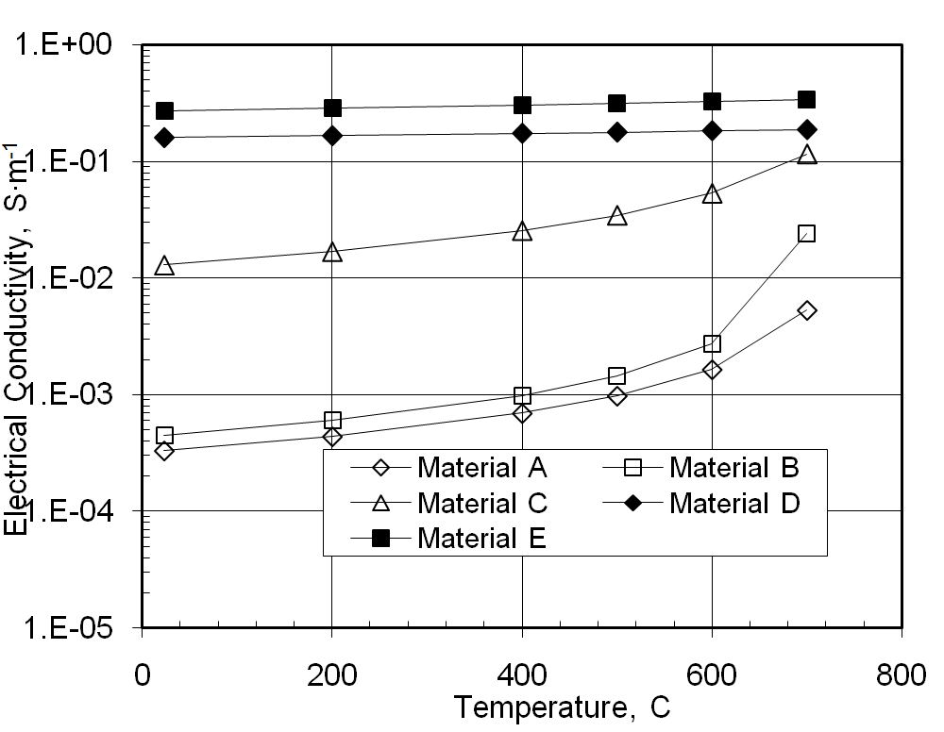
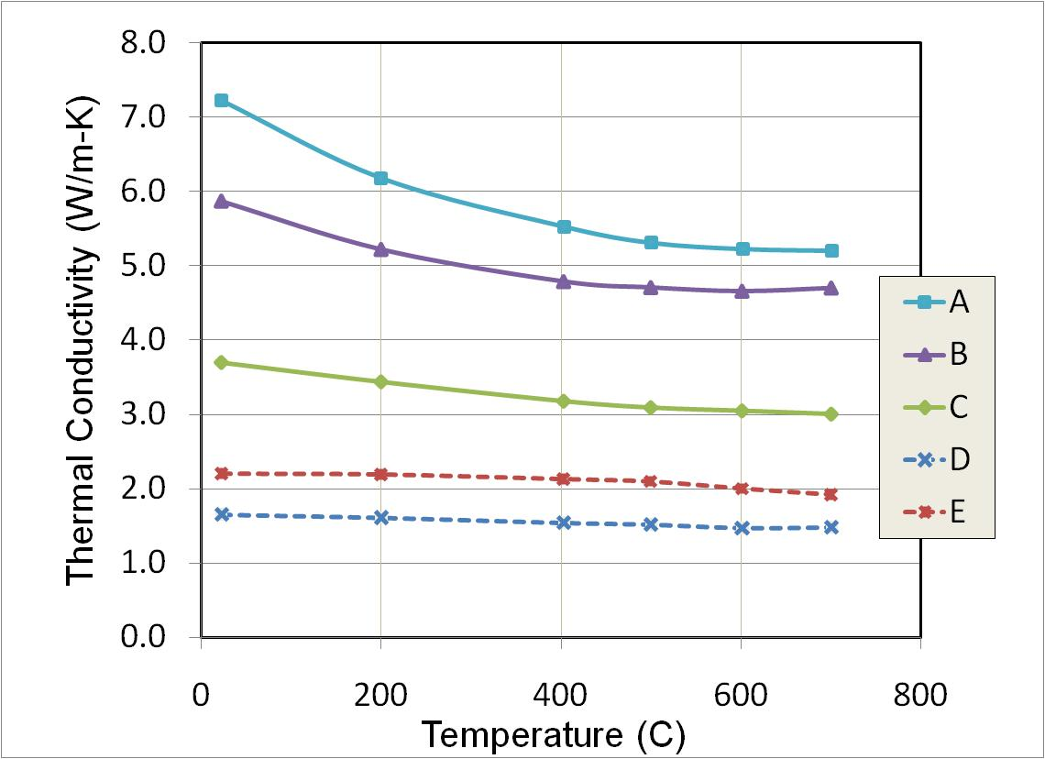
CVI-SiC Core Foam FCI Properties
Conductivities of SiC-Foam with CVD-SiC Face-sheet
Material A: 100 ppi, 0.50” thick, 12% dense SiC foam with 0.070” thick CVD SiC faceplates
Material B: 100 ppi, 0.25” thick, 20% dense SiC foam with 0.070” thick CVD SiC faceplates
Material C: 100 ppi, 0.50” thick, 20% dense SiC foam with 0.035” thick CVD SiC faceplates
Material D: 100 ppi, 0.50” thick, 10% dense SiC foam infiltrated with high density SiO2 aerogel
Material E: 100 ppi, 0.50” thick, 10% dense SiC foam infiltrated with low density SiO2 aerogel

Slide 8
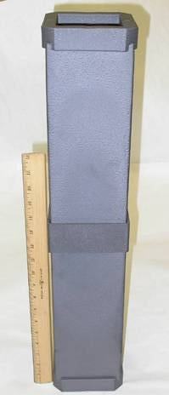
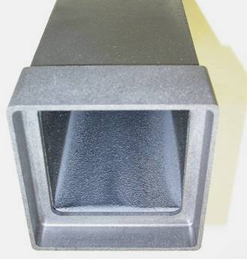
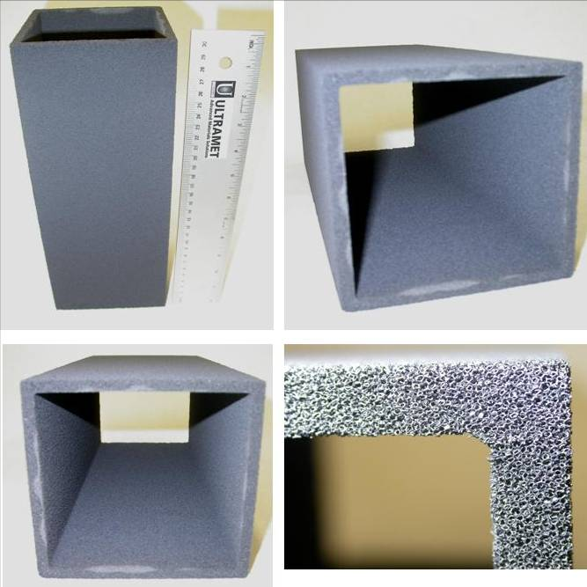
FCI – Prototype Fabrications (Ultramet)
Nominal part size is 116 × 116 × 300 mm long with a 7-mm wall thickness.
Standard processing involves conversion of polyurethane foam to 99% porous carbon foam billet, which is then cut into 130 × 130 × 300 mm long pieces
The FCI ID is established by press-fitting mandrel of desired size into the foam and the OD is formed with a fly-cutter.
Finally the carbon foam is infiltrated by CVD with SiC to ~10-20 vol%
Several prototype parts have successfully been fabricated
63.5 cm
FCI foam core after SiC infiltration

Slide 9
FCI – Prototype Heat Testing
Inductive Heating Tests performed on 0.15 m tall FCI segments
Steady-state Temperatures
Inner Wall (ºC) | Outer Wall (ºC) | ΔT (ºC)
100 | 81 | 19
150 | 121 | 29
200 | 160 | 40
250 | 199 | 51
300 | 242 | 58
350 | 277 | 73
400 | 321 | 79
500 | 390 | 110
560 | 429 | 131
600 | 453 | 147
ID ~ 200 ºC
ID ~ 600 ºC
Stereo microscope inspection did not reveal any visible damage or micro-cracks.

Slide 10
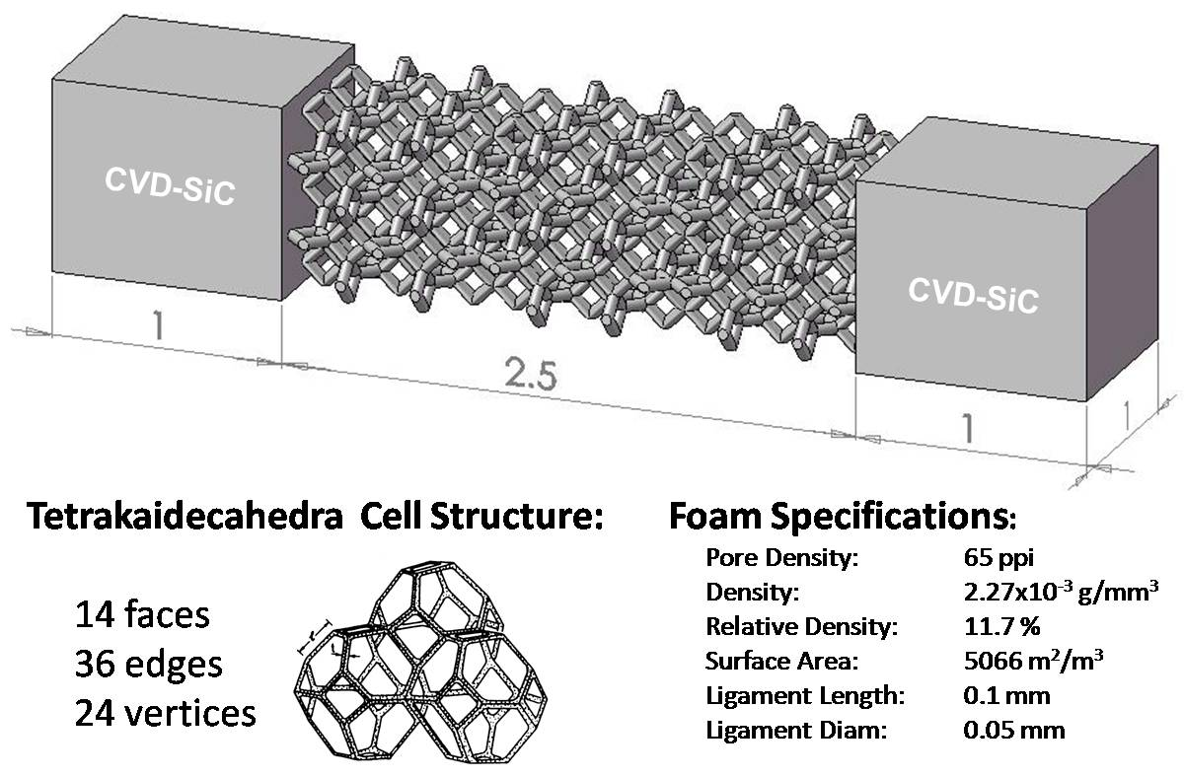
Thermo-mechanical Analysis
Solid Model

Slide 11
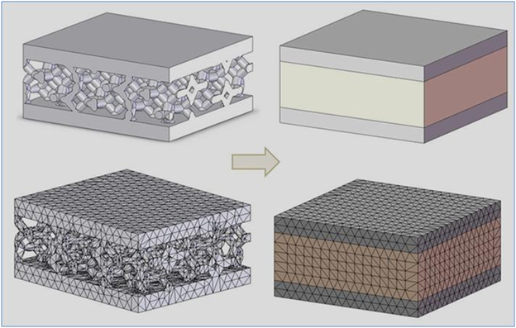
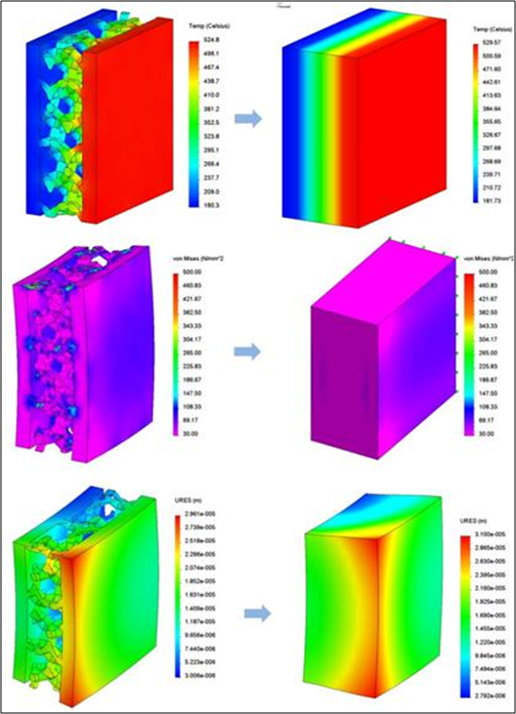
Modeling Surrogate Foam Properties
Detailed 3-D solid model, meshed open-cell SiC-foam core structure, and “surrogate material.”
FEM analysis to establish “surrogate foam” properties
Temperature
Von Mises
Estimated Surrogate SiC-Foam Material Properties
PROPERTY | CVD-SiC | Surrogate Material*
Elastic Modulus (Gpa) | 412 | 11
Poisson's Ratio | 0.21 | 0.21
Thermal expansion (10⁻⁶ K⁻¹) | 4.96 | 4.5
Mass Density (kg/m³) | 3210 | 600
Thermal Conductivity (W/m-K) | 48 | 5
Specific Heat (J/kg-K) | 1096 | 200
Displacement

Slide 12
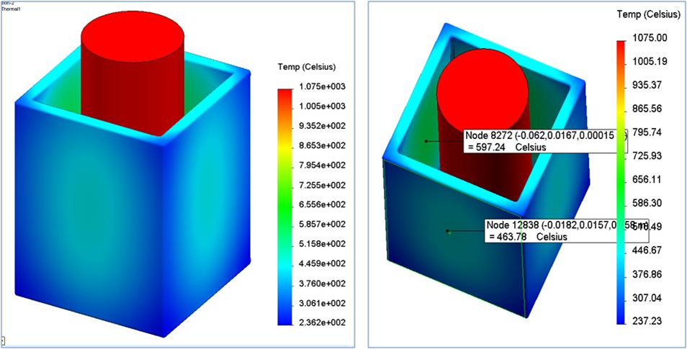
FEM Results
Temperatures:
ID: 596 ºC
OD: 464 ºC
Temperature distribution is not uniform
Maximum ΔT occurs along midsections of FCI walls
Maximum ΔT ~ 137 ºC

Slide 13
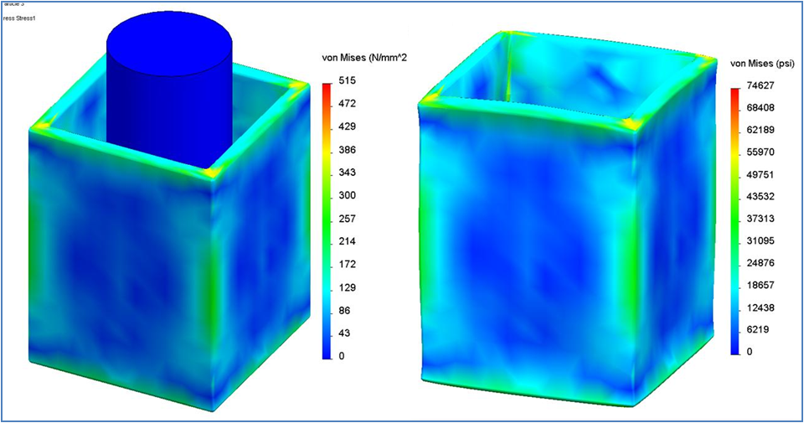
FEM Results
Von Mises Stress:
σ > 380 MPa
σ > 300 MPa
Deformation scale = 100 X
Stress concentrates at top/lower corners
Maximum stress is below CVD-SiC tensile strenght of ~ 300 to 400 MPa

Slide 14
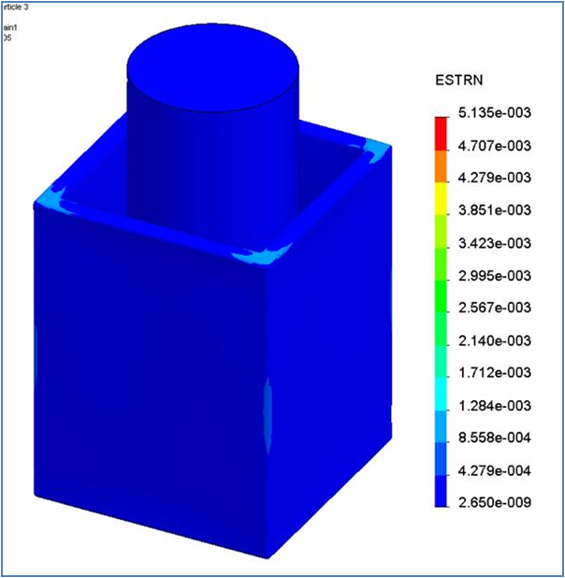
FEM Results
Strain:
ε_{max} ~ 0.12 %
Strain rather than stress is a better indicator for ceramic performance
Maximum strain remains below 0.12 %

Slide 15
FEM Result Discussions
FCI heating tests (Δt ~ 147 ºC) showed no visibly discernable sign of damage (microscopic analysis was not performed)
Conservative thermo-mechanical analysis estimates stresses to be below CVD-SiC tensile strength, even though:
FEM analysis assumes sharp interface between CVD-SiC face sheet and SiC-foam → no gradual transition between CVD-SiC face sheet and SiC-foam
Mechanical properties of surrogate material for SiC foam may be underestimated (E ~ 11 GPa)
The outer 1-mm thick CVD-SiC shell carries the load

Slide 16
Conclusions
Several FCI prototypes structure were fabricated
The FCI wall structure consists of CVI-SiC foam core (~5 mm) between CVD-SiC face sheets (~1 mm)
Heat tests up to ΔT~150 ºC did not result in visibly discernable damage (no microscopical analysis)
Thermo-mechanical analysis of the heat test estimates maximum stresses to be below CVD-SiC tensile strength
The heat tested performance of the FCI prototype implies that the open-cell foam core based FCI structure holds promise for TBM.

Slide 17
shahrams@ucla.edu brian.williams@ultramet.com
Thank you for your attention

Slide 18
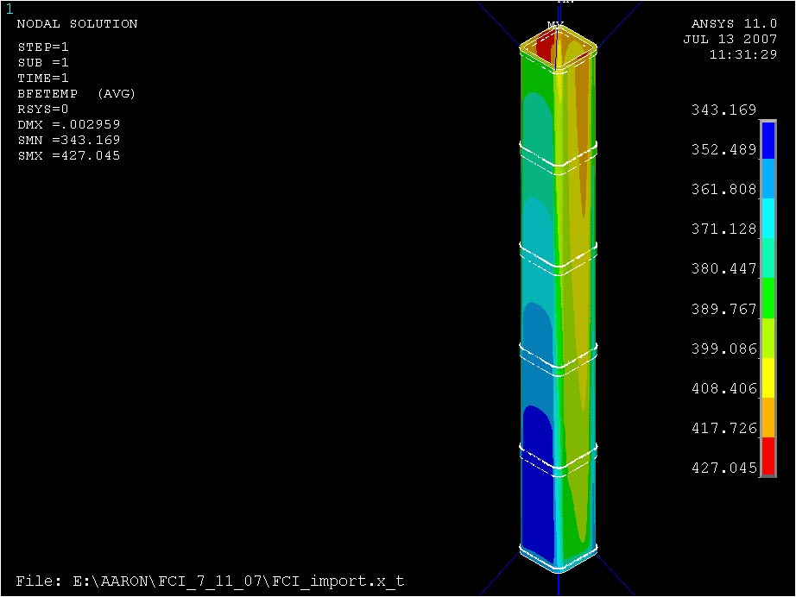
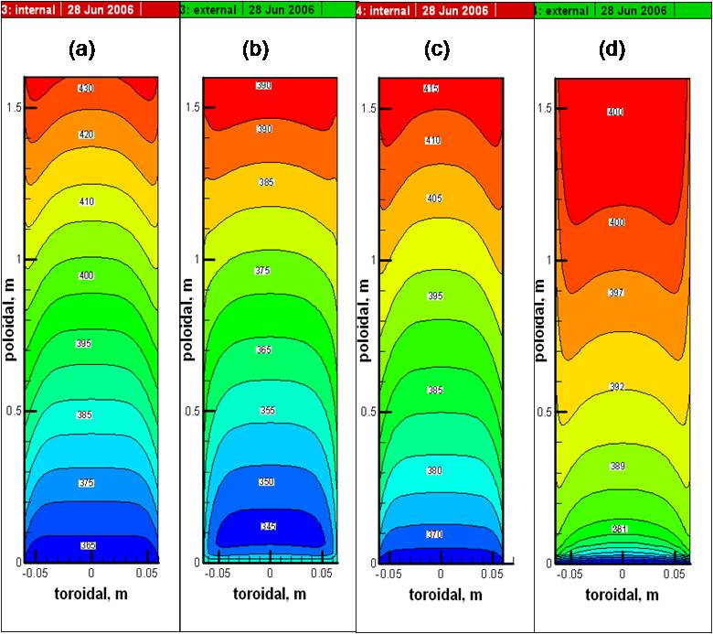
Thermo-Structural Analysis: Non-uniform ΔT
Complete FCI Assembly
TOP of FCI
MHD-Based Temperature Maps
343 ºC
Max. Temperature
Drop across FCI ~ 40 ºC
427 ºC
ISO-
Back-
Front - View
Temperatures

Slide 19
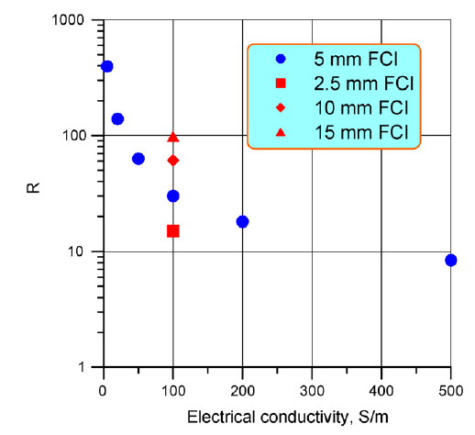
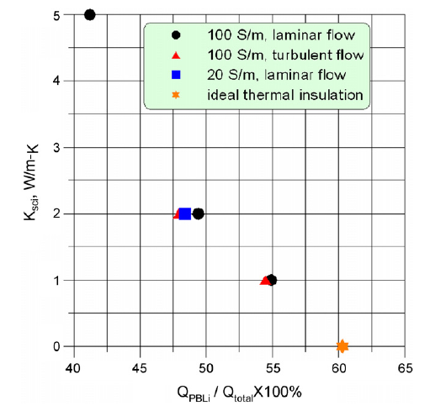
FCI Material Property Requirements
Effect of SiC electrical conductivity and FCI thickness on MHD pressure drop reduction factor R in poloidal flow for DEMO.
Effect of the electrical and thermal conductivity of the FCI on heat losses in the DEMO blanket
S. Smolentsev et al. / Fusion Engineering and Design 83 (2008) 1788–1791

Slide 20
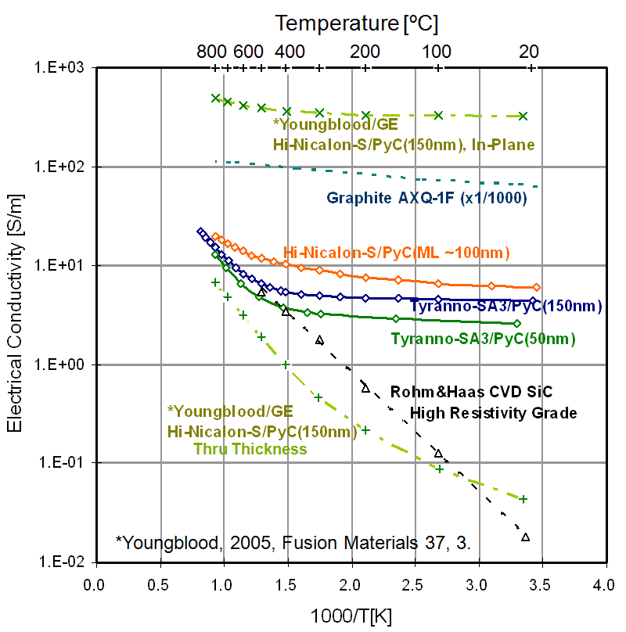
SiC/SiC Un-irradiated & Irradiated Electrical Conductivity
Un-irradiated Thru Thickness
Irradiated Thru Thickness
K.Yutai, 2008
K.Yutai, 2008

Slide 21
Effect of Neutron Irradiation on Electrical Conductivity of CVD SiC
Temperature [ºC]
1000
500
200
100
20
T_{irr}
~375 meV
K.Yutai, 2008 (measurement done at RT)
K.Yutai, 2008
Materials are R&H CVD SiC, n-type with nitrogen as the primary impurity.
Irradiation at lower temperature tends to result in higher carrier density x mobility.
Conduction in 1020ºC-irradiated material is governed by single defect type at all temperatures. The same defect likely dominates in other irradiated materials at relatively high temperatures.

