Slide 1
DCLL TBM Thermo-structural Analysis Status
S. Sharafat, A. Aoyama, M. Dagher (UCLA) With Input from
C. Wong¹, S. Malang² and M. Sawan³
And the US DCLL Team
¹General Atomics, ²FNT Consultant ³UW – Madison, Fusion Technology Institute
FNST MEEETING AGENDA
August 18-20, 2009
Rice Room, 6764 Boelter Hall, UCLA

Slide 2
Presentation Objectives
The DCLL TBM has undergone major design changes since the last time a full thermo-mechanical analysis was performed.
Present the status of the thermo-mechanical analysis of the revised DCLL TBM.
The goal of this presentation is to provide the DCLL team insight into the various aspects and details that are included in the analysis and to discuss any shortcomings and/or suggested changes for the next analysis iteration.
Demonstrate the effectiveness of the developed approach/model to identify critical locations, such as stress concentrations inside the TBM structure.

Slide 3
Talk Outline
Pre-Processing the TBM Solid Model.
Generating Data Tables and ANSYS Scripts
Meshing and Applying Loads and BCs
Thermal Analysis
Structural Analysis
Summary and Consulting

Slide 4
1 – Pre-Processing the TBM Solid Model
Convert CATIA models into ANSYS models:
“CLEAN” the CATIA model of geometric inconsistencies by manually removing small edges, slivers of areas and volumes, intersections, overlaps, fixing zero-thickness geometries, …
Create solid bodies for empty regions occupied by helium and PbLi →necessary for applying loads:
The “Helium Solid” consists of 85 solid bodies → allows application of different heat transfer coefficients and bulk helium temperatures for thermal convection analysis
A total of 91 solid bodies were created and assembled into the TBM Solid Model before importing it into ANSYS for meshing and analysis

Slide 5
1 – Pre-Processing the TBM Solid Model (cont.)
Table 1: Solid bodies and loading component groups
Description | Number of Solid Bodies | Thermal Boundary Conditions Applied to Corresponding Component Groups
TBM structure | 1 | Volumetric heating, first wall heat flux
Flexible supports | 4
PbLi region | 1 | Heat flux due to PbLi heat leakage
Helium: first wall front channels | 70 | Convection coefficient 6979 W/m²-K And Variable He-Bulk Temperatures
Helium: inlet, manifold, 1st layer in | 1 | T_{conv} = 350.00 ºC, H_{conv} = 3586 W/m²-K
Helium: 1st Zone out, 2nd layer in | 2 | T_{conv} = 358.57 ºC, H_{conv} = 3586 W/m²-K
Helium: 2nd Zone out, 3rd layer in | 2 | T_{conv} = 367.14 ºC, H_{conv} = 3586 W/m²-K
Helium: 3rd Zone out, 4th layer in | 2 | T_{conv} = 375.72 ºC, H_{conv} = 3586 W/m²-K
Helium: 4th Zone out, 5th layer in | 2 | T_{conv} = 384.29 ºC, H_{conv} = 3586 W/m²-K
Helium: 5th Zone out, 6th layer in | 2 | T_{conv} = 392.86 ºC, H_{conv} = 3586 W/m²-K
Helium: 6th Zone out, 7th layer in | 2 | T_{conv} = 401.43 ºC, H_{conv} = 3586 W/m²-K
Helium: 7th Zone out, grid channels, outlet | 2 | T_{conv} = 410.00 ºC, H_{conv} = 3586 W/m²-K

Slide 6
1 – Pre-Processing the TBM Solid Model (cont.)
The “Helium Solid Bodies” shown in assembled and in exploded view
Assembled View
Exploded View (temperature coded)

Slide 7
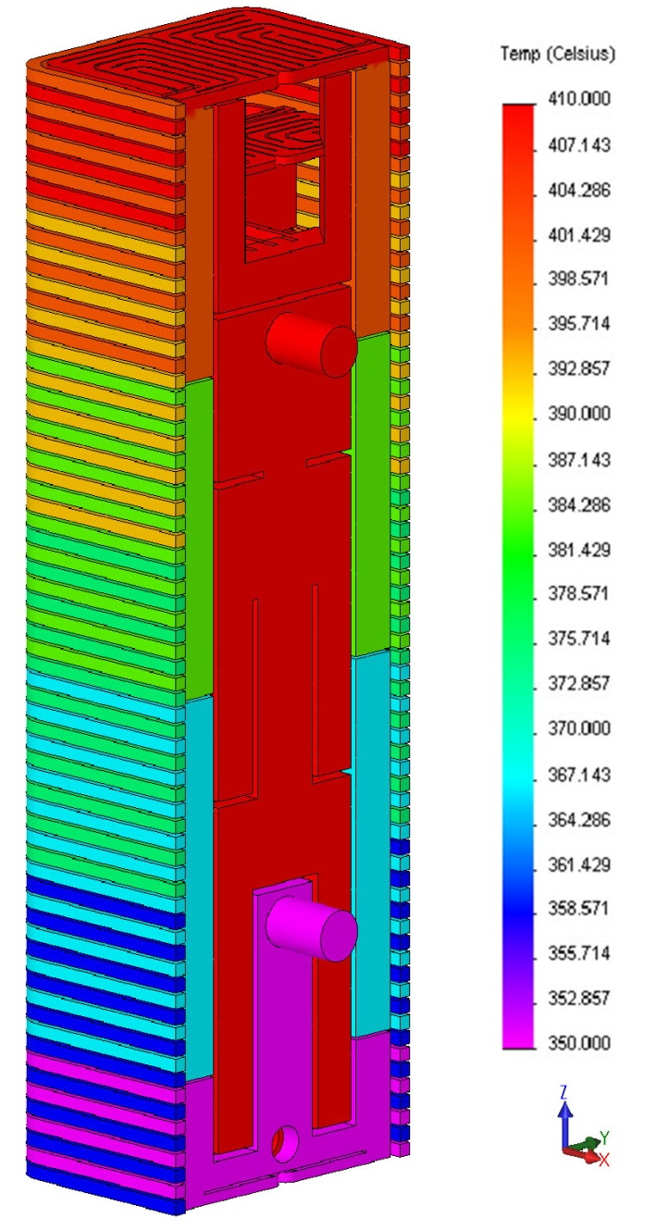
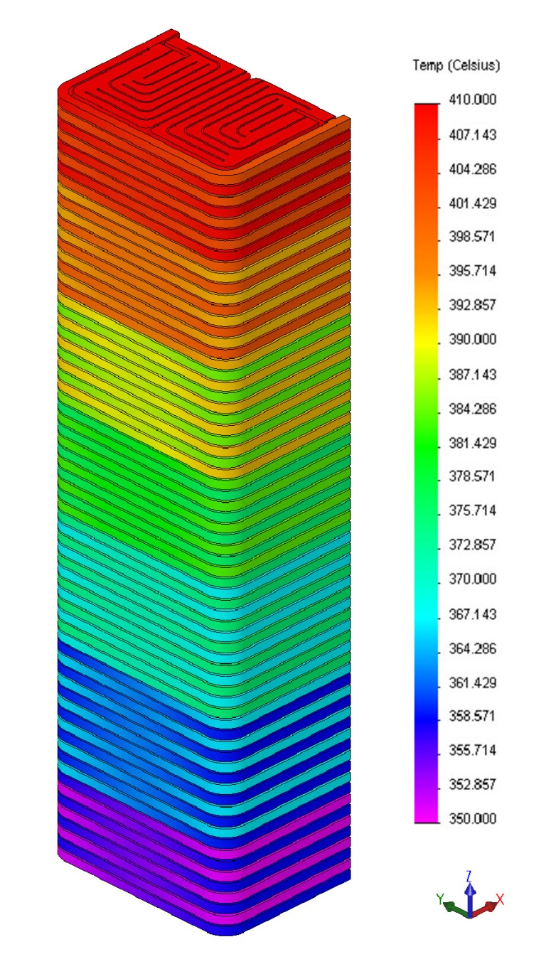
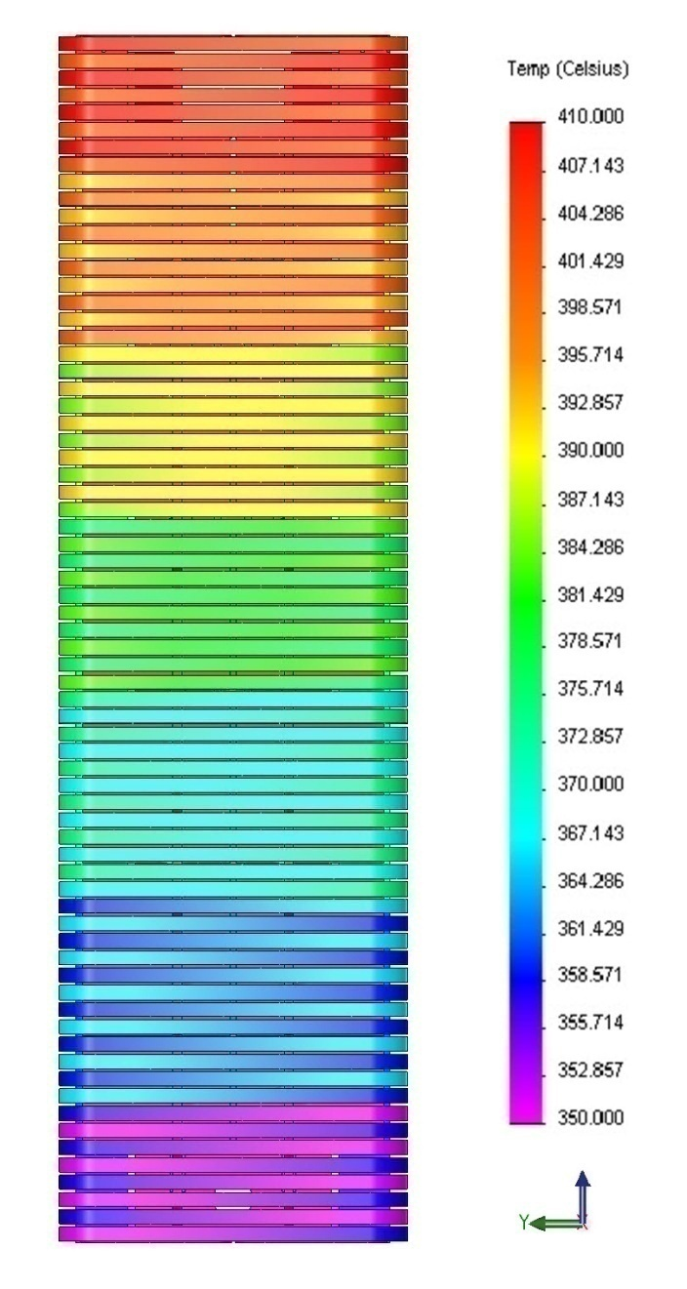
1 – Pre-Processing the TBM Solid Model (cont.)
The “Helium Solid Body” showing applied He-bulk temperatures (7 zones):
ZONE
7
6
5
4
3
2
1

Slide 8
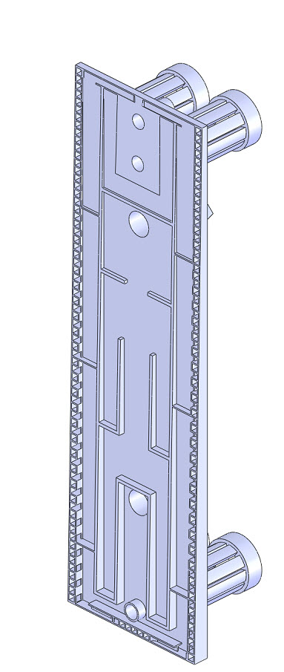
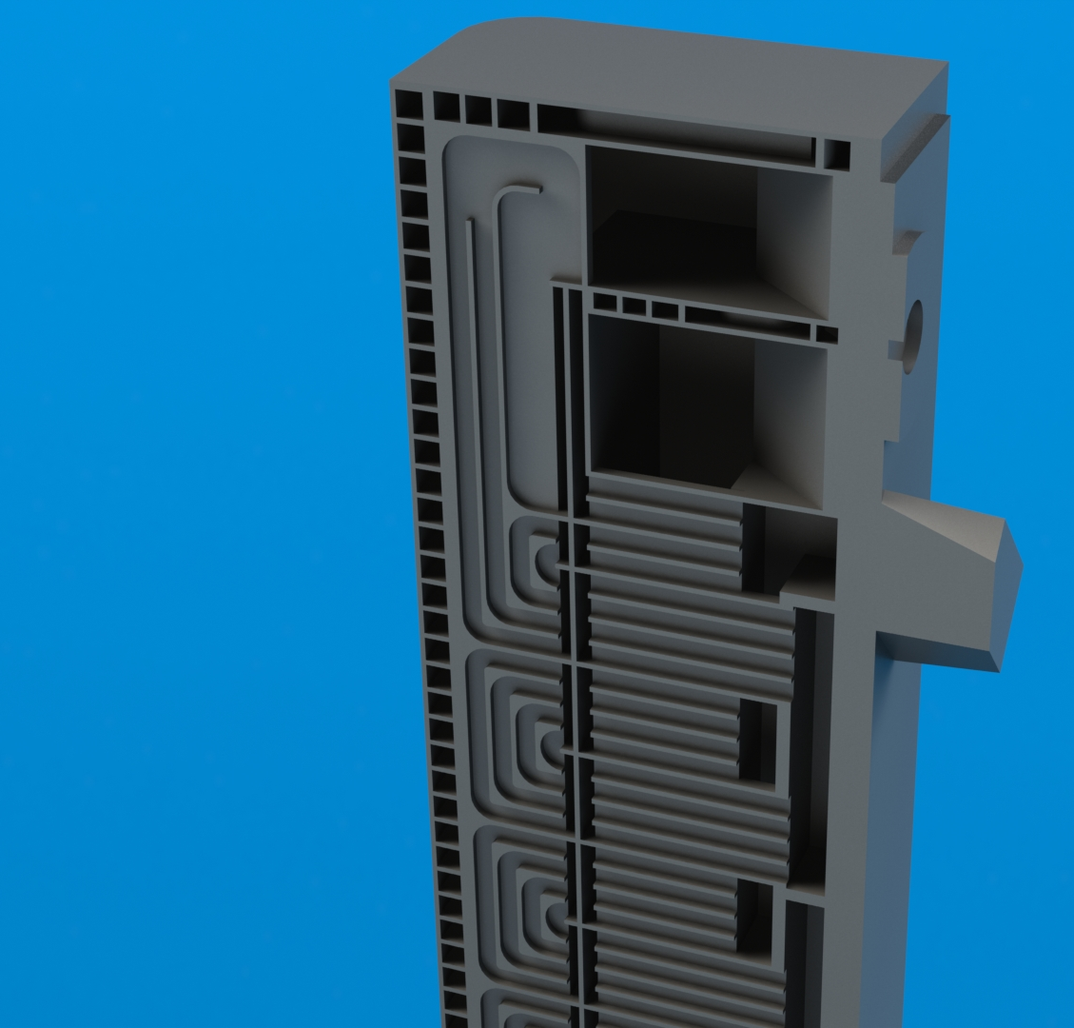
1 – Pre-Processing the TBM Solid Model (cont.)
X-Section View of “TBM Structure Solid Bodies”
Manifold

Slide 9
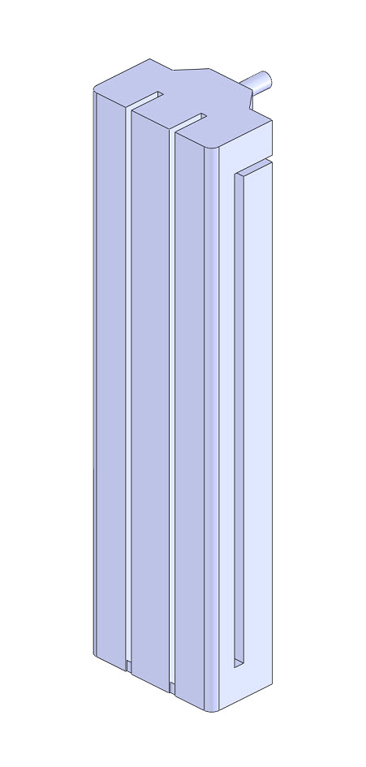
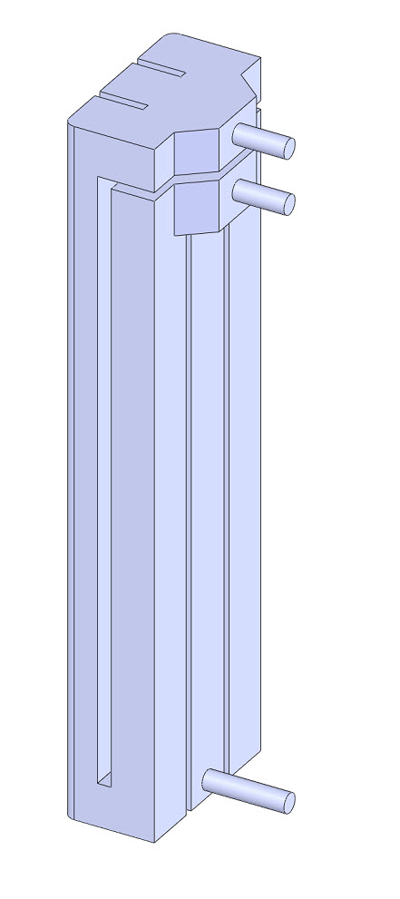
1 – Pre-Processing the TBM Solid Model (cont.)
The “PbLi Solid Bodies” shown in assembled and in exploded view
Iso-view (front)
Iso-view (back)

Slide 10
The Analysis is Divided into Six Sections:
Pre-Processing the TBM Solid Model.
Generating Data Tables and ANSYS Scripts
Meshing and Applying Loads and BCs
Thermal Analysis
Structural Analysis
Summary and Conclusions

Slide 11
2 – Generating Data Table & ANSYS Scripts
Proper loading of the numerous (91) TBM bodies is facilitated by developing data tables and scripts:
Material Properties (F82H, Ti-6Al-4V, PbLi, Be, He)
Boundary Conditions (h_{coef}, He-T_{bulk}, restraints)
Loads:
FW-Surface heat load (q’’= 0.5 MW/m²)
Volumetric heating [q’’’(x,y,z)]
He-pressure (8 MPa)
PbLi pressure (2 Mpa)
Gravity
Material properties are temperature dependent and volumetric heating is material- and space dependent

Slide 12
2 – Generating Data Table & ANSYS Scripts
F82H Properties: TBM structure
Temperature [ºC] | Density [kg/m³] | Young's Modulus [GPa] | Poisson's Ratio | Specific Heat [J/kg-K] | Thermal Conductivity [W/m-K] | Linear Thermal Expansion Coefficient [α]
20 | 7870.95 | 217.26 | 0.29 | 459.64 | 31.53 | 10.35
100 | 7848.61 | 212.23 | 0.29 | 464.53 | 32.20 | 10.66
200 | 7818.67 | 207.33 | 0.29 | 508.89 | 32.84 | 11.02
300 | 7786.49 | 202.73 | 0.29 | 556.44 | 33.22 | 11.36
400 | 7752.06 | 197.12 | 0.29 | 592.27 | 33.30 | 11.67
500 | 7715.39 | 189.18 | 0.30 | 630.13 | 33.02 | 11.96
600 | 7676.48 | 177.59 | 0.30 | 712.37 | 32.34 | 12.23
http://FusionNET.seas.ucla.edu
Ti-6Al-1V Properties: Flexible support
Temperature [ºC] | Density [kg/m³] | Young's Modulus [GPa] | Poisson's Ratio | Specific Heat [J/kg-K] | Thermal Conductivity [W/m-K] | Linear Thermal Expansion Coefficient [α]
20 | 4430.00 | 111.23 | 0.34 | 521.51 | 7.17 | 8.60
100 | 4430.00 | 103.49 | 0.34 | 552.86 | 7.63 | 8.81
200 | 4430.00 | 98.02 | 0.34 | 595.78 | 8.50 | 9.07
300 | 4430.00 | 92.96 | 0.34 | 641.29 | 9.61 | 9.30
400 | 4430.00 | 77.85 | 0.34 | 687.72 | 10.84 | 9.50
500 | 4430.00 | 65.77 | 0.34 | 733.39 | 12.10 | 9.70
600 | 4430.00 | 34.51 | 0.34 | 776.62 | 13.27 | 9.90
http://FusionNET.seas.ucla.edu
ANSYS data tables were generated for 30+ temperatures

Slide 13
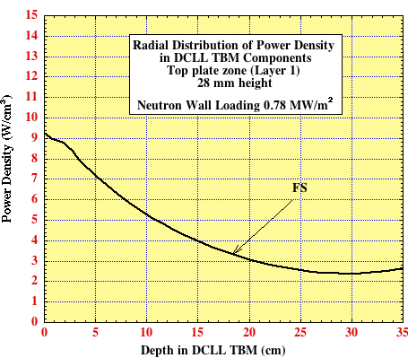
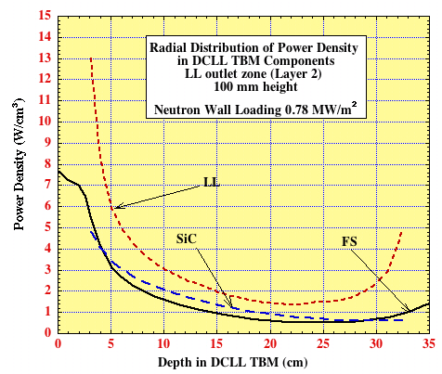
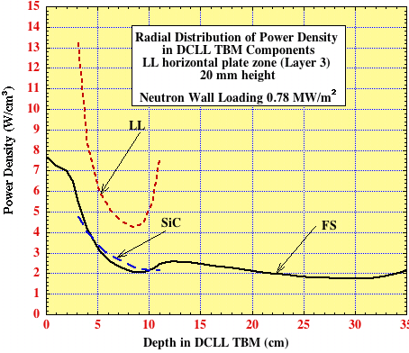
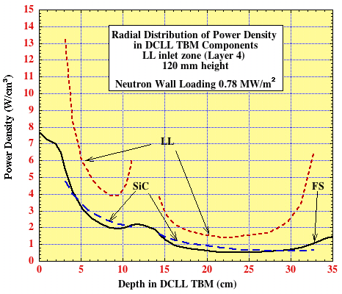
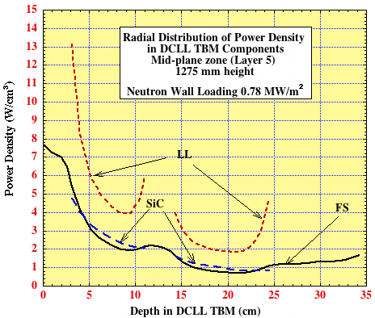
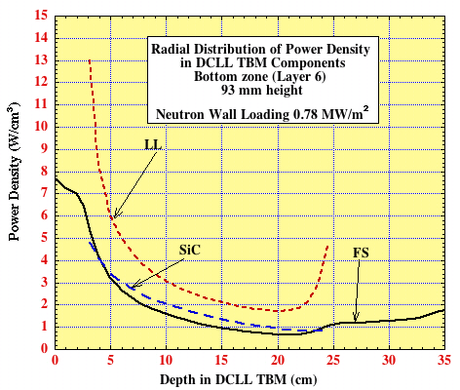
2 – Generating Data Table: Volumetric Heating
Zone 1
Zone 2
Zone 3
Zone 4
Zone 5
Zone 6
Zone 7
Detailed volumetric heating data (x, y, z ) tables were generated

Slide 14
The Analysis is Divided into Six Sections:
Pre-Processing the TBM Solid Model.
Generating Data Tables and ANSYS Scripts
Meshing and Applying Loads and BCs
Thermal Analysis
Structural Analysis
Summary and Conclusions

Slide 15
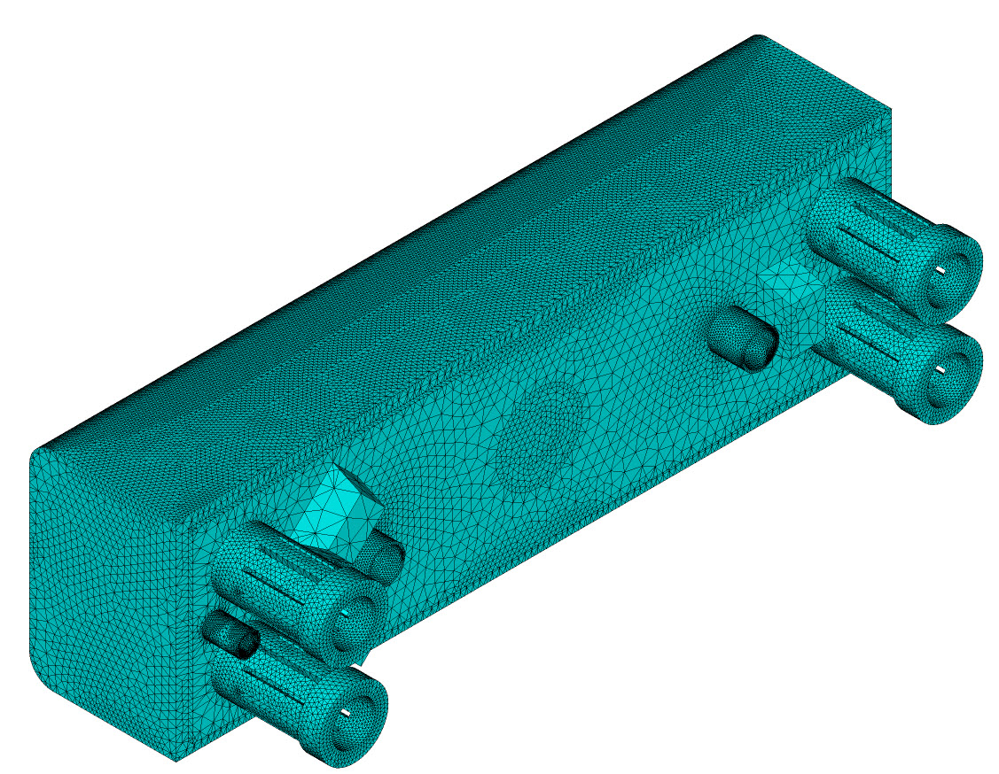
3 –ANSYS Pre-Processing: Meshing
Solid Model, material properties, and data tables are imported to ANSYS
The model is meshed resulting in:
2,821,145 solid elements
774,331 nodes
7,701 keypoints
11,893 lines
4,039 total areas

Slide 16
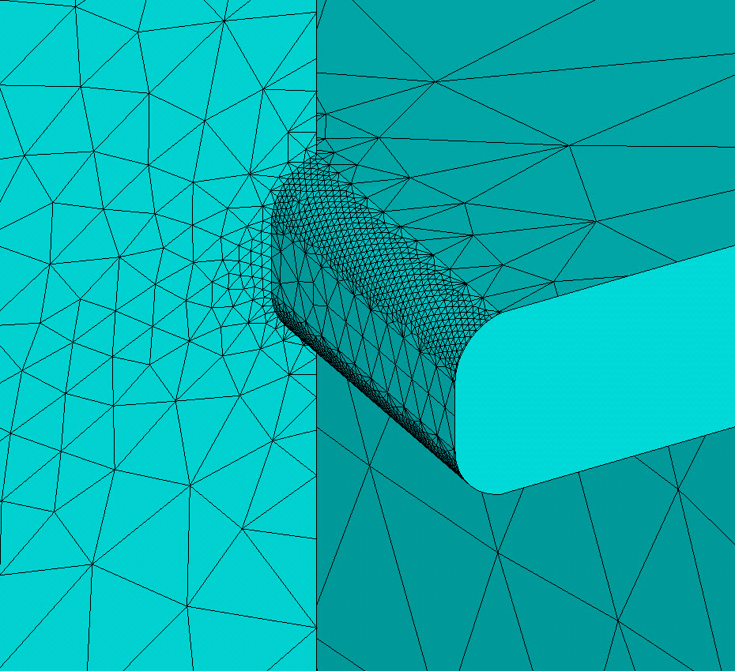
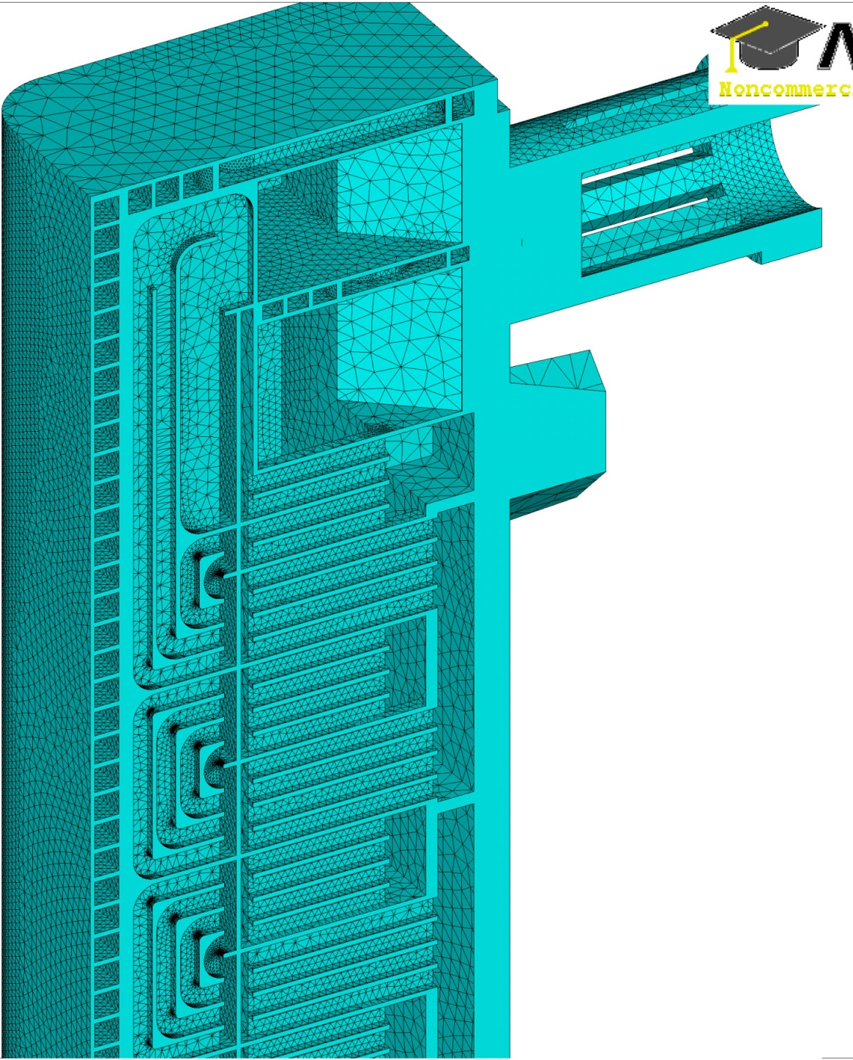
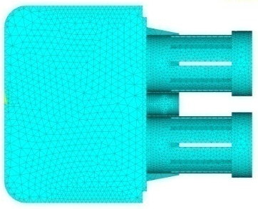
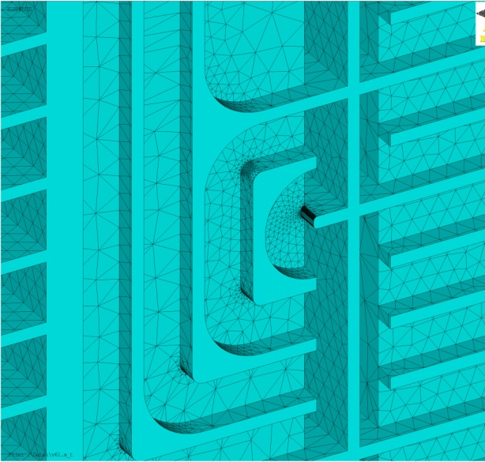
3 –ANSYS Pre-Processing: Meshing

Slide 17
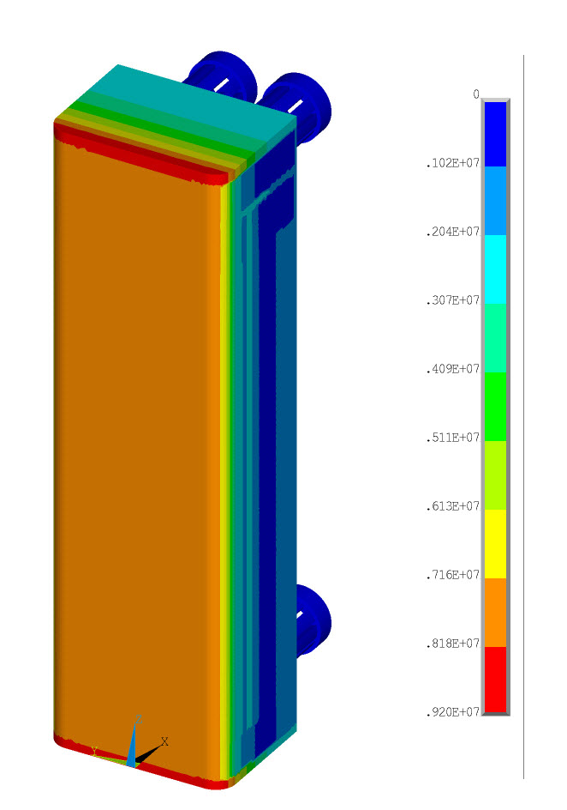
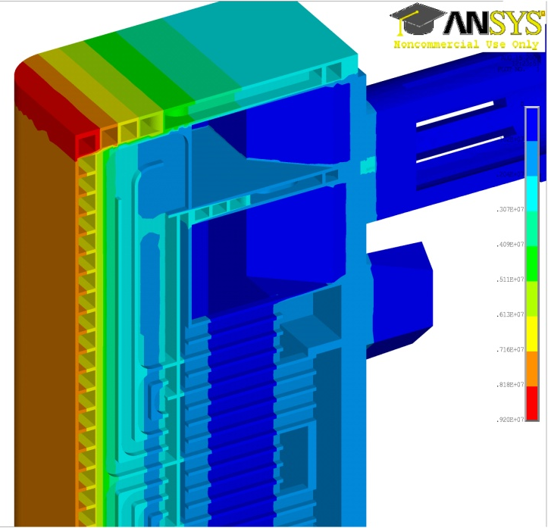
3 – Applying Loads: Volumetric Heating
Volumetric heating is applied to all 91 “solid bodies”

Slide 18
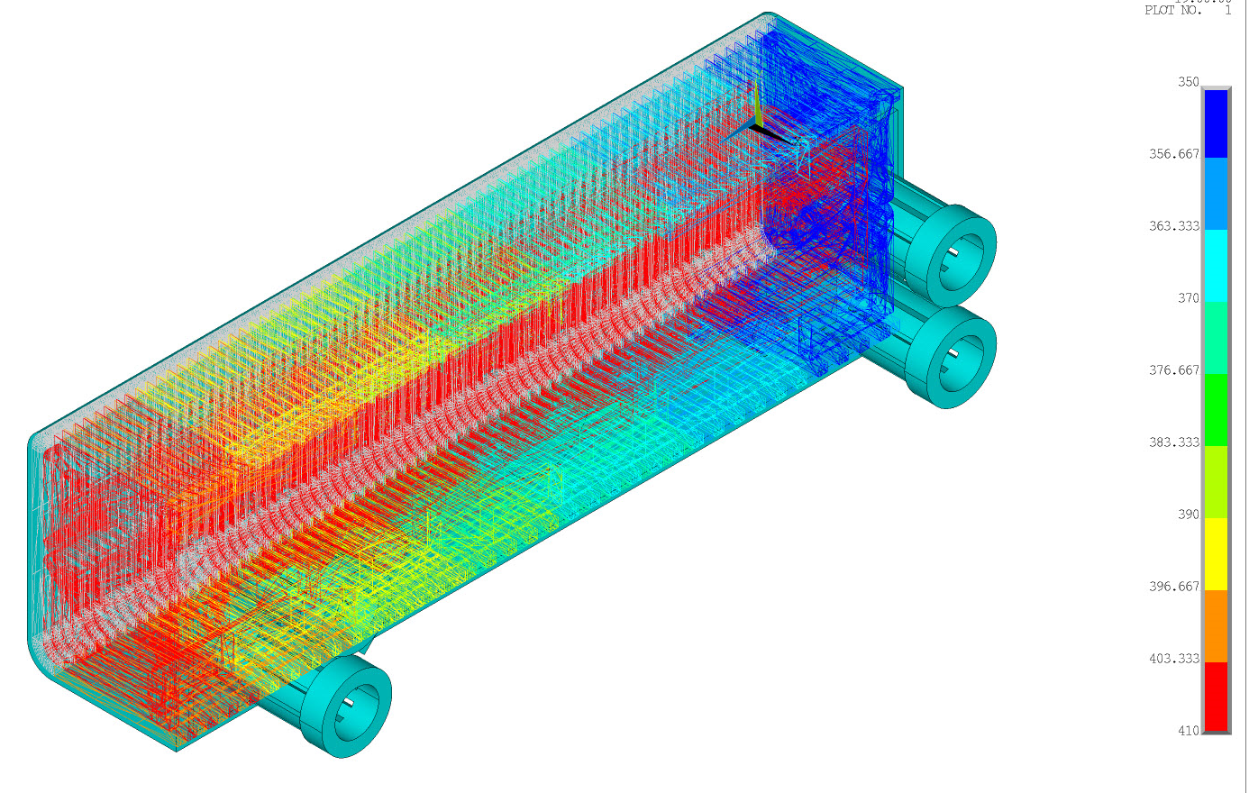
3 – Applying Loads: Convective Cooling
Convective heat transfer coefficients and helium bulk temperatures are applied to all He-channels:

Slide 19
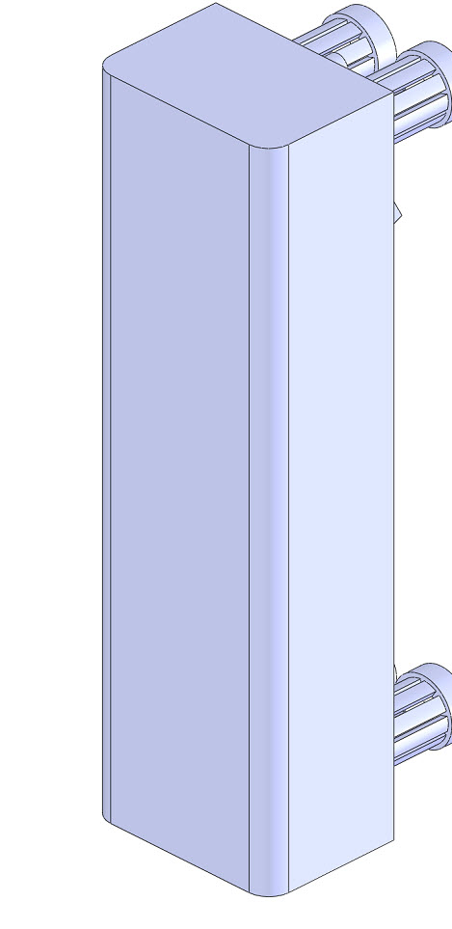
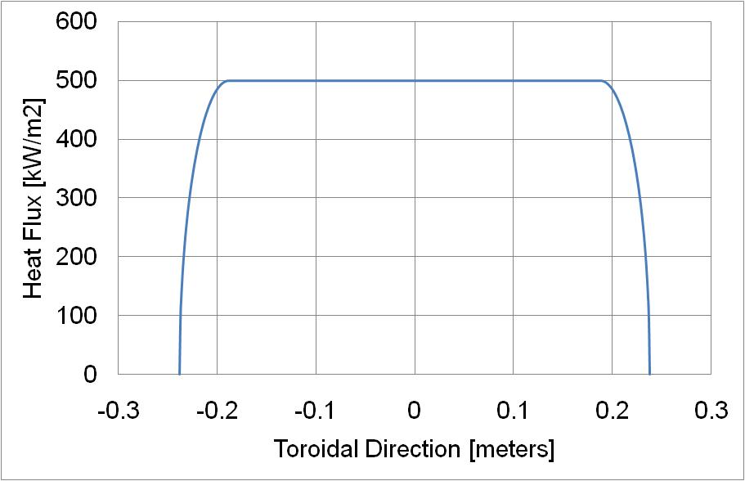
3 – Applying Loads: FW Surface Heat Load
FW Surface heat load is applied taking into account the rounded edges:

Slide 20
The Analysis is Divided into Six Sections:
Pre-Processing the TBM Solid Model.
Generating Data Tables and ANSYS Scripts
Meshing and Applying Loads and BCs
Thermal Analysis
Structural Analysis
Summary and Conclusions

Slide 21
4 –Thermal Analysis Results
Animation shows the temperature in the radial direction through the TBM:
Animation starts with FW

Slide 22
4 –Thermal Analysis Results
Temperatures in the radial direction across the TBM: T_{max} = 560 ºC:
T_{max}=560 ºC
~550 ºC
~507 ºC
~495 ºC
FW

Slide 23
4 –Thermal Analysis Results
Displacement due to thermal expansion : ~10.4 mm total
Animation starts with FW

Slide 24
4 –Thermal Analysis Results
Displacement due to thermal expansion : ~10.4 mm total
Displ. ~5 mm
FW
Displ. ~ 5 mm

Slide 25
The Analysis is Divided into Six Sections:
Pre-Processing the TBM Solid Model.
Generating Data Tables and ANSYS Scripts
Meshing and Applying Loads and BCs
Thermal Analysis
Structural Analysis
Summary and Conclusions

Slide 26
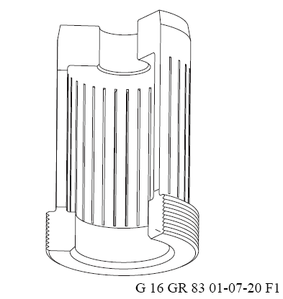
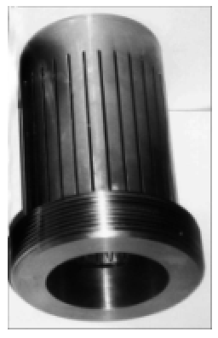
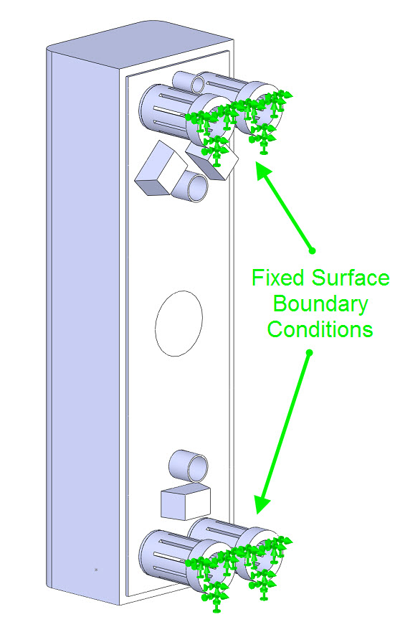
5 – Structural Analysis
We use four flexible supports - design is based on ITER Shield Flexible Joints:
The flexible joints react the module loads in the radial direction while being compliant in the other directions. This feature is provided by a tubular cartridge made flexible by axial slits milled in the middle wall.
The flexible cartridges are made from Ti-alloy (Ti-6Al-4V) due to its high strength, low Young’s modulus and adequate toughness after irradiation

Slide 27
5 – Structural Analysis Results
Stress results serve to identify critical locations, such as stress concentration; they do not represent actual stress values (we used no fillets or rounds, and no stress relaxation)
Flexible supports experience large stress

Slide 28
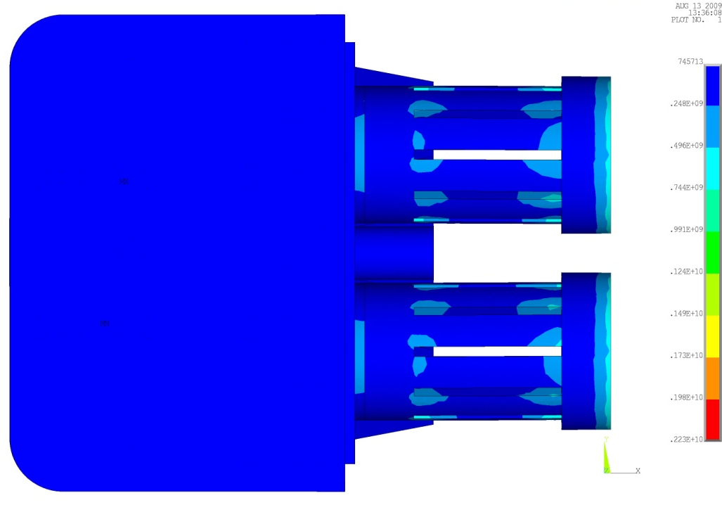
5 – Structural Analysis Results
Von Mises stress contours around of the flexible support.

Slide 29
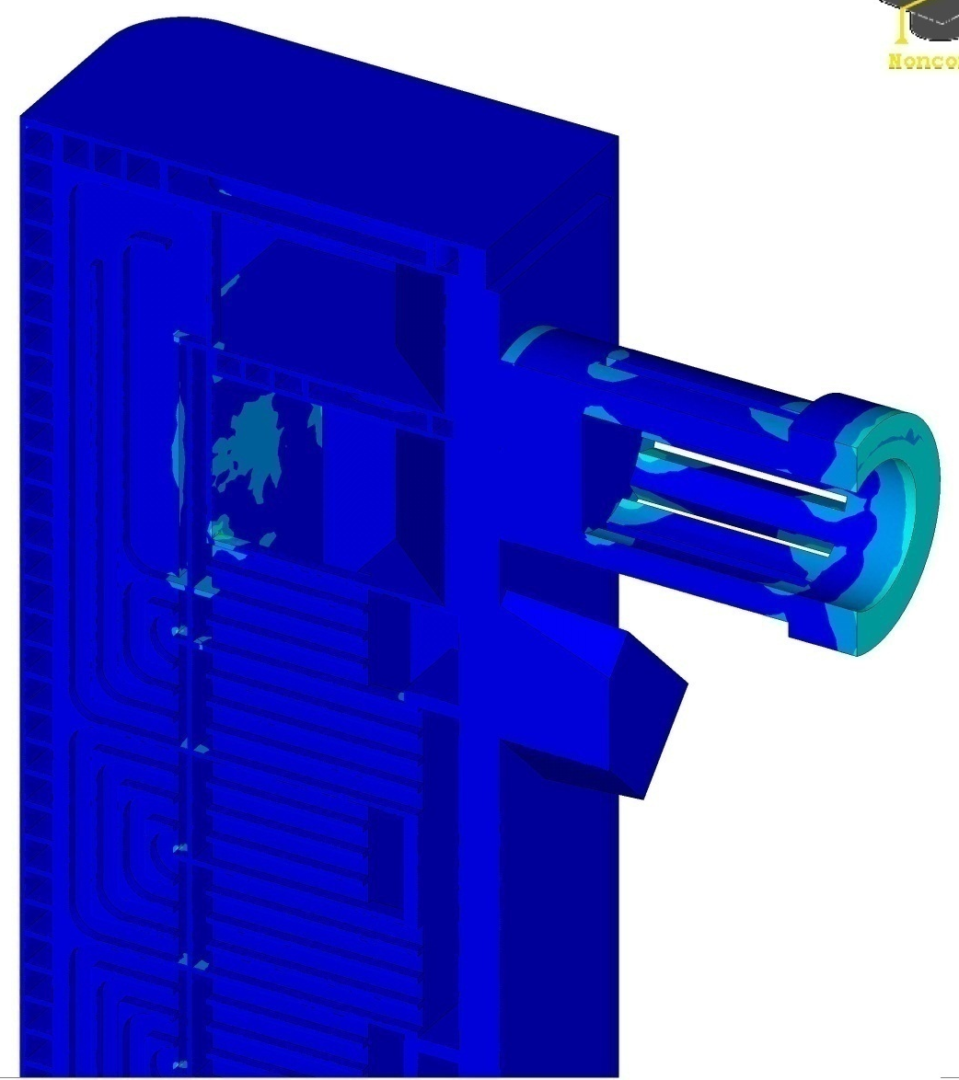
5 – Structural Analysis Results
A large number of stress concentration locations are identified. These need to be alleviated in the next design
Large Stress
Concentration

Slide 30
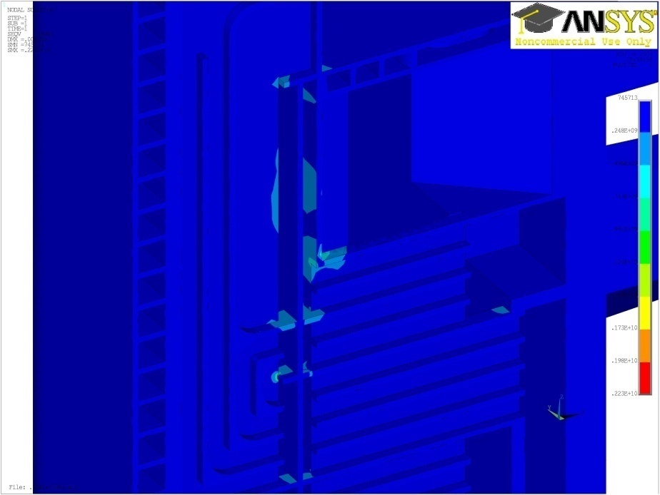
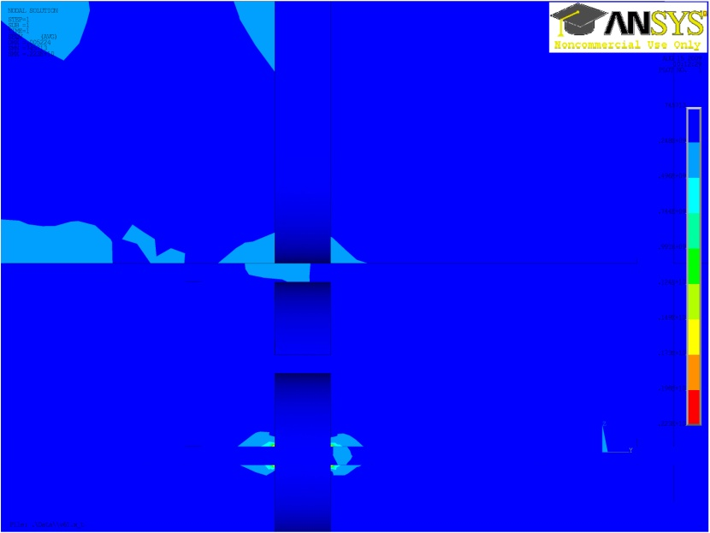
5 – Structural Analysis Results
More examples of stress concentrations inside the TBM

Slide 31
Summary and Conclusions
The TBM CATIA model was “cleaned” and a detailed solid model was created
Data tables for material properties, loads, and BCs were constructed
The TBM model was meshed using ~2.8 M elements (brick)
Thermal analysis (no CFD) identified (1) hotspot along the top TBM edge (560 ºC) and (2) a total displacement of ~10.4 mm
Structural analysis (no fillets) identified stress concentrations which should be addressed in the next design iteration – mostly inside flow dividers and inside support rib structures
Future Work:
Couple CFD-based temperatures and pressures with thermal and structural analysis
Depending on computing resources add fillets and rounds to high stress areas
Optimize the flexible support
Perform detailed “global-to-local” structural analysis of critical areas

Slide 32
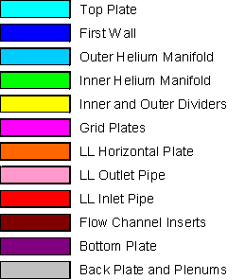
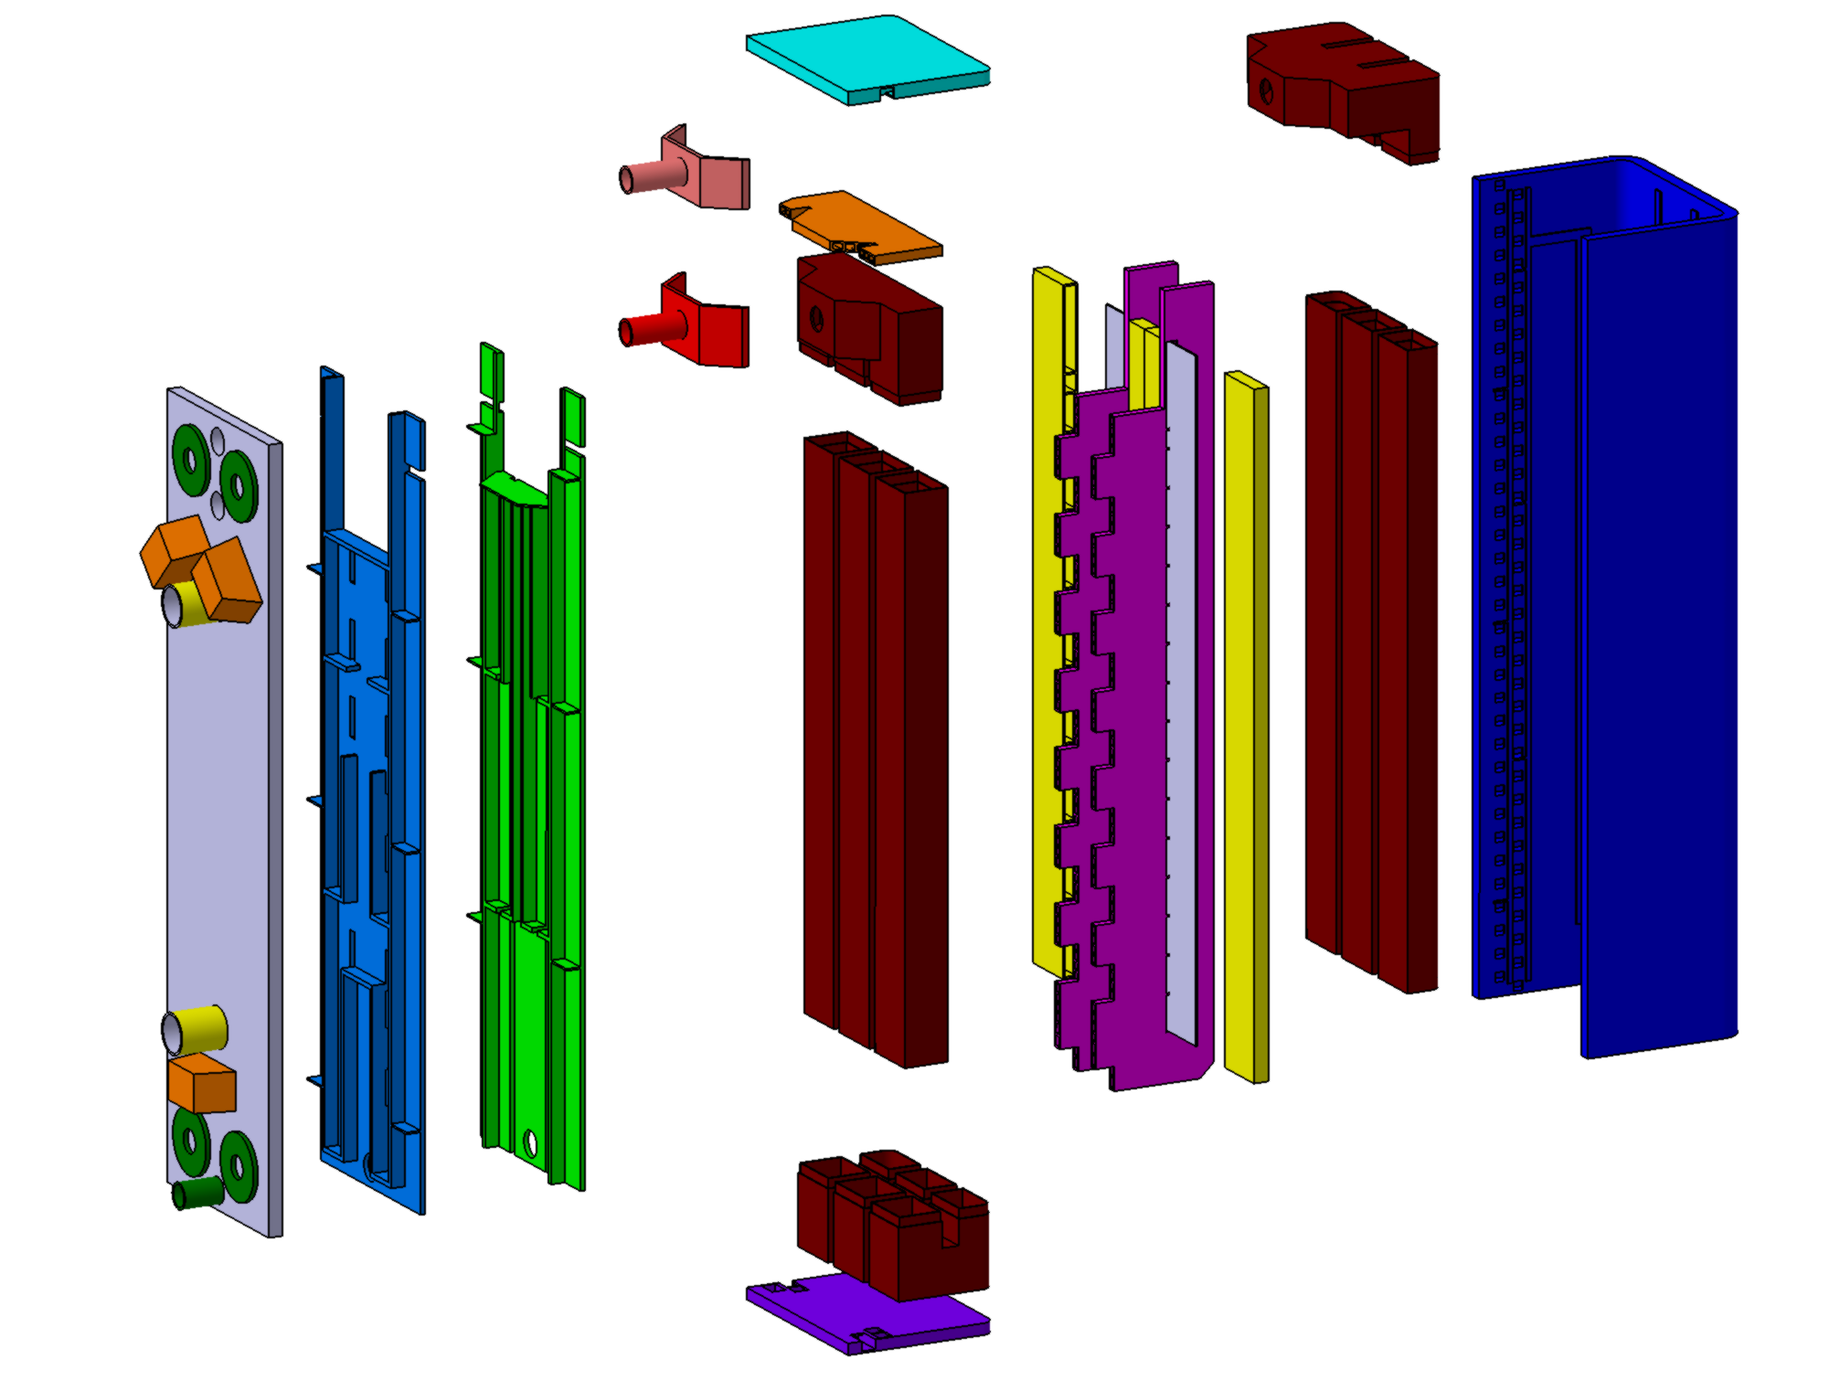
TBM Assembly Exploded View of Major Components

Slide 33
1 – Pre-Processing the TBM Solid Model (cont.)
X-Section View of “TBM Structure Solid Bodies”
Manifold

Slide 34
3 –ANSYS Pre-Processing: Meshing

