Slide 1
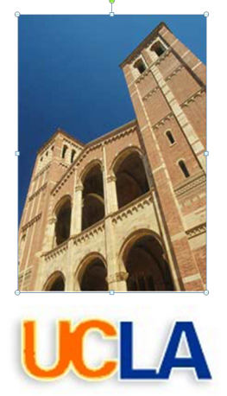
Assessment of the DCLL TBM Failure Modes based on ITER Design Criteria
Shahram Sharafat, Aaron Aoyama, Nasr Ghoniem (UCLA)
Fusion Nuclear Science and Technology Annual Meeting,
August 2 – 4, 2010
UCLA
Rice Conference Room, 6764 Boelter Hall

Slide 2
INTRODUCTION
The DCLL TBM is a safety-critical structure, which operates under low- and heavy loading conditions (normal- and off-normal).
Under normal operating conditions plastic deformation (shake down) will occur, the TBM structure will undergo loss of ductility ( ̴3.7 dpa EOL), … many potential failure modes exist.
Stress analysis alone cannot predict failures* by buckling, global and/or local
collapse, incremental collapse (ratcheting), creep-fatigue, etc.
*see backup slides

Slide 3
Failure Mechanisms
LOW TEMPERATURE:
Limit load collapse, under a single load application.
Excessive displacement and/or deformation, limiting functionality, under a single load application, below the limit load.
Structural instability or buckling, under a single load application.
Progressive collapse by ratcheting under cyclic load.
Fracture by the initiation and/or propagation of a crack under a single load application.
Fatigue failure under cyclic loading.
Breach of the pressure boundary, or structural collapse caused by corrosion induced loss of section.
HIGH TEMPERATURE:
Excessive deformation - loss of functionality, due to creep deformation under essentially steady load.
Creep buckling - time dependent structural instability leading to catastrophic collapse or loss of function.
Cyclically enhanced creep deformation (Creep Ratcheting) - Accelerated creep deformation caused by repeated resetting of stresses by cyclic plastic strain, due to cyclic loads superimposed on a sustained load history.
Accelerated creep rupture - Accelerated creep damage caused by repeated resetting of stresses by cyclic plastic strain, due to cyclic loads superimposed on a sustained load history.
Creep/fatigue interaction - Failure under cyclic conditions in a period, usually less than fatigue due to the cyclic condition alone, or creep rupture due to time-at-stress alone, the mechanism for which may include other time/temperature related phenomena, such as oxide layer cracking, and may be material specific.
ALL TEMPERATURES:
Corrosion, oxidation, and mass transport phenomena
Irradiation induced failure mechanisms

Slide 4
INTRODUCTION
The DCLL TBM is a safety-critical structure, which operates under low- and heavy loading conditions (normal- and off-normal).
Under normal operating conditions plastic deformation (shake down) will occur, furthermore the TBM structure will undergo loss of ductility ( ̴3.7 dpa EOL)…
Stress analysis alone cannot predict failures* by buckling, global and/or local
collapse, incremental collapse (ratcheting), creep-fatigue, etc.
Fortunately, general purpose FEM codes can be used to evaluate performance of
loaded structures in compliance with “Design Criteria” rules.
Design Criteria rules offer tools for assessing the performance of loaded structures by means of limit and shakedown analysis methods of “Design By Analysis” (DBA).
Ultimately, design of robust and reliable TBM structures requires sensitivity studies that:
  combine DBA analyses with probabilistic methods, and
  perform large-scale FEM analyses with the inclusion of hardening and damage.
*see backup slides

Slide 5
TALK OUTLINE
Structural Evaluation Plan (SEP) – Flow of Design Analysis
Definition of SDC-IC Design Criteria
F82H material property data for SDC-IC
Large-scale FEM analysis of the DCLL TBM
Selecting paths (total of 13) through critical locations of the DCLL TBM structure
Application of low- and high temperature SDC-IC rules to the 13 paths.
Tabulated Factor-of-Safety (FoS) of all 13 paths for both un-irradiated and irradiated operating conditions.

Slide 6
Structural Evaluation Plan (SEP)

Slide 7
Structural Evaluation Plan (SEP)
Basic Design Configuration: Sufficient analysis to establish basic shapes and sizes for interfacing with other components.
Deformation Limits & Functional Requirements: Identify deformation limits and functional requirements established by the manufacturer for proper performance.
Structural Evaluation:
  Failure Modes: Identify location of dominant failure modes and load conditions (pressure, thermal, seismic, etc.).
  Screening Analysis:
  Make a preliminary evaluation of the adequacy of the design.
      Typical screening analysis consist of an initial linear elastic analysis,
      comparison with design limits adjusted to account for significant
      fabrication and environmental effects.
  Detailed Inelastic Analysis: After Screening Analysis is complete.
  Support Test Program for Component Design Analysis: Manufacturer should identify structural tests required in support of design analysis.

Slide 8
Sample Screening Analysis
Design Specifications
Initial Design
Design Iteration
Elastic Analysis
NO
Design Criteria Met
YES
Report to Owner
NO
Design Iterations
Simplified Inelastic Anal.
NO
Design Criteria Met
YES
Report to Owner
NO
Proposal for Detailed Inelastic Analysis
Proposal for Supporting Test Program

Slide 9
Screening Analysis Reported Here
Design Specifications
Initial Design
Design Iteration
Elastic Analysis
Flow Chart
(next slide)
NO
Design Criteria Met
YES
Report to Owner
NO
Design Iterations
Simplified Inelastic Anal.
NO
Design Criteria Met
YES
Report to Owner
NO
Proposal for Detailed Inelastic Analysis
Proposal for Supporting Test Program

Slide 10
Analysis Flow Chart for Low-Temperature
SDC-IC Design Rules for Given Operating Conditions
Brittle Fracture:
KI = stress intensity factor (a =h/4),
3Sm ratcheting due to cyclic loading limit
PM+Pb/K = creep damage limit
PL = Imm. Plastic collapse and plastic instabiliy
PL+QL = Plastic Flow Localization
PL + PB + Q + F = ductility exhaustion limit
Notes:
PM+Pb/K = creep damage limit, PL = Imm. Plastic collapse and plastic instabiliy, PL+QL = Plastic Flow Localization, PL + PB + Q + F = ductility exhaustion limit, , Brittle Fracture: KI = stress intensity factor (a =h/4), 3Sm ratcheting due to cyclic loading limit

Slide 11
Procedure for using SDC-IC Design Criteria
Identify Failure Mechanisms and Loading Conditions
Perform Elastic Thermo-mechanical FEM
Check Factor of Safety
Apply Low- and High Temperature Design Rules
Identify Paths through TBM Structure
Linearize Stresses along Paths

Slide 12
SDC-IC design criteria

Slide 13
Some Terminology
PRIMARY AND SECONDARY STRESS:
    “Primary” stress denotes that part of the total stress in equilibrium with external mechanical forces (pressure).
    “Secondary” stress consists of all contributions to an internal, self equilibrating or residual stress state (thermal stress).
    Primary stress is instrumental in causing gross structural collapse whereas the secondary stress is of concern for cyclic load or local damage accumulation.
HIGH TEMPERATURE:
    “High temperature” refers to the operating range of temperature within which time dependent, thermally activated deformation and damage processes occur.
    “High temperature” is, for the most part synonymous with
    “in the creep range”, but others, such as thermal ageing and oxidation/ corrosion are also important.

Slide 14
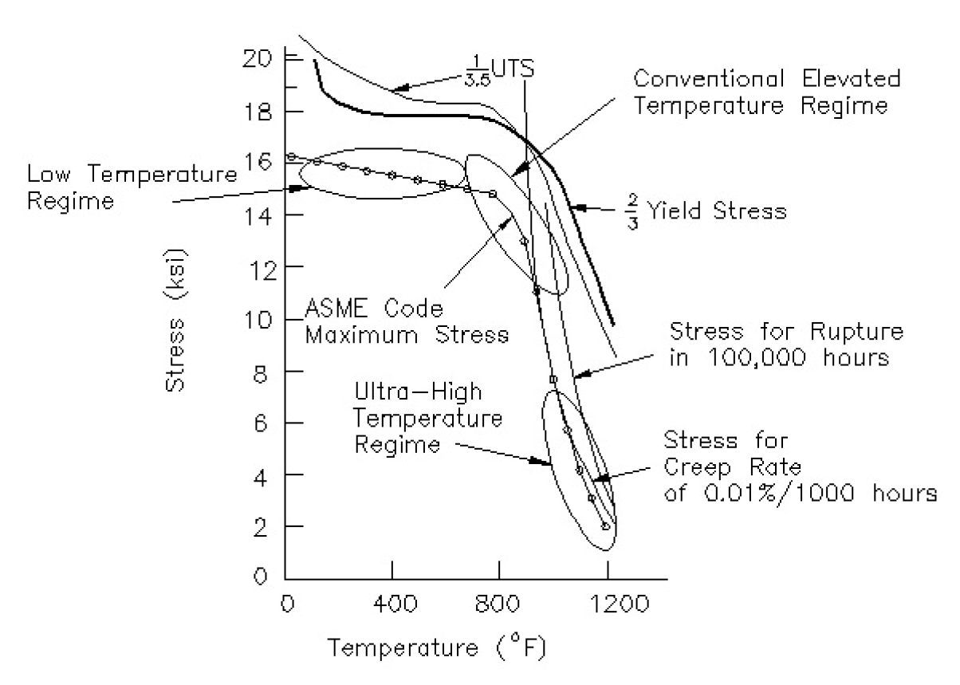
Schematic Diagram of ASME Design Stress Determination
High Temperature
Regime
Low Temperature
Regime

Slide 15
Loading Category Criteria Level
Loading Category | Category Condition (Damage Limits) | SDC-IC Criteria Level
Operational Loading | Normal, Upset | A
Likely Loading | Emergency | C
Unlikely Loading | Faulted | D
Level A and C loadings include electromagnetic loading during plasma disruptions.
Level D postulates earthquakes.
      Level A Design Criteria prevent against:
      immediate plastic collapse,
      immediate plastic instability,
      Immediate plastic flow localization,
      fast fracture,
      local fracture due to exhaustion of ductility,
      ratcheting,
      fatigue,
      thermal creep,
      buckling

Slide 16
Definition of Design SDC-IC Criteria

Slide 17
SDC-IC Design Criteria Procedure
Identify Failure Mechanisms and Loading Conditions
Perform Elastic Thermo-mechanical FEM
Check Factor of Safety
Apply Low- and High Temperature Design Rules
Identify Paths through TBM Structure
Linearize Stresses along Paths

Slide 18
large-scale FEM analysis of
DCLL TBM

Slide 19
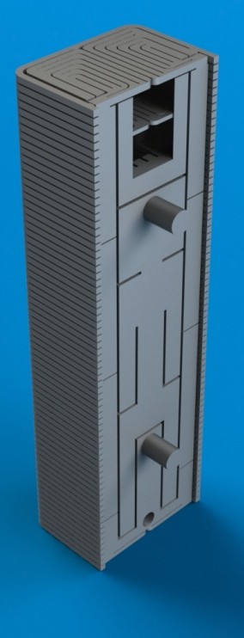

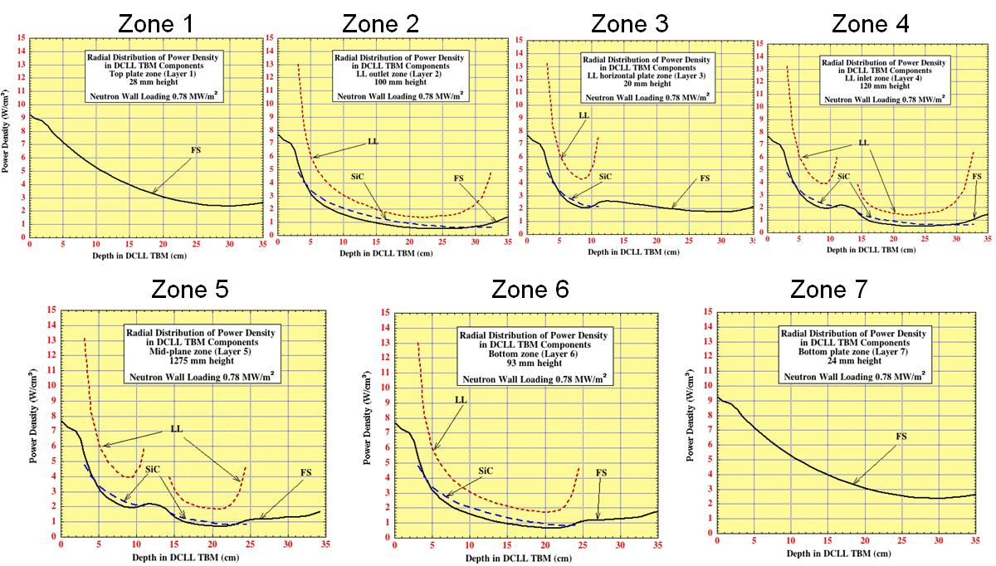
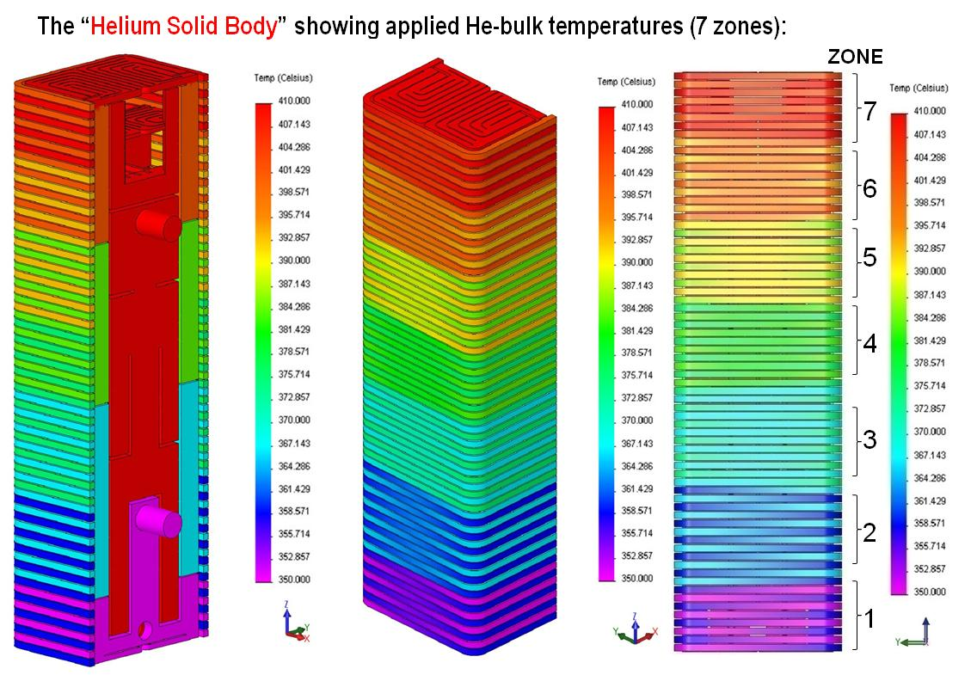
Thermo-mechanical Modeling of TBM
Solid Modeling of 2009 – 2010 TBM :
  Used Original CATIA TBM Model
  Created solid bodies for He & PbLi volumes
  Total of 91 solid bodies were assembled into the TBM Solid Model before importing it into ANSYS
  for meshing and analysis (including Flexible Joints)
Thermo-mechanical Loads:
  Gravity (account for PbLi weight)
  Uniform FW surface heat flux (q” = 0.5 MW/m²)
  He-pressure: 8 MPa; PbLi pressure: 2 MPa
  Convective cooling (location dependent)
  Volumetric heating (material & location dependent)
He-Solid Body
(assembled)
Exploded View of He-Solid Bodies (temperature coded)

Slide 20
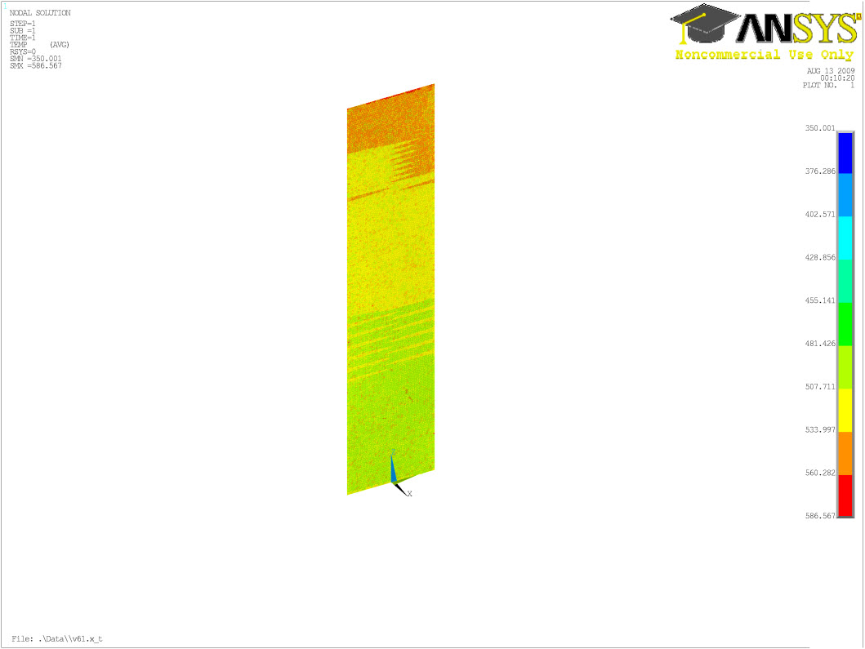
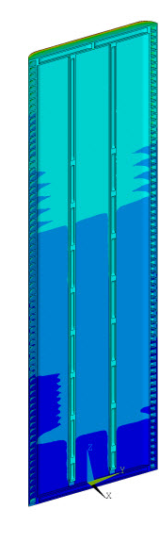
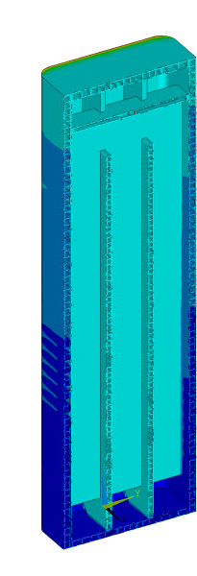
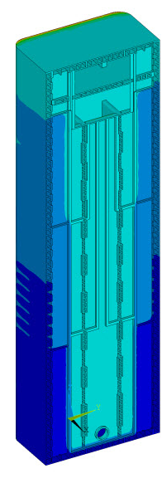
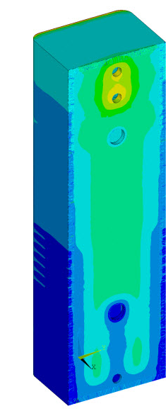
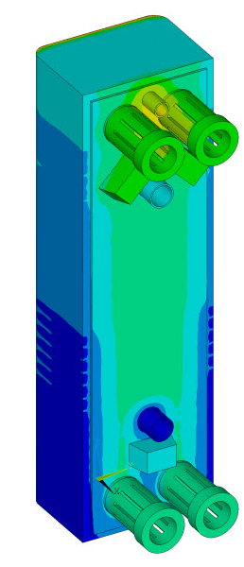
Thermal Analysis: Temperatures
T_{max} = 560 ºC at top of FW
T_{max}=560 ºC
~550 ºC
~507 ºC
~495 ºC
FW
radial
poloidal
BW
toroidal
radial

Slide 21
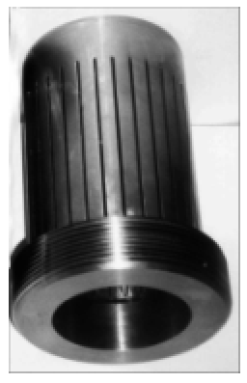
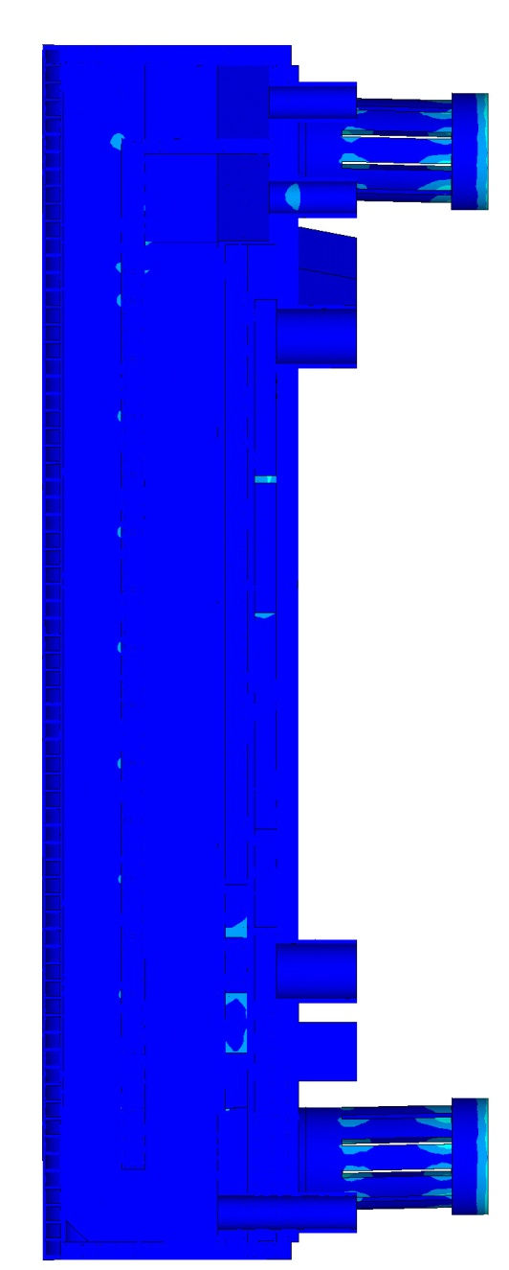

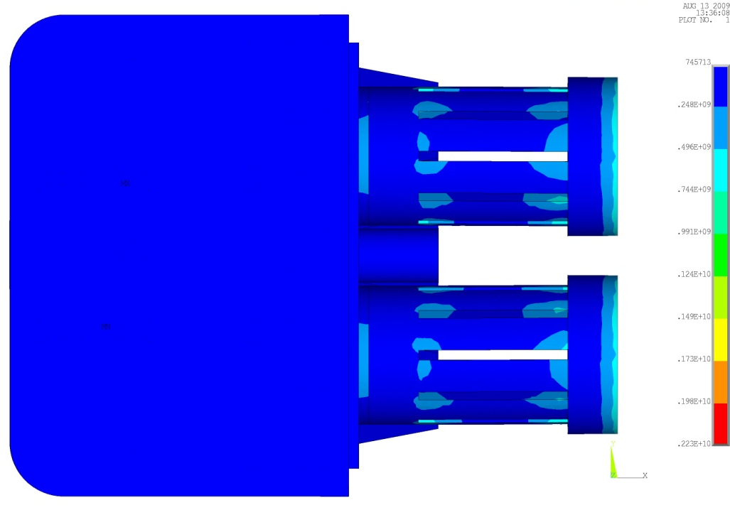
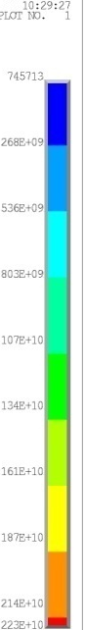
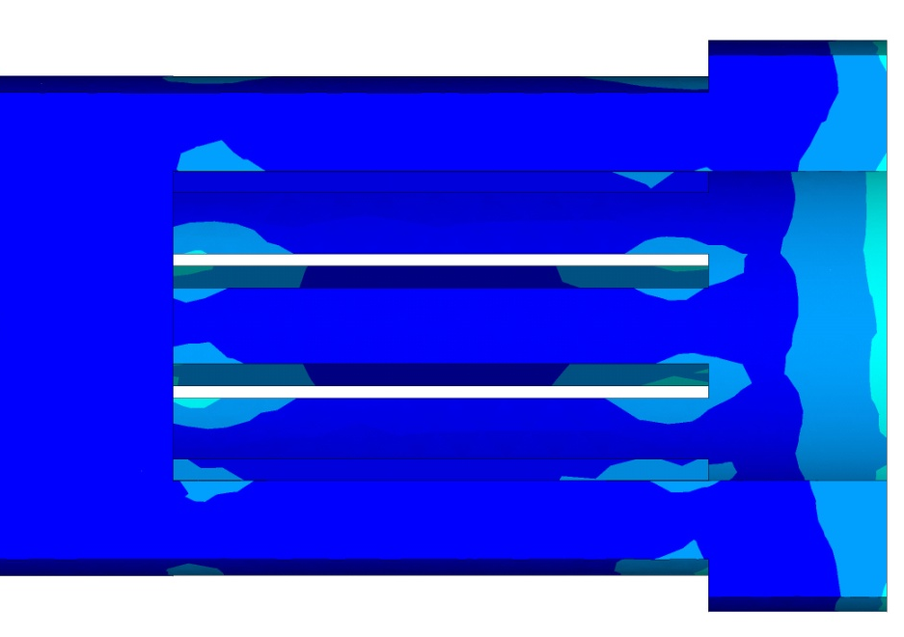
Structural Analysis: Stress
Based on ITER
FW Flexible Joint
Von Mises stress contours
Side Veiw
Top View
(TBM Lid)
Flexible Joint Detail

Slide 22
Applying low- and high temperature SDC-IC rules to DCLL

Slide 23
SDC-IC Design Criteria Procedure
Identify Failure Mechanisms and Loading Conditions
Perform Elastic Thermo-mechanical FEM
Check Factor of Safety
Apply Low- and High Temperature Design Rules
Identify Paths through TBM Structure
Linearize Stresses along Paths

Slide 24
CHOOSING PATHS ALONG CRITICAL LOCATIONS:
(1) Highest Stress
(2) Midsection of FW
(3) Coldest Structure

Slide 25
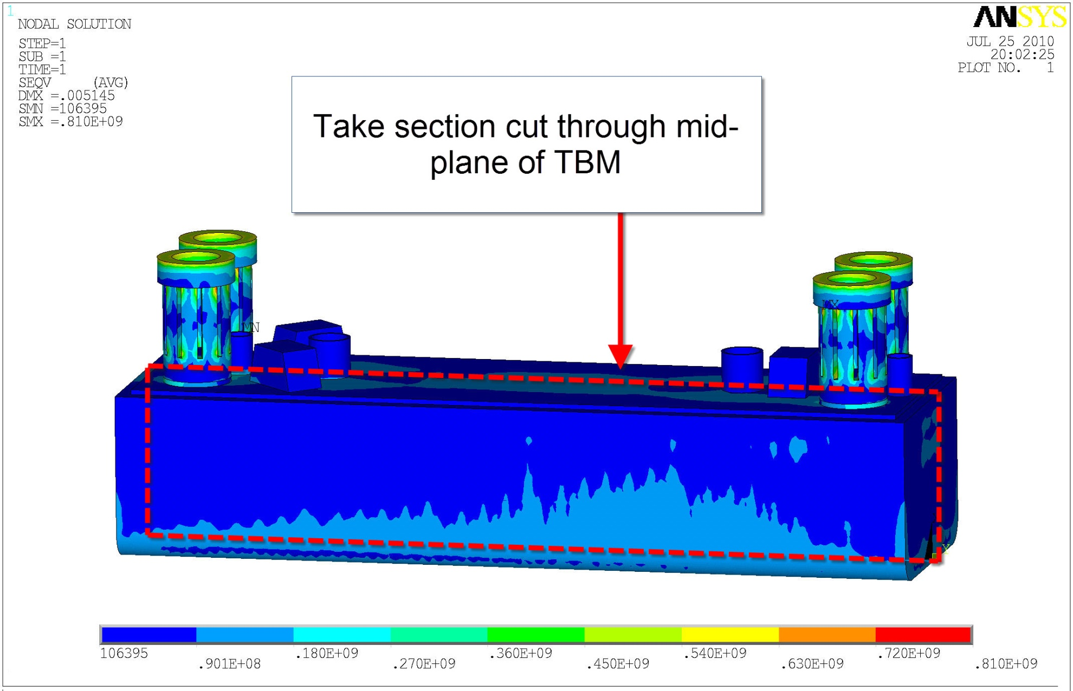
Path through highest stress location
0.4 m
0.6 m
0.2 m
1.6 m

Slide 26
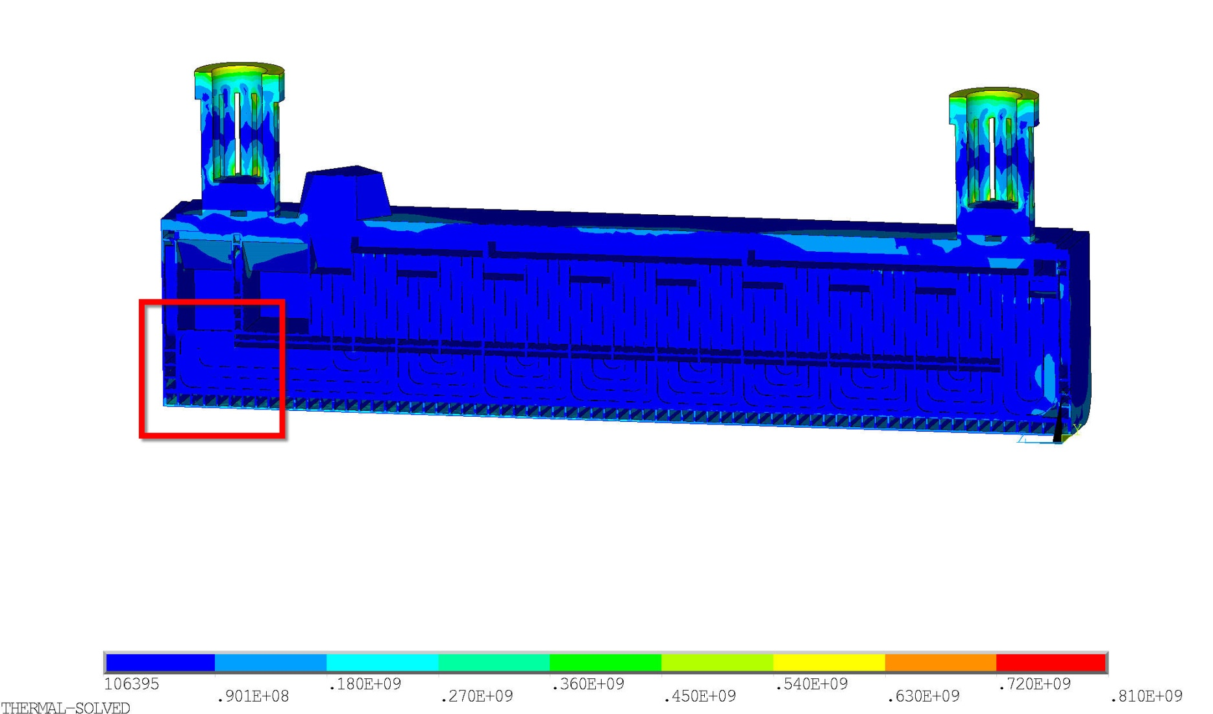
Cross Section Cut through the TBM (mid-plane)
Zooming in on Region
with Highest Stress

Slide 27
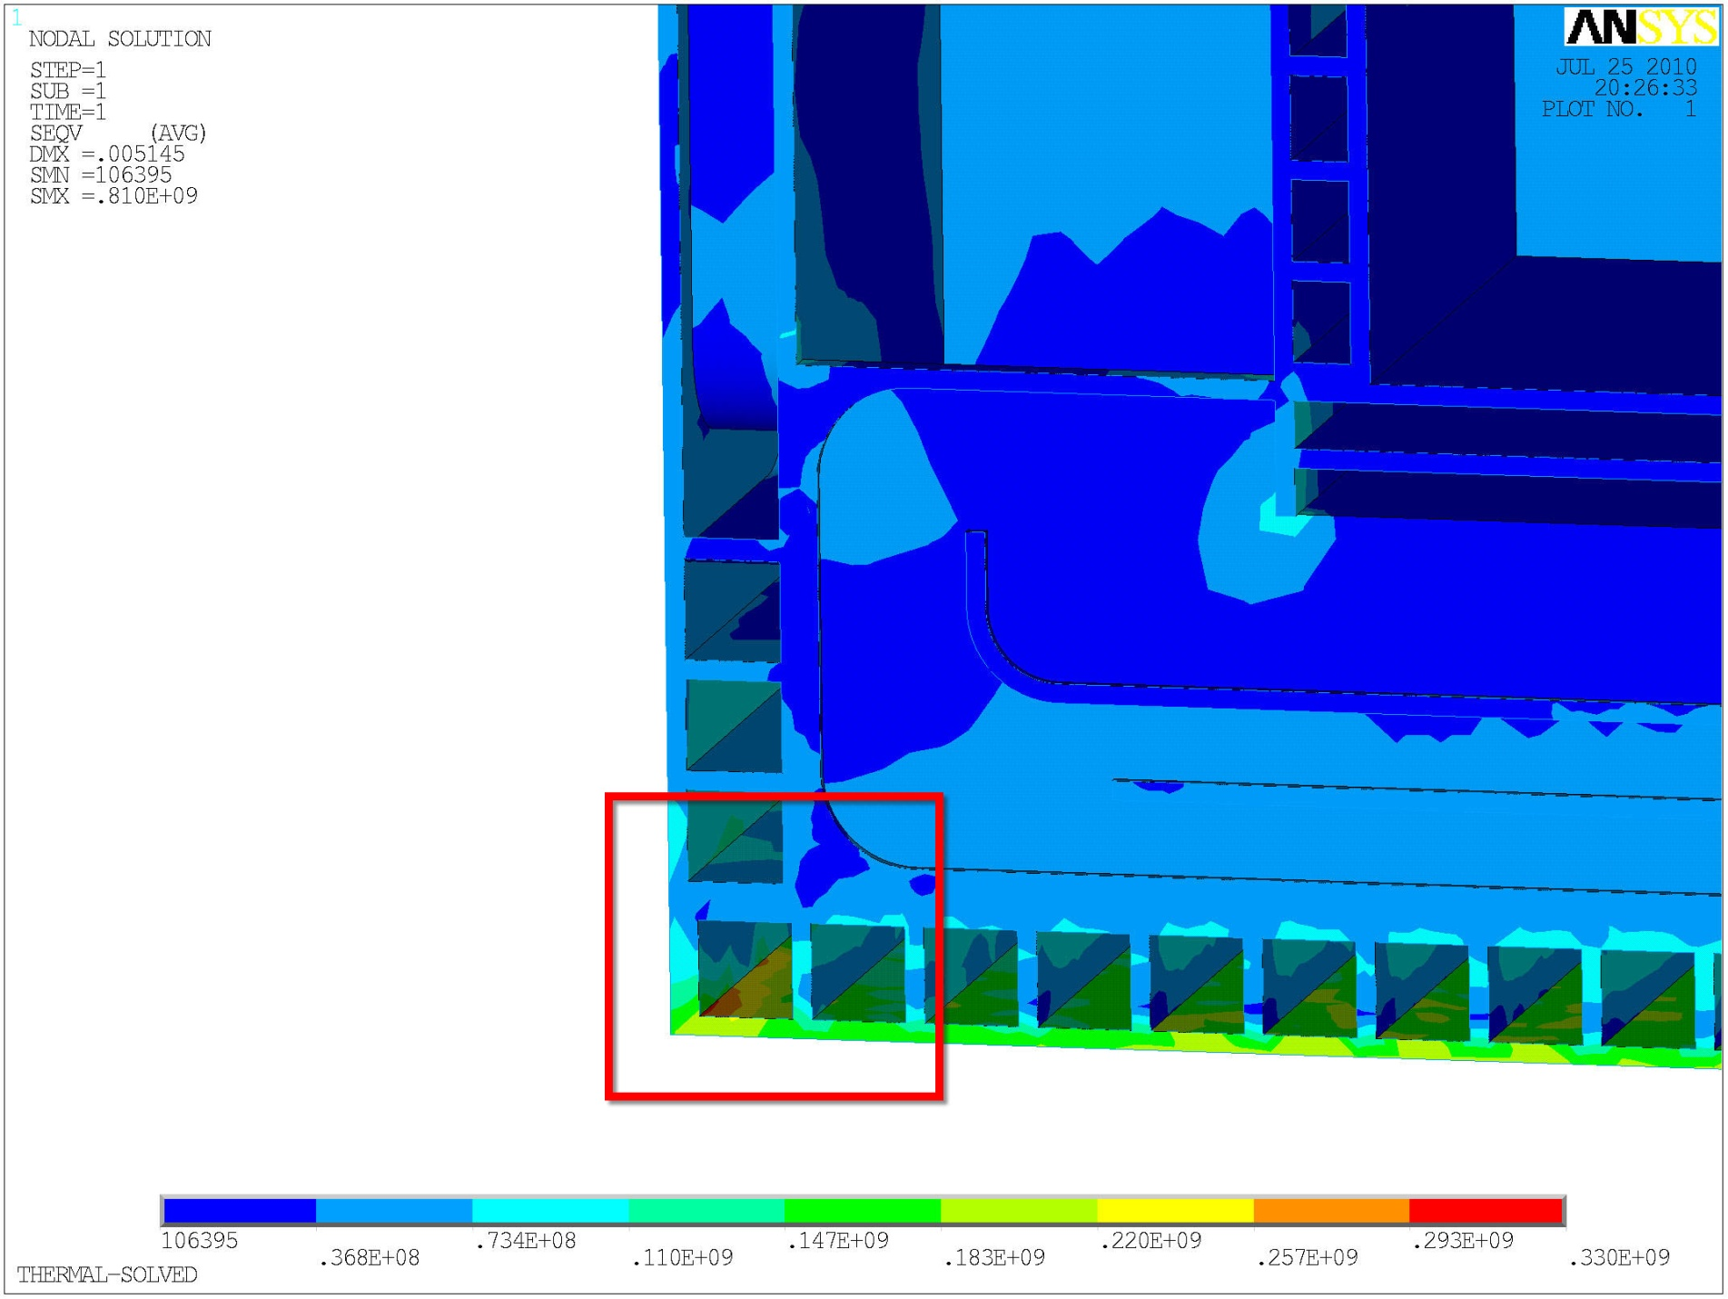
Cross Section Cut through the TBM Mid-plane
TBM Lid
(top of TBM)
Region with
Highest Stress
FW (Plasma side)

Slide 28
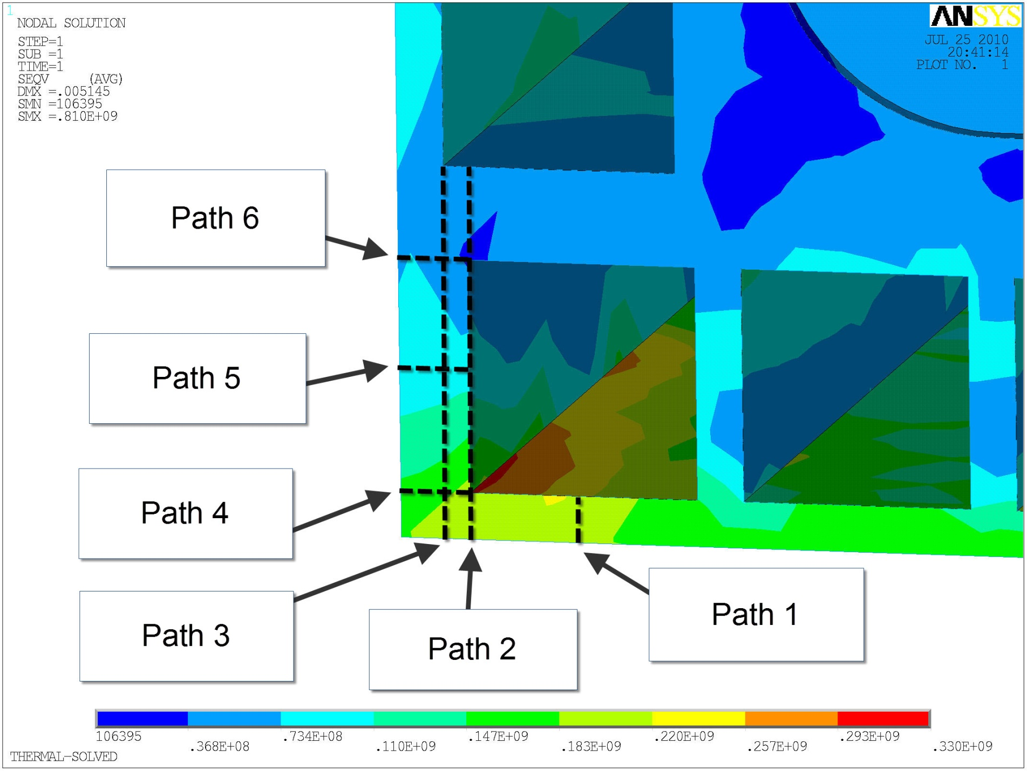
Paths near highest stress location

Slide 29
Path through the FW along
the Midsection of the TBM

Slide 30
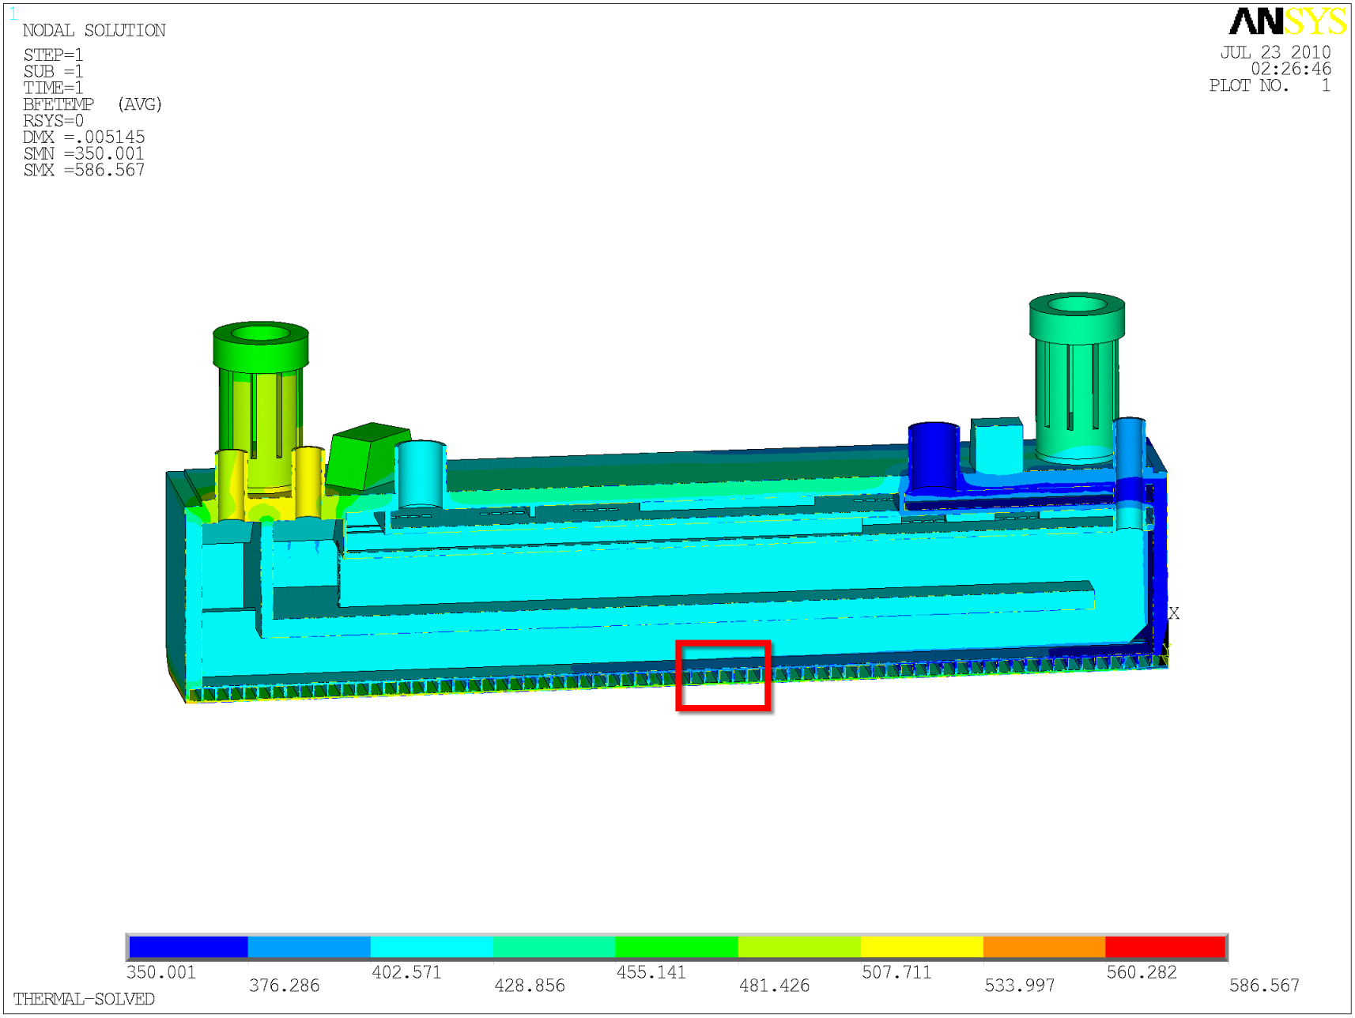
Path through the Mid-section of the TBM FW
Zooming in on the TBM
Midsection - FW

Slide 31
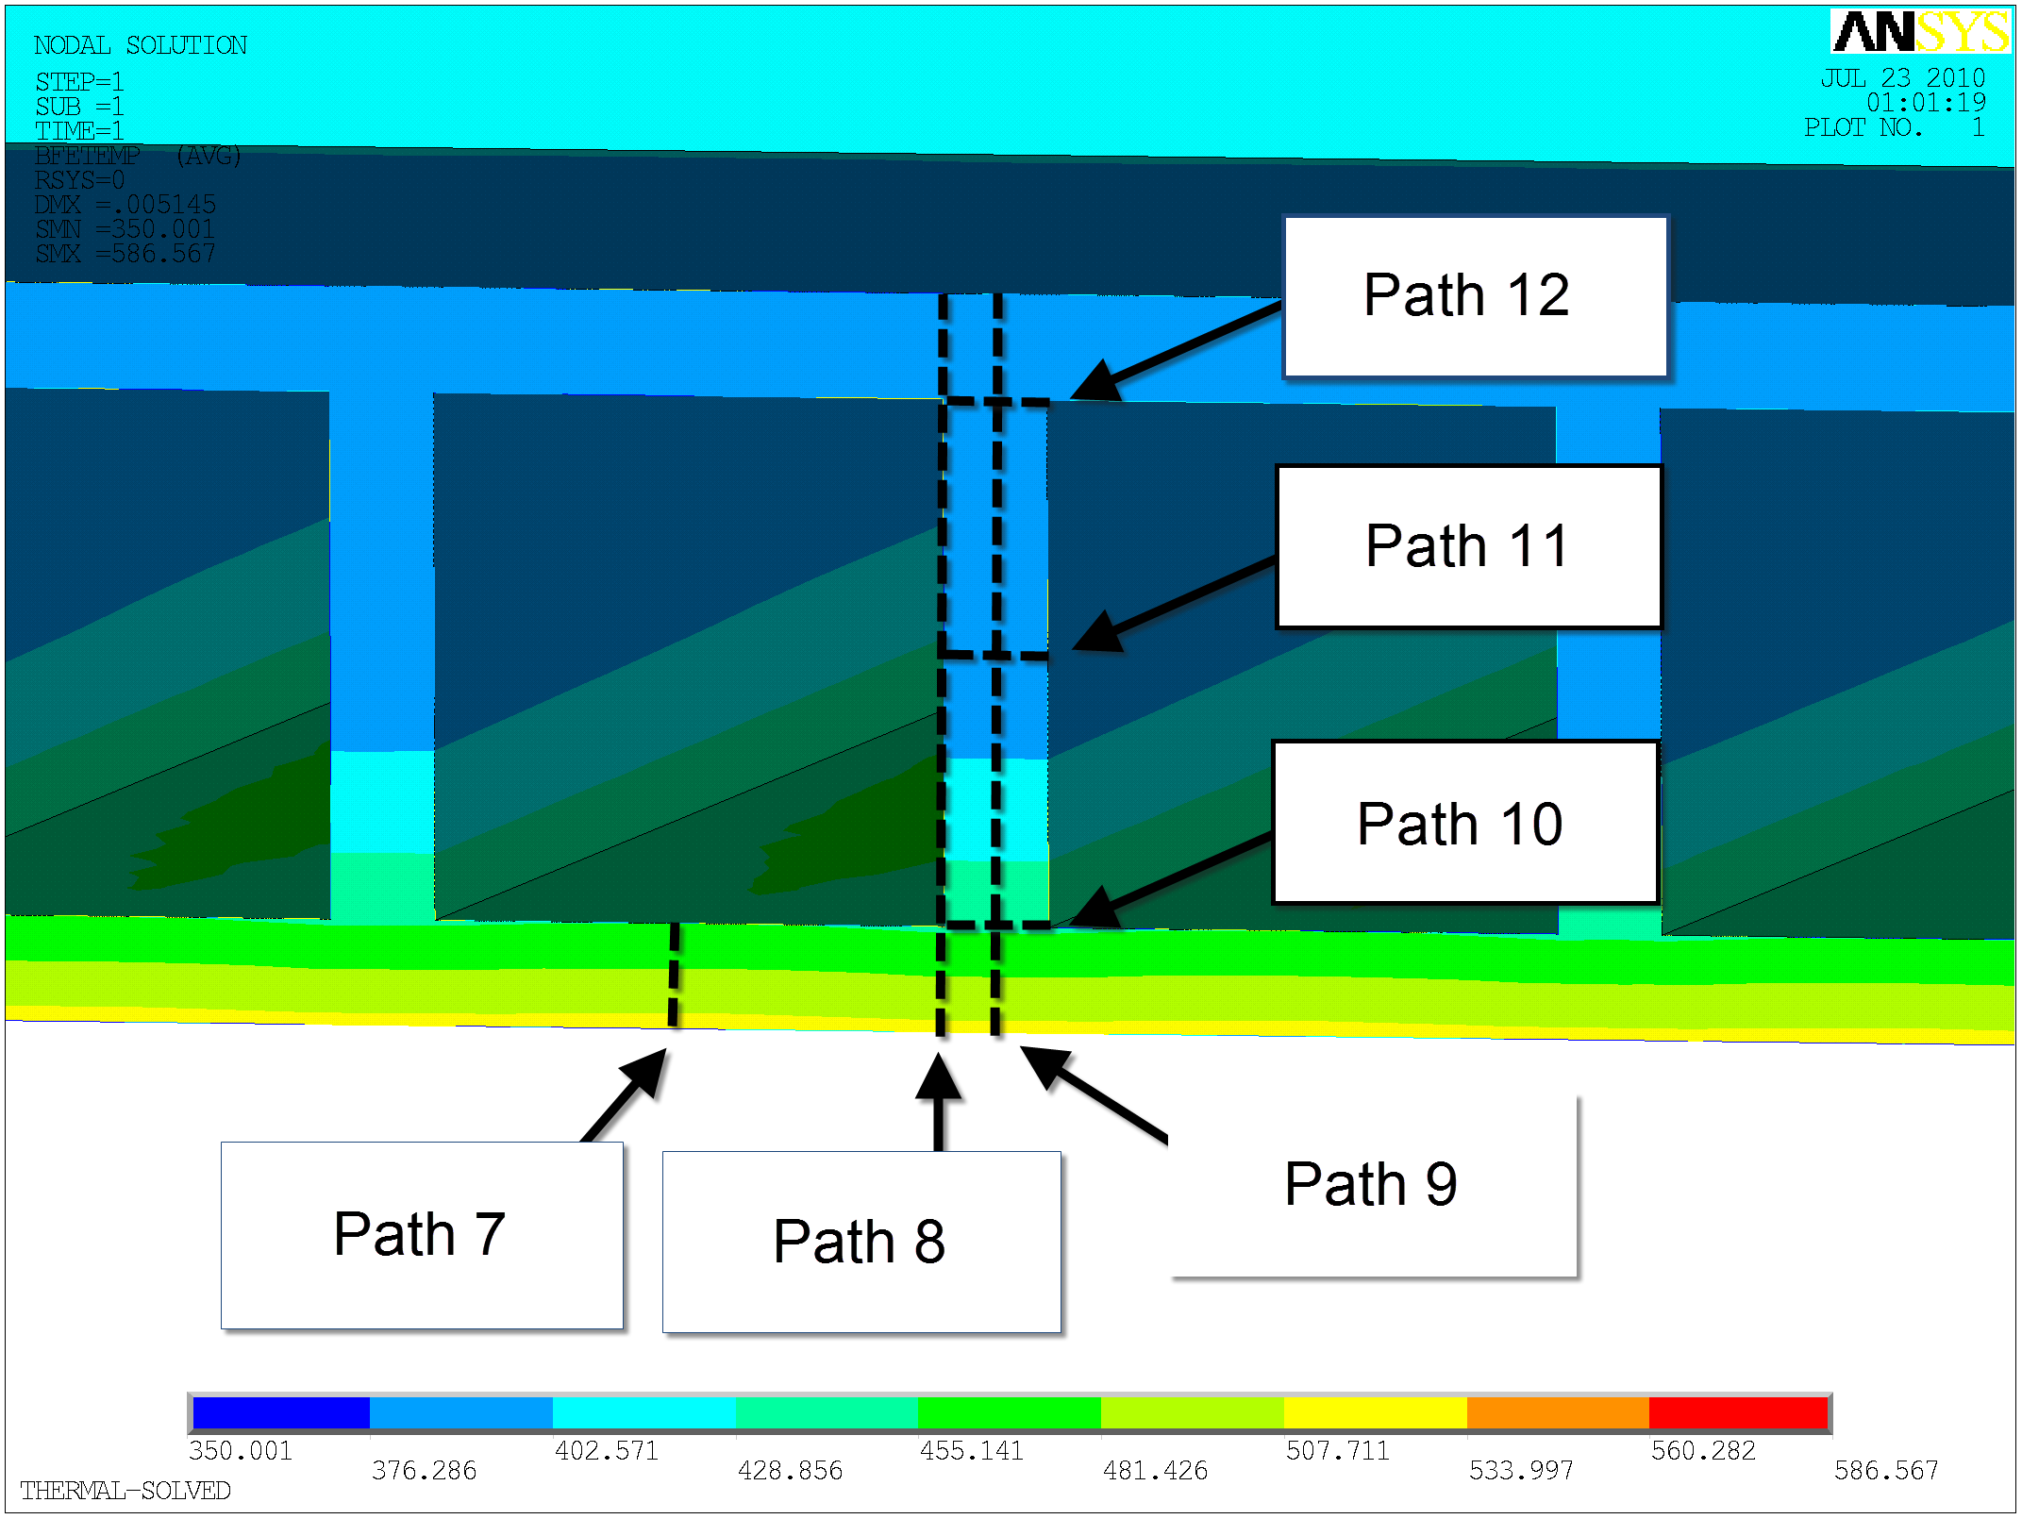
Paths through the TBM FW

Slide 32
Choosing a Path through TBM Structure
with Lowest Temperature

Slide 33
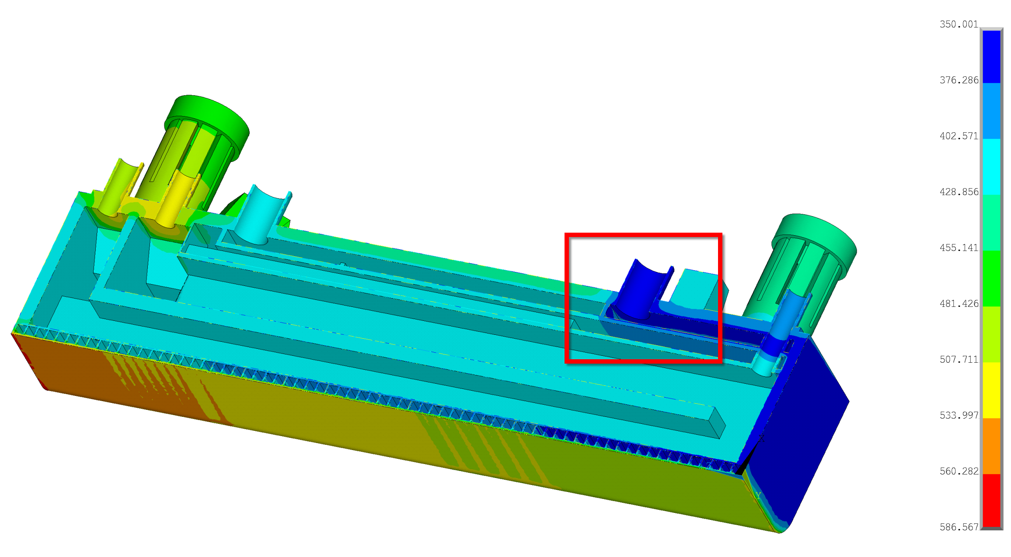
Path through the Coldest Structure
Zooming in on the TBM
Coldest Structure: He-Inlet

Slide 34
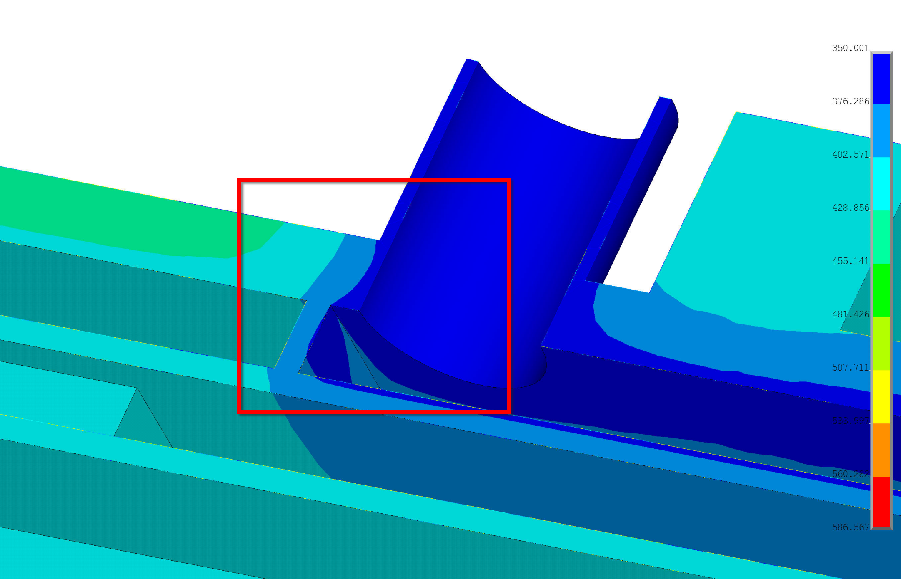
Path through the Coldest Structure of the TBM
He-Inlet Duct
to TBM

Slide 35
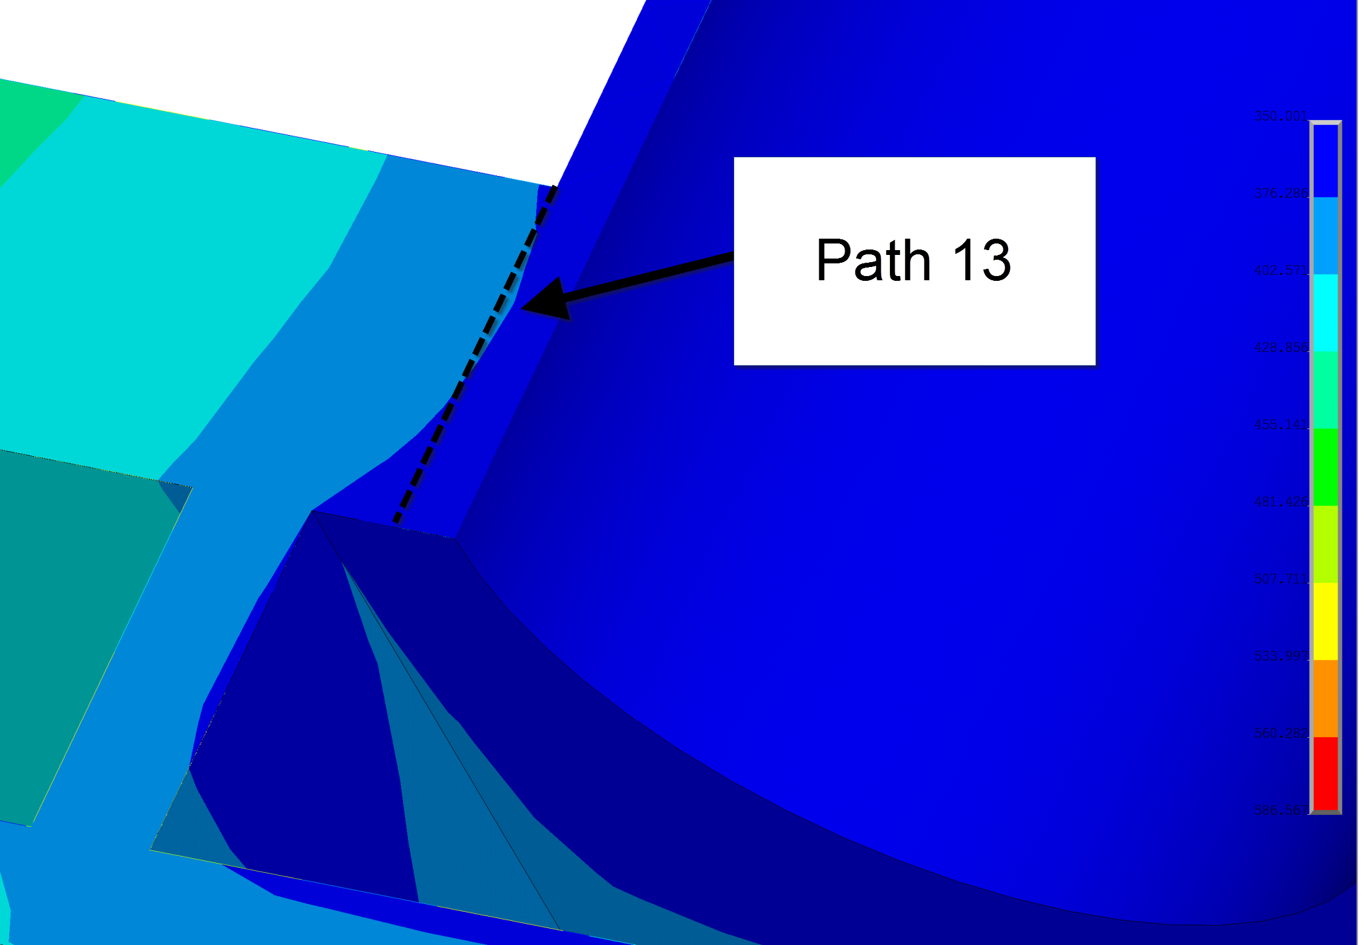
Paths through the Coldest Structure
350 ºC

Slide 36
SDC-IC Design Criteria Procedure
Identify Failure Mechanisms and Loading Conditions
Perform Elastic Thermo-mechanical FEM
Check Factor of Safety
Apply Low- and High Temperature Design Rules
Identify Paths through TBM Structure – Material Data
Linearize Stresses along Paths

Slide 37
F82h material property Data:
(Temperature and irradiation damage dependent)
S_{y(av)}=558.76−0.81574θ+2.7621×10⁻³θ²−3.476×10⁻⁶θ³
S_{y(min)}=0.9025(558.76−0.81574θ+2.7621×10⁻³θ²⁻3.476×10⁻⁶θ³)
S_{u(av)}=666.44−0.84514θ+2.1019×10⁻³θ²−2.617×10⁻⁶θ³
S_{u(min)}=0.9384(666.44−0.84514θ+2.1019×10⁻³θ²−2.617×10⁻⁶θ³)
S_{y(irr)}=S_{y(av,unirr)}(1+0.56628φ+0.44327φ^{1.0673})
S_{u(irr)}=S_{u(av,unirr)}(1+0.56628φ+0.44327φ^{1.0673})
S_{m}=0.3128(666.44−0.84514θ+2.1019×10⁻³θ²−2.617×10⁻⁶θ³)
θ is temperature in ºC

Slide 38
Example: Average Yield Stress (S_{Y(av)})
S_{y(av)}=558.76−0.81574θ+2.7621×10⁻³θ²−3.476×10⁻⁶θ³
S_{y(irr)}=S_{y(av,unirr)}(1+0.56628φ+0.44327φ^{1.0673})

Slide 39
PATH averaged temperatures and stresses

Slide 40
SDC-IC Design Criteria Procedure
Identify Failure Mechanisms and Loading Conditions
Perform Elastic Thermo-mechanical FEM
Check Factor of Safety
Apply Low- and High Temperature Design Rules
Identify Paths through TBM Structure – Material Data
Linearize Stresses along Paths

Slide 41
Linearizing Stress along the paths.
Image Set 1: Linearization Example

Slide 42
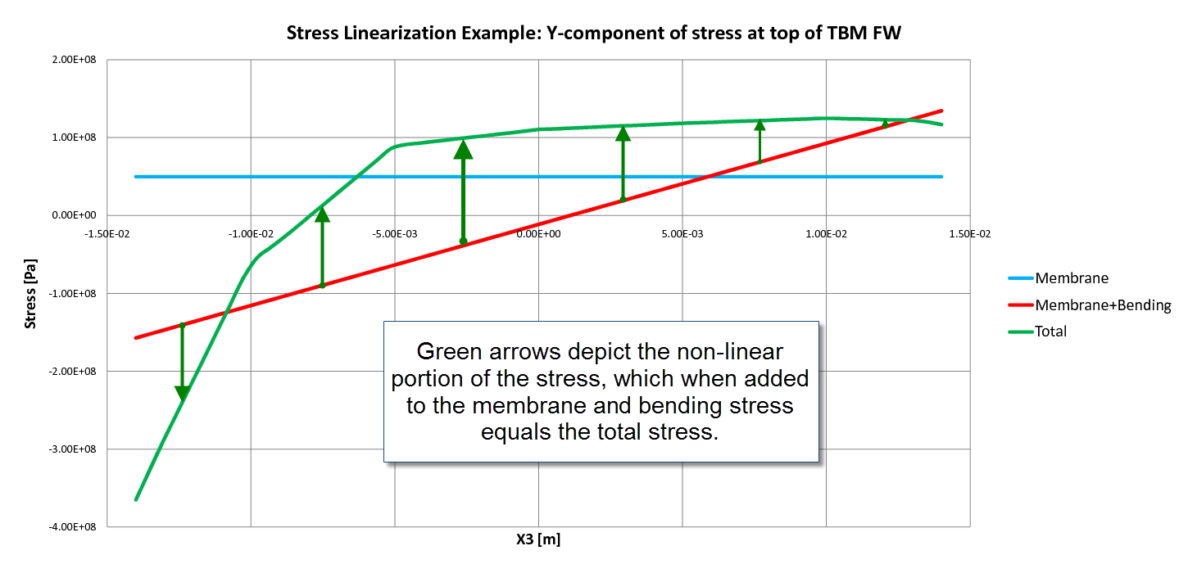
Stress along path near top of TBM
Membrane plus Bending plus Non-linear

Slide 43
TBM Design Criteria Stress Results
Path Average Temperatures
In order to properly determine the material properties to compare our stress results to, temperature data was collected along each of the 13 paths. Average temperatures along each path were determined, and using the correlations, material property data was calculated accordingly.
Path | Average Temperature | S_{y(av)} | S_{y(min)} | S_{u(av)} | S_{u(min)} | S_{y(irr)} | S_{u(irr)} | S_{e} (=S_{m}) | S_{d}
 | [C] | [MPa] | [MPa] | [MPa] | [MPa] | [MPa] | [MPa] | [MPa] | [MPa]
1 | 452.62 | 433.08 | 390.86 | 458.36 | 430.12 | 582.07 | 616.05 | 205.35 | 410.70
2 | 456.62 | 431.24 | 389.20 | 455.77 | 427.70 | 579.60 | 612.57 | 204.19 | 408.38
3 | 461.60 | 428.87 | 387.05 | 452.48 | 424.61 | 576.41 | 608.15 | 202.72 | 405.43
4 | 522.25 | 390.96 | 352.84 | 404.87 | 379.93 | 525.47 | 544.16 | 181.39 | 362.77
5 | 447.42 | 435.38 | 392.93 | 461.65 | 433.21 | 585.16 | 620.47 | 206.82 | 413.64
6 | 430.63 | 442.10 | 399.00 | 471.66 | 442.61 | 594.20 | 633.93 | 211.31 | 422.62
7 | 439.40 | 438.72 | 395.94 | 466.54 | 437.80 | 589.65 | 627.04 | 209.01 | 418.03
8 | 413.18 | 448.06 | 404.38 | 481.20 | 451.56 | 602.21 | 646.75 | 215.58 | 431.17
9 | 413.22 | 448.05 | 404.37 | 481.19 | 451.55 | 602.20 | 646.73 | 215.58 | 431.15
10 | 451.50 | 433.59 | 391.31 | 459.08 | 430.80 | 582.75 | 617.01 | 205.67 | 411.34
11 | 392.14 | 454.01 | 409.74 | 491.65 | 461.36 | 610.20 | 660.79 | 220.26 | 440.53
12 | 391.30 | 454.22 | 409.93 | 492.04 | 461.73 | 610.49 | 661.32 | 220.44 | 440.88
13 | 374.45 | 458.09 | 413.43 | 499.63 | 468.86 | 615.69 | 671.52 | 223.84 | 447.68
S_{e}: allowable total stress intensity; S_{d}: allowable total membrane plus bending stress intensity

Slide 44
Applying SDC-IC Design criteria

Slide 45
SDC-IC Design Criteria Procedure
Identify Failure Mechanisms and Loading Conditions
Perform Elastic Thermo-mechanical FEM
Check Factor of Safety
Apply Low- and High Temperature Design Rules
Identify Paths through TBM Structure – Material Data
Linearize Stresses along Paths

Slide 46
TBM Design Criteria Stress Results

Slide 47
Definition of Design SDC-IC Criteria

Slide 48
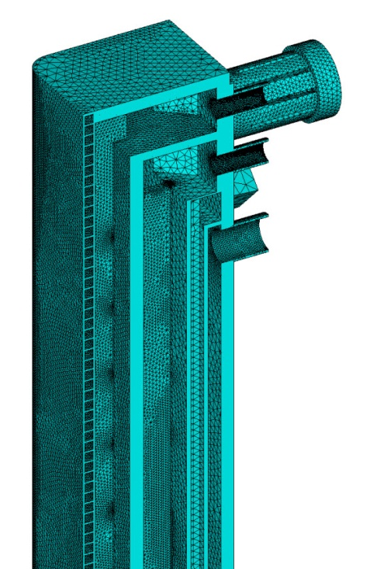

Slide 49
SUMMARY
SDC-IC Design Rules were reviewed and F82H material properties were collected and extrapolated for SDC-IC (including K_{IC})
Large-scale FEM analysis of the DCLL TBM stress results were broken down into membrane, bending, and total stress along 13 different paths through the TBM structure.
Low- and high temperature SDC-IC rules were applied to the paths.
Normal operating loading based Factor-of-Safety (FoS) for both un-irradiated and irradiated materials show that :
  DCLL structural design satisfies all SDC-IC design criteria for normal operation for irradiated (3.7 dpa) material properties
  The FoS for “Plastic Flow Localization Limit” is less then 1 for at the FW near the top of the TBM (Path 1).
  An inelastic analysis would have to be performed to demonstrate that stress relaxation due to local deformation reduces the membrane plus bending stress along Path 1 to acceptable levels.

Slide 50
BACKUP Slides

Slide 51
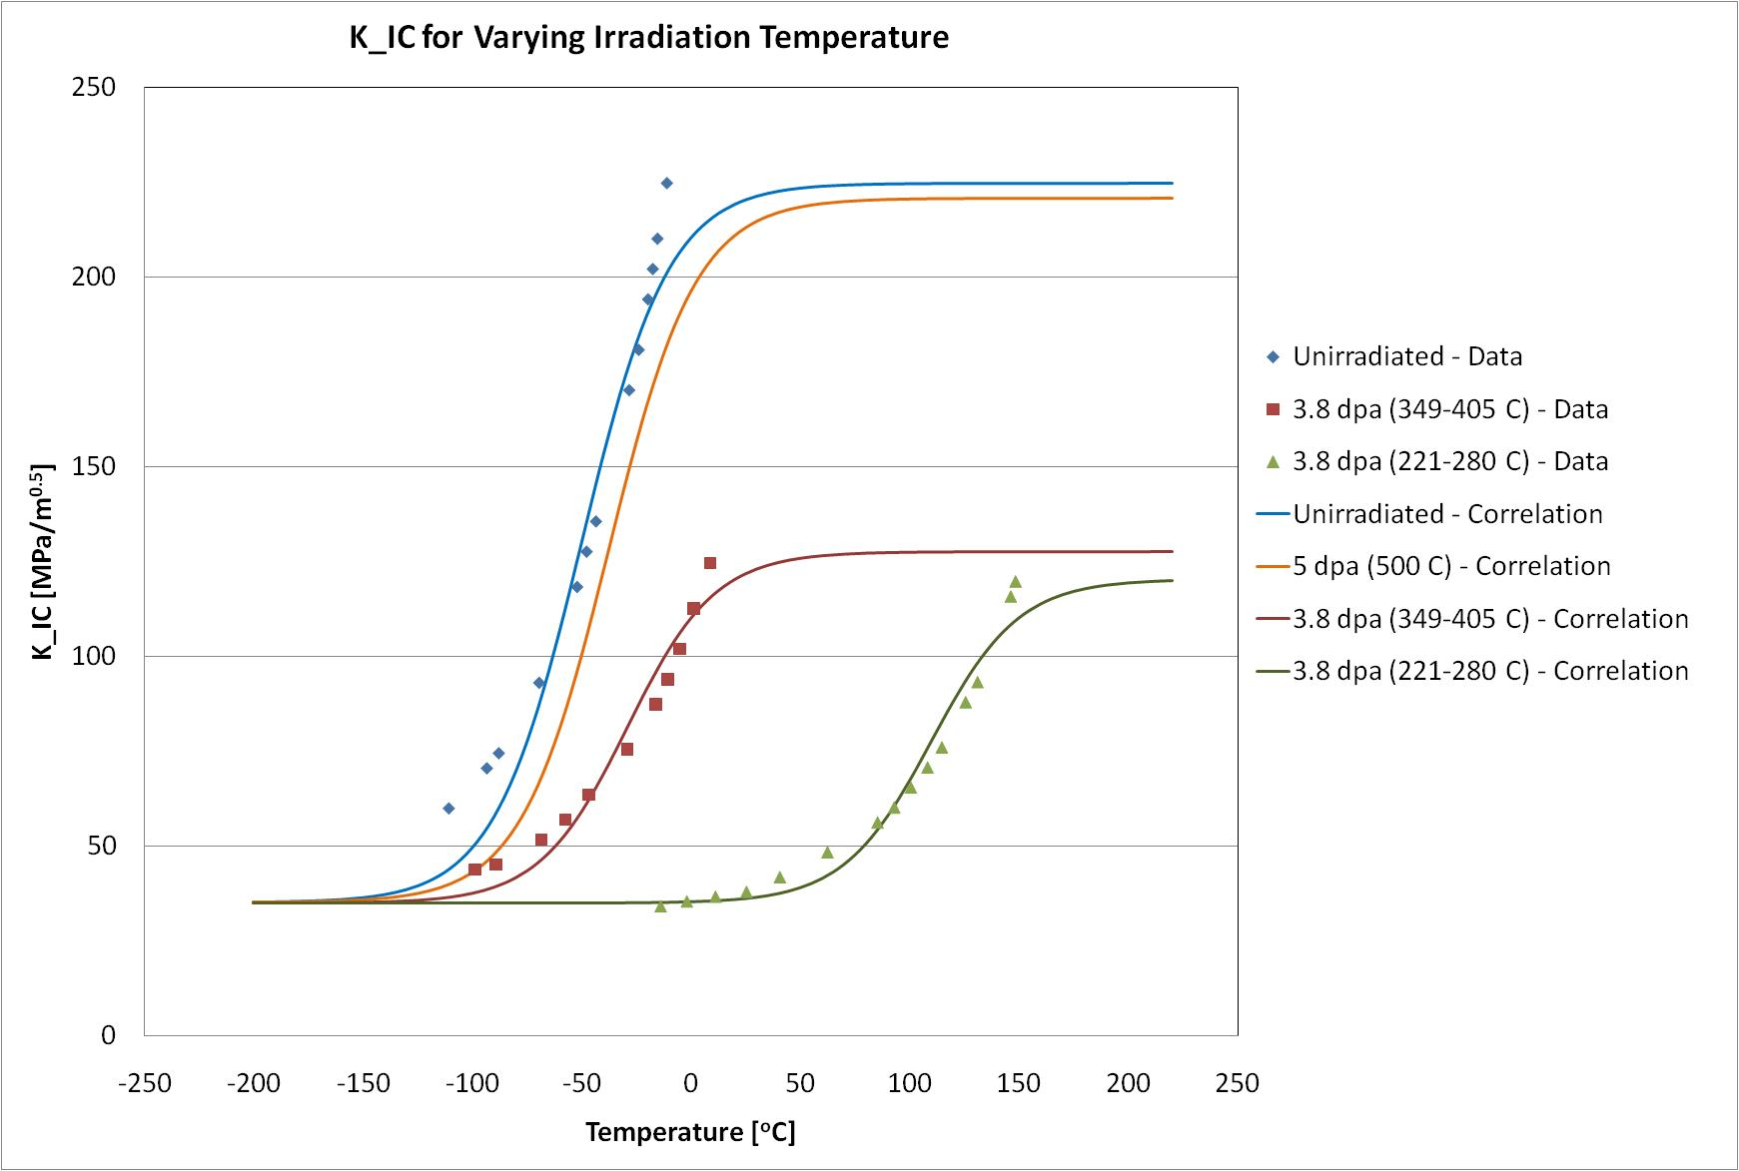

Slide 52
Brittle Fracture Limit Design Rules
 |  | PL+QL |  | PL+Pb+Q+F
Path | a | Stress | KI | Stress | KI
1 | 0.25
2 | 0.50 | 65.52 | 10.69 | 62.15 | 10.14
3 | 0.75 | 29.46 | 4.81 | 26.40 | 4.31
4 | 1.00 |  | 0.00
5 | 1.25 | 120.01 | 8.48 | 119.98 | 8.47
6 | 1.50 | 17.60 | 1.24 | 17.51 | 1.24
7 | 1.75
8 | 2.00 | 4.90 | 0.75 | 3.05 | 0.47
9 | 2.25 | 5.36 | 0.82 | 3.48 | 0.53
10 | 2.50 | 65.53 | 3.78 | 65.57 | 3.78
11 | 2.75 | 50.21 | 2.90 | 50.21 | 2.90
12 | 3.00 | 17.07 | 0.98 | 17.07 | 0.98
13 | 3.25 | 6.88 | 1.09 | 6.85 | 1.08

Slide 53
Brittle Fracture Limit FoS
Path | Maximum KI | KIC | FoS
1 |  | 213.38
2 | 10.69 | 215.06 | 20.12
3 | 4.81 | 216.66 | 45.08
4 |  | 220.90
5 | 8.48 | 210.56 | 24.84
6 | 1.24 | 194.68 | 156.59
7 |  | 204.41
8 | 0.75 | 167.50 | 223.89
9 | 0.82 | 167.56 | 204.96
10 | 3.78 | 212.84 | 56.28
11 | 2.90 | 138.16 | 47.71
12 | 0.98 | 137.34 | 139.50
13 | 1.09 | 126.45 | 116.43

Slide 54
Ultimate Stress

Slide 55
Membrane Stress
S_m = 1/3 S_u(min,T,dpa)

Slide 56
Creep Rupture Stress

Slide 57
Membrane Rupture Stress

Slide 58
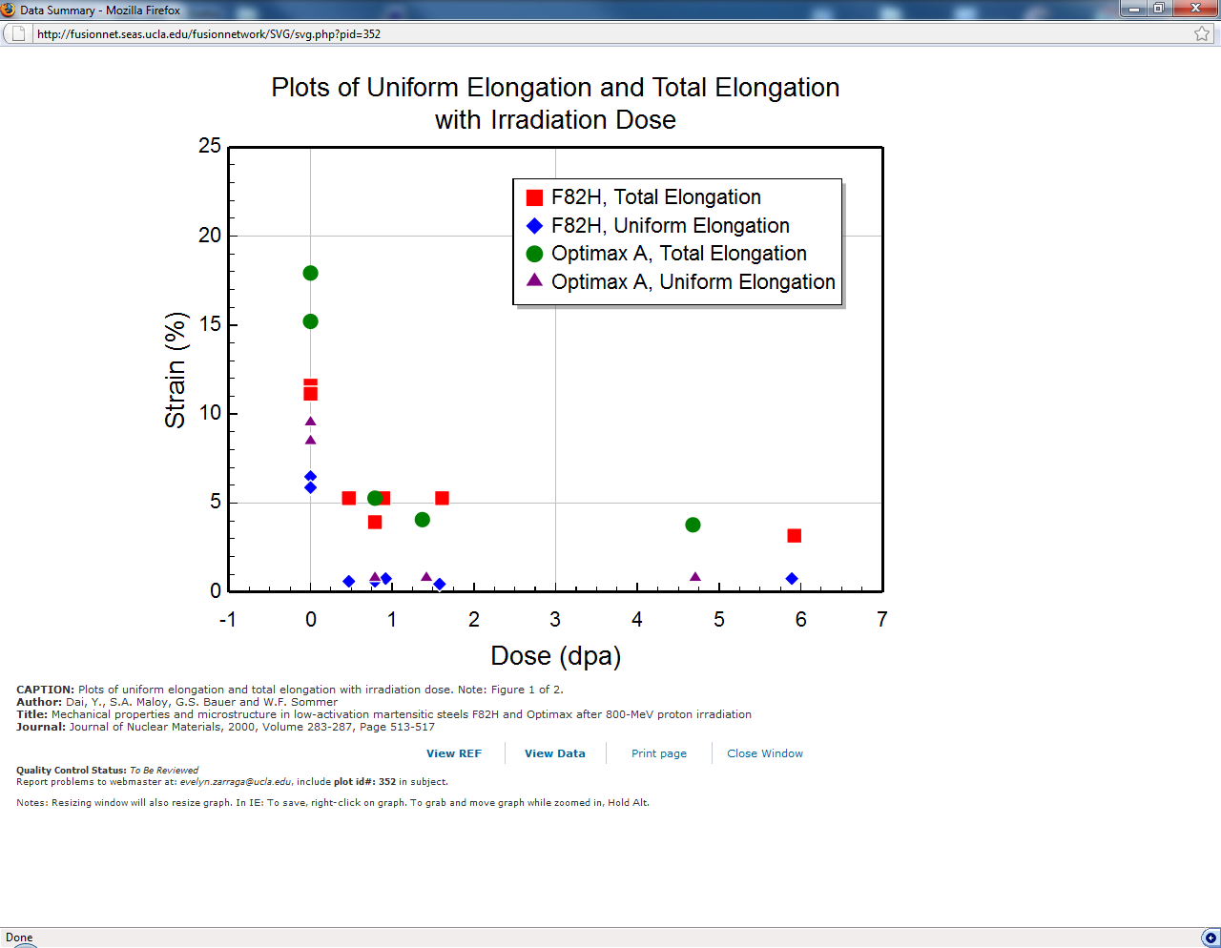

Uniform Elongation
Allowable primary plus secondary
membrane stress intensity:
Allowable total stress intensity:
Notes:
Sd = allowable total stress intensity, Se = Allowable primary plus secondary membrane stress intensity

Slide 59
SDC-IC Low Temperature Design Criteria
LOW TEMPERATURE:
Limit Load – A minimum requirement of a component to support a single application of the worst combination of all the static loads: ensuring that the collapse load exceeds the maximum service load by a suitable factor.
Limiting excessive deformation – Limit placed on displacement and/or deformation, even when the deformations are “small”, i.e. insufficient to affect structural integrity; limit may be defined in the Code as a fixed % of a characteristic dimension (note that displacement may be elastic, while deformation is caused by inelasticity).
Buckling –Load induced geometric imperfections that may lead to premature local or gross structural collapse (bows, bulges, or wrinkles).
Ratcheting – Incremental collapse under a cyclic sequence of loads needs to be avoided. Avoidance of ratcheting can be assured by demonstrating shakedown to a stable cyclic elastic state using a conservative approximate method.
Fast Fracture – Failure by cracking rather than gross plastic deformation (depends on local conditions rather than gross structural behavior and is often catastrophic). First line of defense is based on measures of fracture resistance. - A “postulated crack” is used in some post construction evaluations such as that provided
Fatigue – Crack initiation and propagation, which is a function of local stress/strain state rather than gross structural behavior. Evaluation of fatigue life uses either stress/life or strain/life data as the design criterion.
Corrosion – Corrosion alone is invariably considered as a material selection process preceding design.

Slide 60
SDC-IC High Temperature Design Criteria
HIGH TEMPERATURE:
Elevated temperature operation introduces thermally activated, time dependent processes. Creep is the foremost of these, causing both time dependent deformation and changes to the material.
Creep rupture – Creep rupture failure is the time dependent equivalent of limit load collapse at low temperature where material strength is replaced by the creep strength of a standard specimen for some specified finite life, such as the 2/3rds stress for rupture in 100,000 hours adopted by Sections I and VIII of the ASME Code.
Creep ratcheting (cyclically enhanced creep deformation) – Demonstration that reversed plastic straining due to cyclic loads does not lead to an accelerated general creep deformation rate at a structural level.
Accelerated creep rupture - Demonstration that accelerated creep damage due to periodic resetting of stresses due to cyclic plasticity, does not exceed Code design criteria for cumulative damage.
Creep/Fatigue interaction – Demonstration that material damage due to the combined effects of cyclic loading and sustained hold periods at elevated temperature do not exceed allowable limits.
Corrosion, oxidation, and mass transport phenomena – demonstrations of how these effects take into account effective section size, and possible material interaction or degradation.

Slide 61
SDC-IC All Temperature Design Criteria
ALL TEMPERATURES:
Radiation effects – demonstration and incorporation of material degradation or changes, including possibly drastic changes in applicability of failure criteria, e.g. ductile vs. brittle failure criteria. Some examples of radiation effects include but are not limited to:
      • Irradiation induced swelling
      • Irradiation induced creep
      • Plastic Flow localization due to irradiation (dislocation tunneling)
      • Ductility exhaustion due to irradiation exposure
      • Irradiation induced effects on fatigue, and on K_IC
Seismic loads – demonstration and assurance that such severe and infrequent loading, or more frequent depending upon location, does not pose as a safety risk to the public, and criteria to define permissible operation after such an event, or not.

Slide 62
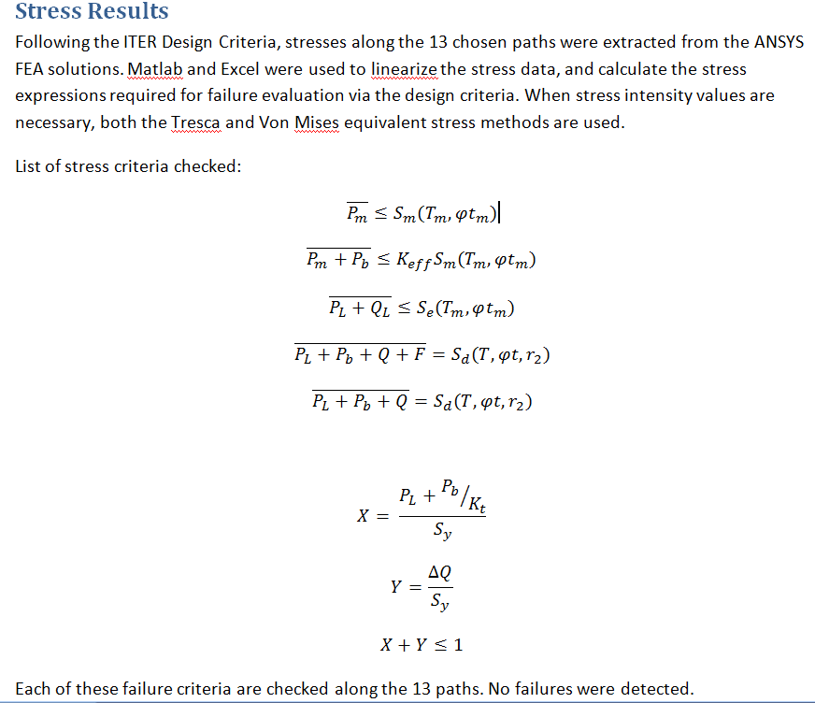

Slide 63
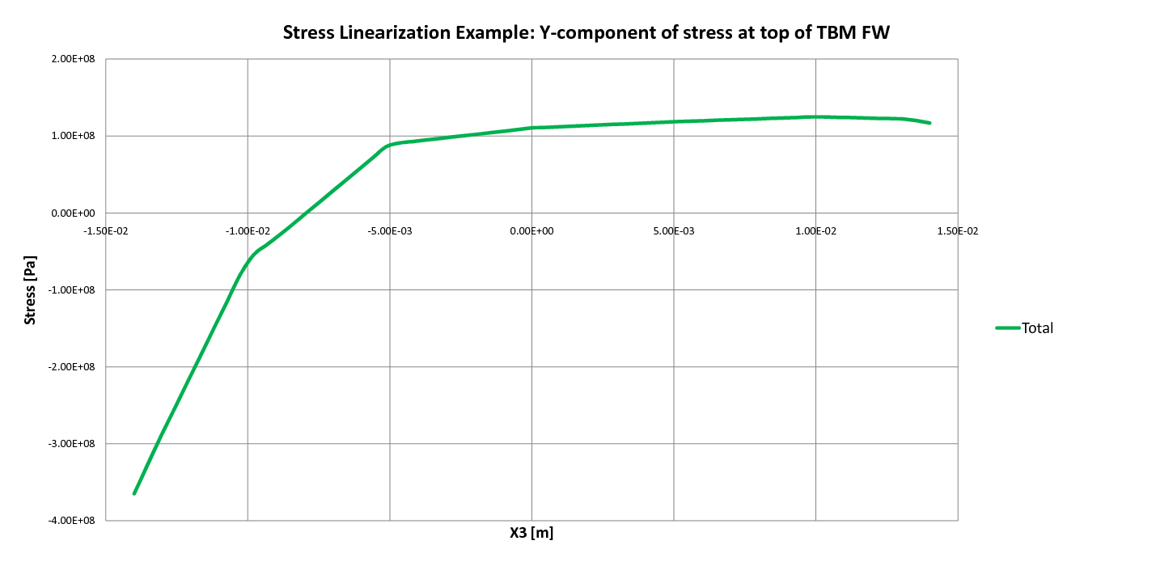
Images depicting linearization of stresses on an example path - TOP of the TBM FW
Path – Through the FW at the Top of TBM
Total Stress

Slide 64
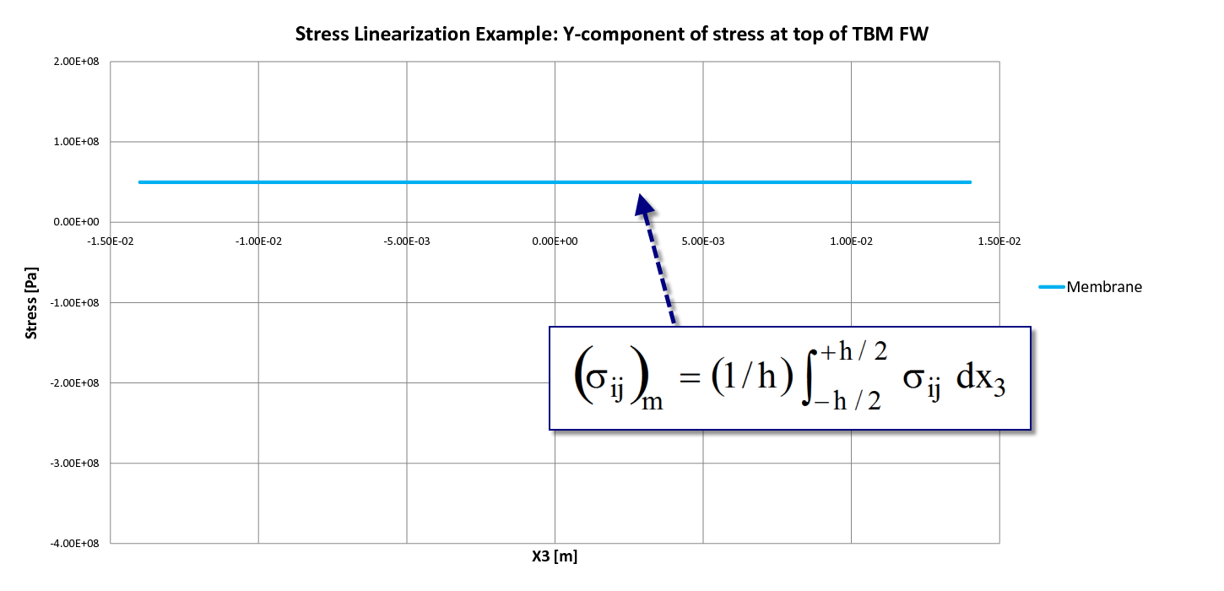
Membrane Stress

Slide 65
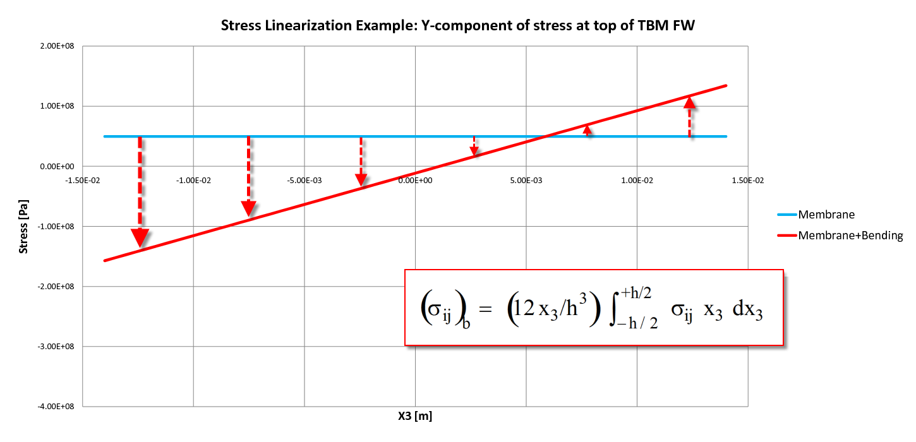
Membrane plus Bending Stress

Slide 66
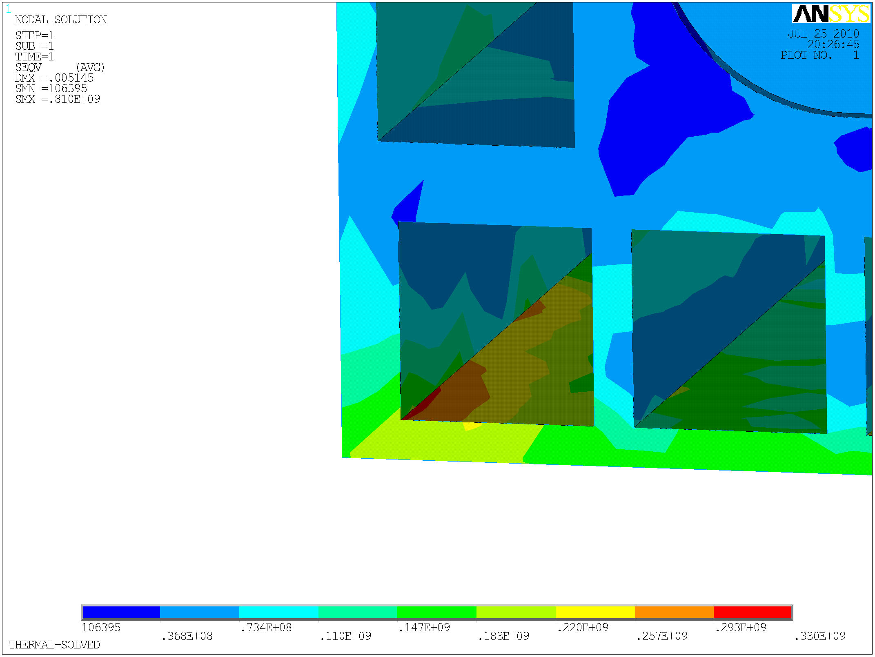
Cross Section Cut through the TBM Mid-plane
Top of TBM
Mid-Plane
Max Stress Concentration
inside TBM (330 Mpa)
FW (Plasma)

Slide 67
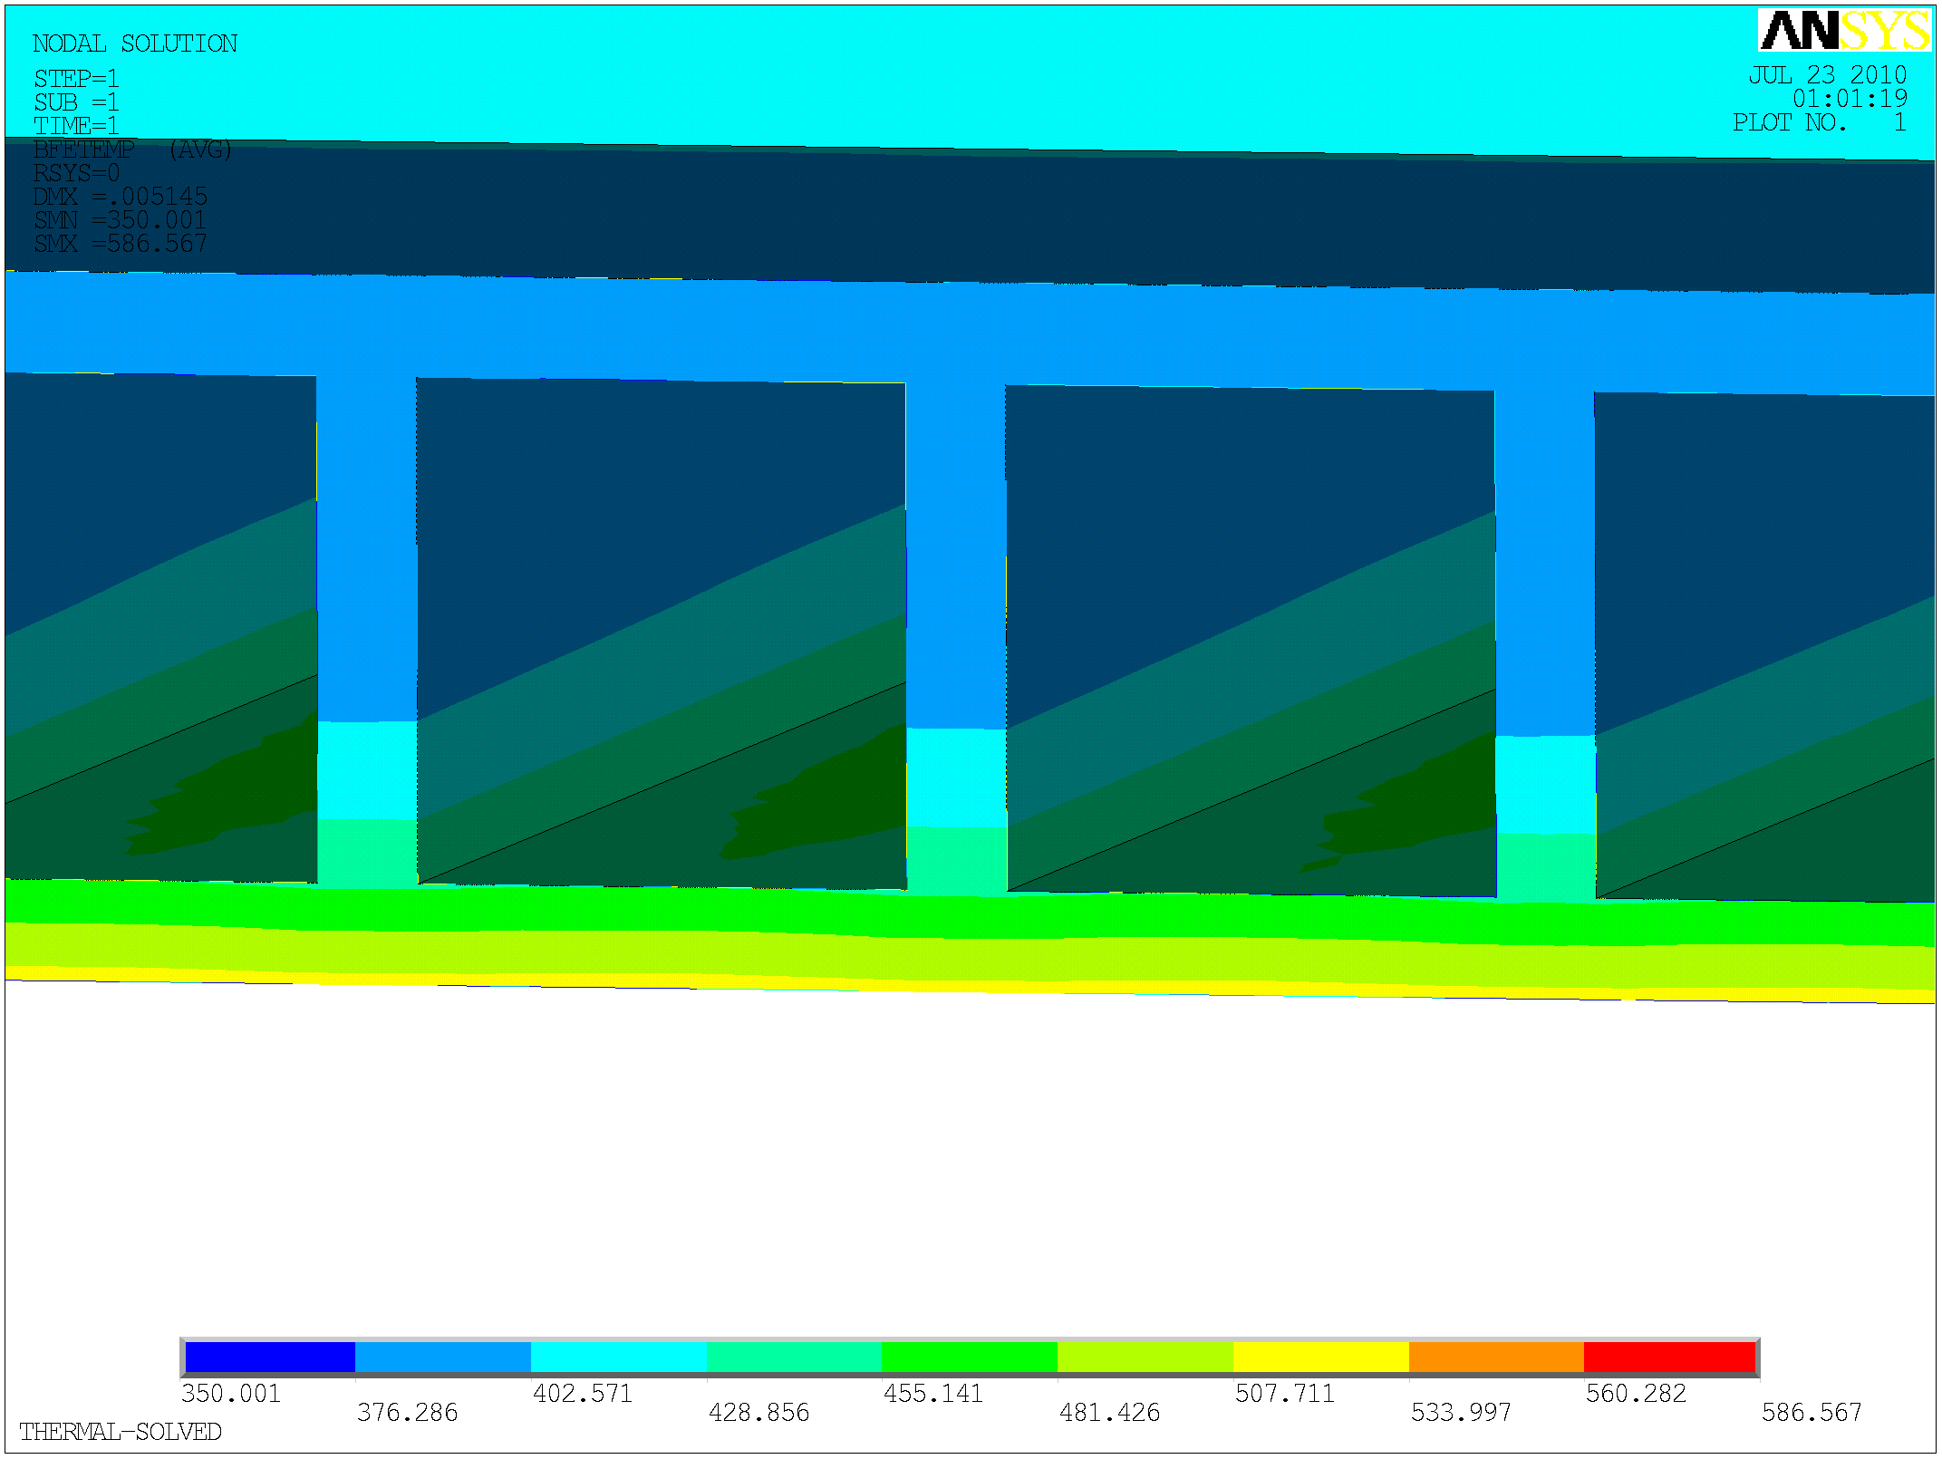
Cross Section Cut through the TBM Mid-plane
PbLi Channel
He
Top of TBM
Max. Temperature
534 ºC
FW (Plasma side)

Slide 68
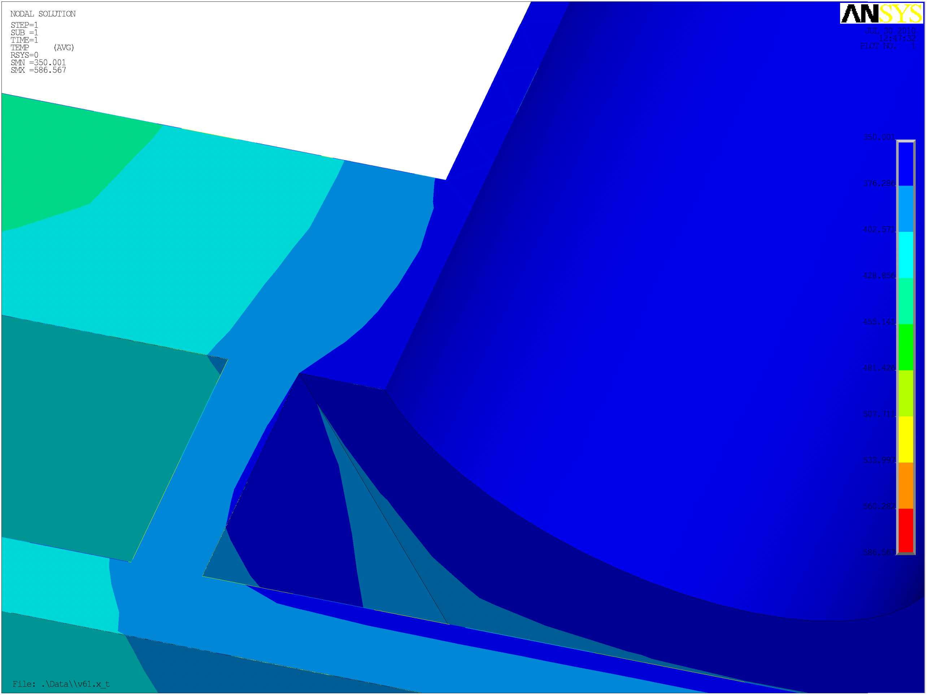
Cross Section Cut through the TBM Mid-plane
Back of TBM
He-Inlet Duct
Mid-Plane Cut
350 ºC
Top of TBM
FW (Plasma side)

Slide 69
DEFINITION OF “HIGH TEMPERATURE”
“High temperature” is taken to refer here to the operating range of temperature within which time dependent, thermally activated deformation and damage processes, even under nominally steady loads below yield, become a significant factor in the behavior of load bearing components.
“Elevated temperature” is, for the most part synonymous with “in the creep range”, but others, such as thermal ageing and oxidation/corrosion are also important.
The threshold temperature is not unique. It is strictly a function of the mode of failure being considered, as well as the design lifetime. For instance, the threshold temperature for constant loading conditions, where stresses are expected to relax to a relatively low steady state, will be higher than one based on cyclic conditions which cause stresses to be repeatedly reset to the yield stress by cyclic plastic deformation.

Slide 70
The implication is that NH assumes failure by creep to occur on a section when the extreme fiber reaches a critical damage equivalent to a tensile test at the maximum steady state stress. This assumption means that local stress relaxation from high local stresses (“F” stresses) is being ignored in the process of evaluating creep life.
The common wisdom is that “rupture” is the result of void initiation and growth, which is observed at the macroscopic level as “tertiary” creep.
Tertiary creep, since it is presumed to be a sign of void formation, is perceived to be a “bad thing”. On the contrary, tertiary creep, whether caused by voids or any other mechanism, is a desirable phenomenon from the point of view of a redundant structure, because it allows the stress at the highest stressed location to relax, so reducing the damage rate locally, and prolonging the life of the component, sometimes by orders of magnitude.

Slide 71
Most pressure vessel applications have hovered around, or slightly below the “cliff top” (figure next slide), where temperature dependencies are significant but contained in a range of 10 to 50% or so of some nominal value.
The much higher temperatures envisioned for the future push the application point down to the foot of the “cliff”, where even moderate temperature differences can represent very large property variations, which may be higher than current approximate methods can cope with.

Slide 72
CLASS-1 Nuclear Components Guidelines
RDT F 9-5T:
      Guidelines and Procedures for Design
      of Nuclear System Components at
      Elevated Temperature, September 1974 (pp 271)
      Westinghouse Electric Corporation,
      Advanced Reactor Division
      Madison, Pennsylvania, 15663
NE F 9-5T:
      Guidelines and Procedures for Design
      of Class 1 Elevated Temperature
      Nuclear System Components, October 1986 (pp 361)
      Report: DE93 011215
Oak Ridge National Laboratory
Oak Ridge, TN

Slide 73
Stress analysis alone cannot predict failures*
A major feature of all mechanical design Codes is a recognition that “stress” is not a sufficient basis for a failure criterion.
Depending on the nature of the failure mechanism involved, the appropriate criterion may be only part of the total stress, or a function of the multi-axial stress state.
Methods of stress classification are therefore an element which is present in all reputable Codes.

