Slide 1



EU DCLL conceptual design for the EU DEMO
David Rapisarda
CIEMAT
2nd EU-US DCLL Workshop University of California, Los Angeles, Nov. 14-15th, 2014

Slide 2
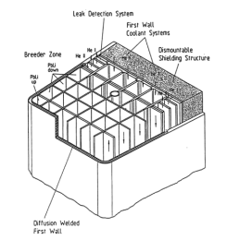
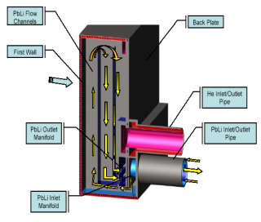
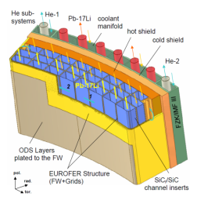
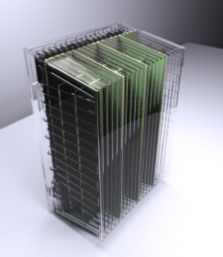
Dual Coolant Lithium Lead (DCLL)
Malang’94
Concerns:
Not tested in ITER (TBM)
Design state lower than HCLL, HCPB, WCLL
Design difficulties linked to relatively high PbLi velocity
  MHD
  corrosion
Main characteristics
Breeder and neutron multiplier:
  PbLi eutectic as breeder, neutron multiplier and tritium carrier
  (Li⁶ enrichment 90%)
Coolant:
  Pb-15.7Li
  Helium for FW and stiffening grid
LM flows at high velocity to extract most of the reactor power
High LM velocity + strong magnetic field → huge MHD effect (pressure drop) takes place → can be corrected through a special component → Flow Channel Insert
Probably one of the BB concepts with highest long term potential of improvement
Advantages:
Wider design margins due to the double cooling system
Lower tritium inventory (and can avoid HTO)
No safety issue related to water
Well suited for presently available nuclear materials
Well suited for Eurofer (upper temp. limited)
Potential for high-temperature → higher plant efficiency
1994
1997
2003
2014

Slide 3
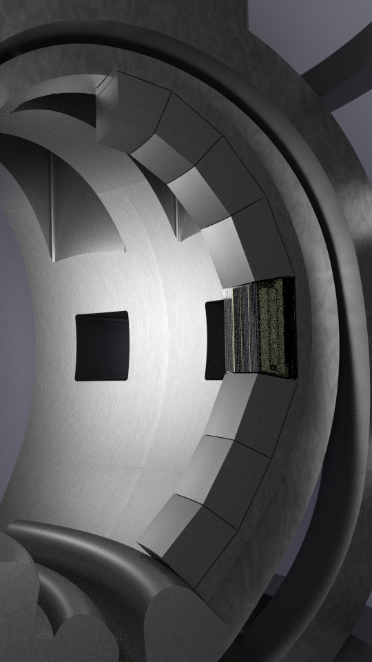
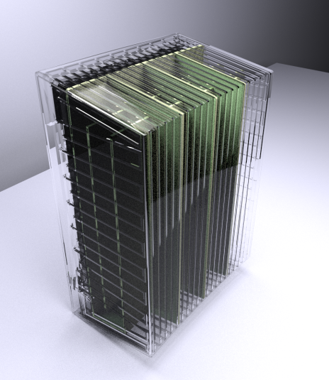


EUROfusion DCLL (2014-18)
The program proposed for the next years (conceptual phase) will consider a “low temperature” version of DCLL as possible blanket for the EU DEMO 2050 → to allow the use of conventional materials and technologies (to cope with issues: high temperature, corrosion, compatibility, etc.).
As main starting points, the new DCLL will have the following characteristics:
EUROFER structure will be used for the blanket → PbLi temperature limitation to 550°C
A new design of the blanket module is necessary, integrating neutronics, thermo-hydraulic, stress and MHD analyses.
MMS (Multi-Module Segment): separate modules connected to a manifold/back plate, permanent self-supporting shield and manifold connected by bolts. Modular blanket design, no exchangeable part.
PbLi flows at high velocity (to be studied) in the Breeder Zone to optimize the power extraction.
FW and stiffening grid will be cooled by He
FCI: sandwich of alumina as primary option. Other alternatives will be explored.

Slide 4
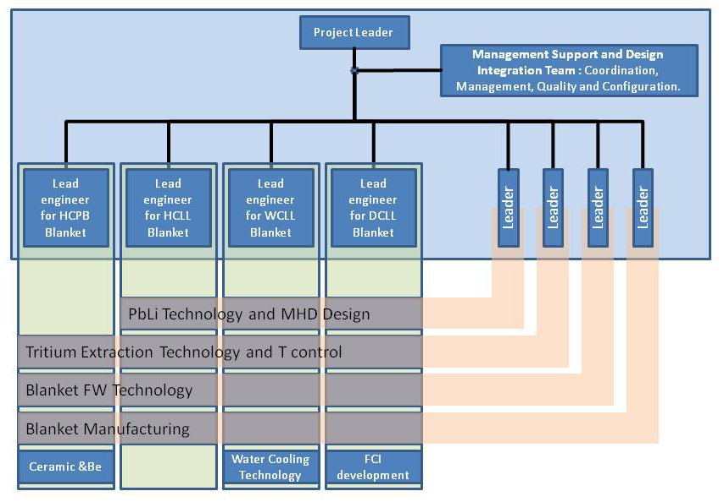



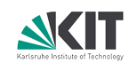
EUROfusion DCLL (2014-18)
DCLL BB Design and FCI R&D
CIEMAT
IPP-CR
KIT

Slide 5

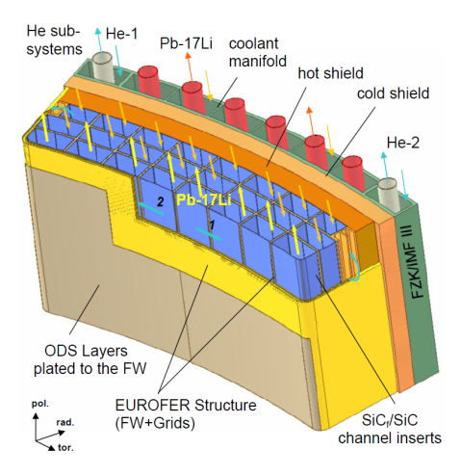
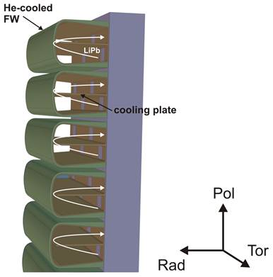
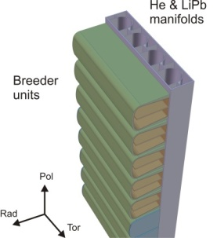
Review of Previous Studies
ARIES-ST
A review of other studied concepts was performed
  SCLL concept (John, KfK 4908, 1991).
  Malang’94
  Aries-ST’97
  Norajitra’03
  Radial design: TW5-TRP-005 (2006, T. Ihli).
Better understand main advantages/problems
Toroidal design
Radial design
Norajitra

Slide 6

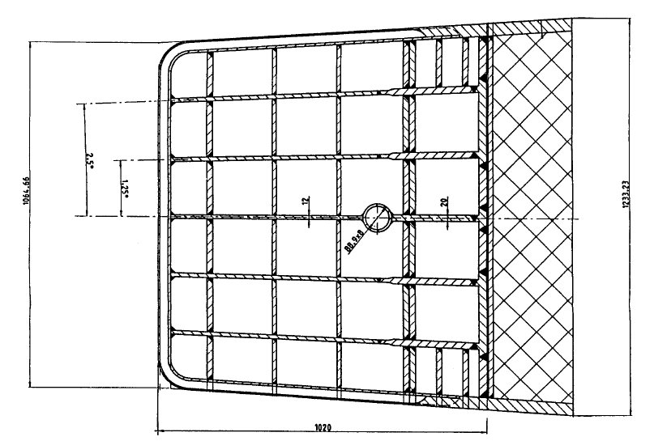
Reference Concept, Malang’94
A conceptual design of the DCLL including accompanying R&D work were provided.
Main characteristics:
  Banana design with U-shaped FW / box
  Low temperature BB → PbLi temperatures: 275°C/425°C inlet/outlet
  η_{th} ~ 34%
  PbLi mainly flows along the poloidal direction in the Breeder Zone at high velocity: ~1 m/s in outboard segment.
  Strong flow direction changes: upper and lower caps; manifolds (MHD effects)
  FCI conforms PbLi channels to limit electrical (& thermal) interaction:
    insulating coatings made of alumina
    FCI, sandwich of steel sheets with a ceramic in between
  FW and stiffening grid are cooled by He.
  Two redundant He Cooling Systems with counter flow
PbLi
He
shielding

Slide 7
EUROfusion DCLL: related activities
PbLi technologies:
  PbLi loop, including auxiliaries and component development
  MHD including computations as well as experiments
  Corrosion experiments at high velocity, characterization of the process, coatings development
  PbLi purification
Tritium technologies:
  TES design
  Tritium transport modeling , including BB and related loops
  Tritium extraction techniques in EU loops
  Development of permeation coatings, characterization (including effect under irradiation)
Balance of Plant
Remote handling
…

Slide 8
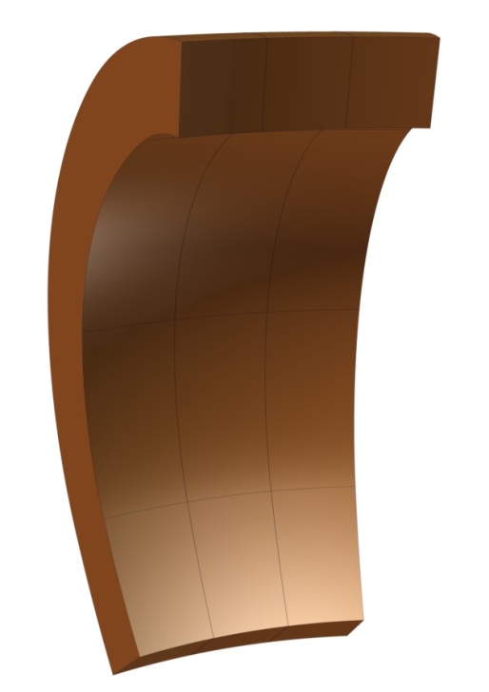
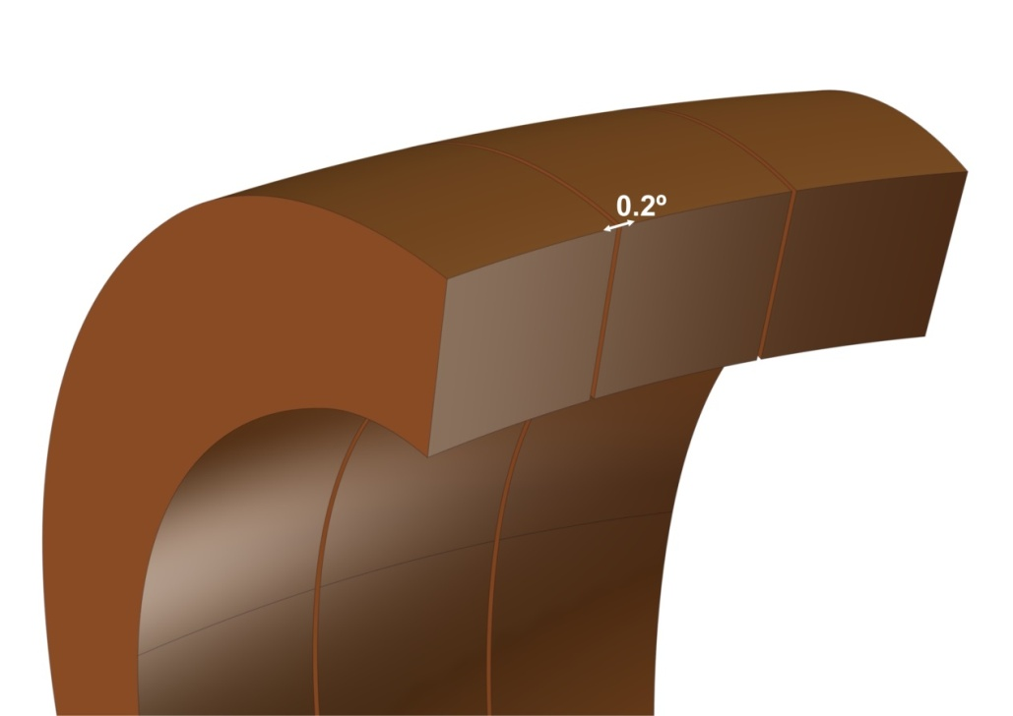
EUROfusion DCLL: starting geometry
Current EUROfusion CAD baseline (16 sectors) → we have the volumes for blanket segments (OB + IB)
The volume available must include: modules + manifolds + shield.
Two approaches to define the toroidal built of outboard blanket segments:
Sector-shaped segment: concentric walls (tokamak Z axis).
  7.5º segment (7.3º + 0.2º gap).

Slide 9
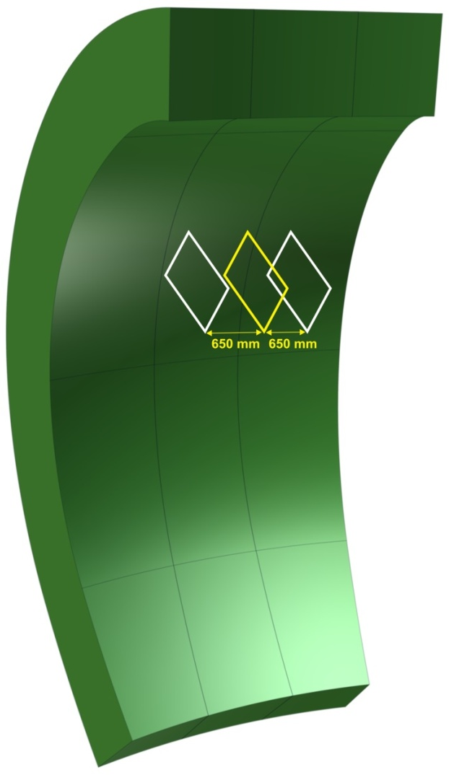
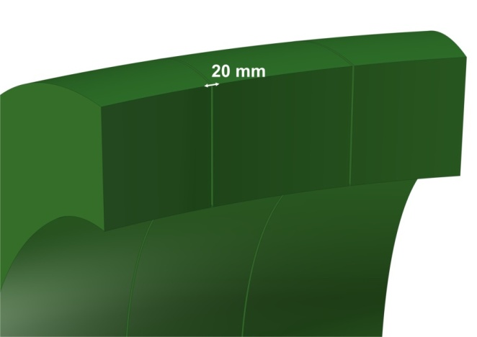
EUROfusion DCLL: starting geometry
Following Remote Maintenance requirement: central segment with parallel walls → permit segment extraction through the upper port
  Solid of revolution + 2 cutting planes (divides the 22.5º sector into two identical parts).
  The distance between each cutting plane and the ZX plane has evolved in last months: 720 mm → 715 mm → 650 mm (current).
  20 mm gap between segments is being considered
present
previous

Slide 10
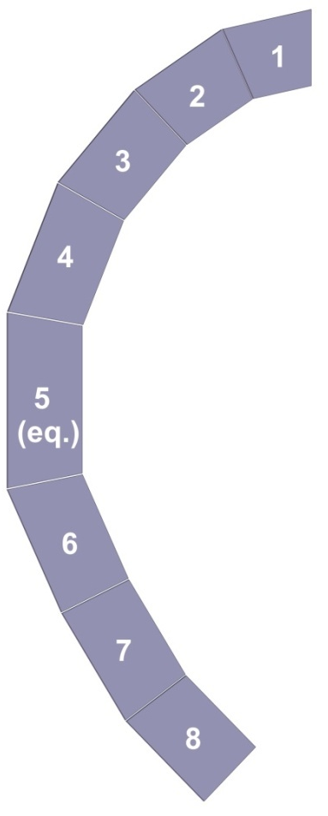
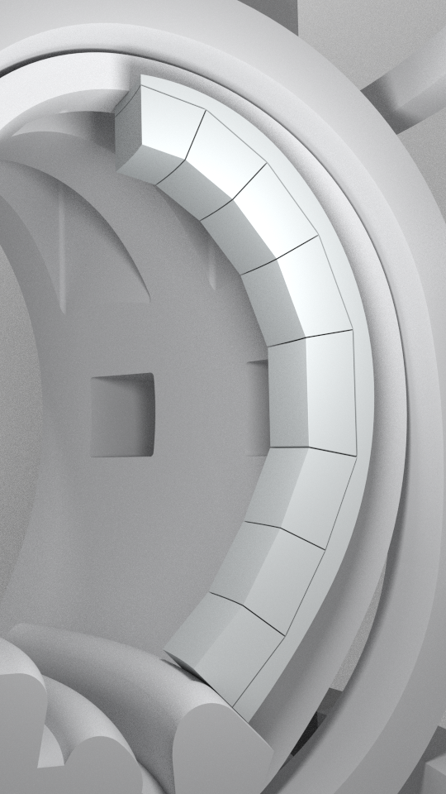
EUROfusion DCLL: Distribution of OB segments modules
OB segment is composed by 8 modules.
Main design criteria:
  Minimize the modules-plasma distance
  20 mm gap between modules.
  The first wall and the rear wall are parallel.
  910 mm radial built.

Slide 11
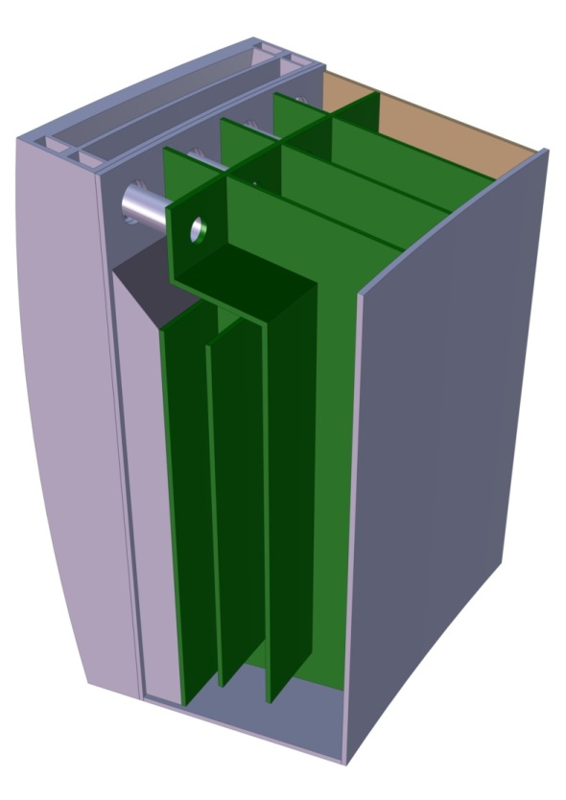
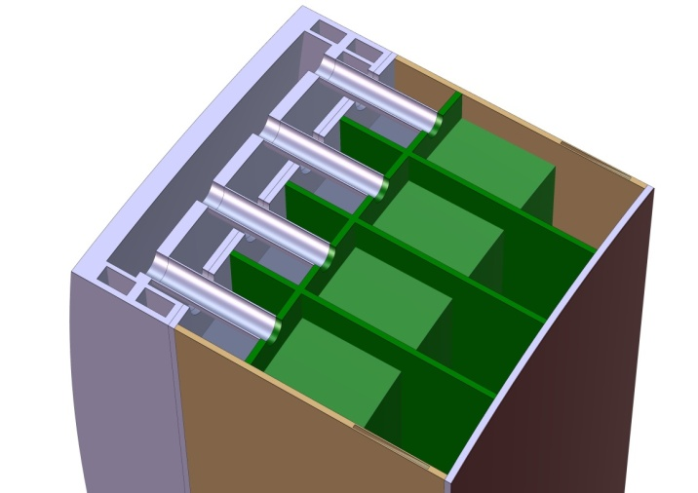
EUROfusion DCLL: OB equatorial module
Full parametric Catia model → easy and fast modifications.
Poloidal ducts with rectangular cross section.
Turns in planes perpendicular to the toroidal magnetic field.
The module is toroidally divided into 4 parallel PbLi circuits. Stiffening grid radial walls.
Internal helium manifolds
He
PbLi
910 mm
BSS
Breeding Zone
FW
1800 mm
2140 mm
1300 mm
300 mm
300 mm
Back Supporting Structure:
Integration of service connections for every modules.
Shielding & supporting functions.
Helium → feeding to internal manifolds for distribution.
BZ 680 mm

Slide 12
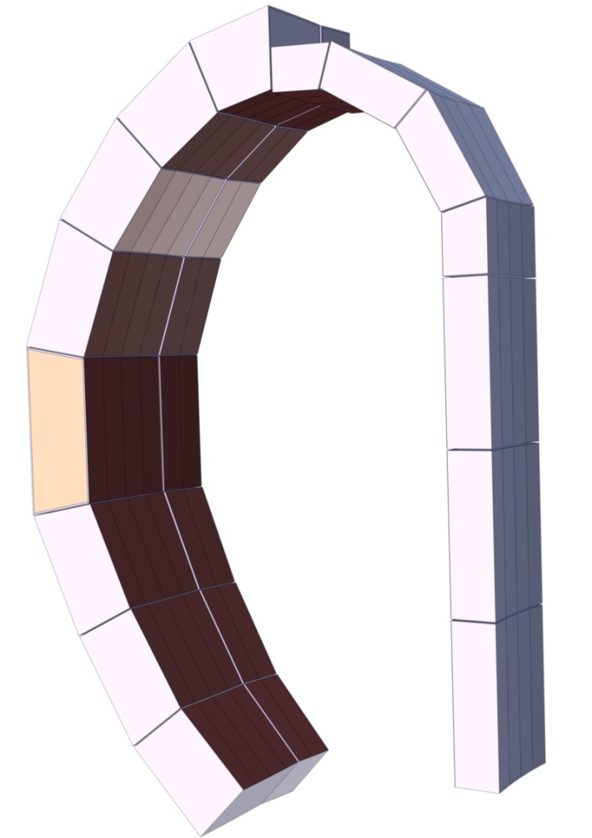
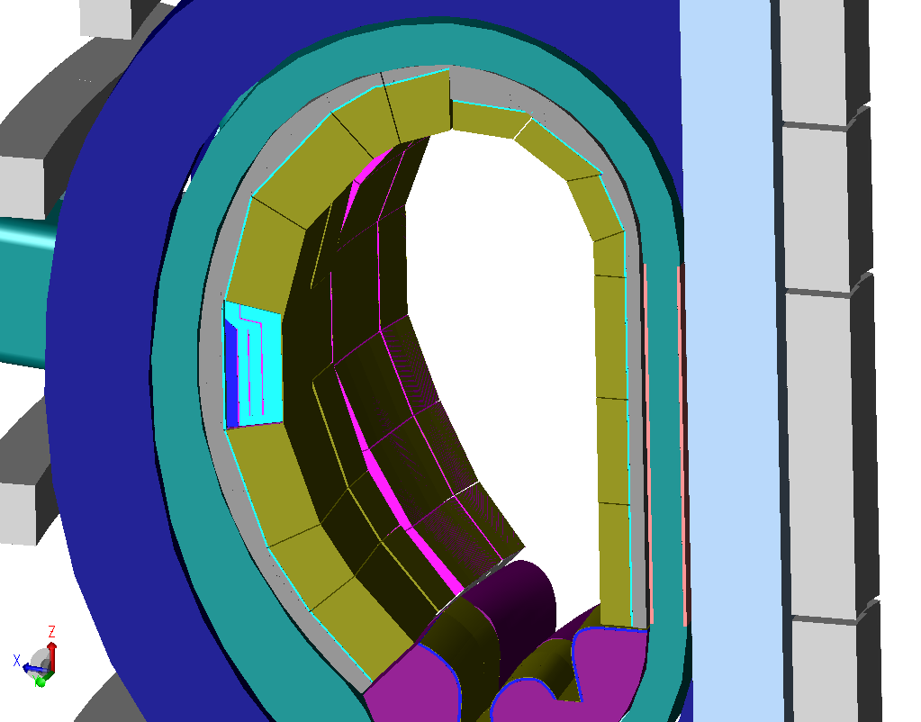
EUROfusion DCLL: model for neutronic analysis
Both outboard (8 modules) and inboard (7 modules) segments have been designed and adapted to MCNP requirements and to the present DEMO model
Optimize the TBR: thicker breeder zone
IB segment modules radial built: 500 mm.
2013
2014
Comparison between 2013 and 2014 segments

Slide 13
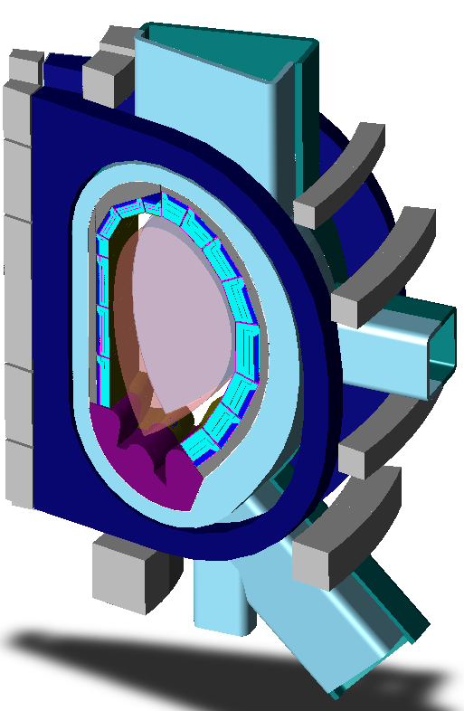
EUROfusion DCLL: neutronic analysis
BB DESIGN REQUIREMENTS
Tritium Breeding Ratio (TBR) | ≥ 1.1
Energy amplification factor | >1
STRUCTURAL LIMITS
Helium production- reweldability limit – for steel (Shield and Vacuum Vessel) | ≤1 appm He
Radiation design limits for the superconducting TF-COILS | Inicial | New
Integral neutron fluence for epoxy insulator [m⁻²] | ≤2-3×10²² | ≤1×10²²
Peak fast neutron fluence (E>0.1 MeV) to the Nb₃Sn superconductor [m⁻²] | ≤1×10²²
Peak displacement damage to copper stabiliser, or maximum neutron fluence, between TFC warm-ups [m⁻²] | ≤1∼2×10²¹ Equivalent to 0.5∼1×10⁻⁴ dpa
Peak nuclear heating in winding pack [W/m³] | ≤5×10³ | ≤0.05×10³

Slide 14
EUROfusion DCLL auxiliaries: Tritium Extraction
Dual Coolant Lithium Lead (DCLL) blanket → high PbLi flow rates → low tritium partial pressure → favorable for control of tritium permeation.
PAV is the baseline technique
Permeator against vacuum (PAV): tritium diffuses through a permeable membrane in contact with the liquid metal and is then extracted by a vacuum pump.
Advantages:
  Low residence time of T in PbLi loop (seconds, minutes?)
  Single-step process
  Passive system
  It can be thermally governed
  Compact and easy to integrate on-line
  Easy to manufacture
PbLi in
c₁
PbLi out
c₂

Slide 15
DCLL auxiliaries: BoP
Strong points of DCLL BoP:
  Most of the blanket heat is removed by the liquid metal
  As the mass flow of helium involved in the DCLL is less than other helium concepts some benefit is expected in the total pumping power
However:
  The low He inlet temperature to the blanket (250ºC/300ºC) is a constraint to take advantage from high temperatures of cooling medium leaving divertor and/or liquid metal leaving the blanket
  Different thermal sources (DIV, LM, He) with different temperatures and power ranges difficult the matching, being necessary to test different layouts
Solution:
  Supercritical CO2 (S-CO2) Brayton power cycles are proposed due to their good adaptation to medium/high temperature sources
  Some strong points of S-CO2 are: low volume of turbomachinery, low thermal inertia, easy detritiation of CO2

Slide 16
Main issues to be assessed (some related presentations in this WS)
MHD effects on all relevant geometries
  Elisabet Mas de les Valls
  Sergei Smolentsev
  Ramakanth Munipalli
    Mitigation through Flow Channel Inserts: design and fabrication, irradiation effects
  Prachai Norajitra
  Maria Gonzalez
  Yutai Katoh
    FW: fabrication of ODS plated FW, irradiation effects
    Corrosion: corrosion of the pipes and blanket structures by circulating PbLi at high temperature and velocity
    Tritium permeation into He circuit
  Carlos Moreno
    Tritium recovery/extraction: efficient extraction of tritium from PbLi flowing at a much higher velocity than HCLL and WCLL.
  Ivan Fernandez
  Marco Utili
  Paul Humrickhouse
  PbLi purification

Slide 17
Conclusions & future work
2014
Preliminary design of the equatorial OB module:
  Adapted to the new DEMO model
  Parallel walls
  PbLi bulk velocity ∼10 cm/s (much lower than expected! TBC)
  PbLi outlet temperature: ∼ 500 ºC
Preliminary design of the BSS: common manifold to all blanket modules
Neutronics
  Adapted model OB + IB
  Preliminary estimations TBR ∼ 1.041 → optimization of the BZ is needed
2015
Adaptation of the 2014 work to new DEMO specifications
Preliminary design of the equatorial IB module
BSS: detailed study on shielding and supporting functions

Slide 18
Thanks for your attention
2nd EU-US DCLL Workshop University of California, Los Angeles, Nov. 14-15th, 2014

