Slide 1
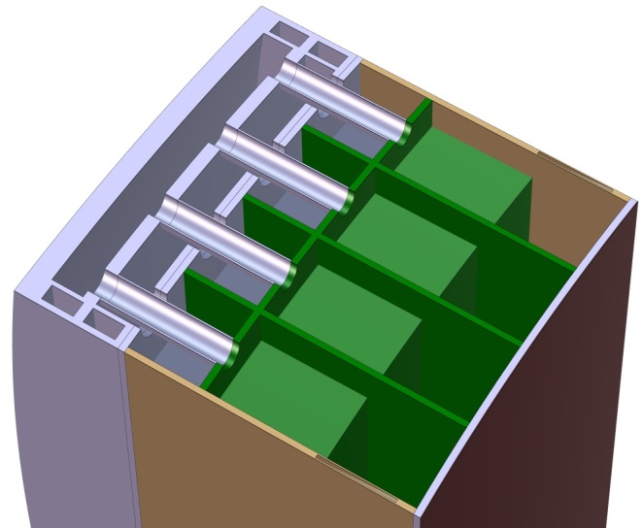
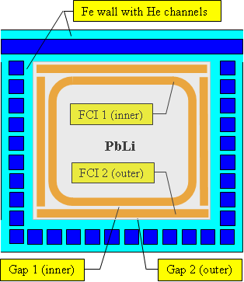
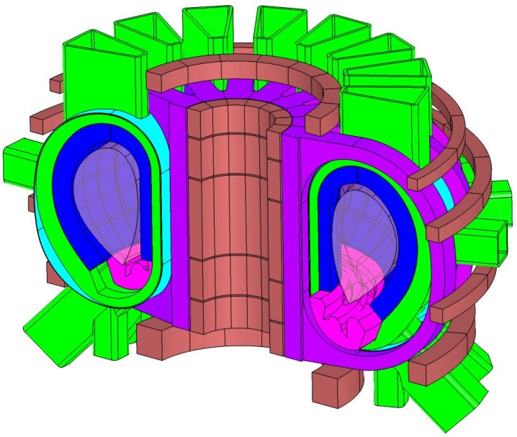
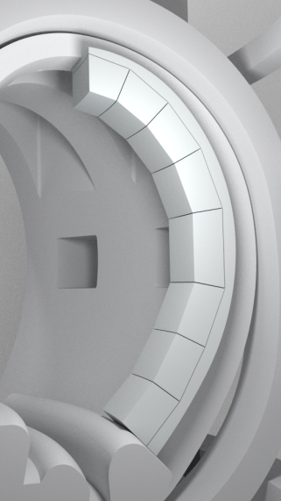
2nd EU-US DCLL Workshop UCLA, November 2014
Manufacturing of Sandwich FCI for the EU DEMO DCLL
Prachai Norajitraª, Widodo Widjaja Basukiª, Maria Gonzalez^{b},
David Rapisarda^{b}, Magnus Rohdeª, Luigi Spataforaª
ªKarlsruhe Institute of Technology, P.O. Box 3640, 76021 Karlsruhe, Germany
^{b}CIEMAT, Avda. Complutense, 40, 28040 Madrid, Spain
BSS
Breeding Zone
PbLi
EU PPPT DEMO
DCLL 2014
Integration in DEMO 2014
Nested FCI
Notes:
Hier ist eine Übersicht über meinen Vortrag zum Thema Divertor Entwicklung.
Ich werde zur Erinnerung das modulare Design 1-Finger und 9-Finger Modul kurz aufzeigen,
und dann zum Schwerpunkt Divertor Fertigung übergehen.
Im Detail sind das die Fertigung von 9-Finger Modulen, sowie die Versuche über Ti-Lötung und W-Tiefziehen.
Zum Schluß werde ich den Plan 2012 und den Budgetbedarf präsentieren.

Slide 2
Content
Why do we need flow channel inserts (FCIs)?
Basic design principles for FCI
Requirements for FCI materials
Selected materials and their major properties
Several different FCI design types (pros and cons)
Demonstration of manufactured FCIs
Investigations of starting materials and post-examination of mock-ups
Conclusion and outlook

Slide 3
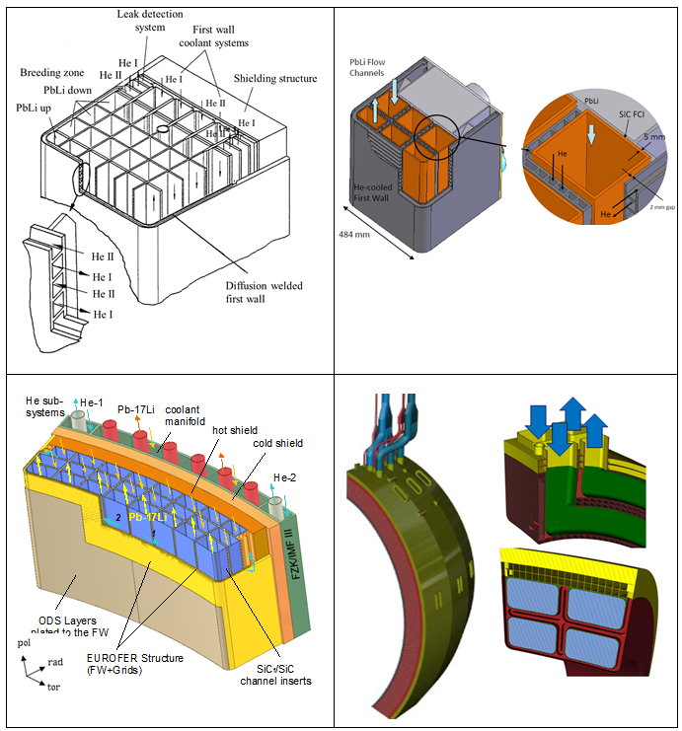
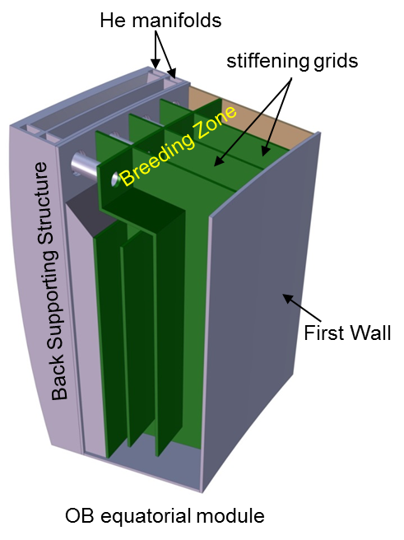
DCLL Blanket Concept Evolution
EU DEMO
ARIES-ST
Some common features:
Dual coolants:
He for cooling of structures
PbLi as breeder and self-cooling medium
Poloidal PbLi flow ┴ magnetic field
LT 425 °C
HT ≥700 °C - SiC_{f}/SiC
1994 (Ref. 1)
1997 (Ref. 2)
EU PPCS
EU PPPT
[1] S. Malang et al., FZKA 5581, 1995.
[2] D. K. Sze et al., Fus Eng Des, 48, 371 (2000).
[3] P. Norajitra et al., FZKA 6780, 2003.
[4] I. Fernández, D. Rapisarda, et al., this conference.
LT ~450 °C
HT 700 °C - SiC_{f}/SiC
2003 (Ref. 3)
2014 (Ref. 4)

Slide 4
Fundamental Problem with LM Flow Through the Magnetic field
→ MHD pressure loss !
Remedy by the use of FCI
(e.g. of sandwich type)
S. Malang et al, FZKA 5581 (1995)

Slide 5
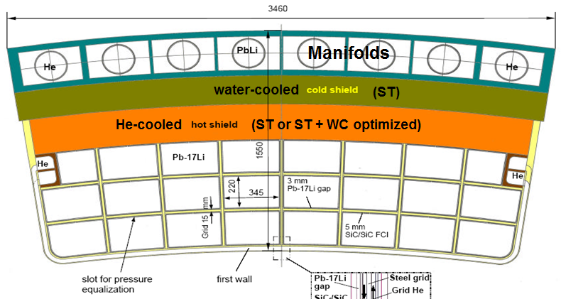
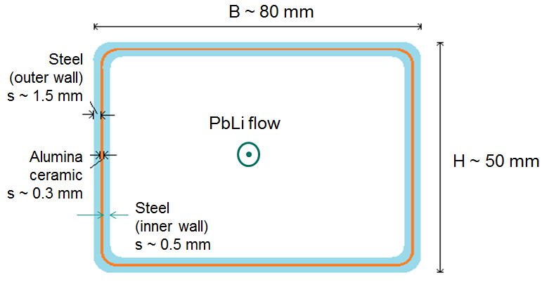
Considerations about Sandwich FCI Design
[P. Norajitra et al, EU PPCS-C, FZKA 6780, 2003]
Thermal insul.
1:4 scale
Electrical insul.
Nested FCI
[S. Malang et al, FS&T, 60, 249 (2011)]

Slide 6
FCI Design: Insulating Material
Requirements:
High electrical resistance (FCI inner part)
Good thermal insulation (poor thermal conductivity) (FCI outer part)
High LM corrosion* resistance
* f (LM velocity, contact temp., grade of insulating material)
No seeping of liquid metal through insulation material (LM tightness)
As low as possible activation
Note:
The following investigation focuses on commercially available Al₂O₃ and SiC ceramics materials.
SiC_{f}/SiC composites will be studied in future steps.
Notes:
6

Slide 7
FCI Design: Insulating Material
Material | Electrical Resistivity (Ωm) | Electrical Dielectric Strength (MV/m) [1] | Heat conductivity (W/mK) | Bending Strength (MPa) | Thermal Expansion Coeff. (10⁻⁶/K) | Tmax, LM corrosion (°C)
Al₂O₃ [1] | 10¹² | 17 | 10 – 16 (80 %) 16 – 28 (95 %) 19 – 30 (> 99%) | 300 | 6 – 8 | 550 °C (excellent purity is required) [3])
SiC [1] | ~1 – 10⁴ [2] | 20 | 40 – 120 (Sintered) 20 (Recrystallized) | 500 – 800 | 4 – 5 | < 800 °C [4]
Eurofer* [6] | 0.5 – 1.1·10⁻⁰⁶ |  | 26 (RT) – 29 (500°C) | Rm: 668 (RT) – 423 (500°C) Rp02: 546 (RT) – 390 (500°C) | 10 (RT) – 12 (500°C) | 550 °C [5]
*Stainless steel 1.4404 was used as a substitute for Eurofer due to the better availability.
[1] http://www.keramverband.de/keramik/englisch/fachinfo/eigenschaften.htm
[2] http://accuratus.com/silicar.html
[3] W. Krauss et al, Journal of Nuclear Materials, 455, 522 (2014)
[4] C.P.C. Wong et al, Journal of Nuclear Materials, 367–370, 1287 (2007)
[5] J. Konys et al, Journal of Nuclear Materials, 417, 1191 (2011)
[6] RCC-MRx DMRx 10-115 A3.Gen et A3.19AS Eurofer
Notes:
7

Slide 8
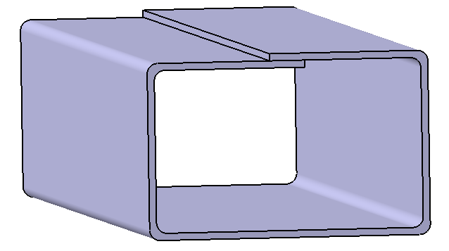
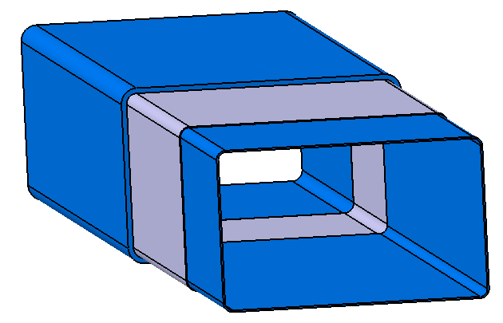
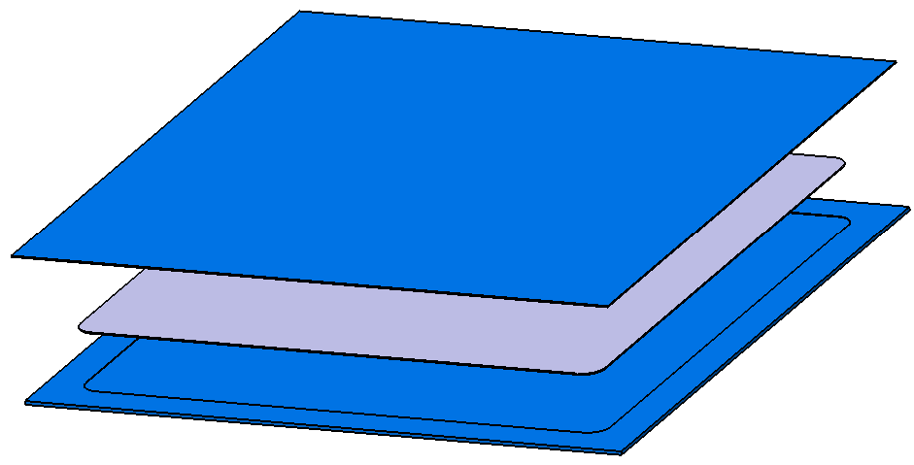
Two Bent-Tube Design
Bent-Tube Design
Tube-in-Tube Design
s
steel
H
L
W
steel
Al₂O₃ (or SiC)
Ceramic Inter-Layer
s ~ 0.1-0.3 mm
steel
steel
Dimensions:
W = 80 mm, H = 50 mm, L = 250 mm, s ~1-1,5 mm
Notes:
8

Slide 9
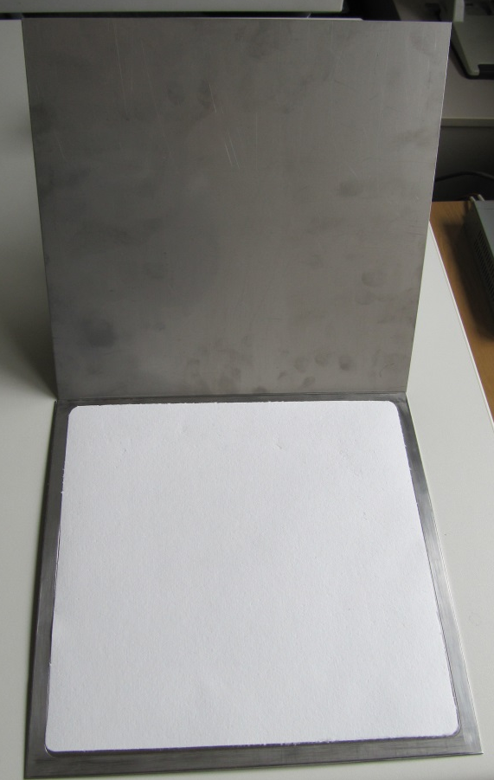
Manufacturing Study for Bent-Tube FCI (Step 1)
Advantages:
Flexible choice of insulation material (e.g. ceramic paper)
No contact between ceramic interlayer and liquid metal.
Flexible design, no high accuracy required.
Disadvantages:
Bare steel sheet edges provide some bridge for "dirty" current.
No cutting of the mock-ups possible (falling out of loose interlayer)
→ Functional testing and qualification only feasible in a liquid metal loop.
FCI Components:
2 steel sheets, 0.5 mm thick (for wrinkle-free bending)
Two options for intermediate layer
A) Ceramic paper (~0.3-0.5 mm, KAGER)
B) Ceramic spray / paste (Dr. Stephan Rudolph)
Ceramic paper

Slide 10
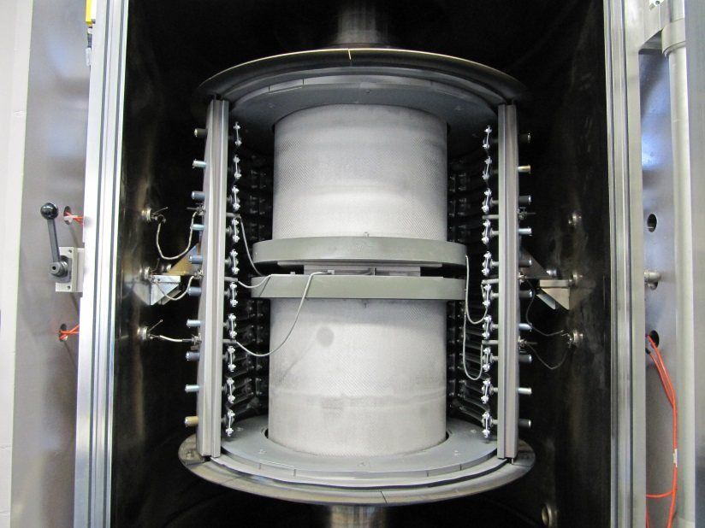
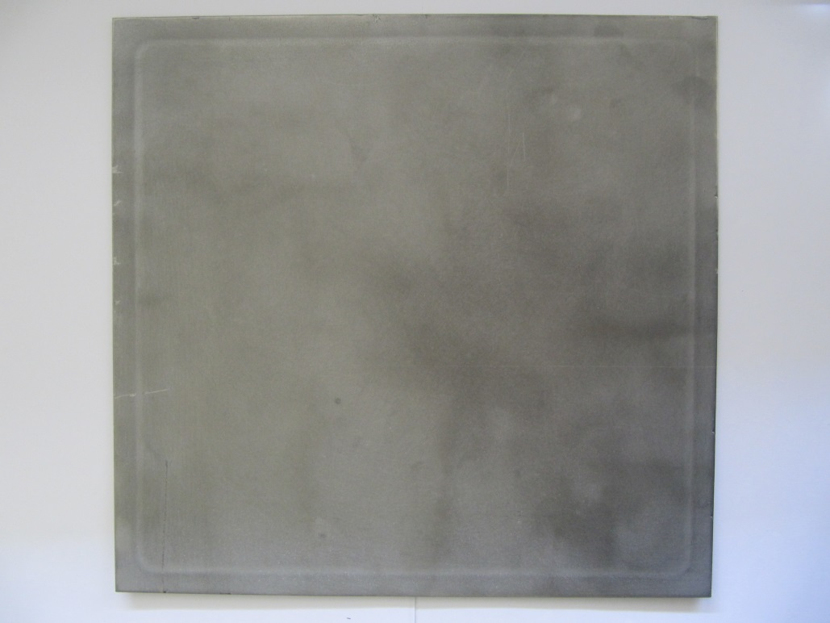
Manufacturing Study for Bent-Tube FCI (Step 2)
In cooperation with KIT/IMVT
Diffusion bonded sandwich sheet (example)
Diffusion bonding by axial pressing in vacuum furnace (10 MPa, 1000 °C, 6h)
Notes:
10

Slide 11
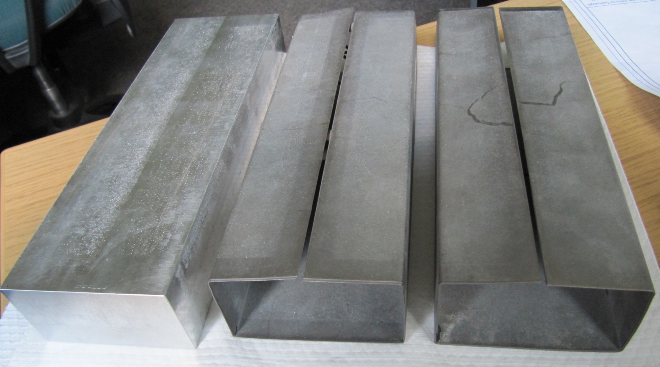
Manufacturing Study for Bent-Tube FCI (Step 3)
(A) with Cer paper (B) with Ceramic spray
Aluminium bending core
Sandwich FCIs bent after diffusion bonding step

Slide 12
Manufacturing Study for Tube-in-Tube FCI (Design 1)
A) Closed design variant
– Outer Steel Tube
– Ceramic (Alumina)
– Inner Steel Tube
In cooperation with KIT/TID
Advantages:
No contact between ceramic and liquid metal (completely sealed).
No high purity of ceramic required (wrt LM corrosion), the poorer the quality the better.
No electrical “bridges”.
Accurate pre-defined geometry for a plug-assembly of FCI individual parts.
Disadvantages:
Higher production costs for fit precision parts.
Ceramic parts can not be mechanically reworked due to high hardness.
No cutting of the mock-ups possible.
Functional testing and qualification only feasible in a liquid metal loop.
Applicability of this design version is dictated by Eurofer/PbLi corrosion at ~ 550 °C.

Slide 13
Manufacturing Study for Tube-in-Tube FCI (Design 2)
B) Semi-open variant
– Outer Steel Tube
– Ceramics: Alumina
(Tmax ~ 550°C wrt LM corr.)
– No Inner Steel Tube
In cooperation with KIT/TID
or SiC Interlayer
(Tmax ~ < 800°C)
Advantages:
Simpler manufacturing than “closed” variant.
No electrical “bridges”.
Accurate pre-defined geometry for a plug-assembly of FCI individual parts.
Disadvantages:
High purity of the ceramic is required (wrt LM corrosion).
Higher production costs for fit precision parts.
Ceramic parts can not be mechanically reworked due to high hardness.
No cutting of the mock-ups possible.
Functional testing and qualification only feasible in a liquid metal loop.
Max. oper. temp. of this design is dictated by Cer/PbLi corrosion at ~ 550 – <800 °C.
offset of ~ 20 mm for plug-in

Slide 14
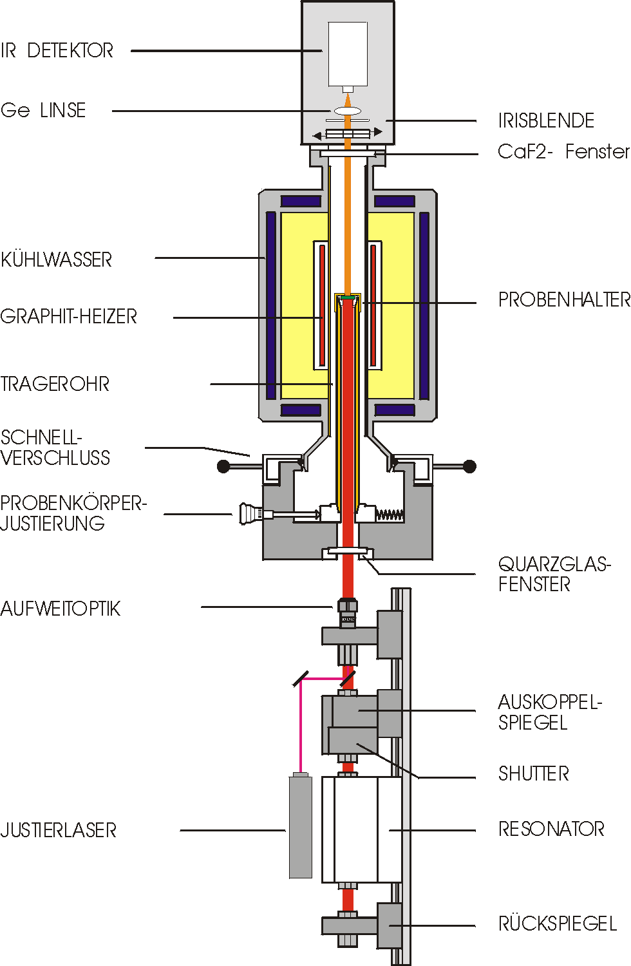
Thermal Diffusivity of Starting Materials
In cooperation with KIT/IAM-AWP
IR detector
Ge lens
1
Iris diaphragm
B-T FCI
CS
CaF₂ IR window
(2nd MSR @ RT)
Cooling water
2
Graphite heater
Specimen holder
Support tube
SiC
Quick closure
Specimens adjustment
Al₂O₃
Quartz glass window
3
Divergent optics
(2nd MSR @ RT)
4
Output coupler mirror
Shoulder
CP
Adjusting laser
Resonator
1: Cut sample from bent-tube FCI with cer spray (CS)
2: Steel – SiC adhesives – Steel
3: Steel – Al₂O₃ adhesives – Steel
4: Steel –ceramic paper (CP) – Steel, glued with Al₂O₃ adhesives
Rearview mirror
Laser flash thermal measurement device

Slide 15
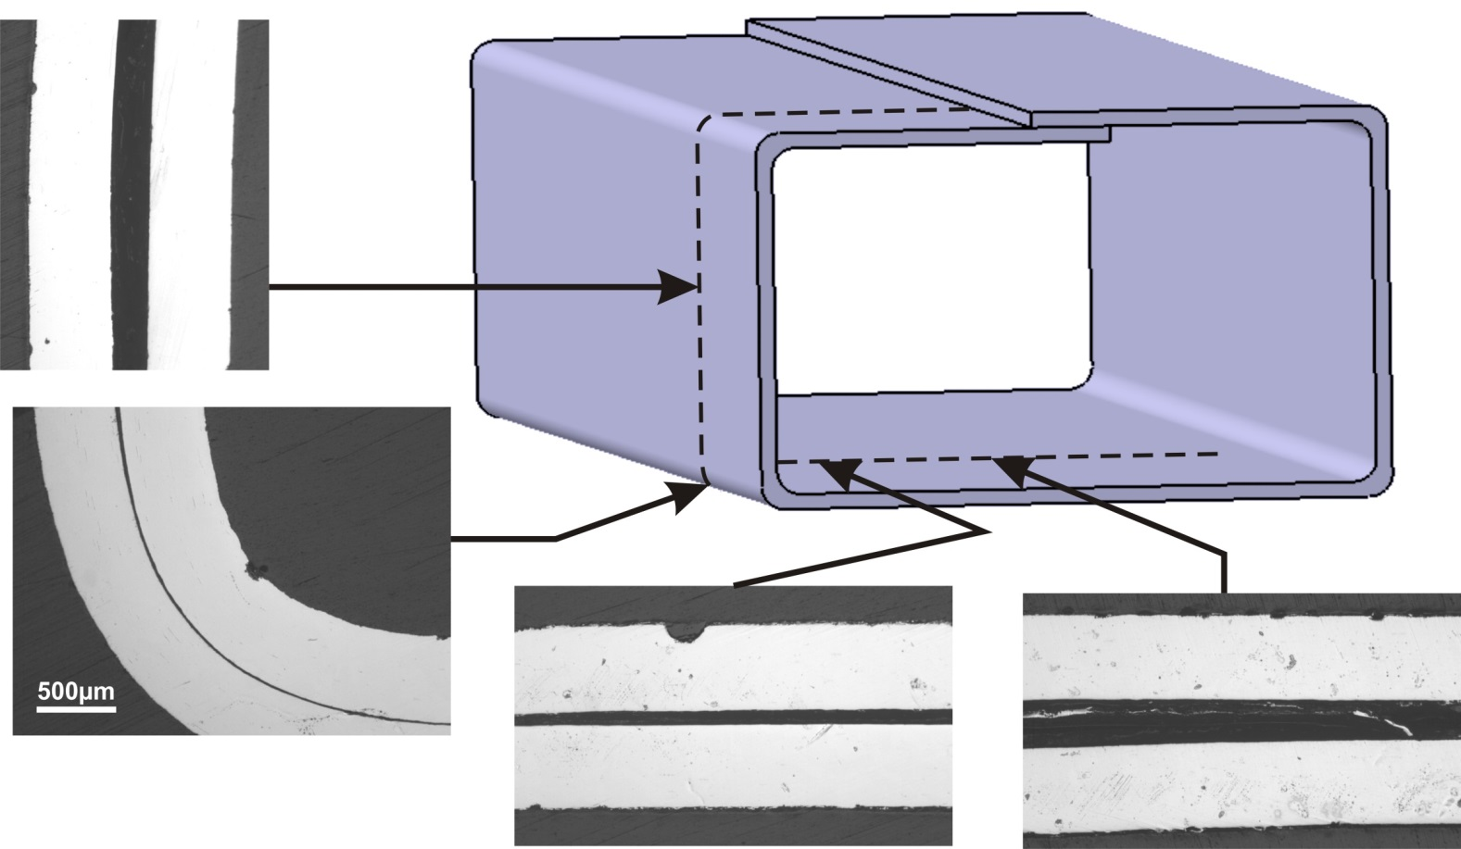
Post-Examination of Produced Bent-Tube Mock-Ups (with Ceramic Spray)
In cooperation with KIT/IAM-WBM
Steel sheet
Ceramic layer
steel sheet
steel sheet
Optical Micrograph
Ceramic layer
No wrinkles formation observed.
Despite strong bending at corners, no contact between the steel sheets, i.e. no short circuit.
No constant insulation thickness.

Slide 16
Preliminary Resistivity Data for Produced Tube-in-Tube FCI Mock-Ups
In cooperation with CIEMAT
Surface resistivity was calculated from the resistance measurement between two electrodes on the surface of the insulating material, taken into account electrode dimensions.
Measurements were performed on the tube-in-tube, semi-open mock-ups with alumina and SiC insulator (Table).
Overall results:
Good agreement with literature reported data.
High dispersion in resistivity values indicates the presence of defects, impurities, low grade or poor homogeneity of dopant in ceramic insulator.
 | Al₂O₃ | SiC
mean resistivity (ohm.m) | 4 ±2 x 10¹¹ | 0.1 – 10²
Al₂O₃
SiC
Testing on small sample recommended

Slide 17
Conclusions
Requirements for the ceramic material for use in FCI design were summarized, material data for selected Al₂O₃ and SiC presented.
Two design variations Bent-Tube and Tube-in-Tube were presented.
The latter with subdivision in Closed- and Semi-open designs.
Their advantages and disadvantages were discussed.
Manufacturing studies conducted with 1:4 scale mock-ups have confirmed the feasibility and manufacturability for all design variants.
Measurement of starting material properties and post-examination of produced mock-ups show good agreement with literature.
Open issues for future R & D are:
Transferability to a 1:1 full scale mock-up has to be checked.
Study on 3D printing technology.
Function tests and characterization of FCIs under real magnetic conditions in a PbLi loop.
Manufacturing study for an advanced FCI with SiC_{f}/SiC composite material.
Influence of n-irradiation on the properties of ceramic material, in particualr radiation-induced electrical degradation (RIED).

Slide 18
Thank you for your attention!

