Slide 1
What is Dual Coolant Blanket?
Siegfried Malang
2nd EU-US DCLL Workshop
University of California,
Los Angeles
November 14-15, 2014

Slide 2
Versions of DCLL blankets
Historical order:
Original DCLL concept as included into the EU Blanket Comparison and Selection Study (1995)
HT DCLL as suggested in the ARIES-ST study (1997) and used as Model C in the EU-PPCS
LT DCLL blanket as a candidate for the start of a conservative FNSF or EU-DEMO-01

Slide 3
A) Original DCLL concept
Characteristics:
Only first wall cooled with Helium
PbLi exit temperature limited to ~ 425 C for corrosion reasons
Grid plates and separation plate between poloidal ducts either coated with Alumina or electrically insulated with sandwich flow channel inserts,
Achievable efficiency in the power conversion system ~ 33 %

Slide 4
Original DCLL Blanket Concept

Slide 5
High Temperature DCLL Blanket
Characteristics:
Entire blanket structure cooled with Helium,
Grid plates and separation plate between poloidal PbLi ducts electrically and thermally insulated against PbLi with flow channel inserts made of SiC
PbLi inlet/outlet temperatures ~ 450 C/700 C
He inlet/outlet temperatures ~ 350 C/450 C
He inlet pressure 8 MPa
~ 50 % of total heat extracted with PbLi, remaining 50 % with He
Achievable efficiency in the power conversion system ~ 45 %

Slide 6
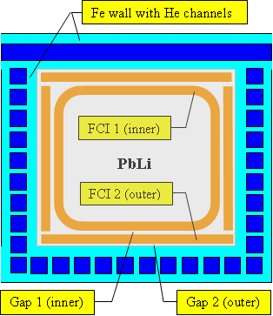
High Temperature DCLL Blanket

Slide 7
B) Low Temperatures DCLL blanket
Characteristics:
Intended for the use in an early FNSF and DEMO for the case
SiC FCI’s can’t be qualified in time (high fluence irradiation tests
in fusion typical neutron field required),
FW and entire blanket structure cooled with Helium
Sandwich FCI’s in all poloidal ducts are used for electrical and thermal insulation,
PbLi inlet/outlet temperatures ~ 350 C/470 C
He inlet/outlet temperatures ~ 350 C/500 C
Achievable efficiency in the power conversion system ~ 36 %

Slide 8
Principle of Sandwich Flow Channel Insert

Slide 9
Comparison of LT and HT DCLL blanket
MHD pressure drop in the LT DCLL considerably higher because it is determined by the high electrical conductivity of the sandwich-steel- liner (~ 0.5 mm),
LM exit temperature limited to ~ 470 C in order to limit interface temperature of the steel-liner for corrosion reasons,
Thermal stresses in the blanket structure reduced by the more uniform temperature field, but much higher MHD pressure drop can cause higher primary stresses in the structure if thickness of walls is not increased.

Slide 10
Summary and Conclusions
In the EU blanket and comparison study the DCLL blanket was an interesting competitor to the WCLL blanket.
The HT DCLL study as suggested in the ARIES-ST study was the leading PbLi blanket concept in the European PPCS with the WCLL and the HCLL concepts as competitors.
In the EU DEMO 01 study, the candidate blanket concepts are
- Helium Cooled Ceramic Breeder (HCCB) blanket
- Helium Cooled Lead-Lithium (HCLL) blanket
- Water cooled Lead-Lithium (WCLL) blanket
- Dual Coolant Lead-Lithium (DCLL) blanket
The most attractive concept is the HT DCLL blanket because it promises an efficiency up to 45 % based on FM steel as structural material with a maximum operating temperature of 550 C.
The LT-DCLL blanket with sandwich FCI’s can be used for the start of DEMO 01 in case the SiC-FCI’s can’t be qualified in time.

