Slide 1
Maintenance Schemes for a DEMO Power Plant
and related DCLL Designs
Siegfried Malang
2nd EU-US DCLL Workshop
University of California,
Los Angeles
November 14-15, 2014

Slide 2
Candidate Maintenance Concepts
Replacement of blanket modules through maintenance ports with articulated booms.
Vertical replacement of blanket segments through ports at the top of the torus
Horizontal replacement of torus sectors through large maintenance ports between TF-coils

Slide 3
A) Replacement of blanket modules
Typical Examples:
a) Module replacement as suggested in
EU Power Plant Conceptual Study (PPCS)
b) Module replacement as suggested in the
ARIES Compact Stellarator (CS) Study
c) Module replacement as suggested for the
pre-conceptual design of the DCLL blanket
for a US-DEMO

Slide 4
Replacement of blanket modules (continued)
Critical issues for module replacement:
- Difficult and time-consuming handling of large
number of modules,
- Difficult attachment of the (hot) modules
to the (cold) vacuum vessel,
- Difficult attachment of the coolant access pipes
to the modules inside the VV.

Slide 5
B) Vertical replacement of blanket segments
Typical Examples:
a) EU DEMO-NET concept, serving as basis
for EU blanket selection exercise,
b) PPPL Pilot plant study,
c) EU MMS concept,

Slide 6
Vertical replacement of segments (continued)
Critical issues of vertical replacement:
Available space at the top between TF-coils very limited, making the attachment of coolant access pipes there difficult
Mechanical attachment of segments to the VV difficult (differential thermal expansion, disruption forces)
Handling of the long segments (moving in radial, toroidal, and vertical direction), confinement of radio-activity (Tritium, dust) outside the VV difficult.

Slide 7
Horizontal replacement of torus sectors through large ports between TF-coils
This is the standard maintenance method for all ARIES Tokamak power plant studies with the following characteristics:
Blanket segments covering the full width and height of a sector are attached to a “skeleton ring”, providing a strong structure continuous in poloidal direction. Temperatures of this ring and the blanket segments are very close.
Skeleton ring rests on the VV at the bottom only, allowing free thermal expansion in toridal and poloidal directions.
Coolant access pipes are attached to the skeleton ring at the bottom region only, can be cut/rewelded there inside the port.
Entire sector is withdrawn into transfer cask docked on the port flange.
Blanket segments are disconnected from the skeleton ring in a hot cell.

Slide 9
Implication of the maintenance method on the DCLL blanket design
Crucial issue:
MHD pressure drop in long poloidal ducts and the flow distribution from the LM access pipes to large number of parallel ducts depends on the size and shape of blanket modules or segments.
With most of the candidate maintenance schemes, the LM enters and leaves either at the top of the torus or the bottom of it. This means for vertical replacement of segments or horizontal replacement of sectors really long flow paths.
A design with multi module segments (MMS) can reduce the flow path length, provided there is sufficient radial space for the poloidal LM manifolds.

Slide 10
Design of DCLL blankets for MMS exchange
The LM inlet and exit pipes are attached to the replacement unit at the maintenance ports at the top of the torus.
There are 2 IB and 3 OB segments contained in each torus sector. These segments cover the entire height of the torus, but they are in poloidal direction subdivided into ~ 7 modules. These modules with a maximum height of < 2m are attached to the hot shield/manifold component.
The coolant supply to each blanket module is provided by connecting the module to the supply ducts in the manifold region.
This is the typical arrangement of HCPB, HCLL, and WCLL blankets.
For the DCLL blanket it would mean, that the ducts for He and LM coolant in these manifold run the entire height from the top port to the bottom of the segment and up to the top again. The big question is, if there is sufficient radial space for all these poloidal ducts in order to limit the LM velocities to tolerable values.

Slide 11
Alternative Design of DCLL blankets for EU DEMO 01
The following radial depths in the IB region are given by the system code:
FW/breeding zone 500 mm
Multi-module manifold+ supporting structure 300 mm
If we would arrange all coolant access ducts in this 300 mm thick region from the top to the bottom and back to the top, the LM velocity in these ducts and therefore the MHD pressure drop would be really high, especially for the design with sandwich flow channel inserts.
Therefore, we suggested to use this region as HT shield, supporting structure, and He-manifold only, and arrange in the 500 mm thick breeding zone two rows of poloidal ducts over the entire height of the segment. (back row down flow, front row up flow)

Slide 12
Comparison of the suggested DCLL layout for EU DEMO 01 with ARIES-ACT-2
Radial thickness at IB-region:
DEMO 01 ARIES-ACT-2
FW/breeding zone 500 mm 620 mm
Blanket back plate 130 mm
He-manifold+ structure 300 mm 250 mm
______________________________________
Total IB thickness 800 mm 1000 mm
In ARIES-ACT-2 the He-manifold+structure was made to a life-time component by this 200 mm increased thickness.

Slide 13
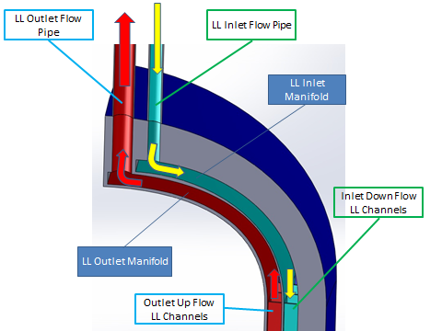
LM Access-Pipe at upper Port

Slide 14
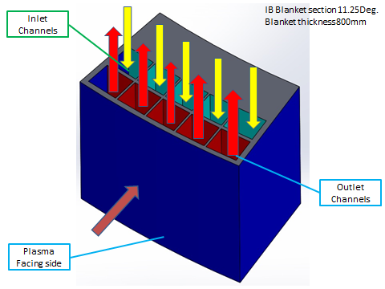
Poloidal LM ducts in IB segment

Slide 15
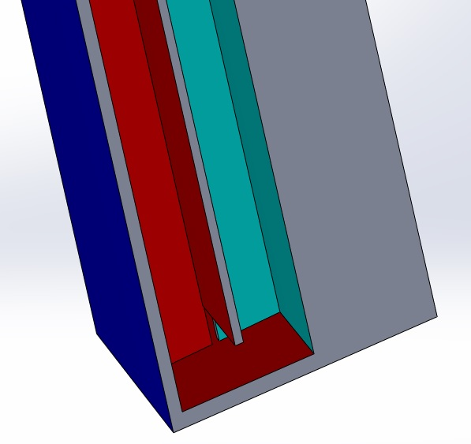
Transition from down-flow to up-flow

Slide 16
Summary and Conclusions
Possible maintenance schemes for the replacement of FW/breeding blankets:
- Replacement of small modules by an articulated boom,
- Vertical replacement of blanket segments through ports
at the top of the torus,
- Horizontal replacement of entire torus sectors through
large ports between the TF-coils
Selected method for EU DEMO 01:
- Subdivide each sector into 2 IB and 3 OB segments
to be exchanged through a port at the top of the torus,
- Subdivide a IB segment in radial direction into a 500 mm thick
FW/breeding region and a 300 mm thick
He-manifold + HT shielding zone
- Subdivide the breeding zone into a back row of LM down-flow ducts
and a front row of up-flow ducts.

