Slide 1
Be/FS joining for ITER TBM
Ryan Matthew Hunt
FNST Meeting
August 18, 2009
A collaboration between UCLA, SNL-Livermore, Brush-Wellman, Axsys Inc. and Bodycote.
F82H supplied by JAEA through TITAN collaboration

Slide 2
Outline
Introduction
Current Knowledge
Bonding Layering Scheme
Initial Progress
Experimental Procedure
Characterization of Cu//F82H bond
Analysis of Ti//Cu Diffusion Zone
Conclusions
Future Work

Slide 3
Introduction
Application: ITER requires a 2mm coating of Beryllium on plasma facing surfaces of TBMs
Be used as armor layer
RAFM steel used as structural material (F82H, Eurofer, etc.)
Research Task: create a robust diffusion bond between two dissimilar metals strong enough to survive in ITER:
Beryllium & RAFM steel (F82H)
2mm coating on plasma facing surfaces

Slide 4
Current Knowledge
Be reacts with just about everything
Exceptions: Ge, Si, Ag, Al
Forms brittle intermetallic compounds
Need a diffusion barrier material
Much research in last 15 years to solve this problem in relation to FW beryllium bonds
Be to CuCrZr, Be to SS, Cu to SS
Arrived at Ti/Cu interlayer scheme

Slide 5
Layering Scheme
HIP
Be
F82H
Ti (5-25 μm) via PVD
Cu (10-30 μm) via PVD
Piggyback on FW shield module research:
Titanium diffusion barrier
Must be thin as possible
Costly to fabricate thick layer; too thick Ti may fail from brittle fracture
Copper compliant layer
Stress from thermal expansion difference is absorbed by ductile Cu

Slide 6
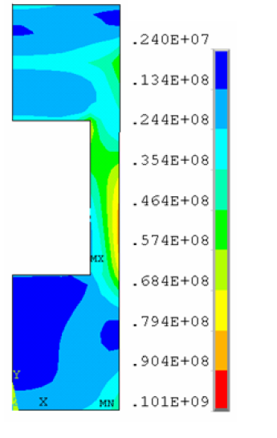
Limitations on Joint
Fabrication
HIP temp bounds:
< 850 C recrystallization temperature of Beryllium
Want lowest temp possible to avoid extraneous heat treatment of TBM structural joints
> 650 C insufficient bonding below this temp (known from FW research)
i.e. FW Be/CuCrZr bond uses 2 μm Ti, 25 μm Cu @ 560 C HIP, for 2 hrs
Implementation
Strength of interface need exceed stress in region
σ=57 MPa predicted from thermal stress [Lee2006]
3D FEM analysis of TBM armor layer not yet completed

Slide 7
Initial progress
(Prior to inclusion of Beryllium)
Measure strength of Cu direct bond to RAFM steel
Previously, Cu to SS easy to bond. SS had nickel to aid diffusion. RAFM has much less Ni. Cu may not bond as well.
Experiment 1: Measure Cu to F82H bond strength
Tensile, shear, and toughness at interface
Determine min. thickness of Ti that still blocks diffusion at HIP temperatures
Experiment 2: For each possible HIP temp., measure depth of diffusion of Cu into Ti

Slide 8
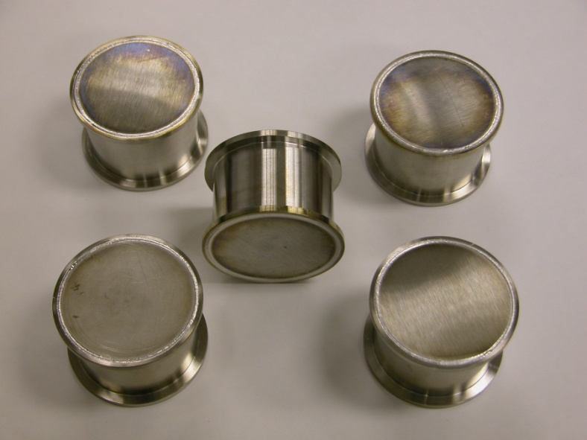
Experimental Procedure
Experiment 1
Fabricate 5 HIP SS cans with Cu & F82H substrates inside
HIP for 2 hours, 103 MPa @ 650, 700, 750, 800, 850 °C
Measure strength in MTS tensile, shear & toughness
Experiment 2
Fabricate samples
Anneal in vacuum furnace to simulate HIP bond
Measure diffusion depth via EMP line scans
25 μm Cu
20 μm Ti
Substrate
*Cu used for simplicity

Slide 9
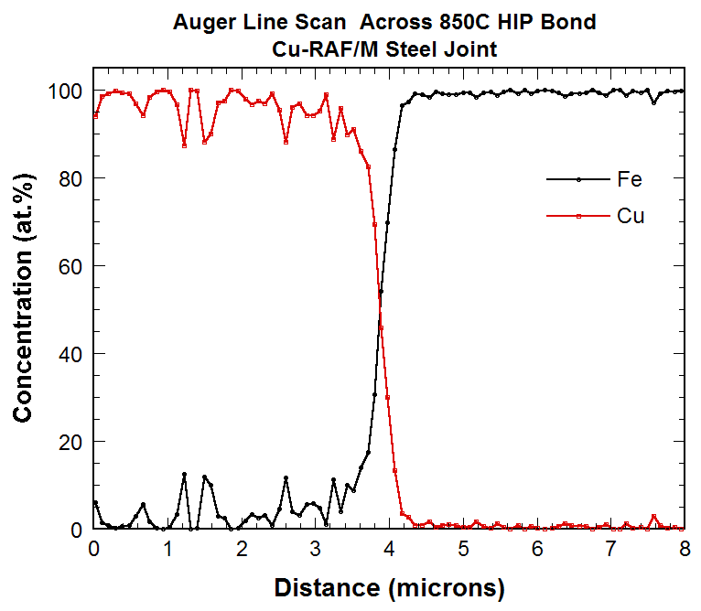
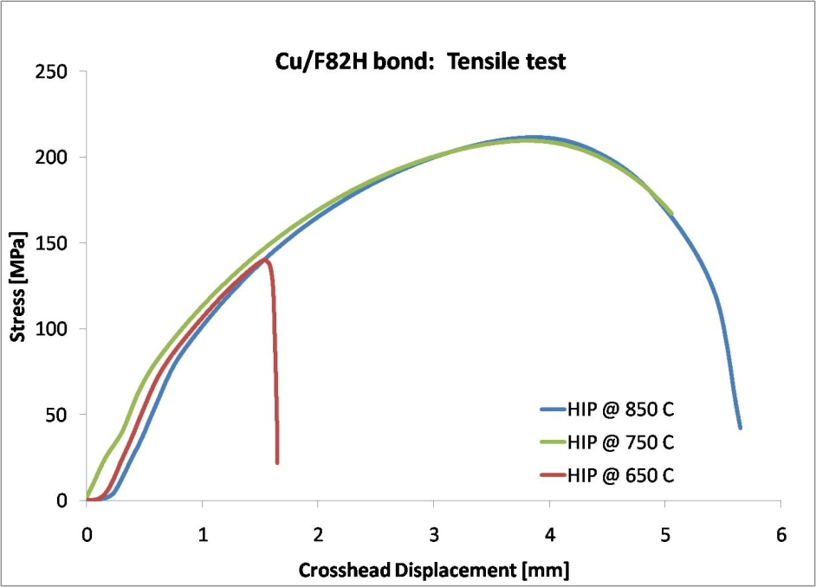
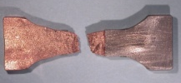
Characterization of Cu//F82H bond
Composition:
AES shows very narrow (~1 μm) diffusion zone after 850 °C HIP
(Analysis of lower temps underway)
Strength:
@ 850 C and @ 750 C → Failure in Cu bulk material
achieves 211 MPa min. tensile strength
@ 650 C → Failure at material interface
creates insufficient bond
(Awaiting results for 800, 700 C HIP bonds)

Slide 10
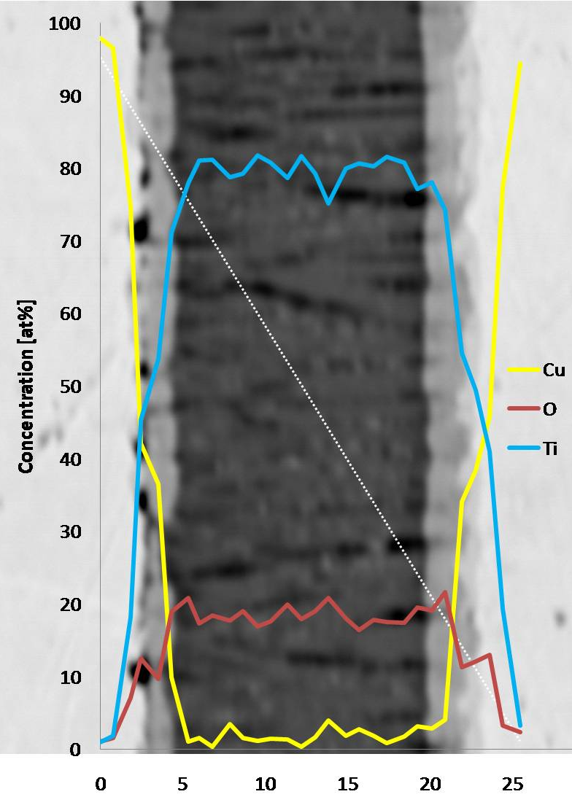
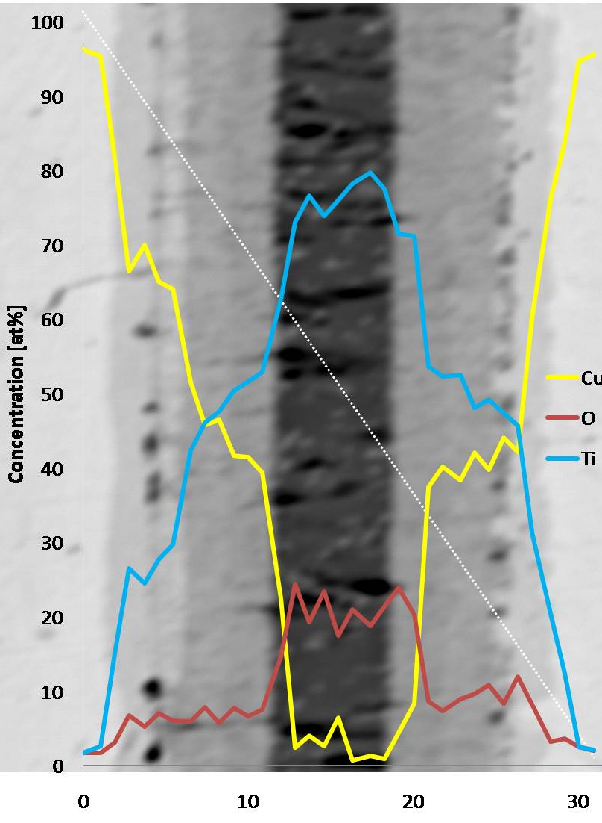
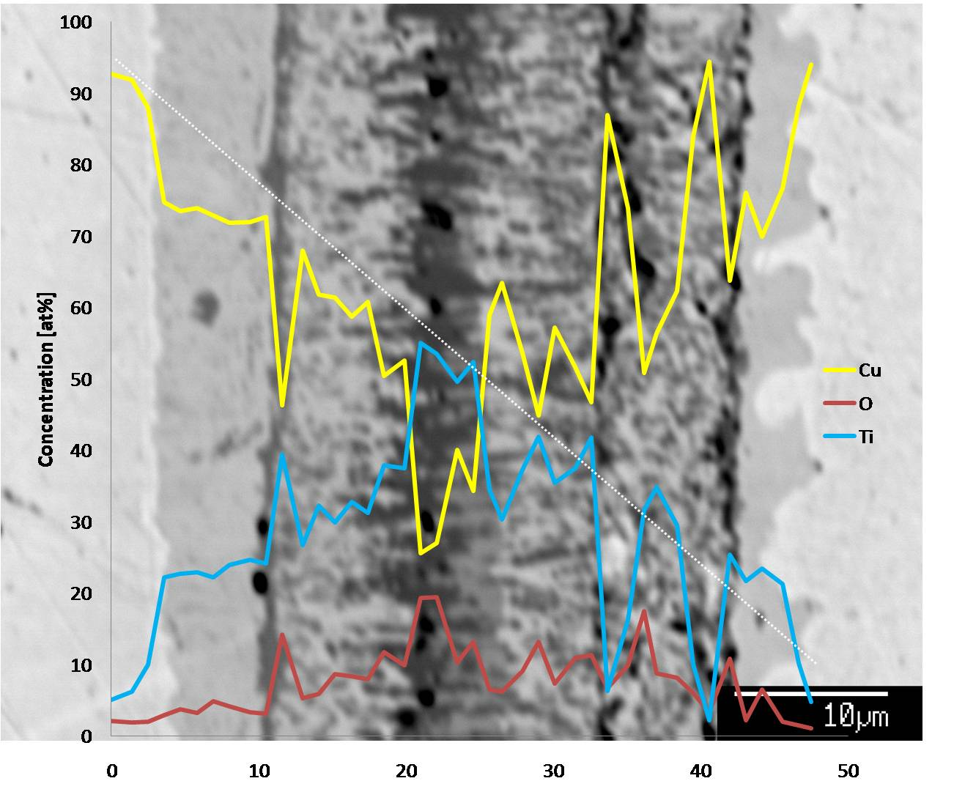
Analysis of Ti//Cu Diffusion Zone
Samples annealed 30 min.
Use data to predict depth for 2 hour anneal →
Note: Oxygen levels in Ti higher than expected. PVD chamber potentially problematic. May Cause slightly different diffusion behavior.
650 °C
750 °C
850 °C

Slide 11
Initial Conclusions
Ti/Cu interlayers, HIP at 750 °C for 2 hrs, 103 MPa, appear to be viable recipe for bonding.
750 °C is promising result, close to PWHT of TBM, (as desired by JAEA research)
800, 700 °C Cu/F82H HIP cycle results underway
Higher temp HIP cycles may require unreasonable amount of Ti to completely block diffusion of Cu into Be
Still can slow diffusion

Slide 12
Future Work
Full Joint
Manufacture coupons to include Beryllium, utilizing analysis from current experiments
10 sample matrix:
Expect failure in Ti/Cu intermetallics
For comparison - direct bond, only Ti, only Cr, Cr/Cu
Design Analysis
Show that bond will survive in ITER
Perform FEM stress analysis of TBM. Include:
Primary (pressure) and Secondary (thermal) loading in region
Cyclic loading for lifetime of ITER
Effects of irradiation will not be studied. Suggested as future work for qualification.

Slide 13
Question?

Slide 14
HIP Temp [C] (2 hrs, 103 MPa) | Max Tensile Strength [MPa] | Max Shear Strength [MPa] | Ti/Cu Diffusion Depth [μm] (30min anneal) | Predicted Ti/Cu Diffusion Depth [μm]
650 | 134.73 | 103.8 | 5 | 9
700 | ? | ? | 8 | 16
750 | 211 | 116 | 12 | 24
800 | ? | ? | through | ?
850 | 211.56 | 114.26 | through | ?

