Slide 1
SiC as a FCI alternative material for an EU_DEMO DCLL breeder blanket
M. González, D. Rapisarda, A. Ibarra
National Fusion Laboratory, CIEMAT, Madrid, Spain.
Notes:
once more, good afternoon
this time I would like to review the viability for using SiC as an alternative insulator for the technological FCI of an european DCLL DEMO breeder blanket

Slide 2
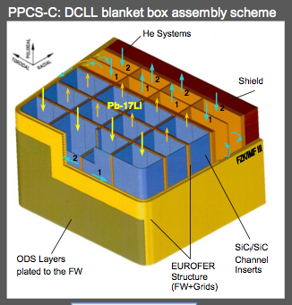
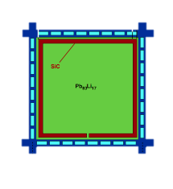
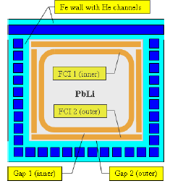
Flow Channel Inserts,
the DCLL more challenging component
Electrical insulation issue to minimize the MHD pressure drop
Thermal insulator
Withstand the thermal stress from temperature gradients
Radiation resistant
Chemical compatibility with PbLi
from Norajitra’s 2003 design
SiC
Smoletsev et al, FST, 50 (2006) 107–119
Notes:
FCI, the electrical insulation issue to reduce the MHD pressure drop. In addition this in-channel devices will contribute to the thermal insulation between the high temperature liquid metal and the steel structure, limited to temperatures below 700ºC. Together with its properties as an insulator, this part of an DCLL breeder should tolerate the thermal stress generated due to the thermal difference between its surfaces, should exhibit the maximum radiation resistance and chemical compatibility with the liquid metal.
A good candidate due to its proven good properties is SiC ceramics.
Two designs are being considered, mainly trying to minimize the thermal gradients.

Slide 3
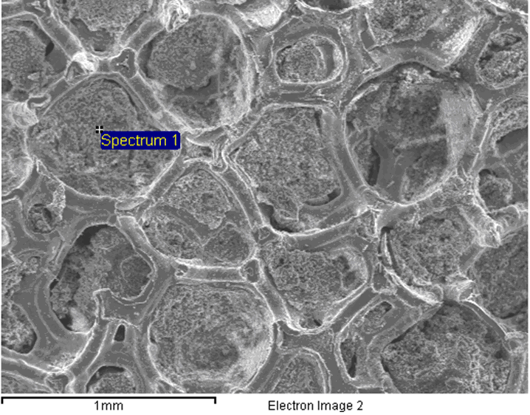
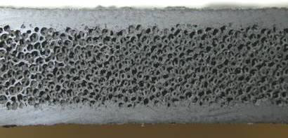
SiC US material for FCI applications
SiC_{f}/SiC composite
foam-based SiC
Remaining critical issues:
SiC and Pb-17Li chemical compatibility – at flowing condition and temperature distribution.
Mechanical integrity -- due to radiation induced swelling and temperature gradients induced mechanical stresses.
Swelling -- radiation resistance combining high temperatures and high doses
C.P.C. Wong et al. Fusion Science and Technology, 64 (2013) 623–630
Notes:
SiC has been extensively analyzed as FCI material for US researchers.
Being the continuous fiber-reinforced SiC composite and the porous SiC the most promising forms of this material.
Althought seems to satisfy the requirements, still remains few critical issues that need to be addressed.
Its chemical compatibility with flowing PbLi and operational temperature distribution
Its mechanical integrity when submitted to temperature gradients and radiation enviroment.

Slide 4
even when EU_DCLL is considering steel + alumina ceramic sandwich-like structures for the FCIs,
is also SiC a reasonable choice for the low temperature in-channel insulation?
Notes:
the question arising is,

Slide 5
Spanish experience on SiC (I)
Material
Different types of commercial SiC:
1) hot pressed (HP) SiC, 2) reaction bonded (RB) SiC, 3) high resistivity cubic CVD SiC (IMR, Tohoku University, Japan), 4) PVT N-6H SiC wafer (Tankeblue), 5) 2D and 3D SiC_{f}/SiC (2D - Ube and 3D – Shikibo, Japan, provided by ENEA, Italy)
Objective
Electrical insulation under temperature and ionizing radiation
Notes:
Some spanish groups have extense experience on characterizing SiC for Fusion applications
this is the case of Ibarra’s group at CIEMAT, who have tested different commercial SiC with the aim of characterizing the electrical insulation behaviour under ionizing radiation and temperature variable conditions.

Slide 6
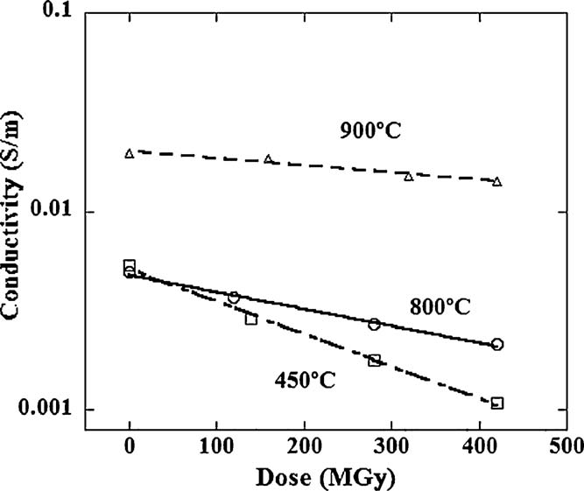
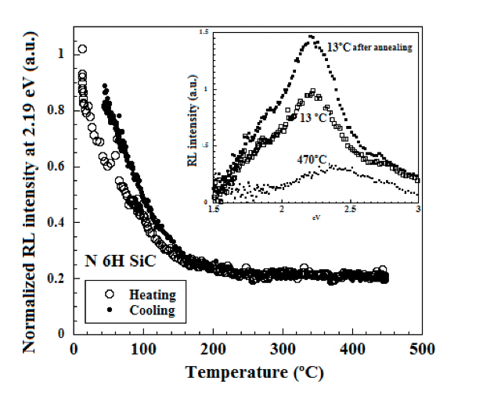
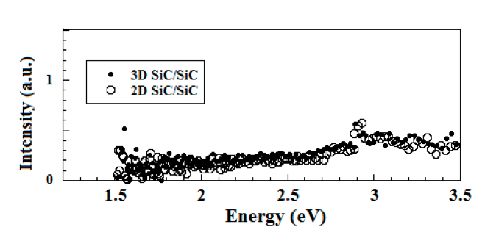
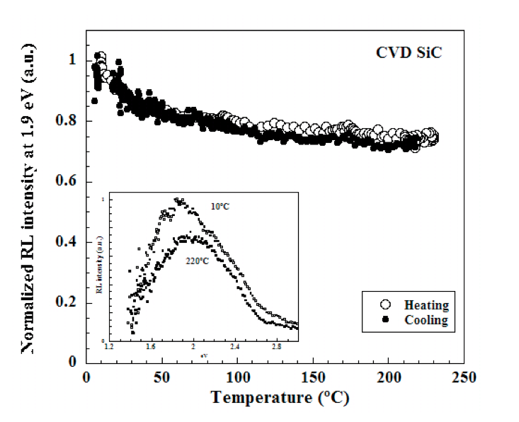
Spanish experience on SiC (I)
Obtained results
Monitoring SiC radiation damage (crystalline structure) evolution with ionizing irradiation and temperature by radiation induced luminescence (RL) and electrical conductivity.
HP SiC
CVD SiC
M.T. Hernandez et al.
FED, 86 (2011) 2242–2445
M.Malo et al. FED 89 (2014) 1274–1279
Notes:
RL was used as a tool for in-situ monitoring of radiation damage.
Emission spectra, luminescence efficiency and the effect of irradiation temperature were found to strongly depend on SiC type.
In the case of N-6H SiC evidence for correlation between emission band energy and crystal structure modification has been found.
For the two SiC/SiC materials no RL was found in experiments covering a wide dose rate range and high accumulated doses.

Slide 7
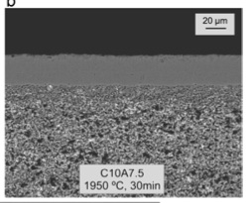
Spanish experience on SiC (II)
Material
CVD SiC coated porous SiC ,
to avoid liquid metal corrosion and T permeation
Objective
Thermal and electrical insulator
Mechanical strength to withstand strong thermal gradients and thermo-electrical stresses
Resistant to PbLi corrosion
Notes:
In the framework of TechnoFus project, CEIT produced a porous SiC material coated with a 30 micron layer of CVD SiC to test its behaviour in a LT DCLL breeder environment.

Slide 8
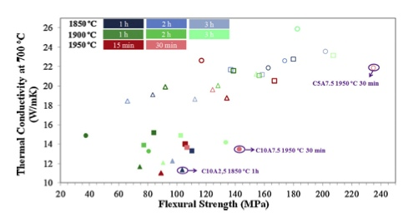
Spanish experience on SiC (II)
Obtained results
The most promising porous SiC material is
82.5wt% SiC + 10wt% C + 7.5wt% Al2O3+Y2O3 sintered at 1950◦C/30min.
porous SiC
N. Ordás et al. FED, 89 (2014) 1274–1279
Notes:
A broad distribution of high temperature thermal conductivity data was found, the conductivity depending on composition (particularly the oxide dopant proportion) and the ceramic sintering conditions.
Those materials showing the lowest thermal conductivity having optimum flexural strength were selected to be coated with an anticorrosion layer and further analysis.

Slide 9
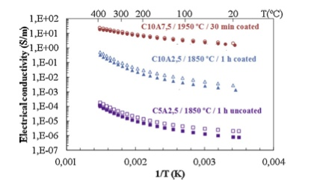
Spanish experience on SiC (II)
Obtained results (II)
The most promising compositions were 30 µm CVD SiC-coated.
CVD SiC-coated
porous SiC
N. Ordás et al. FED, 89 (2014) 1274–1279
Notes:
Surface corrosion and electrical conductivity as a function of temperature were tested on coated ceramics.
A 30 micron CVD SiC layer covering the porous SiC surface can provide partial protection against corrosion to pure LL liquid, while electrical conductivity was maintained below resonable limits at high temperatures.

Slide 10
even when EU_DCLL is considering
steel + alumina ceramic sandwich-like structures
for the FCIs,
is also SiC a reasonable choice
for the low temperature FCI insulation?
Potential material:
SiC-coated porous SiC
Key properties to be tested
(mainly radiation effects
on insulator properties
at operational conditions)
Notes:
At the light of this two interesting experimental works on the characterization of SiC, the initial question considered seems to be found an answer on a coated porous SiC.
Nevertheless, key properties need to be tested, the most important related to radiation effects, as RIC and RIED, creep behaviour, …

Slide 11
Suggested Working Plan. Testing SiC ceramics as LT_DCLL FCI
Objectives:
to select the appropriate material from available/commercial options
CEIT porous SiC-coated SiC,
commercial SiC_{f}/SiC,
and also SiC used in the US_DCLL
engineering validation
to complete databases

Slide 12
Suggested Working Plan. Testing SiC ceramics as LT_DCLL FCI
Objectives:
to select the appropriate material from available/commercial options
CEIT porous SiC-coated SiC,
commercial SiC_{f}/SiC,
and also SiC used in the US_DCLL
engineering validation
to complete databases
we would appreciate if UCLA group could help us obtaining porous SiC
to be tested for the LT EU_DCLL

Slide 13
Suggested Working Plan. Testing SiC ceramics as LT_DCLL FCI
Objectives:
to select the appropriate material from available/commercial options
CEIT porous SiC-coated SiC,
commercial SiC_{f}/SiC,
and also SiC used in the US_DCLL
engineering validation
to complete databases

Slide 14
Suggested Working Plan. Testing SiC ceramics as LT_DCLL FCI
at low working temperatures (up to 500C),
including under ionizing radiation
and irradiated material (post examination) testing
after thermal gradients, thermal cycles and LM
insulator properties retention: electrical and thermal conductivities
- material integrity (cracking, steel-insulator detachment, …)

Slide 15
Suggested Working Plan: Complementary testing SiC ceramics
Thermo_mechanical tests (tensile, compression, 3-point bending) inside a double FE_SE + FIB microscope.
Radiation effects (Radiation Induced Conductivity, Radiation Induced Electrical Degradation, …). Mainly ionizing radiation.
Simulating internal diffusion of neutron reaction products (He).

Slide 16
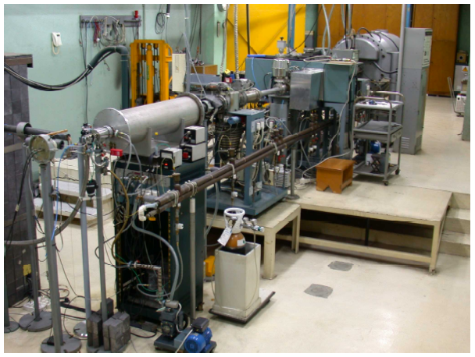
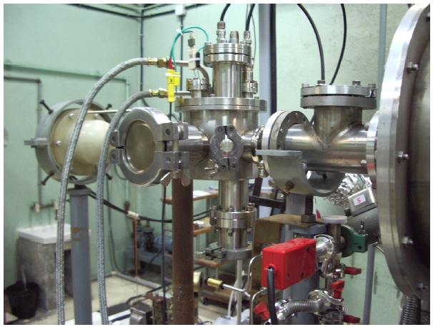
CIEMAT (Madrid, Spain) Irradiation Facilities (I)
* electron-irradiation HVEC Van der Graaf accelerator
= high vacuum (better than 3 x 10⁻⁶ bars)
= 1.8 MeV at a dose rate of 7kGy/s
= irradiation temperatures upto 800ºC
electron beam
direction
VdG irradiation facility and
Deuterium absorption + thermal induced-desorption measuring chamber

Slide 17
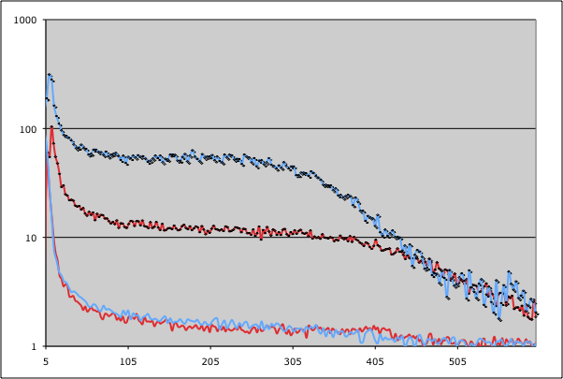
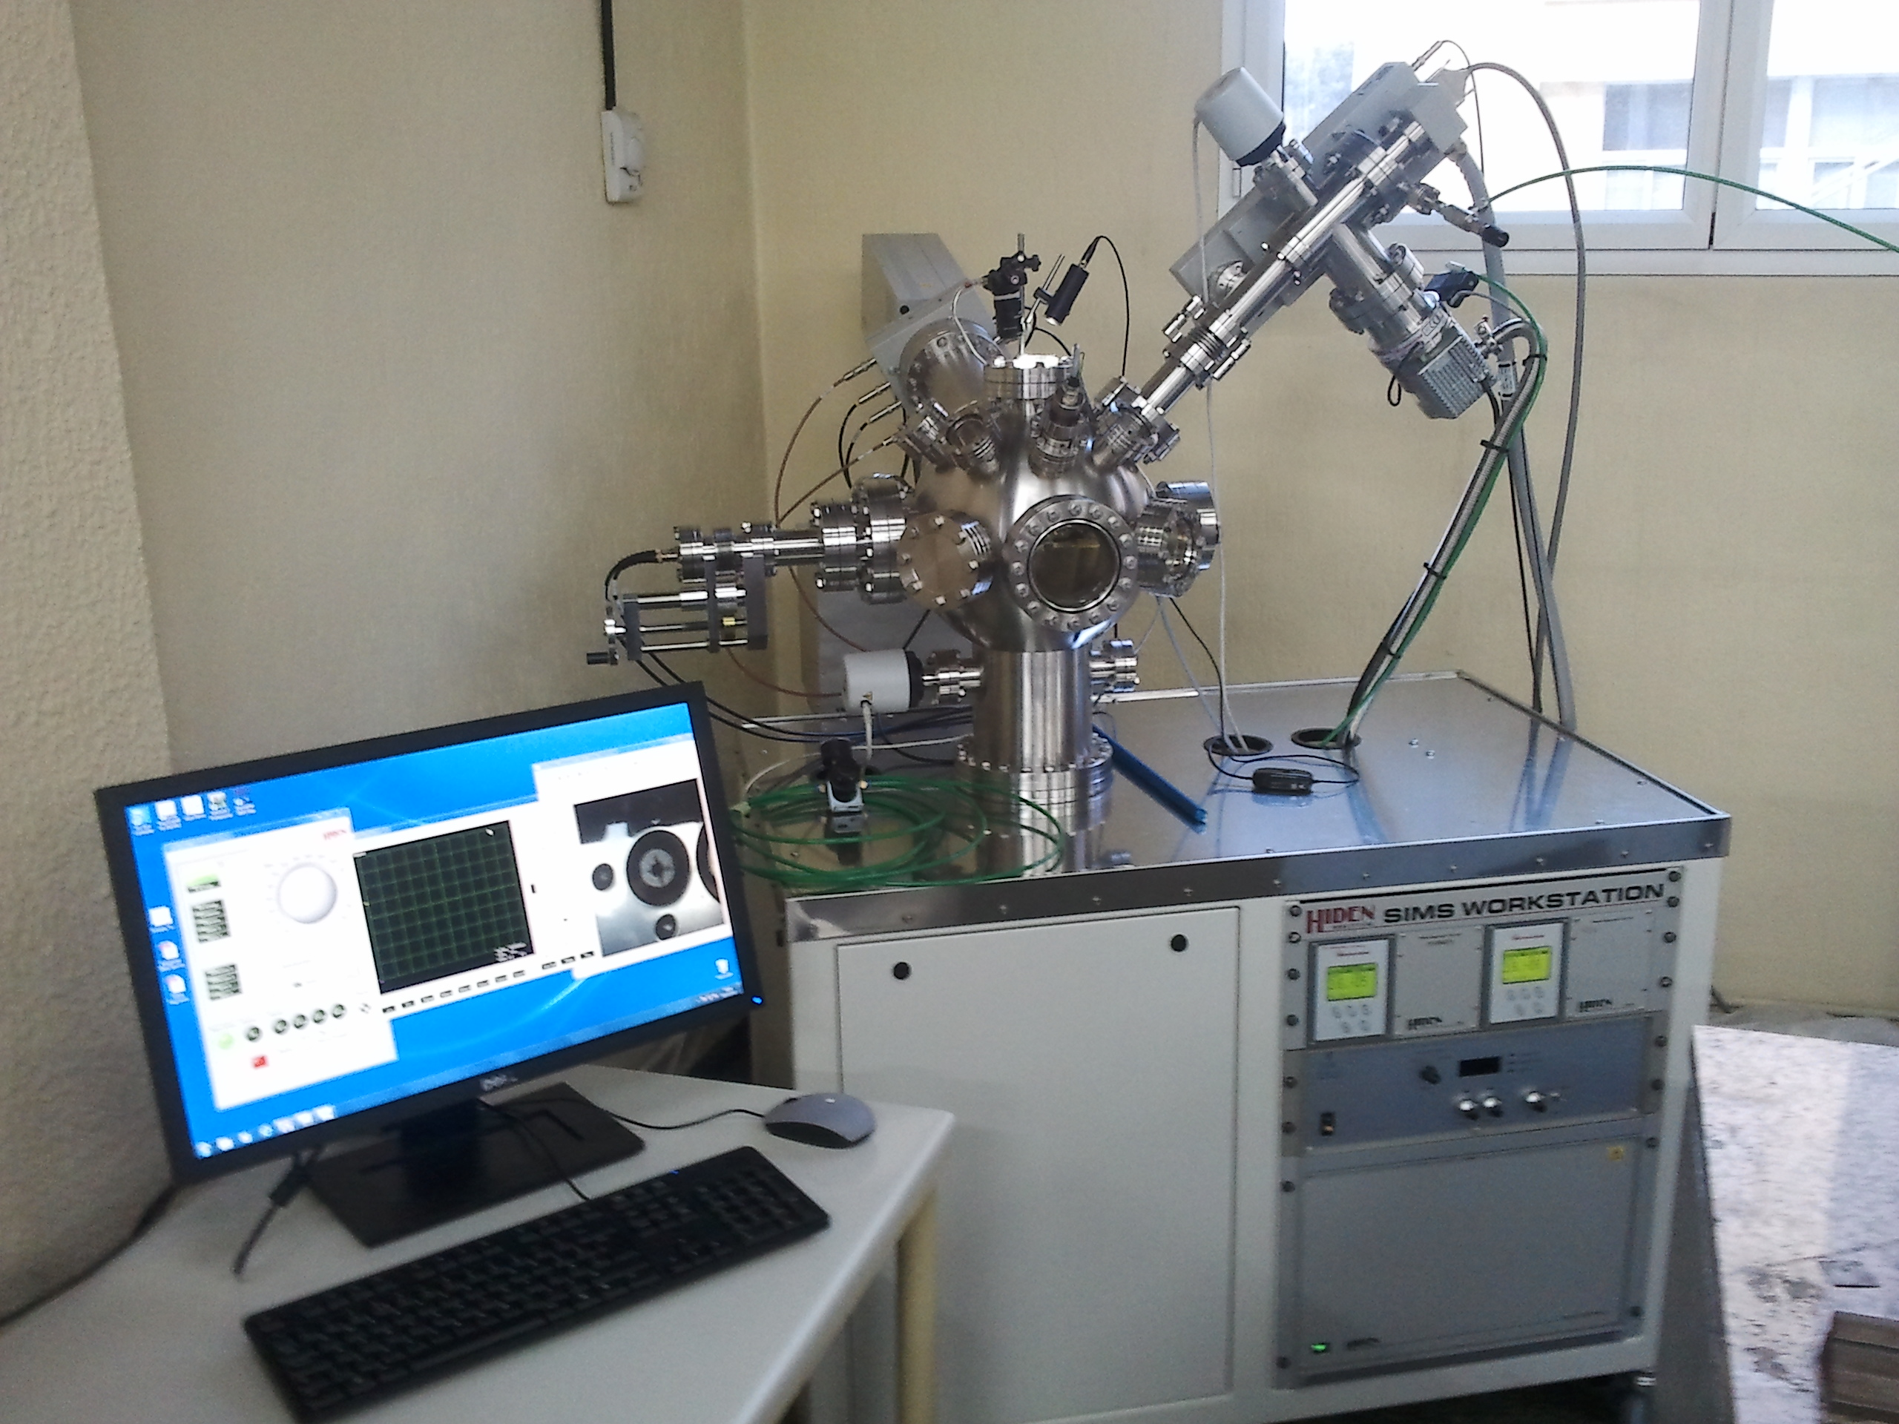
CIEMAT (Madrid, Spain) Testing Facilities (II)
Elemental depth profile analysis by using SIMS technique (secondary ion mass spectrometry)
HIDEN SIMS Workstation.
the depth monitoring of component species, impurities and dopants
6kV oxygen ion gun and LM Cs, as the primary ion sources.
Chamber vacuum pressure better than 5 10 ⁻⁸ mbars.
Quadrupole mass spectrometer.
Evolution of a mass signal as a function of time
JUST AN EXAMPLE !!
Not showing the breeder behaviour !!
HIDEN SIMS Workstation

Slide 18
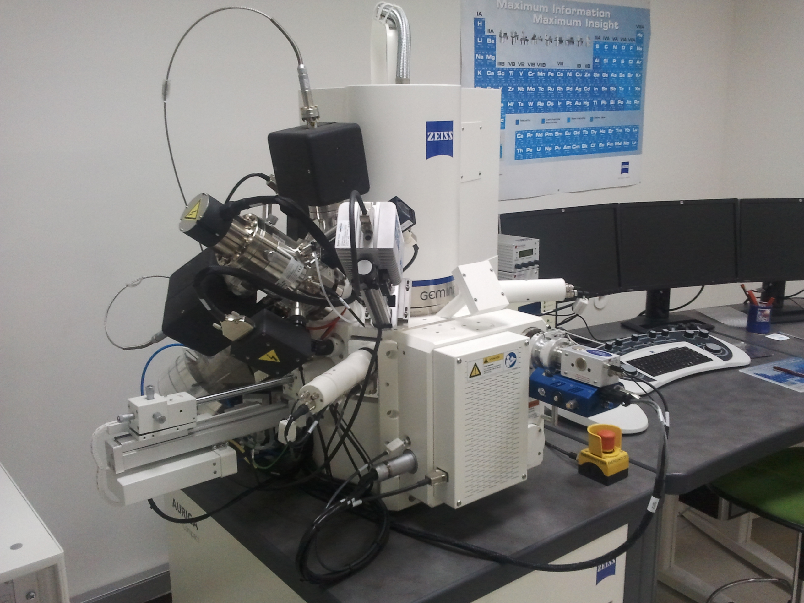
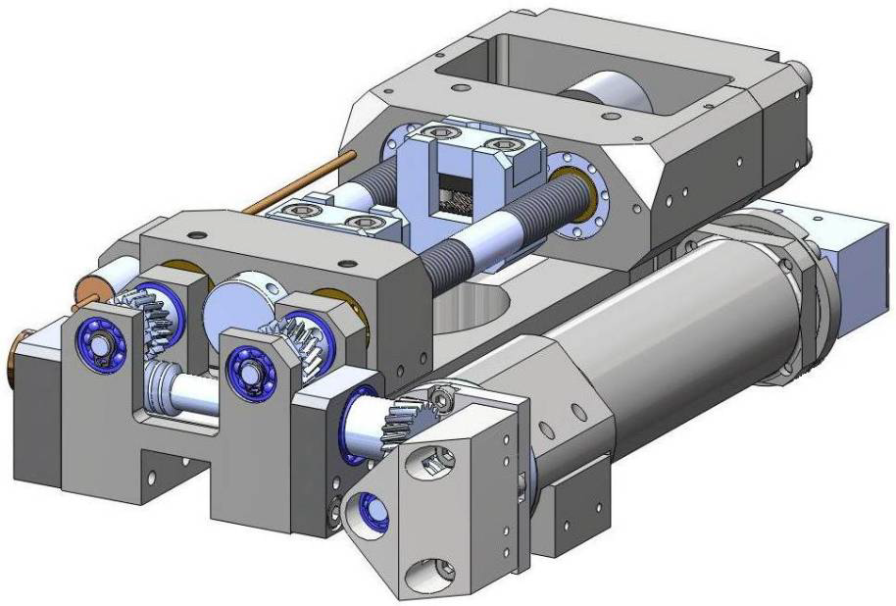
CIEMAT (Madrid, Spain) Testing Facilities (III)
Microscopy inspection by means of FESEM.
On FIB-polished cross-sections of about 10 x 10 x few mm
Focussing on material degradation.
Complete structural and compositional study due to EBSD and EDX detection, respectively.
FESEM + FIB Zeiss Auriga Compact
Microtensile/compression testing inside of the FESEM Zeiss Auriga.
Typical specimen size: 50 x 10 x 5 mm
Loads from 10kN to 10N; resolution 1N to 0,01N
Heating element up to 800C
Adaptation to EBSD

Slide 19
additionally, we offer our facilities and experience for characterizing
US-SiC

Slide 20
Thanks so much
for your attention
Dr. M. González

