Slide 1
Conceptual design of the CIEMAT LiPb loop
Iván Fernández
CIEMAT
2nd EU-US DCLL Workshop, University of California, Los Angeles, Nov. 14-15th, 2014

Slide 2
Summary
Objectives
Summary of the preliminary design
Main parameters
Basic layout
Main dimensions
Monitoring and control system
Electromagnetic pump
Flow meter
Glove box

Slide 3
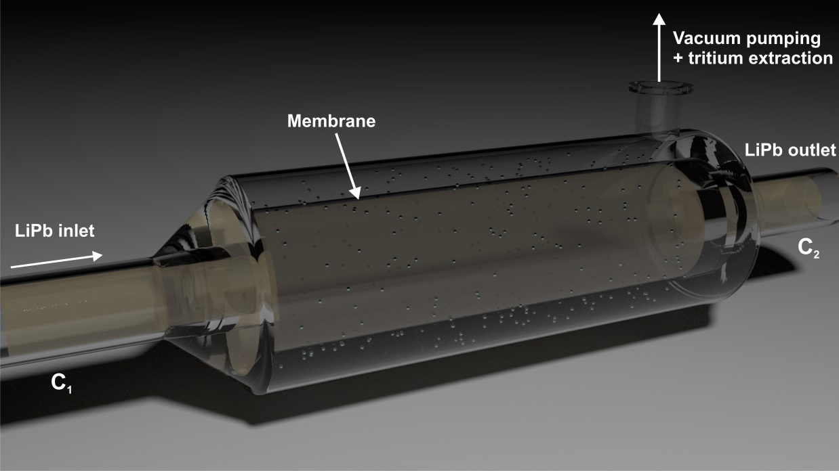
Objectives
Eurofusion WP5: Testing different permeator against vacuum (PAV) concepts under high velocity LiPb flows.
To evaluate hydrogen isotopes permeation in flowing LiPb at DEMO relevant conditions (temperature, velocity, partial pressure, etc.).
To carry out different tests in a range of such conditions.
To test different permeator design concepts or configurations for efficiency/reliability assessments.
To test different materials.

Slide 4
Summary of the preliminary design
Forced circulation loop.
Permanent magnet electromagnetic pump.
Modular design: increase in the number of sections as the different construction and LiPb management learning stages are being completed.
The circuit comprises two zones (double leg): cold leg and hot leg.
Lower operational requirements in terms of temperature.
Limitation of the corrosion issue.
The test sections are located in the hot leg.
Use of by-pass lines (hot section, test sections).
Electrical heating system and thermal insulation in the whole loop.

Slide 5
Summary of the preliminary design
The melting tank is also part of the liquid metal circuit.
Additional storage/emergency tank.
An internally cooled glove box is used for the filling/purification processes (an oxygen removal unit is included).
Pressurized argon is used to fill the melting tank and the glove box, before beginning the loop filling process.

Slide 6
Main parameters
LiPb volumen ~35 m³
Velocity ≤ 1 m/s (higher velocities can be reached)
Flow range: 0.2-4 l/s
Temperature ≤ 500ºC
Hydrogen/deuterium partial pressure <1 Pa
Vacuum pressure inside the permeator ~ 10⁻³ mbar

Slide 7
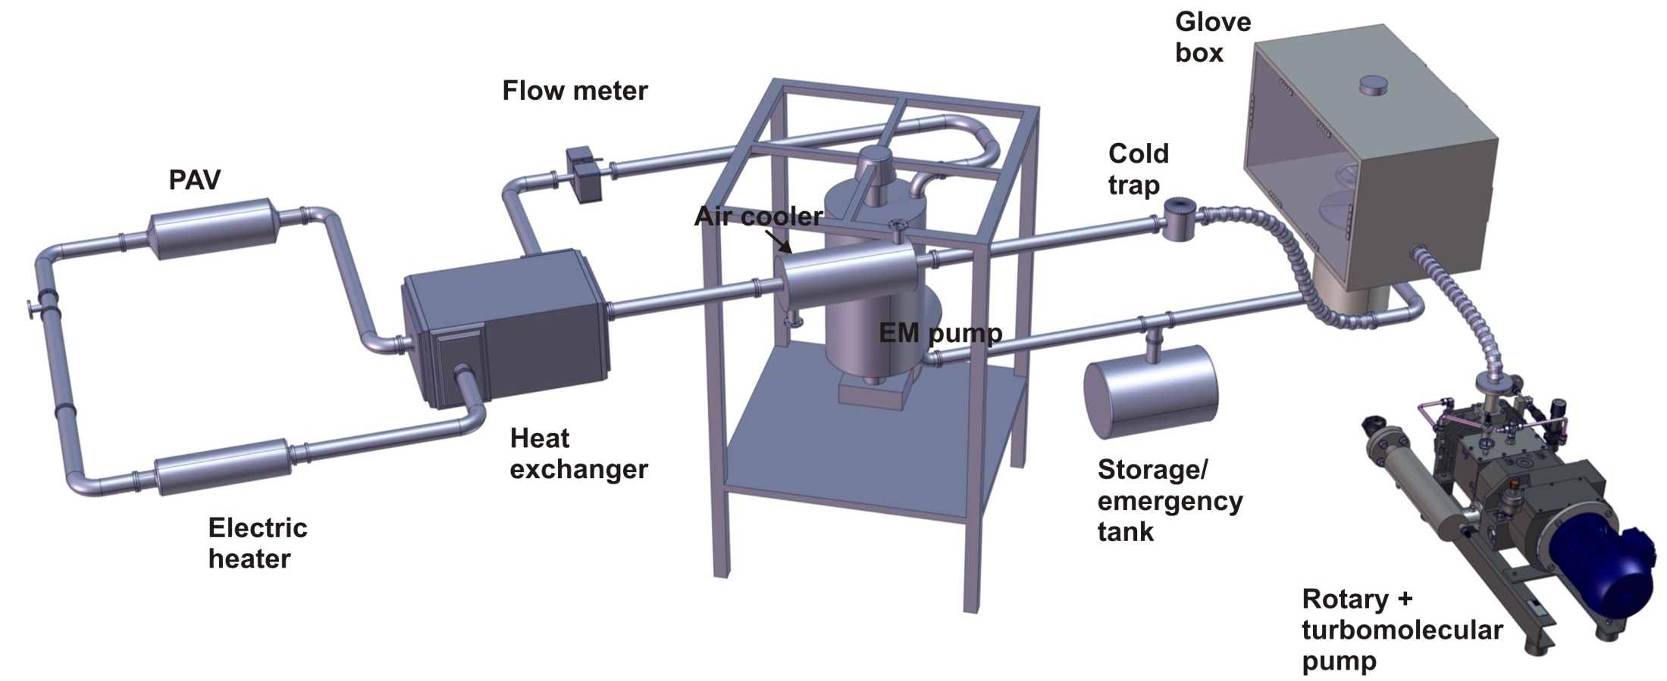
Basic layout

Slide 8
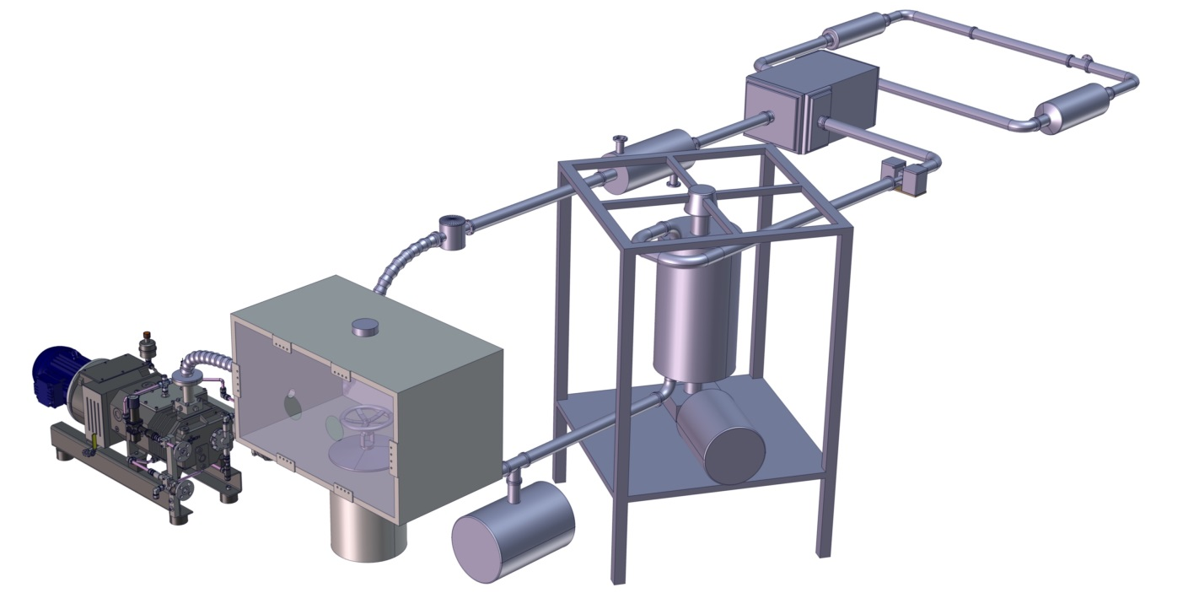
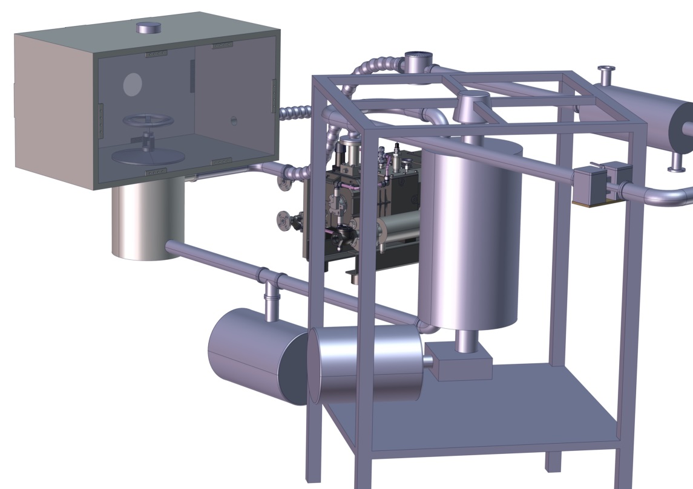
Basic layout

Slide 9
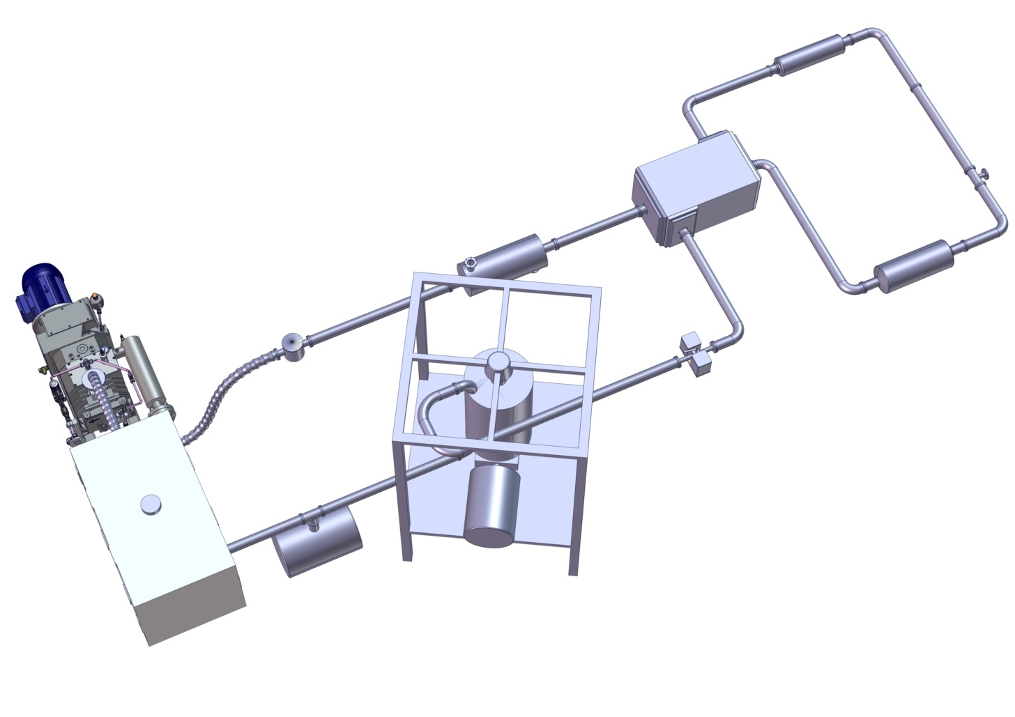
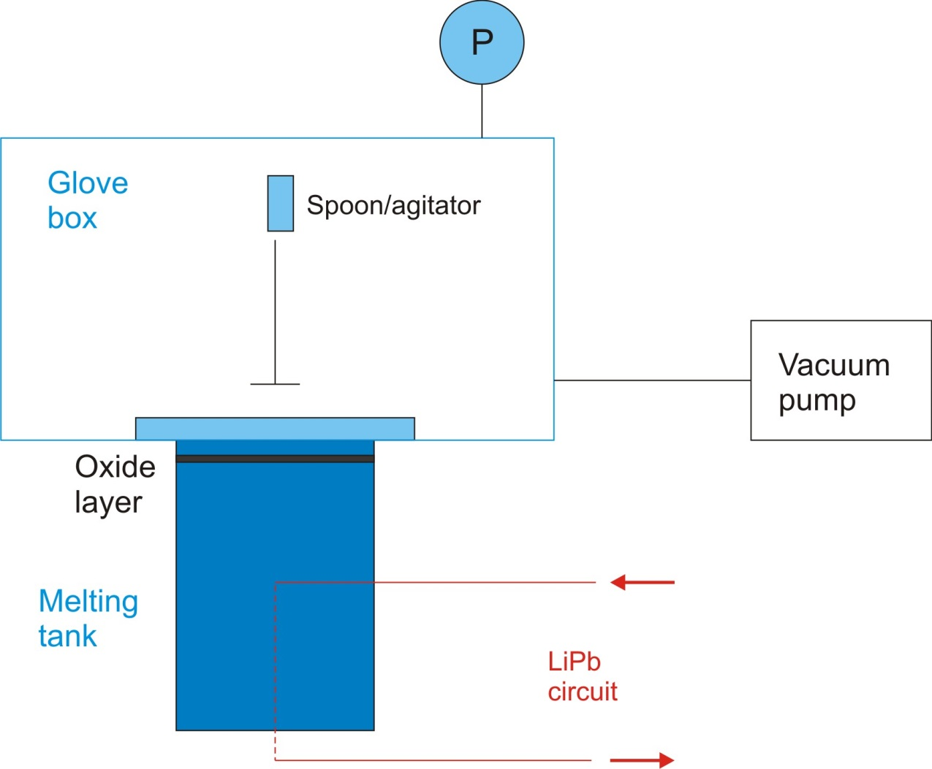
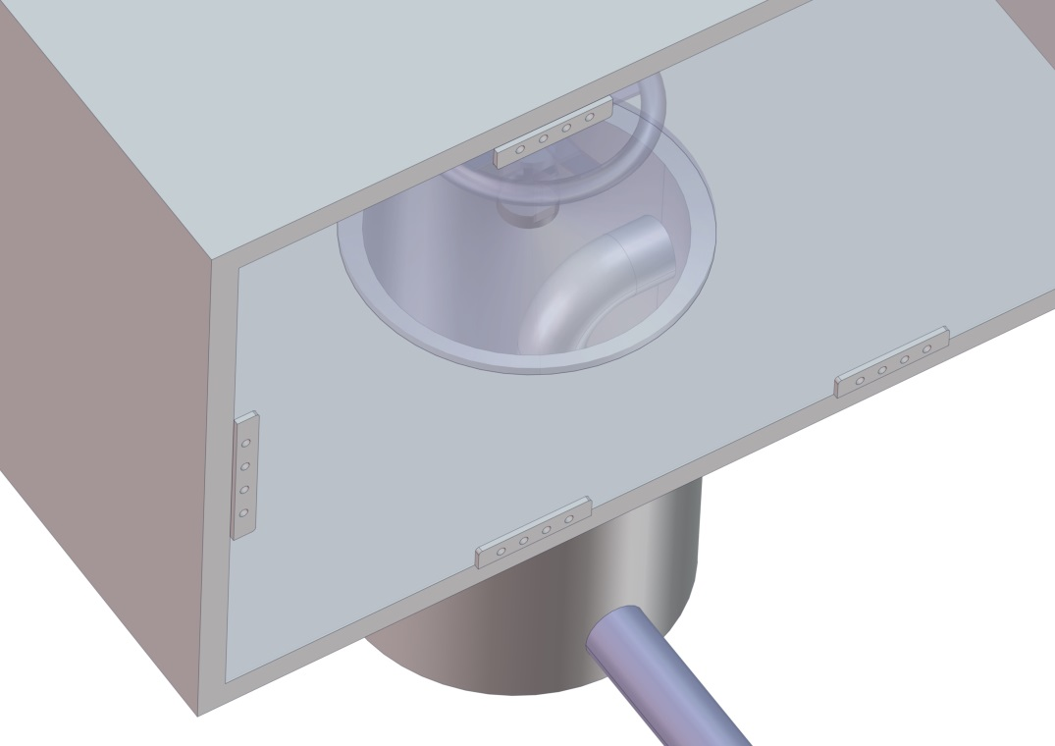
Basic layout

Slide 10
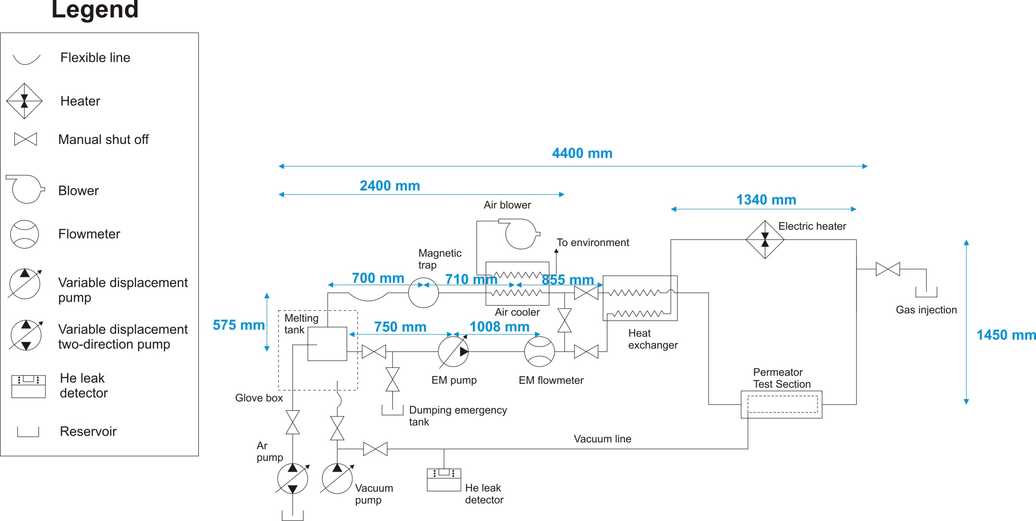
Main dimensions

Slide 11
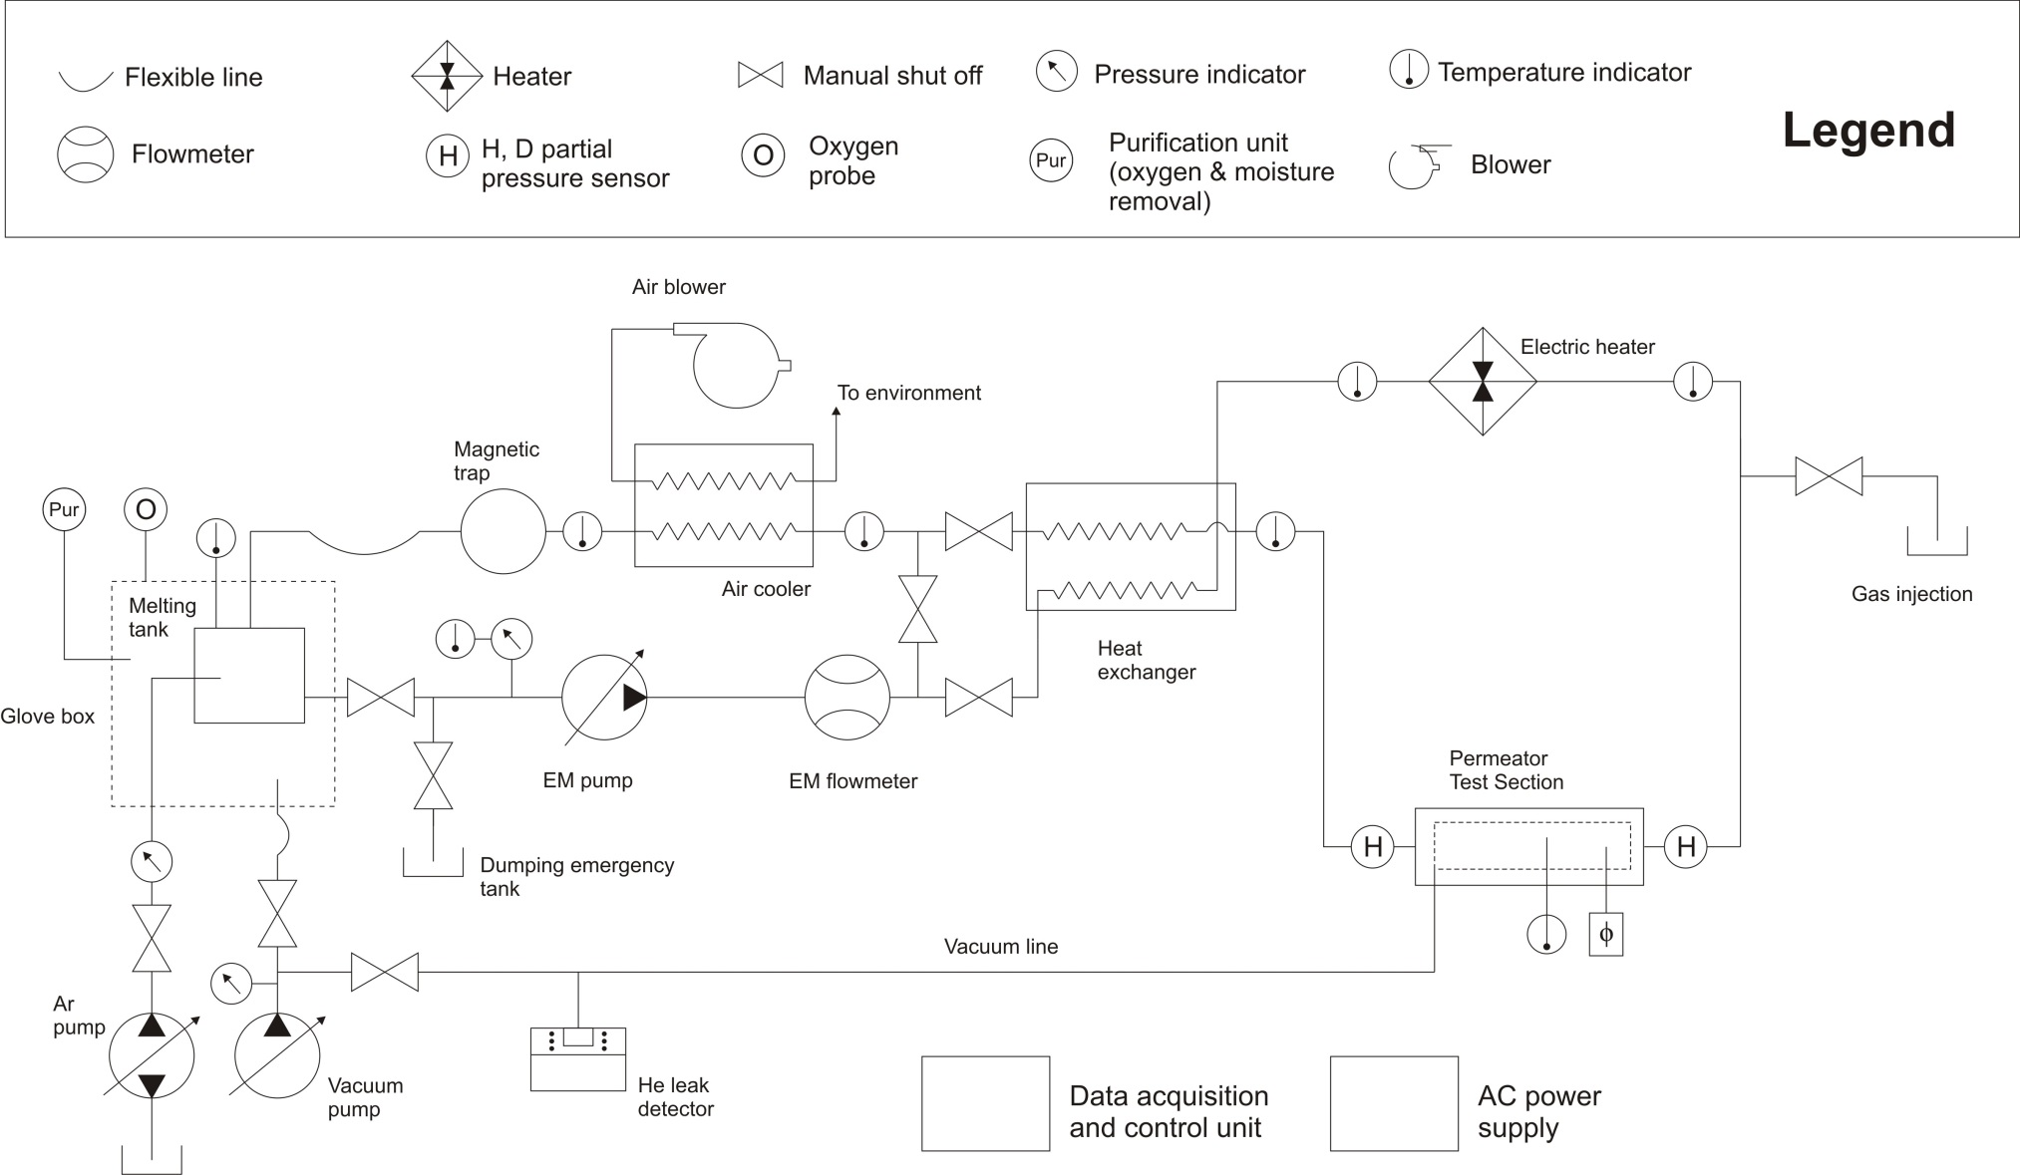
Monitoring and control system

Slide 12
Electromagnetic pump
The use of mechanical pumps for heavy liquid metals involves some problems related to the reliability of propellers and seals which must operate at elevated loads and under severe operational conditions (corrosion).
Electromagnetic induction pumps do not present these problems, but the manufacturing process (usually based on three-phase linear inductors) is complex and expensive, whereas the efficiency is quite low (specially for liquid metals with low electric conductivity).
Electromagnetic pumps based on rotating permanent magnets offer several advantages for this application:
No problems related to the reliability of propellers and seals.
Simpler construction.
Much higher efficiency.

Slide 13
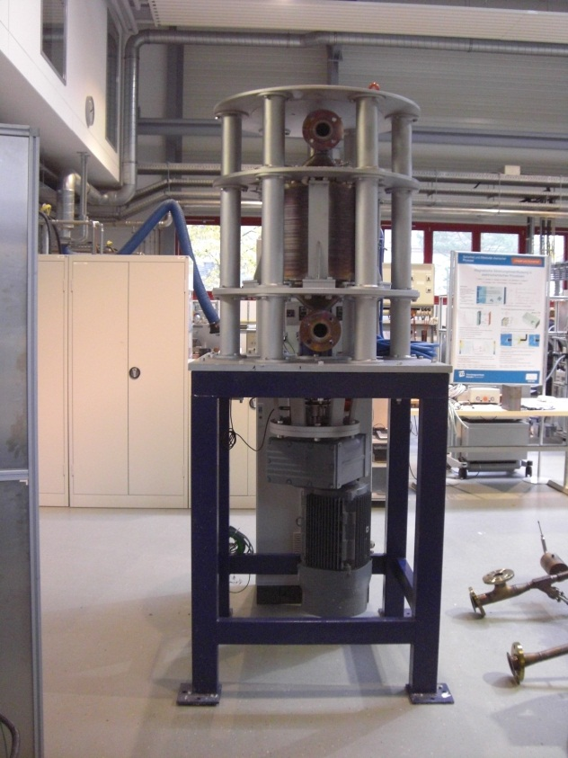
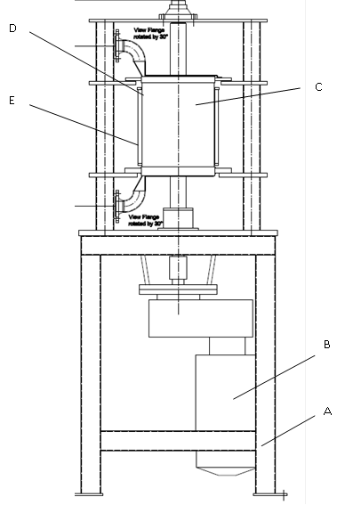
Electromagnetic pump
Permanent magnet electromagnetic pump.
Manufactured by SAAS.
Rotor type with separate supporting bearing and flexible coupling to the motor.
P_{elec}=18 kW
Diameter of rotor: 350 mm.
Temperature measurement: thermocouple type K.
Type of magnets: Sm2Co17
Channel material: Steel 1.4571.
Data control unit with frequency converter.

Slide 14
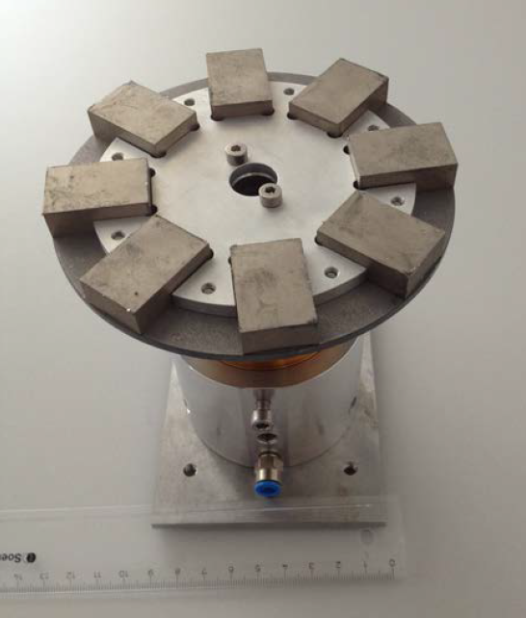
Flow meter
Flow meter EMD flywheel.
Manufactured by SAAS.
Measurement range < 2 m/s.
Slow response to transient regimes.
Diameter of disk: 120 mm.
Power supply: -
Pressed air supply: 3 bar (dry, filtered).
Rotating disk equipped with SmCo magnets.
Air lubricated precision bearing.
Speed sensor PNP.
Chanel material: SS 1.4571

Slide 15
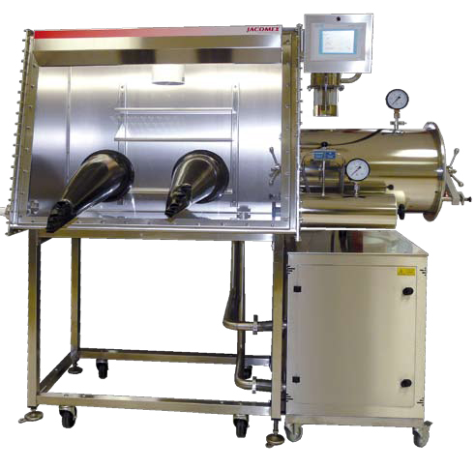
Glove box
GP concept – modular glove box with autonomous purification system.
Manufactured by Jacomex.
Vacuum antechamber.
User interface.
Automatic pressure control.
Purification unit: O₂ < 1 ppm.
Internal cooling system.

