Slide 1



Experimental data for tritium transport modeling
Iván Fernández
CIEMAT
2nd EU-US DCLL Workshop, University of California, Los Angeles, Nov. 14-15th, 2014

Slide 2


Summary
Permeation facility
Absorption-desorption facility
PCTPro-2000
Trapping facility
Experiments under irradiation
Characterization of coatings
Deuterium release on ceramics for solid breeder
Materials database

Slide 3

Characterization of hydrogen isotopes transport properties
CIEMAT facilities installed in the University of the Basque Country to determine:
  Diffusivity.
  Solubility.
  Permeability.
  Surface constants (dissociation and recombination).
  Trapping.

Slide 4
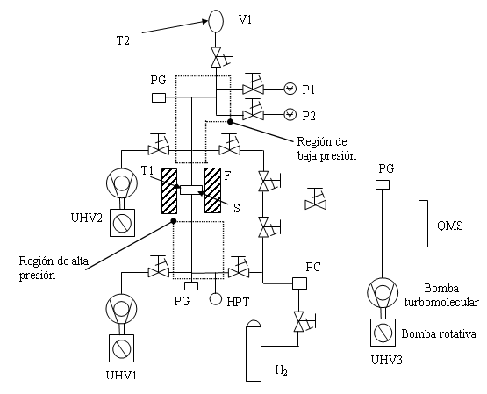
Permeation facility
Permeation column
Layout of the facility
The permeation flux under diffusive regime for each temperature depends on:
  sample thickness,
  load pressure and
  gas permeability (φ)

Slide 5
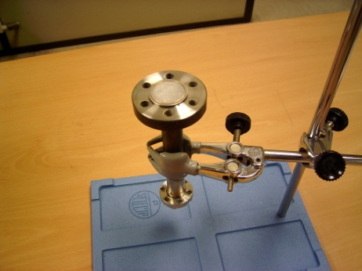
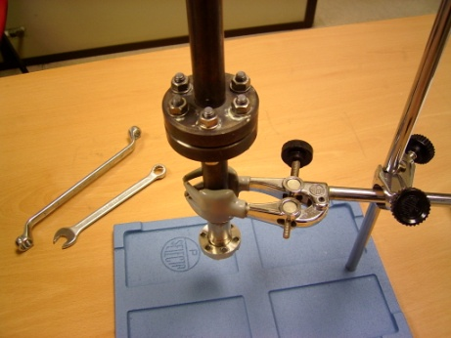
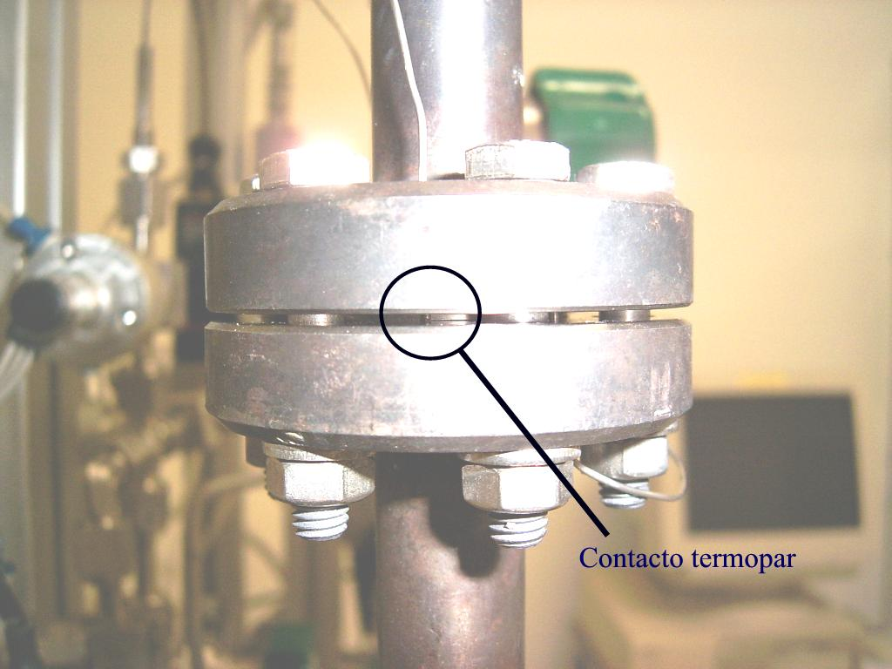
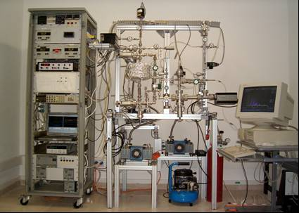
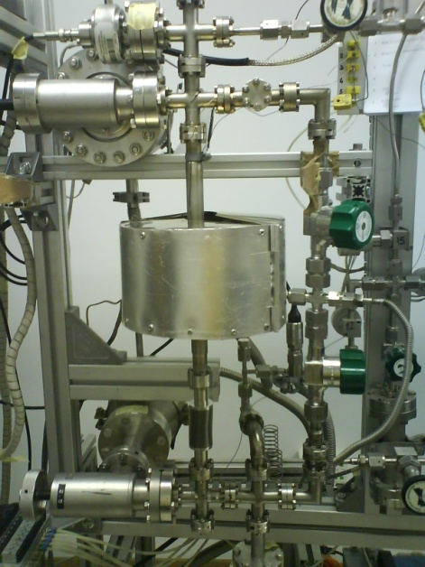
Permeation facility

Slide 6
Permeation experiments data
Pressure increment due to permeation
Gas flux under steady-state regime (J) due to Δp through a membrane with thickness d → Richardson’s law:
Dependence of permeability, diffusivity and solubility on T (Arrhenius eq.):

Slide 7
Absorption-desorption facility
T1
Quartz nose
F
T2
Crucible and sample
P1
P2
BAG
QMS
LV1
Gs2
V2
T3
V1
LV2
G1
P4
Air compressor
Turbomolecular
pump
Filter
Turbomolecular
pump
UHV1
UHV2
Primary rotatory
pump
Primary rotatory
pump
H₂ ,D₂ supply
BAG Bayard-Alpert sensor P1,2 Capacitive manometers (Baratron) UHV Ultra high vacuum pumping unit
F Furnace G1 Electro-pneumatic gate valve G2 Manual gate valve
QMS Quadrupole mass spectrometer P4 High pressure transducer T1,2 Thermocouples
T3 Pt resistance thermometer LV1,2 Manual valves V1 Experimental chamber
V2 Volume of expansion

Slide 8
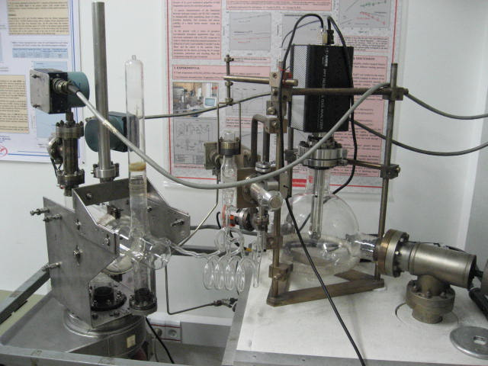
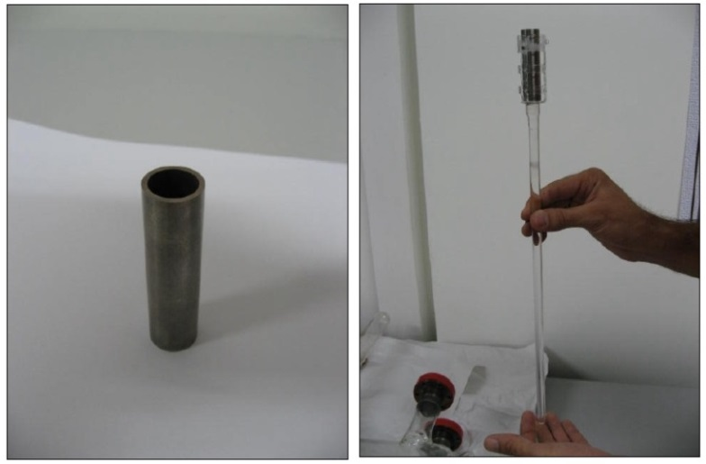
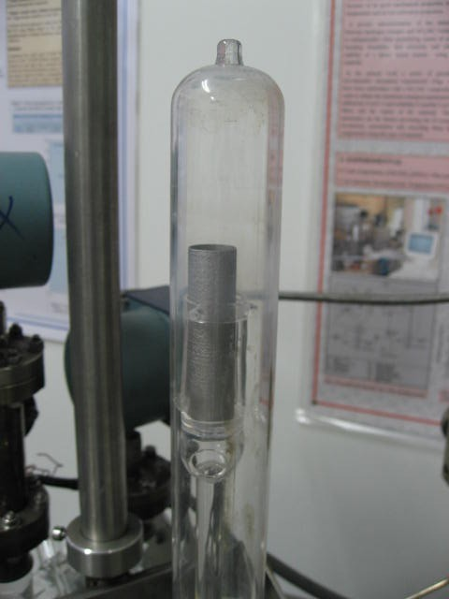
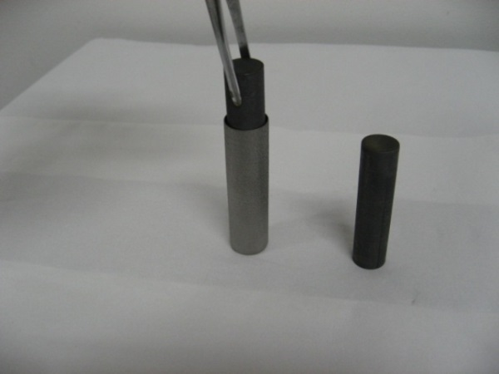
Absorption-desorption facility

Slide 9
Absorption-desorption experiments data
p(t)
Absortion
Pumping
Desorption
x
H₂
p_{l}
c₀
x = a
(H)
p_{f}
Tungsten crucible
PbLi
x = 0
c(x)
t
t_{l}
t_{p}
t_{r}
Absorption
Desorption

Slide 10
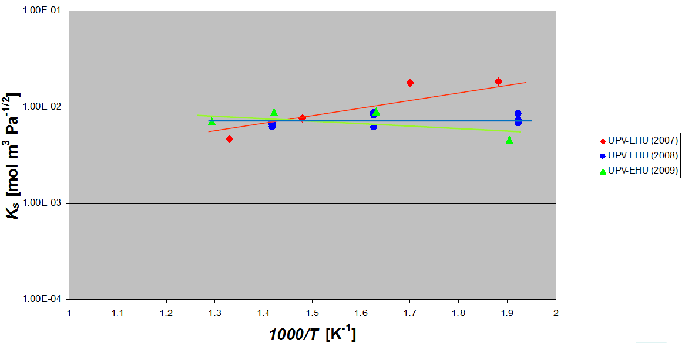
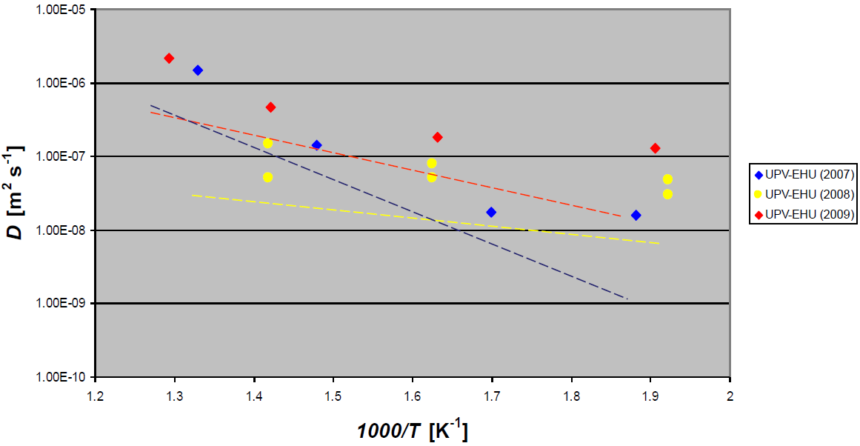
H solubility and diffusivity in Li15.7Pb

Slide 11
Examples of ongoing activities
F4E-FPA-372 (R&D experimental activities in support of the conceptual design of the European Test Blanket System).
  Determination of H and D recombination and dissociation constants in Eurofer and SS-316L (permeation facility).
  Experiments on H and D absorption-desorption in Zr-Co getters.

Slide 12
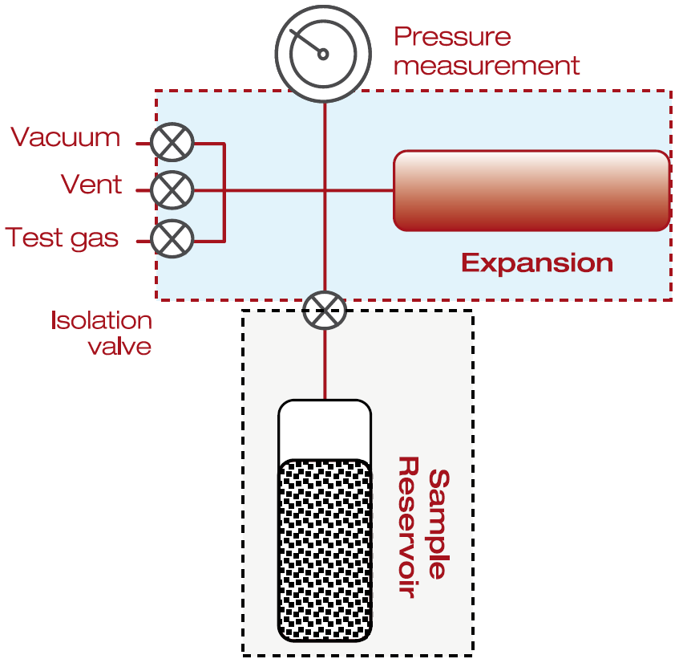
PCTPro-2000
Fully automatic equipment with wide ranges of temperature, pressure and sample size.
Based on the Sieverts’ method: a sample at known pressure and volume is connected to a reservoir of known volume and pressure through an isolation valve.
Opening the isolation valve allows new equilibrium to be established.
Gas sorption is determined by difference in actual measured pressure (Pf) versus calculated pressure (Pc).
Temperature range | -260ºC to 500ºC with a range of simple holders options
Calibrated reservoirs | 5 high pressure calibrated volumes
Operating pressure range | From vacuum to 200 bar Pressure regulation: automated PID software controlled Aliquot sizing ~Fixed P, Δp or f(Δp)
Pressure measurements | 4 pressure transducers Pressure regulation: 2 transducers for vacuum to 200 bar Experiment pressure: 1 transducer for vacuum to 200 bar
Maximum sensitivity | 3 μg H2 equivalent to 0.3 wt% for 1 mg of sample (with the MicroDoser sample holder)

Slide 13
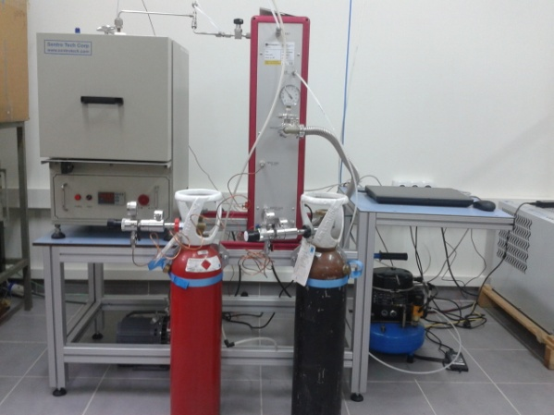

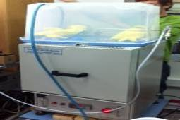
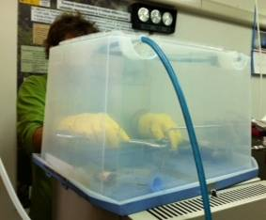
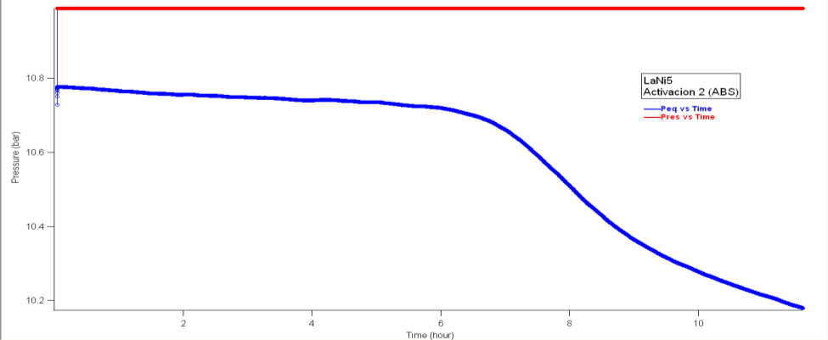
PCTPro-2000
The facility has been calibrated using a sample of LaNi₅: PCT curves at different temperatures.
A new design of the reactor has been implemented and a glove box has been manufactured (samples handling).
Manual
valve
PCTPro-2000
Glass-quartz
p_{MAX}=2 bar
SS-304
p_{MAX}=15 [kg/cm²]
User
interface
Furnace
1200ºC
P=2 kW
Hydrogen
Helium
A new design of the reactor has been implemented and a glove box has been manufactured (samples handling).
Technical problems for a long time, but the facility is operational again.

Slide 14
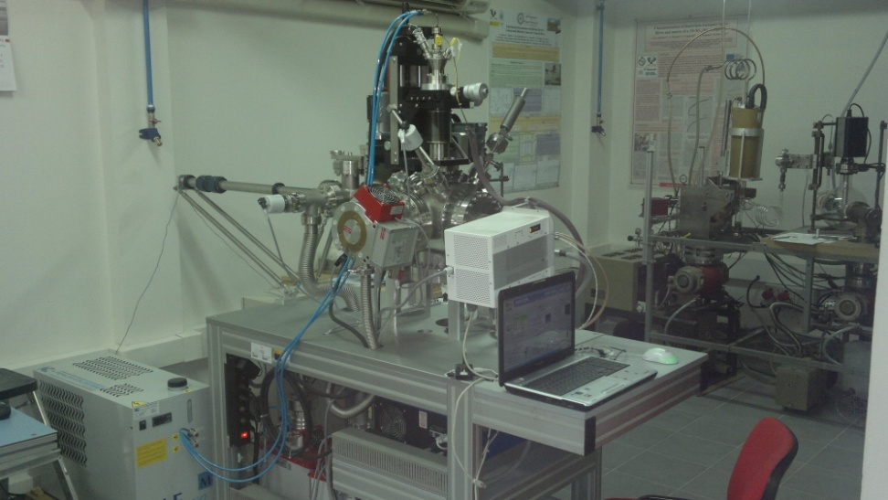
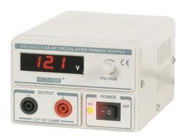
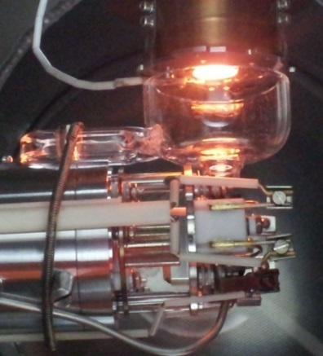

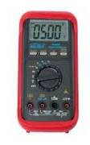
Hydrogen trapping by helium in materials
Thermal desorption spectrometry.
Helium implanting + D electrolytic loading by applying cathode over-potentials → thermal desorption and mass spectrometry analysis (He and D).
Deuterium loading
ANODE
(Pt wire)
Dissociation
2D₂SO₄ 4D⁺ + 2SO₄⁼
1N D₂SO₄ in D₂O
0.25 g/l NaAsO₂
Anode reaction
2SO₄⁼ 2SO₄ + 4e⁻
2SO₄ + 2D₂O 2D₂SO₄ + O₂
CATHODE
(sample)
Cathode reaction
4D⁺ + 4e⁻ 2D₂

Slide 15
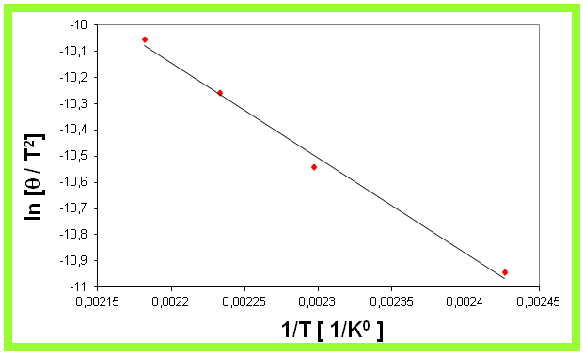
Thermal desorption spectrometry
Deuterium evolution
(D-atoms/(g-alloy*sec))
(Lee & Lee, 1986)
Type of trap | Binding energy (eV)
Interstitial | 0.03 - 0.10
Dislocations | 0.25 - 0.31
Vacancies | 0.40 - 0.50
Cluster | 0.60 - 0.70
Inclusion | 0.90 - 1.00
0.3 eV

Slide 16
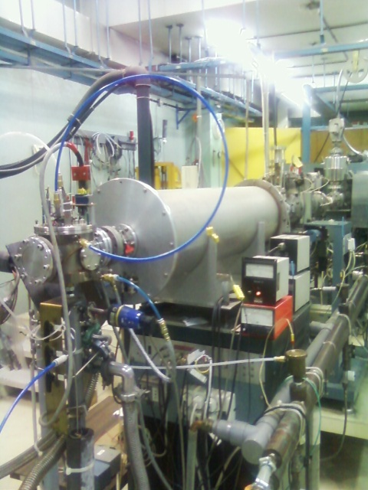
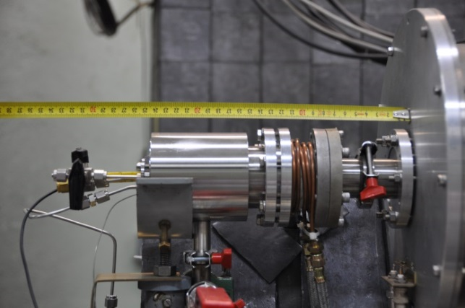
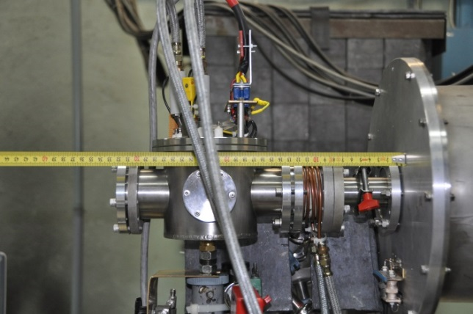
Experiments under irradiation in CIEMAT
1.8 MeV Van de Graaff accelerator.
  Beam: electrons, 0.25 to 1.8 MeV, 10 pA to 150 µA
  Samples from ≈ 3 mm² to about 20x20 cm²
  For insulator work typical dpa rates range from about 10⁻¹² to 10⁻⁸ dpa/s and ionization rates (Bremsstrahlung or direct electron irradiation) from 0 to ~10⁴ Gy/s
  10⁻³ dpa/day for steels in volumes of approximately 3x3x1 mm³.
Irradiation chamber and accelerator
Radiation enhanced permeation chamber
Radiation enhanced desorption chamber

Slide 17
Experiments under irradiation in CIEMAT
BA activities: radiation enhanced D/He absorption and desorption in ceramics.
  Radiation enhanced diffusion and redistribution of helium in LiNbO₃.
  Radiation enhanced deuterium absorption in different oxides (SiO, MACOR, Al₂O₃).
  Radiation enhanced deuterium absorption in SiC.
As a consequence of irradiation the absorbed deuterium is stabilized in deeper traps increasing the temperature for desorption

Slide 18
Experiments under irradiation in CIEMAT
Deuterium absorption for RB-SiC is very low, but noticeable absorption occurs when both material and deuterium gas are subjected to a radiation field increasing linearly with irradiation dose.
The main desorption T for implanted D is higher than 800ºC

Slide 19
Sôret effect experiment
Thermal gradient is a driving force for tritium permeation across plates in diffusion-limited regimes (Ludwig-Sôret or thermo-transport effect).
It has been considered as relevant for FW tritium balances correcting permeation by factors of ~40% of the permeation flux.
Values of heat of thermo-transport are unavailable in literature. They are expected to be negative (as in the case of alpha iron) → possible reduction of permeation across Eurofer walls.
New basic transport data for H/D in Eurofer will be generated.
Expected isotopic differences can be compared and isotopic thermal-migration values extrapolated for tritium.

Slide 20
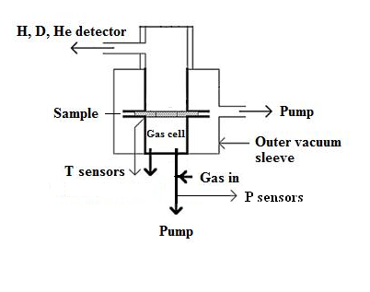
Experimental rig
Test chamber divided into 2 smaller chambers: pressurized gas chamber and vacuum chamber. Test sample (membrane) located between the gas cell containing H₂ or D₂ at a controlled pressure and the coupling to the gas detector.
Annealed cooper rings.
Thermal gradient between the sample surfaces achieved by an oven in thermal contact with one face and water cooling on the other face.

Slide 21
Experimental rig
Measurements in SS 316L and Eurofer.
T range: 300-550ºC; H₂/D₂ partial pressure range: 0.1-1000 Pa.
Diffusion measurements: use of a Pfeiffer Smart Test commercial gas leak detector with sensitivities of ≥10⁻⁸, 10⁻¹⁰, and 10⁻¹² mbar l/s for the three mass selection possibilities: 2 (2D or 1H₂), 3 (³He or 1H₂D), or 4 (⁴He or 2D₂) respectively and a detection limit of ~1·10⁻¹².
The experimental system can be used as an independent unit that may be set up in different locations or can be integrated in the beam line of the CIEMAT Van de Graaff electron accelerator, allowing thermo-diffusion measurements to be performed under irradiation conditions if considered pertinent.

Slide 22
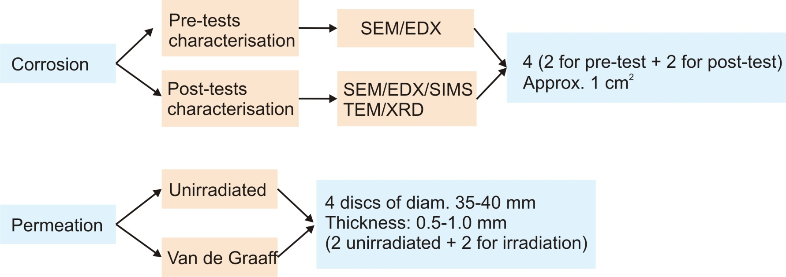
Characterisation of coatings as corrosion & permeation barriers
Eurofusion WP5.3.1, WP5.3.2.
Al₂O₃ coatings produced by Pulsed Laser Deposition and ECX.
Schedule 2014-2015:
  Permeation chamber modification to perform initial measurements during irradiation at temperatures up to 250 C by the end of 2014.
  A new permeation chamber to increase sample temperature will be fabricated in parallel (during 2015).
  Perform permeation experiments under irradiation.

Slide 23

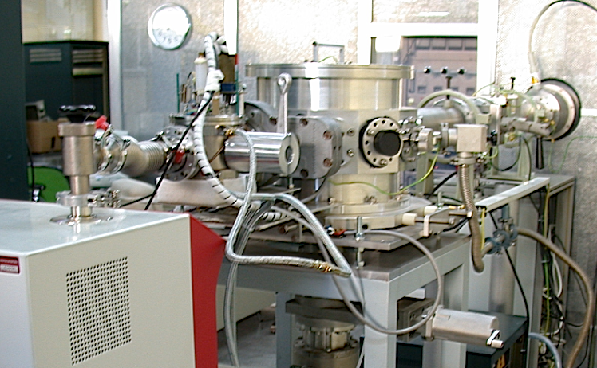
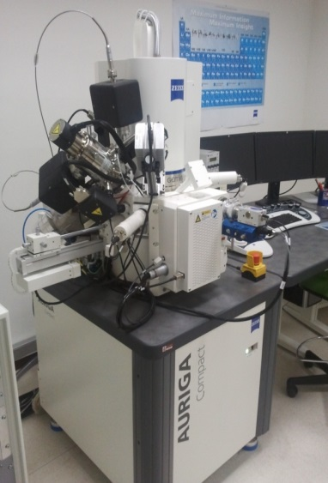
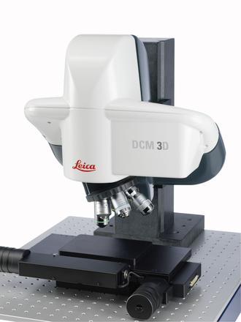
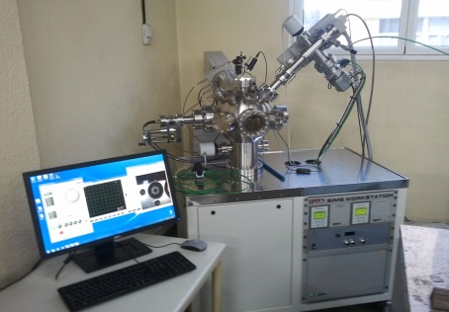
Characterisation of coatings as corrosion & permeation barriers
2 MeV Electron Van de Graaff accelerator
60 keV DANFYSIK ion implanter
SIMS
Optical/Confocal
microscopy
Dual Beam Microscopy
(FIB/SEM)

Slide 24
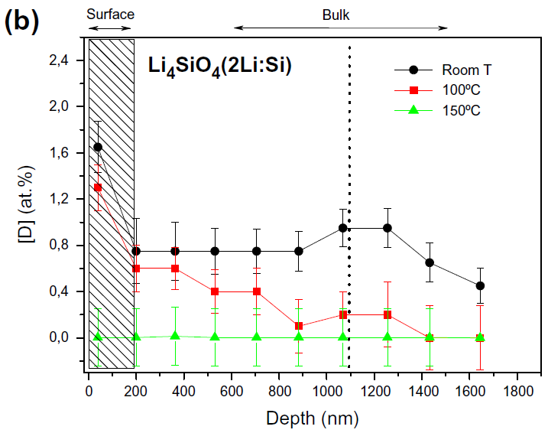
Implanted deuterium release in ceramics
Study of the D depth distribution and thermal release in three different candidates as solid breeder: Li₄SiO₄, Li₂TiO₃ and a third one with a higher Li:Si proportion (3:1).
RNRA technique.
Relevant correlations with the ceramic microstructural and morphological features (porosity, pore size distribution and grain size) have been found.
Annealing at T=100ºC promotes D release; for T≥150ºC the whole D is released.
D atomic concentration is significantly higher at the surface than in the bulk → surface play an important role in the D release.
Comparison of D release data for samples with high porosity & low grain boundary density and samples with low porosity & high grain boundary density → grain boundary might be an alternative path to pores for D diffusion.

Slide 25
Fusion materials database
The creation of a wide materials database for fusion technology was suggested several years ago (e.g. Lead–lithium eutectic material database for nuclear fusion technology, E. Mas de les Valls et al., Journal of Nuclear Materials 376 (2008) 353–357).
Following this idea, a shared and agreed materials database for tritium transport modeling as a computer expert system should be promoted.
Needed for future qualification and licensing of components and systems.
Chemical interactions data should be included.
Possible proposal for the next IEA meeting?

