Slide 1

EU DEMO Project
Gianfranco Federici and the PPPT Team
Power Plant Physics and Technology

Slide 2
Outline
Background/ Context
Design approach
Preliminary design choices
Main Design and R&D Priorities, e.g.:
  Power exhaust / divertor
  Tritium breeding / power extraction blanket
  Remote Maintenance
PPPT Implementation
Conclusions

Slide 3
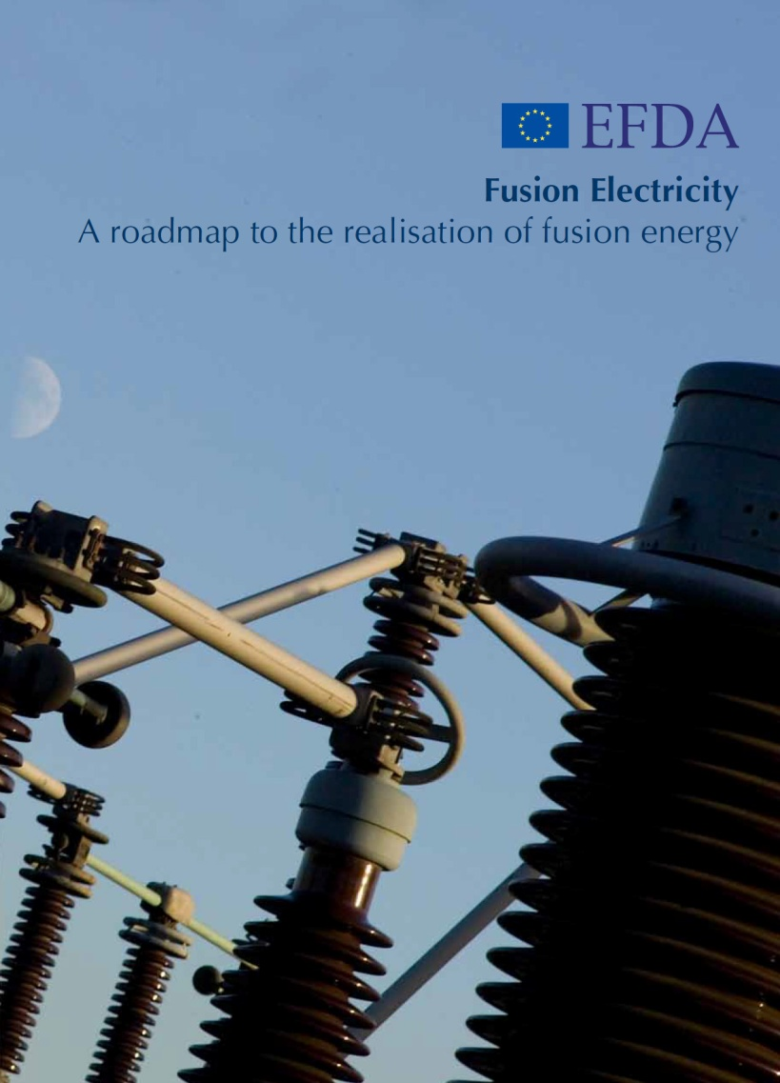
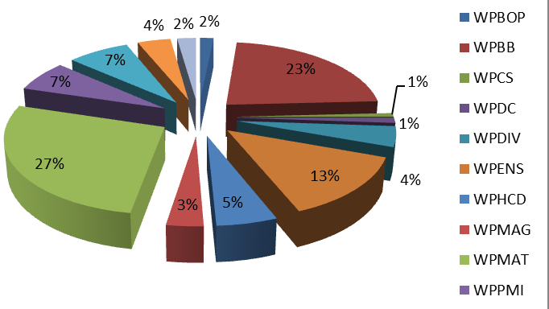
A roadmap to the realisation of fusion energy
  8 Strategic missions to address challenges in two main areas:
ITER Physics
  Risk mitigation for ITER
  JET, Medium Size Tokamaks, PFC devices
DEMO Design
  Conceptual design studies
  A single step to commercial fusion power plants
  Production of electricity with a closed fuel cycle
Back-up strategy
  Stellarator
Three periods (ITER on critical path/ schedule uncertainties)
2014 – 2020 (Building ITER & support experiments + DEMO CDA)
2021 – 2030 (Exploiting ITER and DEMO EDA)
2031 – 2050 (Building and Exploiting DEMO)
Important to increase the involvement of industry
PPPT Projects (total ~110 M€) 2014-18
EC contribution (~55%)

Slide 4
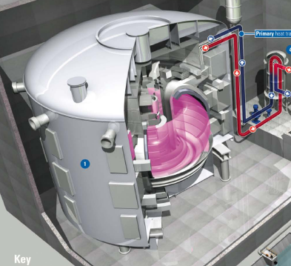
Outstanding technical challenges with potentially large gaps beyond ITER
Still a divergence of opinions on how to bridge the gaps to fusion power plants
Most of the issues are common to any next major facility after ITER
  ITER will show scientific/engineering feasibility:
  Plasma (Confinement/Burn, CD/Steady State, Disruption control, edge control)
  Plasma Support Systems (LTSC magnets, fuelling, H&CD systems)
  Most components inside the ITER VV are not DEMO relevant, e.g., materials, design. TBM provides important information, but limited scope.
DEMO Issues/gaps
T breeding blanket technology (M4)
Divertor design configuration and technology (M2 & M6)
Safety and licensing (M5)
  Plant design integration incl. BoP (M6)
  Remote maintenance and plant availability (M6)
  Operating plasma scenario and control and efficient CD systems (M1)
For any further step, safety, power exhaust, breeding, RH and plant availability are important design driver and CANNOT be compromised

Slide 5
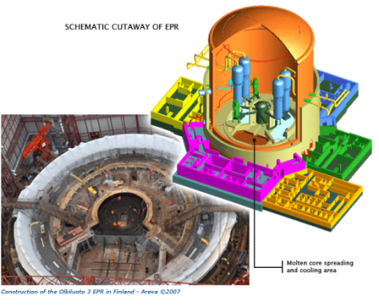
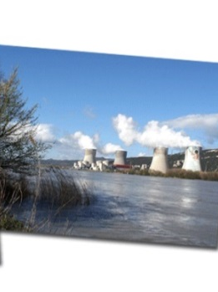
Advanced Reactor Designs
Development Paradigm: Fission Power Plants
Safe Operation
T Self Sufficiency
Availability
Power Handling
Cost
Thermal Efficiency
Electrical Output
 = KPI Partially Met (DEMO 1)
= Tech advancement needed to reach KPI targets (DEMO 1)
= Further Tech advance to fully reach KPI target (DEMO 2)
 = KPI Fully Met
Increasing Expected Performance
Short Pulse…………………………….………………..Pulse Length………………………………..………………Steady State
Ceramic / LiPb Breeder / Eurofer…..…………..Blanket Technology……………………….…….LiPb / SiC/ DCLL
EUROFER <550C…………………………Max Temp. Structural Materials …………ODS RAFM/ HT FM> 600C
Conventional…..……………………………..…………..Divertor Configuration………………………Advanced Novel
LTSC Coils…………………………………….…….Magnet Technology….……………………………..HTSC with Joints







ITER
(low availability)

Costs of Development
(prior to commercial deployment)
Decreasing Technology Readiness
Departure from Existing Designs (=ITER)
Evolutionary designs, GEN III
Innovative designs,
i.e., design requiring substantial developments, GEN IV
Substantial R&D
Prototype and/or DEMO plant
+
Confirmatory testing
+
Engineering
Evolution thanks mainly to advances in safety, materials and technology (+ strong involvement of industry from beginning
Confirmation testing+ Engineering
Existing operating plants (high availability)
Departure from Existing Designs

Slide 6
Basic Concept Design Approach
Design integration essential from the early stage to identify requirements for technology R&D
A systems engineering approach is needed to identify design trade-offs and constraints; and prioritize R&D
Ensuring that R&D is focussed on resolving critical uncertainties in a timely manner and that learning from R&D is used to responsively adapt the technology strategy is crucial.
Define Requirements
Refine Design
Develop Design
Conduct R&D
Evaluate Design Performance
Decision Point:
develop further?
Clear assessment methodology needed e.g., by assigning a TRL and updating TRL as R&D tasks are completed
Involvement of industry is highly desirable
Lessons learned from the pas

Slide 7
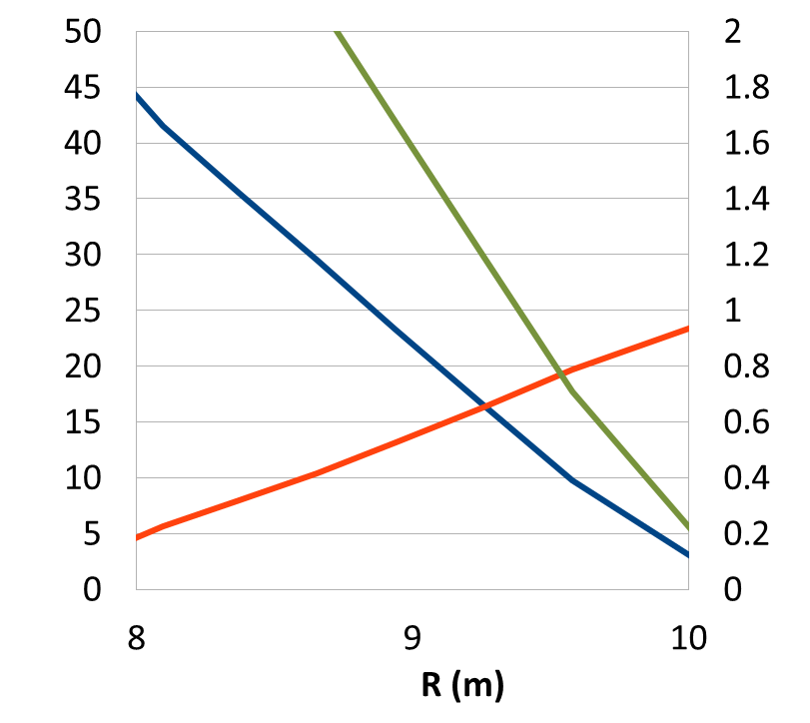
Readiness of assumptions
Operational point (in terms of Beta N, q₉₅, n/n_{GW}, and H) should lie within the existing database of tokamak discharges that have run for at least several current redistribution times, implying that we also know how to control these scenarios.
Credible and sufficient power exhaust protection.
Adequate breeding coverage area.
PROCESS:
Fix P_{el,net}, τ_{pulse}
Scan Z_{eff}
Divertor heat load and H-mode limits as a machine size driver
P_{sep}/P_{LH}
Power transported by electrons and ions across separatrix:
  P_{sep}=P_{α}+P_{add}-P_{rad,core}
Material Limit Condition for divertor :
  P_{sep}/R≤20MW/m ⇒ P_{sep,max}∼R
Boundary condition to access and stay in H-mode (P_{LH}∼R):
  P_{sep} ≥ P_{LH} ⇒ P_{sep,min}∼R
P_{sep}/R
P_{rad,core}/P_{rad,tot}
R. Kemp (CCFE)

Slide 8
EU DEMO design point studies
  Systems Code PROCESS to develop self-consistent design points.
      Rather than focusing solely on developing the details of a single design point keep some flexibility at the beginning
      Reasonable readiness of physics and technology assumptions
      Identify key driver and constraints (e.g., divertor protection, vertical stability)
      Sensitivity to design assumptions and impact of uncertainties [R. Kemp, IAEA/ FEC 2014 St. Petersburg] (e.g., Pulsed vs steady-state, A=R/a, TF Ripples, Divertor Protection)
  Iterate between the Systems Code and more detailed analysis such as integrated scenario modelling with transport codes (refine design space)
      Preliminary plasma scenario modelling [G. Giruzzi, IAEA/ FEC 2014 St. Petersburg]
      DEMO pedestal predictions [R. Wenninger, IAEA/ FEC 2014 St. Petersburg]
  This approach provides confidence in the choice of the operating point

Slide 9
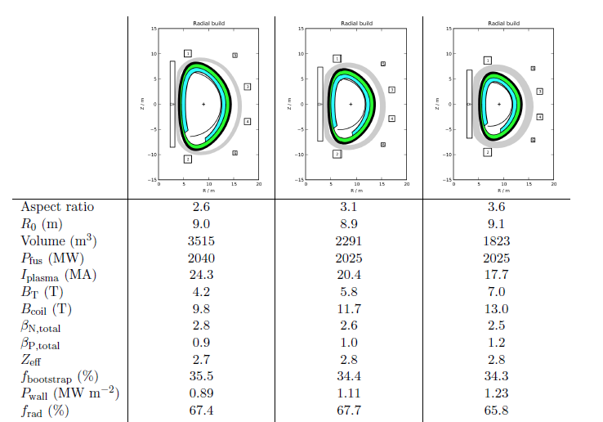
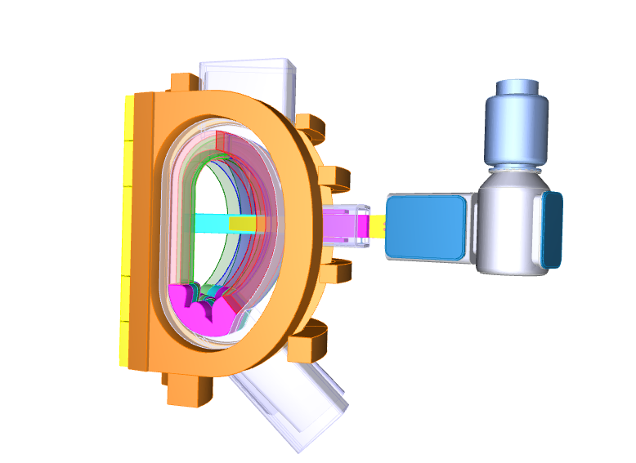
Preliminary DEMO design options being studied
Aspect ratio trade-off studies are underway
A=2.6
A=3.1
A=3.6
Design features (near-term DEMO):
2000 MW_{th}~500 Mw_{e}
Pulses > 2 hrs
Single-null water cooled divertor
PFC armour: W
LTSC magnets Nb₃Sn (grading),
B_{max} conductor ~12 T (depends on A)
RAFM (EUROFER) as blanket structure
Vacuum Vessel made of AISI 316
Blanket vertical RH / divertor cassettes
Lifetime: starter blanket: 20 dpa (200 appm He); 2nd blanket 50 dpa 2nd, divertor: 5 dpa (Cu)
Under
revision
 | Inductive (2.6) | Steady State
R₀ / a (m) | 9.0/ 2.8 | 8.1/ 3
Κ₉₅ / δ₉₅ | 1.6/ 0.33 | 1.6/ 0.33
A (m²)/ Vol (m³) | 1687/ 3515 | 1318/ 2363
H-factor / Beta_{N} | 1.1/ 2.8 | 1.3/ 3.4
P_{sep} | 150 | 100
P_{F} (MW) / P_{NET} (MWe) | 2040/ 500 | 2104/ 500
I_{p} (MA) / f_{bs} | 24/ 35% | 19.9/ 56%
B at R₀ (T) | 4.2 | 5.0
B_{max} conductor (T) | 9.8 | 12.2
BB i/b / o/b (m) | 1.07/ 1.56
NWL MW/m² | 0.9 | 1.2
Open Choices:
Breeding blanket design concept selection planned for 2020
Primary Blanket Coolant/ BoP
Protection strategy first wall (e.g., limiters)
Advanced divertor configurations
Number of coils

Slide 10
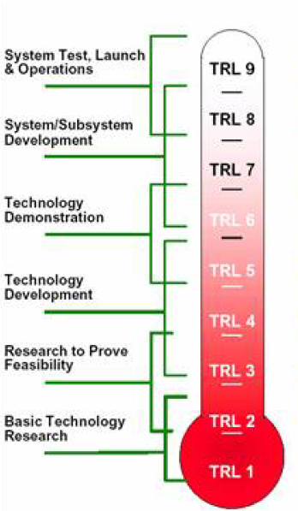
Enabling DEMO Reactor Technologies
Important experience relevant for DEMO is expected to be gained by the Construction, Commissioning and Operation of ITER.
Modest R&D, for some of the components, foreseen in Horizon 2020
Readiness after ITER
Readiness Now
Cryopumps
Nb₃Sn LTSC
NB (1MeV)
Divertor RH
(TRL 7-8)
ECRH 170 GHz
(TRL 6-7)
Blanket RH
(TRL 4)
Diagnostics not fully relevant
(TRL 3 – 4)
Water BoP (TRL 7-8)
Divertor RH
ECH 170 GHz
He BoP
(TRL 4-5)
Nb₃Sn LTSC
(TRL 4)
NB (1MeV)
(TRL 3)
Blanket RH
(TRL 1-2)

Slide 11
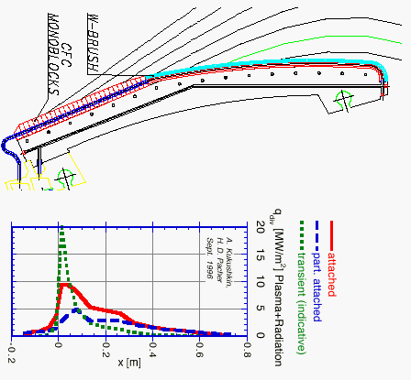
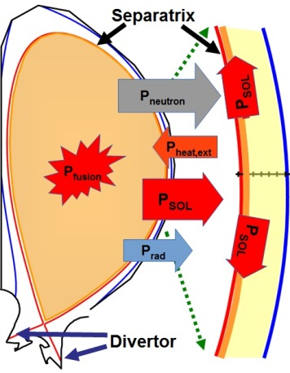
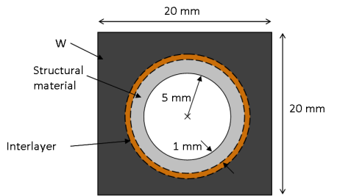
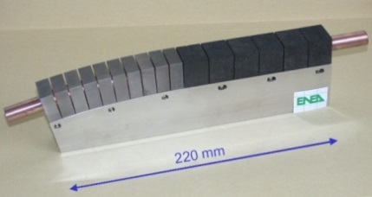
Divertor configuration and target R&D Strategy
Heat flows in a narrow radial layer (SOL) of width λ_{q} (~1 mm)
Scales only weakly with machine size [T. Eich 2013].
ITER
Single-null divertor
Water –cooled, 100ºC (inlet)
W armour/ Cu-alloy as heat sink
Targets qualified for 20 MW/m²
DEMO
Conventional divertors
Stability of detachment
ELMs and Disruptions
Sweeping/ Wobbling
Advanced divertors
Snowflakes
Super-X
Liquid Metals
Physics
TRL
Water cooled design
Armour: Tungsten
Structural: Cu-alloys
EOL <10 dpa, 200-350ºC
Limited effort on He-cooling and on LM
Very LOW readiness
Technology
Forces on the PF coils are the critical issue
Plasma control problems
Design integration problems
Notes:
May 2014 HHF tests at IDTF in St Petersburg, beyond the design requirements
- 3 W mbs (2 ANSALDO 6 mm W and 1 Plansee 5.5 mm W)
- 5000 cycles at 10 MW/m² + 300 cycles at 20 MW/m² + 700 cycles at 20 MW/m²

Slide 12
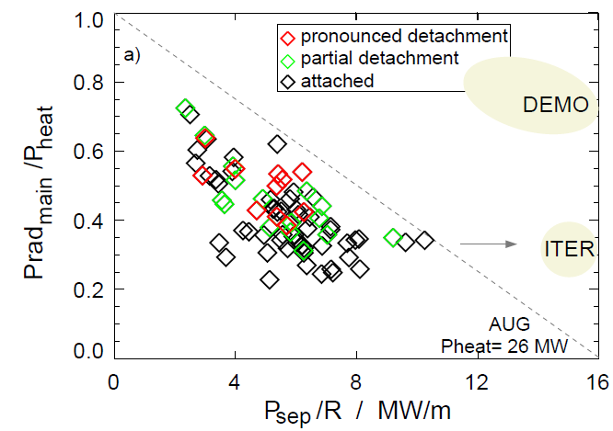

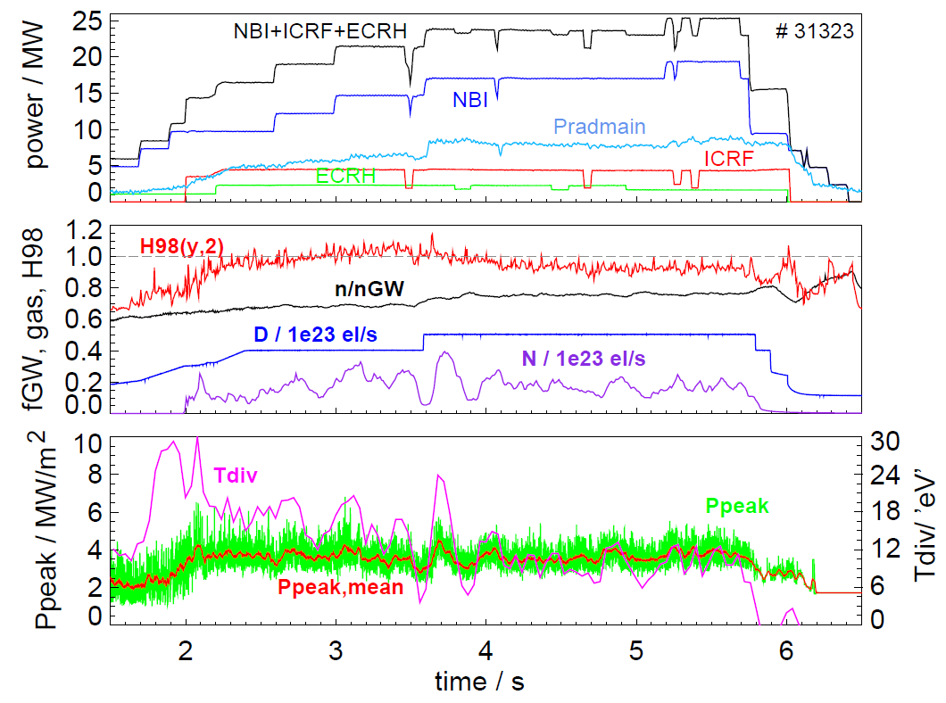
Encouraging recent results from Asdex-Upgrade
Divertor heatflux control with nitrogen seeding
A. Kallenbach, IAEA / FEC 2014
Psep / R = 10 MW/m !
P_{sep}/R is divertor identity parameter, provided similar density and power width λ_{q}
Here: (weak) partial detachment
1/3 cryo, p_{0,div} = 4 Pa
Room for stronger detachment?
→ simpler and cheaper divertor !

Slide 13















DEMO breeding blanket: very low TRL
No one is perfect!!!
Tritium Breeding Blankets - the most important & novel parts of DEMO
Large knowledge gaps will exist even with a successful ITER TBM programme
Feasibility concerns and Performance uncertainties → Selection now is premature
Concerns | HCPB | HCLL | WCLL | DCLL
Tested in ITER TBM |  | ☺
Suitability for Eurofer
FW heat flux capability
Safety issues of coolant
Technology readiness BoP
Potential for high coolant outlet temperature
Coolant pumping power
Shielding efficiency/ n-streaming void space
Activation products in coolant (water)
Breeding efficiency
Tritium extraction from breeder
Tritium extraction from coolant
Tritium permeation through heat exchanger
Notes:
Another equally challenging area is the Breeding Blankets, whose primary functions of:
Breeding sufficient Tritium to sustain fusion operations
Absorbing neutrons and extracting the thermal energy for use in electrical production
are really at the core of the DEMO Plant functionality.
Only HCPB and HCLL will be tested as part of the ITER TBM programme: but, even following a successful TBM prog, large knowledge gaps will remain due to the much lower n-fluence of ITER.
Here we can see a qualitative comparison of 4 breeding blanket concepts currently under assessment in the DEMO CDA phase. Clearly, each blanket concept has a mixture of strengths and weakness and much more R&D, design and analysis is required at both a system and component level in order to make an objective selection by 2020.

Slide 14
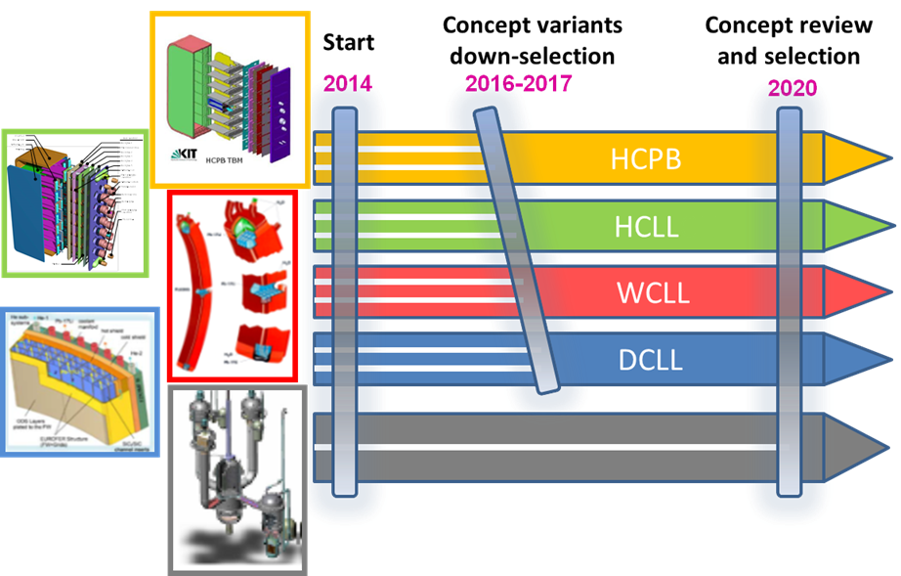
EU Blanket Designand R&D Strategy
(talk of L. Boccaccini)
Develop a feasible and integrated DEMO blanket system conceptual design of 4 concepts.
BoP cycle and technology plays a substantial role in concept selection.
Complementarity with TBM Programme

Slide 15
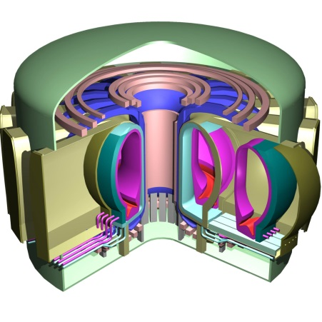
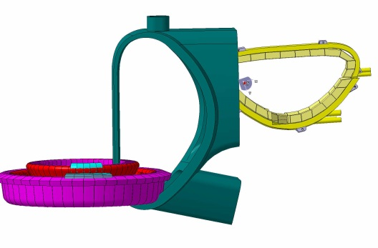
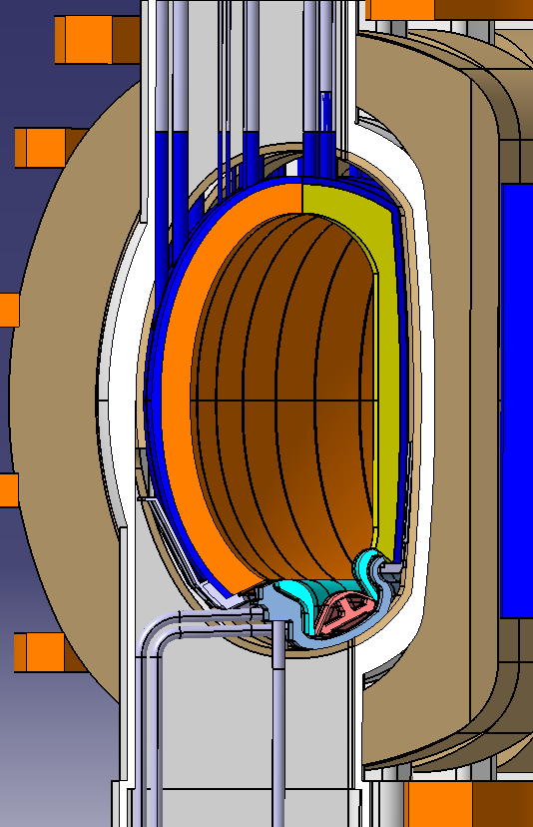
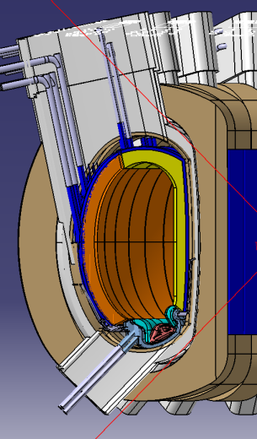
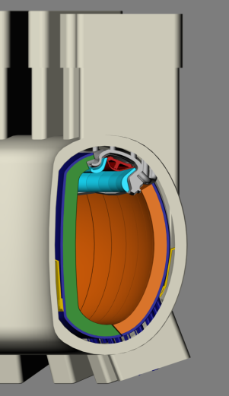
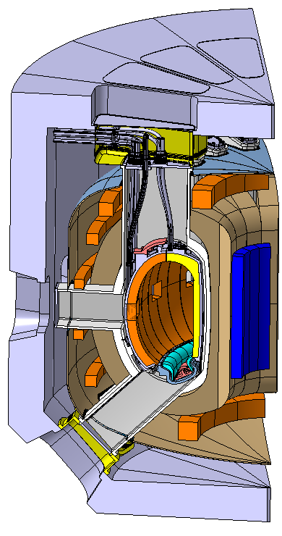
Remote Maintenance Architecture Analysis
Vertical port maintenance preferred:
From a range of designs examined in 2011, options to 4 quasi-vertical alternatives went forward… ITER, Aries, NET, and free thinking alternatives
CAD models created:
Kinematic studies determine optimum design for maintenance
Vertical port maintenance preferred:
Simpler pipe handling
Ease of inboard segment extraction
Access to connection points for a crane
  Through the floor maintenance
Large upper port opening (NET)
Diverter on the roof
Straight vertical port
Courtesy of A. Loving and his team, CCFE

Slide 16
Involvement of Industry
Areas of potential industrial involvement:
Technical Management
  Project / Programme Management
  Plant engineering processes: Systems Engineering and Design Integration
  Cost, risk, safety and RAMI analysis
  Evaluation and selection of design alternatives
  Plant engineering tools, modelling and simulation
  Technology assessment i.e. technology audits, TRL assessment, technology scenario analysis i.e. where are relevant technologies (e.g. HTS) going over the next 5 years?, etc.
Design Engineering
  Design for robustness and manufacture of critical components/systems; include design simplification/ reduce fabrication costs
  Impact assessment on the application of existing technologies under DEMO environmental / operating conditions i.e. pulsed operation on BoP components
  Manufacturing development and qualification with emphasis on performance and cost optimization of design solutions

Slide 17
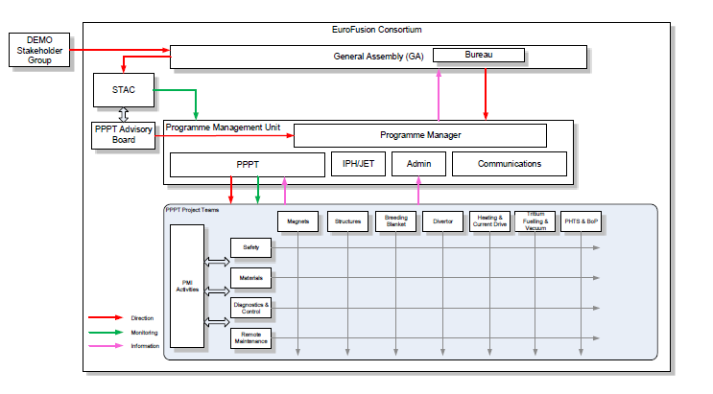
PPPT Implementation
A project-oriented structure set-up
Resources in Horizon 2020 secured
A new governance system based on the principle of joint programming

Slide 18

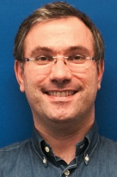
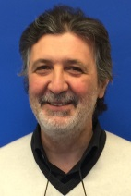

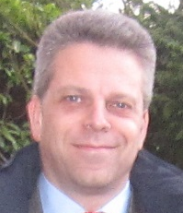
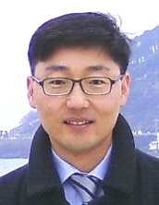
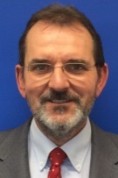

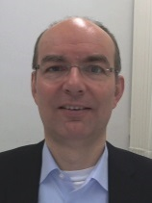
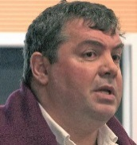

PPPT Project Leaders
Current Status of PPPT Projects:
Well defined scope of work / deliverables / milestones / resources
Interlinks /opportunities for industrial involvement + training
All PMPs approved by Project Boards
N. TAYLOR
Safety and
Environment
L. ZANI
Magnets
L. BOCCACCINI
Breeding Blanket
Early Neutron
Source
Containment
Structure
PPPT PMU
Project control/
coordination
System & Design Integration
Physics Integration
M. RIETH
Materials
J. H. YOU
Divertor
A. LOVING
Remote Maintenance
M. Q. TRAN
Heating and
Current Drive
W. BIEL
Diagnostics, Control
E. CIPOLLINI
Heat transfer, Balance
of Plant, Sites
C. DAY
Tritium, Fuelling
and Vacuum

Slide 19
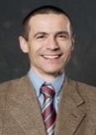

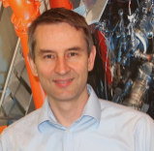
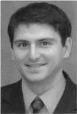


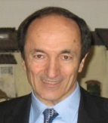
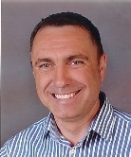

PPPT PMU Team
GIANFRANCO FEDERICI
Head of Department
Project control
System and design integration
Physics integration
CLAUDIUS MORLOCK
Project Control Group Manager
MARK SHANNON
Systems Engineering and Design Integration Group Manager
RONALD WENNINGER
Physics Integration Group Manager
CHRISTIAN BACHMANN
System Level Analysis and Project Coordination Officer
?
Senior Breeding Blanket Project Control and Integration Officer
Design integration
System level analysis
WPDIV project RO
WPCS project RO
FRANCESCO MAVIGLIA
Plasma Engineering and Analysis Support Officer
Blanket design integration
WPBB project RO
WPTFV project RO
Plasma engineering analysis
Engineering data model management
THOMAS FRANKE
Design Integration and Project Coordination Officer
Auxiliary systems design integration
WPHCD project RO
WPDC project RO/ engineering integration
BOTOND MESZAROS
Senior Configuration control and CAD management officer
SERGIO CIATTAGLIA
Senior Plant Safety Design Integration Officer
Design integration
CAD management
EBERHARD DIEGELE
Senior Material Project Control and Integration Officer
Safety design integration
WPSAE project RO
WPBOP project RO
Materials and design criteria
WPMAT project RO
HELMUT HURZLMEIER
Senior CAD operator
MATTI COLEMAN
Design Integration and Project Coordination Officer
CAD management
CAD operations
Plant design integration and modelling
WPMAG project RO
WPRM project RO

Slide 20
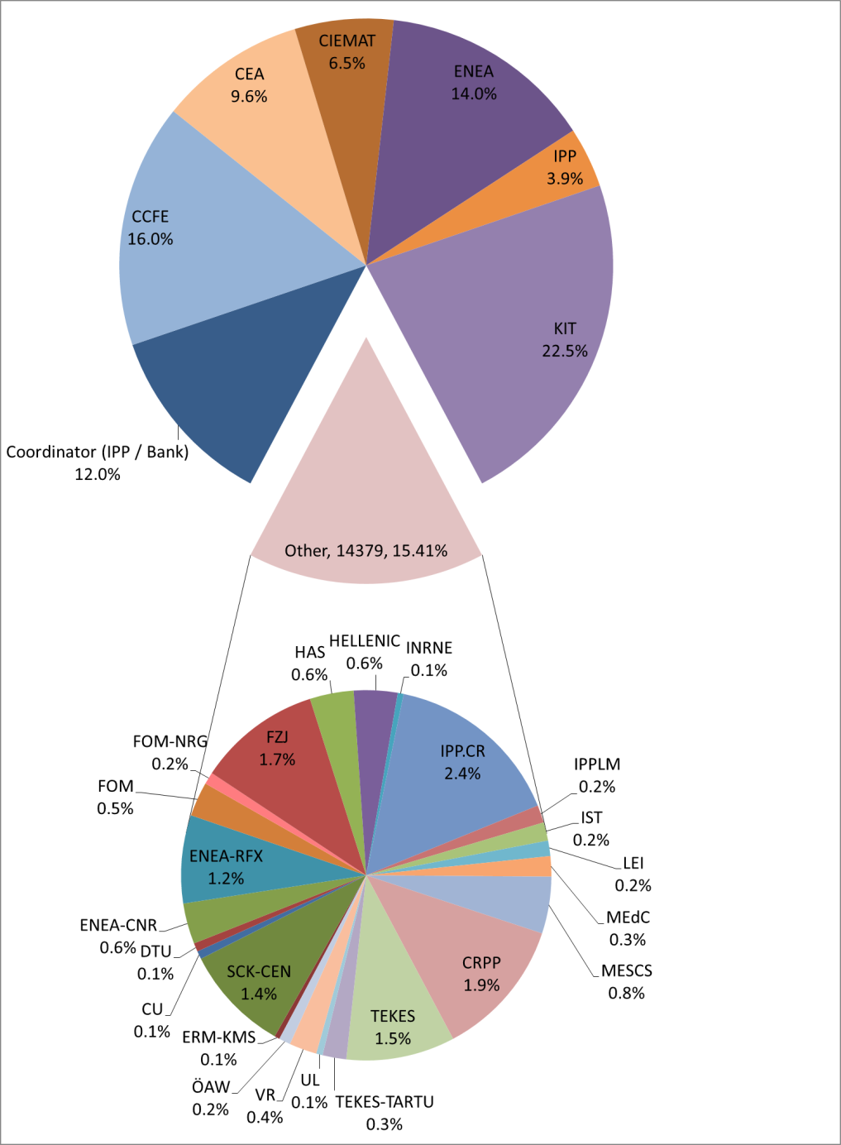
PPPT: allocated by Research Units (EC/k€), 2014-2018
 | Grand Total / EC (k€) | #RUs
Balance of Plant | 1,731 | 4
Breeding Blanket | 24,503 | 7
Containment structures | 861 | n.a.
Diagnostic and control | 1,205 | n.a.
Divertor | 4,753 | 6
Early Neutron Source definition and design | 14,551 | n.a.
H&CD systems | 5,852 | 11
Magnet system | 3,552 | 13
Materials | 29,375 | 22
Plant level system engineering, design integration and physics integration | 7,330 | 14
Remote maintenance system | 7,973 | 7
Safety | 4,291 | 7
Tritium Fuelling and vacuum system | 2,443 | 8
Grand Total | 108,420

Slide 21
PMU Key Functions
Project Coordination and Control: Scope, Schedule/ Resources
Design and Physics Integration
Requirements Analysis
  Stakeholder Requirements Definition / Plant Requirements Analysis
Plant Design Definition and Optimisation
  Plant Design Optimisation Studies
    An Independently moderated TRL Assessment.
    A Parameter trade off assessment and prioritisation exercise.
        Aspect Ratio Scan:
        Development of a blanket attachment system
        Recirculating Electrical Power Requirements
        Sweeping of Divertor Strike Points
    A Critical Decision Making Process
System Level Analysis & Plant Engineering Studies
Systems Engineering Framework and Technical Processes
  Definition of a Systems Engineering Framework
  CAD configuration management
Project Management Activities
  Definition of Deliverables for the CDA
  Formation and Maintenance of the Master Schedule
  Interface Management
DEMO Physics Integration
  System Code Analysis and Development of Point Design Options
  DEMO Physics Basis Development
  DEMO Physics Design Integration

Slide 22
Summary
The demonstration of electricity production before 2050 in a DEMO Fusion Power Plant is a priority for the EU fusion program
ITER is the key facility in this strategy and the DEMO design/R&D is expected to benefit largely from the experience gained with ITER construction
Nevertheless, there are still outstanding gaps requiring a vigorous integrated design and technology R&D (e.g., breeding blanket, divertor, materials)
Design integration essential from the early stage to identify requirements for technology and physics R&D
A systems engineering approach is needed to identify design trade-offs and constraints; and prioritize R&D
Ensuring that R&D is focussed on resolving critical uncertainties in a timely manner and that learning from R&D is used to responsively adapt the technology strategy is crucial
Involvement of industry from the early stage is desirable

Slide 23
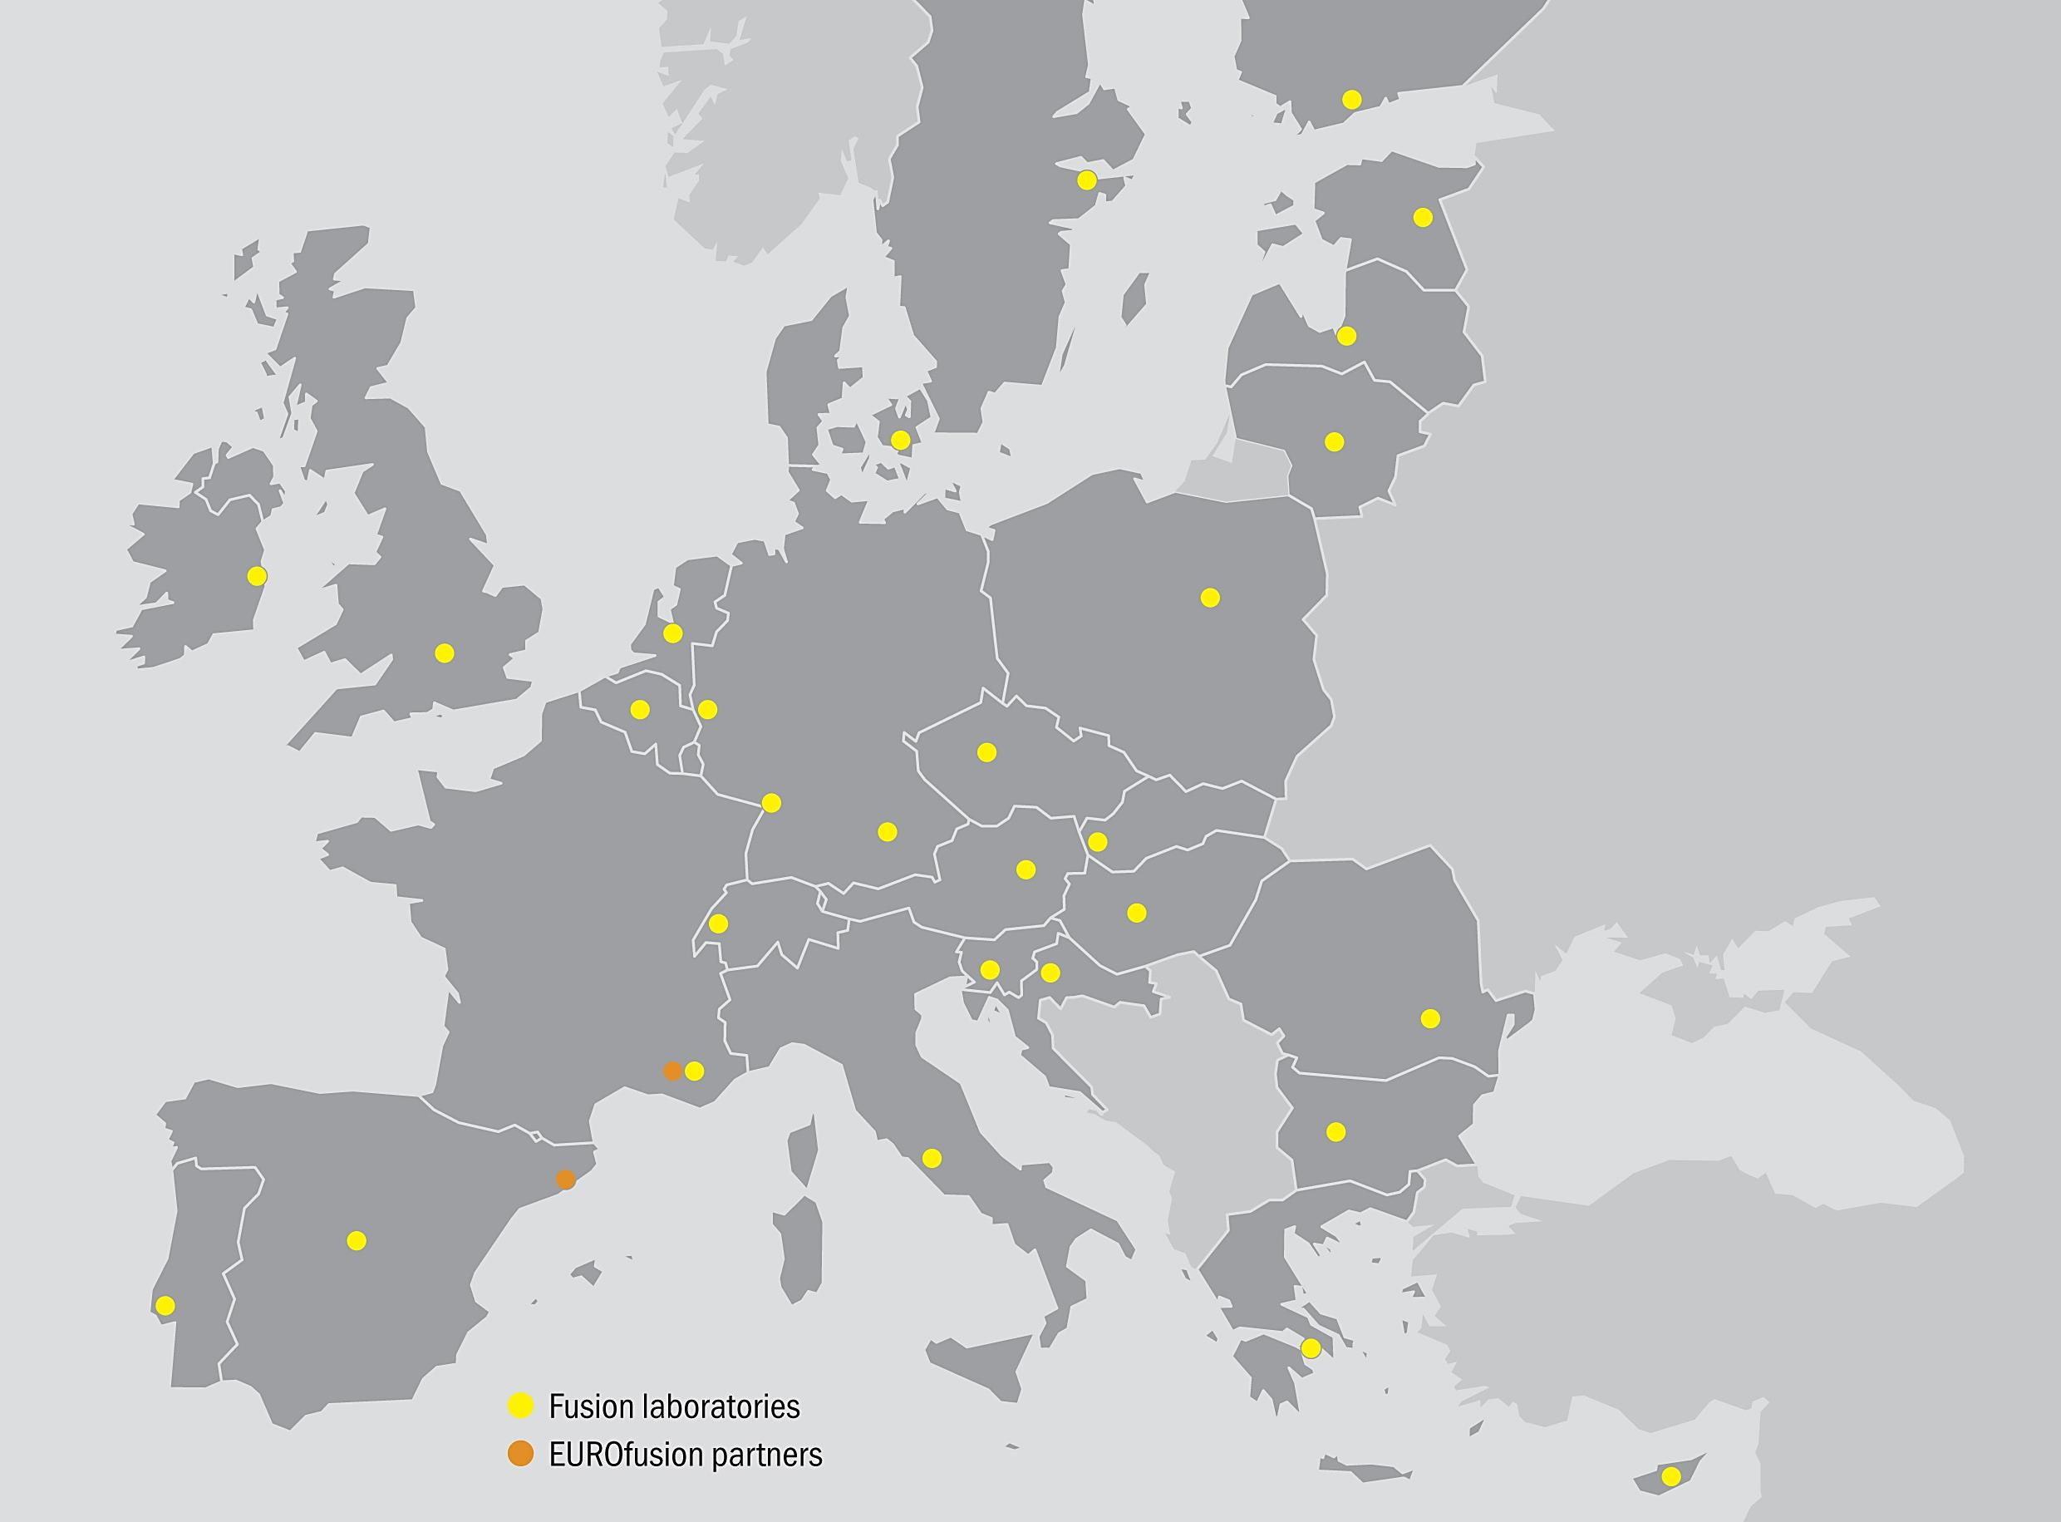
EUROfusion Consortium
29 members in 27 EU countries
Thank you for your attention
Any Questions?
Acknowledgments
PPPT PMU Team: R. Wenninger, F. Maviglia, M. Shannon, C. Bachmann, B. Meszaros, T. Franke, S. Ciattaglia, E. Diegele, M. Coleman, H. Hurzlmeier, C. Morlock
PPPT Distributed Project Team Leaders: L. Boccaccini (WPBB), J-H You (WPDIV), E. Cipollini (WPBOP), T. Loving (WPRM), L. Zani (WPMAG), M. Rieth (WPMAT), W. Biel (WPDC), M.Q. Tran (WPHCD), C. Day (WPTFV), N. Taylor (WPSAE)
IPH PMU Team: X. Litaudon, D. McDonald
Eurofusion PM: T. Donne
F. Romanelli

Slide 24
Additional slides

Slide 25
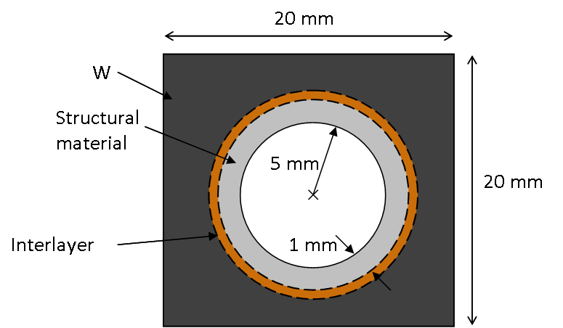
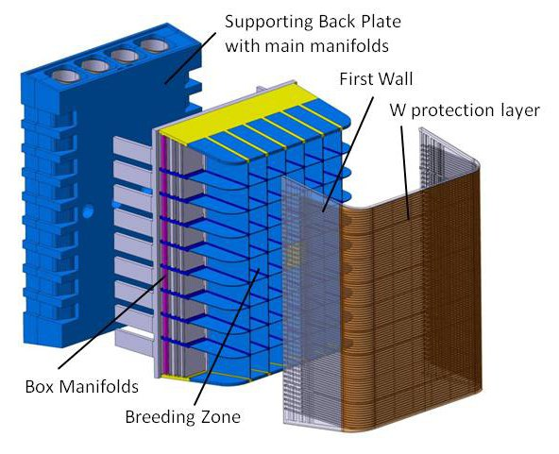
DEMO IVCs lifetime design requirements and materials issues
Divertor: life limiting phenomena is erosion
Main Chamber wall/ Breeding Blanket
S. Kecskes (KIT, 2013)
Armour: W
Structural: EUROFER97
Damage in FW steels: 10 dpa/fpy
Starter blanket≈20 dpa; ~6000 cycles.
2nd blanket: 50 dpa
q> 10 MW/m²
Armour: Tungsten
HS: Cu-alloys
Coolant: Water
Material issues
Low-temp. embrittlement of Eurofer (WCLL)
Decline in strength above 550°C
Creep-rupture limits operation to <550°C for >12 10³h
Lack of Design-code development
Physical sputtering (Te~5 eV) will limit the lifetime of the diveror to 1-2 FPY
Advanced Steels
RAFM steels for water-cooled applications
Adv. Steel for High Temperature applications
ODS RAFM steels for high temp strength.
Damage in Cu: 3-5dpa/fpy, up to 2 fpy (replacement)
Engineering Data and Design Integration
Materials Database and Handbook
Structural Design Criteria
Testing in fission reactors (HFIR, BOR-60)
IFMIF/ ENS
Material issues (Cu-Cr-Zr)
Radiation-induced embrittlement <~200°C
Softening > 350°C
Irradiation data needed

