Slide 1
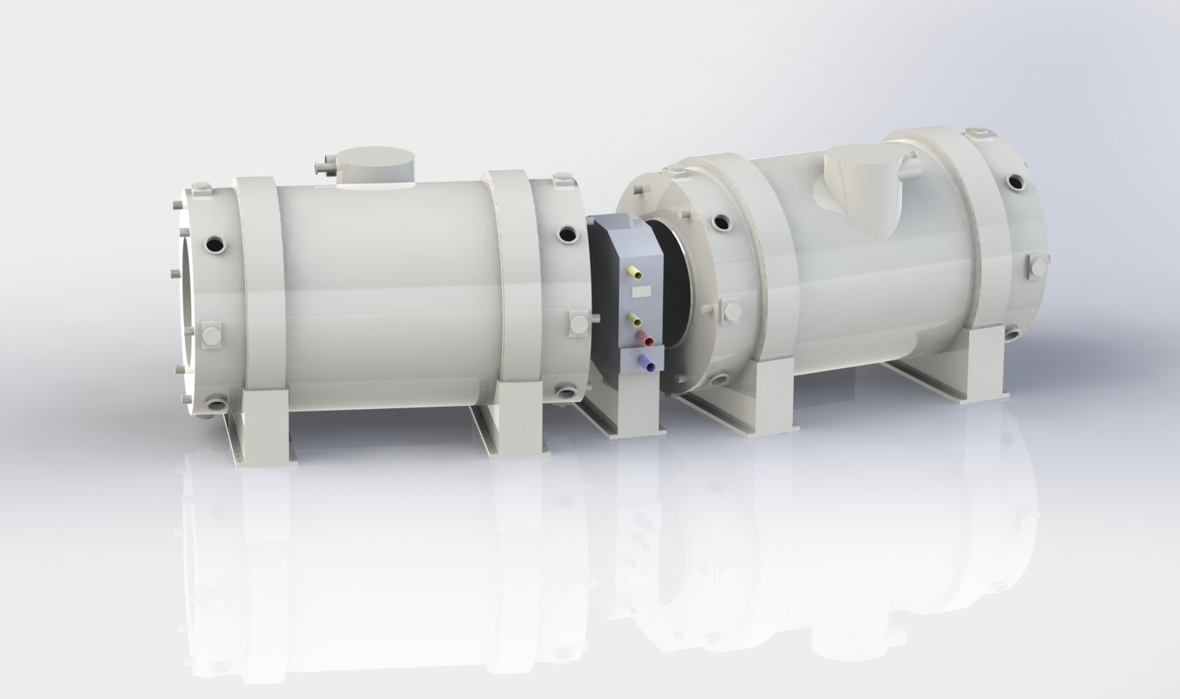
Conceptual Design of a
Multi-effect DCLL Test Stand
2nd EU–US DCLL Workshop
November 14-15, 2014
UCLA
Presented by
Richard W. Callis

Slide 2
How Does One Create a Cost Affective DCLL Test Stand
Creating a multi-affect Blanket test stand from the ground up maybe costly and thus less likely to be supported by DOE in the present budget constrained environment
To bring the cost down utilization of existing support systems and designs
  More than half the cost of superconducting magnets resides in the engineering design and tooling
  The LHe refrigerator and power supplies may be of equal value to the magnet fabrication costs.
  In high performance magnets the cost of the SC cable dominates the fabrication costs
Magnet should be copy of an existing design, which uses less exotic SC conductor, and site magnet at an existing magnet test facility

Slide 3
Performance Parameters of a DCLL Test Stand
Performance Requirements
Helium Temp/Flow Rate/Pressure per blanket module | 500°C, 1.5 kg/s, 8MPa
PbLi Temp/Flow Rate/Pressure per blanket module | 700°C, 30 kg/s, 1MPa
Surface Heating , module area | 0.5 to 2.0 MW/m², 2 m²
Tritium extraction rate | 0.002 g/hr
Fraction Tritium recovered | 99.9%
Magnetic Field | 2-5 T
Volumetric heated, volume | Sim. w/heaters, 2 m³
Availability | 70%
Duty factor (annual) | 50%
Pulse Length w/integrated conditions | weeks
(from Zinkle FESAC Report 2012)

Slide 4
GA is Evaluating Two Configurations for the DCLL Test Stand
In addition to the performance goals, a Blanket Test Facility should provide
  easy access to install and remove blanket modules,
  provide a simple means to change the field gradients,
  and reduce the amount of stray magnet field, by using an iron return yoke.
The US is presently fabricating two superconducting magnets which could be used in a DCLL Test Stand
  Fermilab Muon-to-Electron high conversion experiment
  ITER Central Solenoid Magnet modules

Slide 5
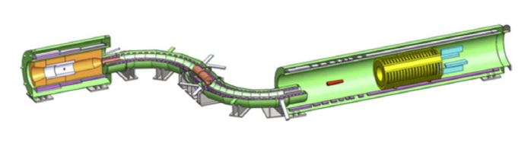
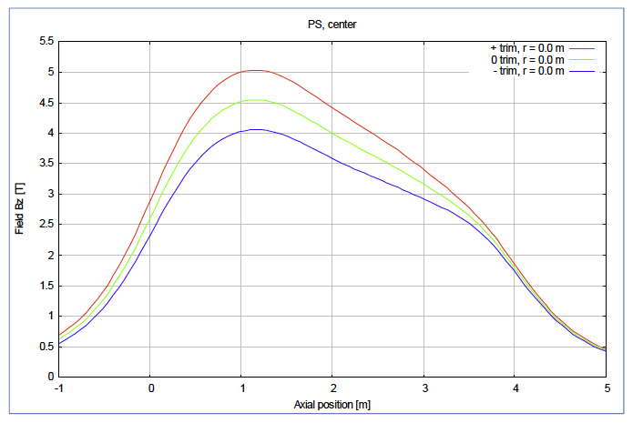

Two of the Muon Production Solenoids Can be Used
Production Solenoid
Detector Solenoid
The Mu2e Production Solenoid has three nested solenoids
  produces 4.5 T in its bore and tapers to1.5 T at its exit
  has a1.7m bore
  Incased in its own cryostat

Slide 6
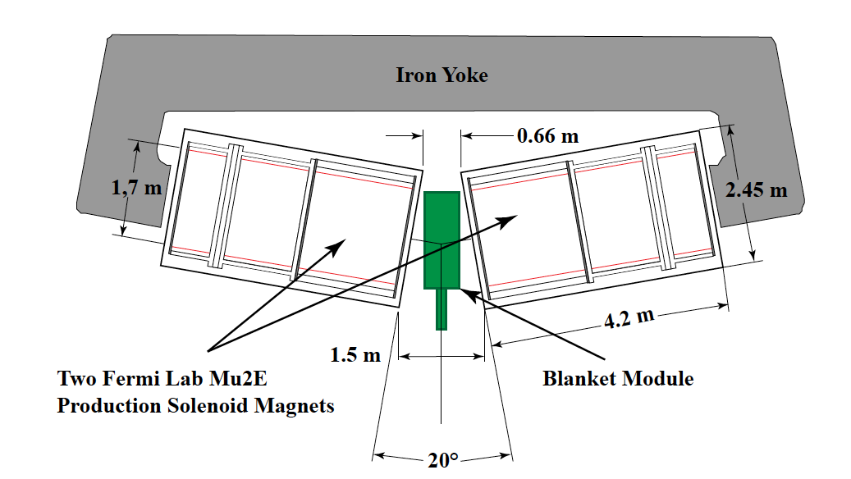
Two Production Solenoids can be Used to Form the Basis of a DCLL Test Stand
DCLL TS based on Mu2e production solenoid
  2.5 T test field
  Solenoids canted 20° to simulated reactor field gradients
  Can support a blanket module 0.66m wide by 1.5 m tall
  Easy blanket access
  Iron yoke return
  Solenoids can be pivoted to adjust field gradients

Slide 7
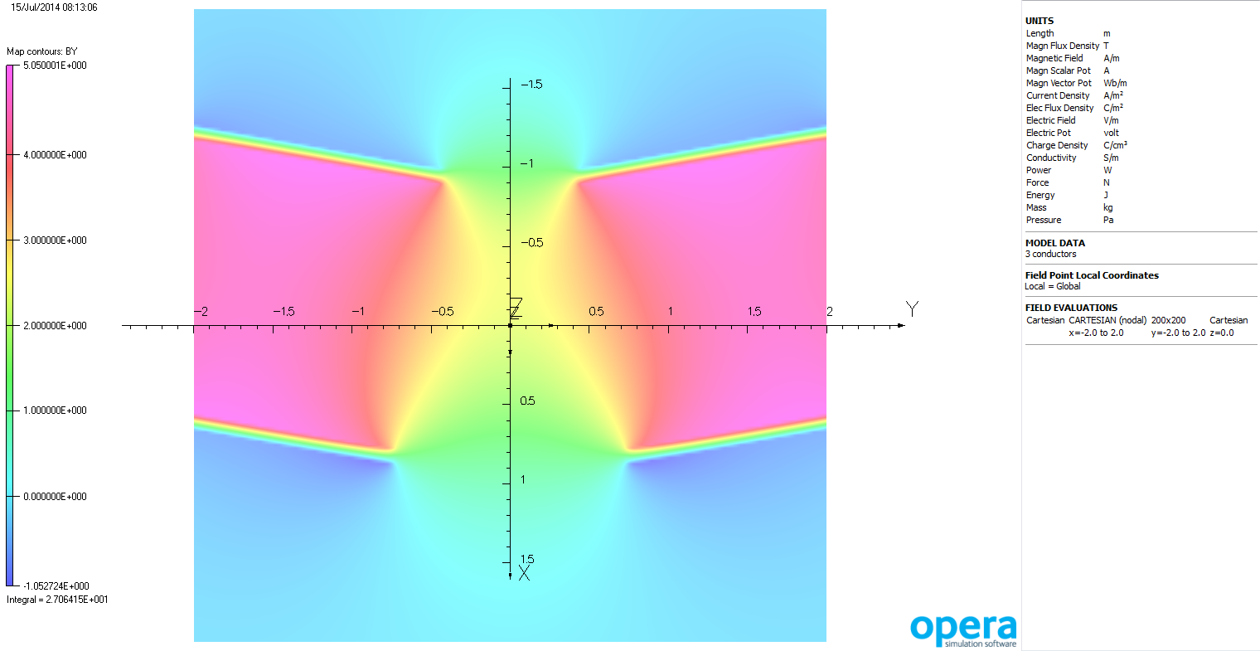
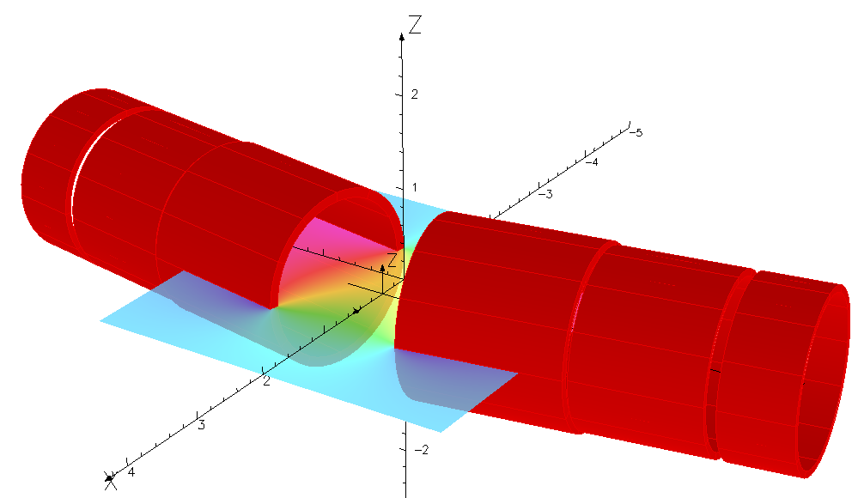
Field B_{y} in Plane z=0
Unit: T
2.40 T

Slide 8
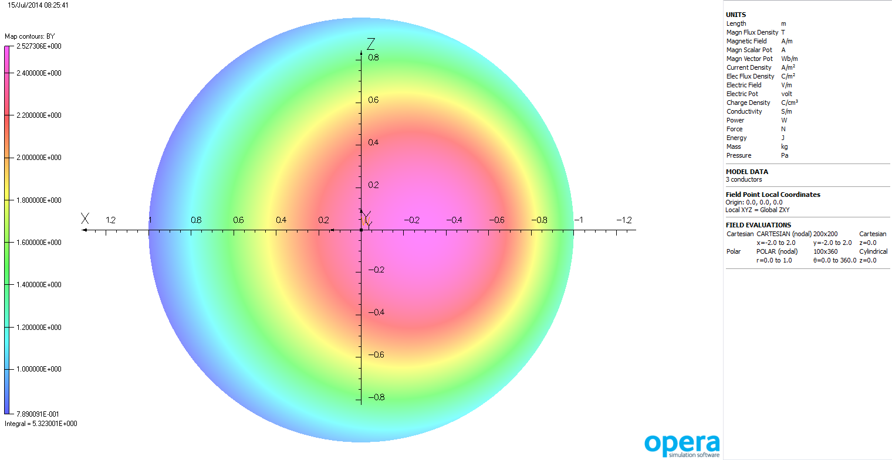
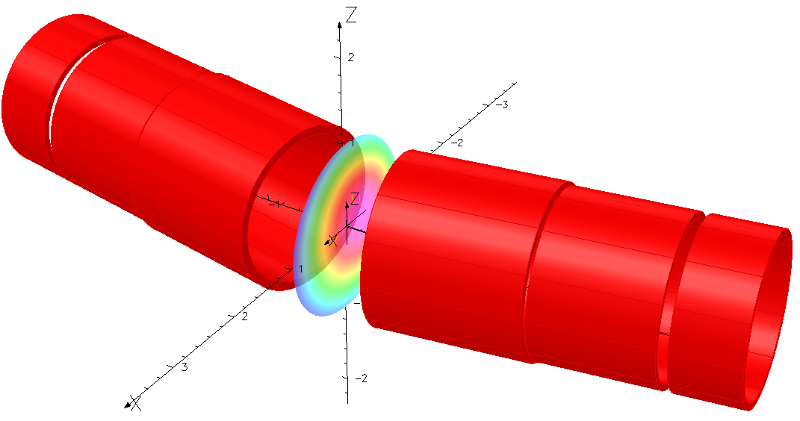
Field B_{y} in Plane y=0
Unit: T
2.53 T

Slide 9
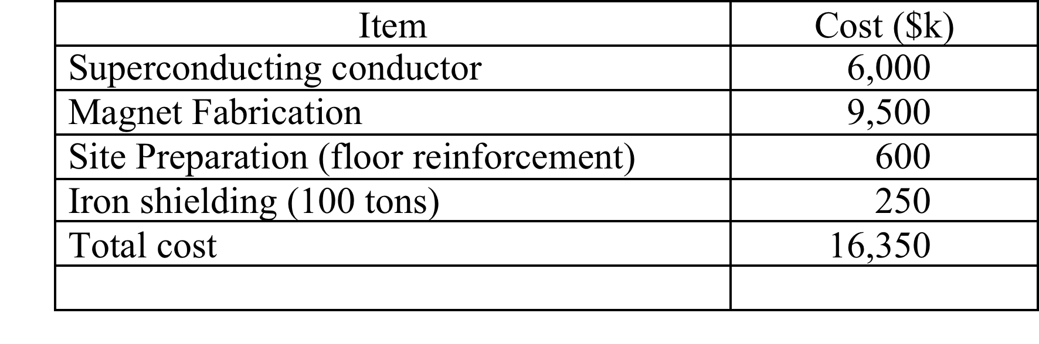
2.5 T DCLL TS Magnet System Costs
These costs do not include
  The liquid PbLi loops,
  The He cooling loops,
  The surface and bulk heating hardware
  Data acquisition & control
  Other blanket testing infrastructure

Slide 10
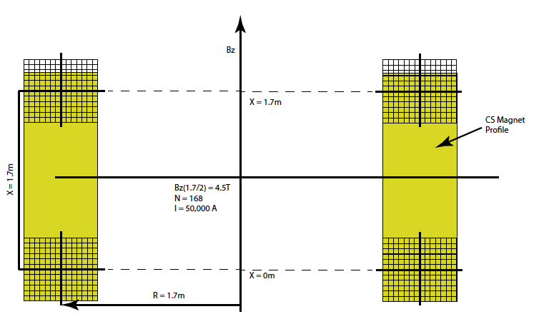
If 5T is Required then a Helmholtz Coil based on the ITER Central Solenoid Design Would be Needed

Slide 11
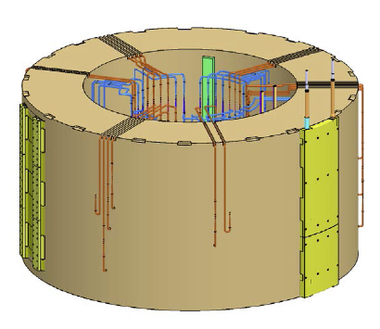
An ITER CS Magnet can be Modified as a Helmholtz Magnet
A Helmhotz coil pair can be made using 4 CS magnet 6 layer (hexa-pancake) sections
  5T test area
  Routing of Lhe cooling lines needs modification
  Since entire coil set is inside a cryo dewar, blanket module will have to have its own vacuum jacket and cryo insulation
  No iron yoke is needed
ITER CS Magnet
BT³F using
4 hexa-pancake

Slide 12
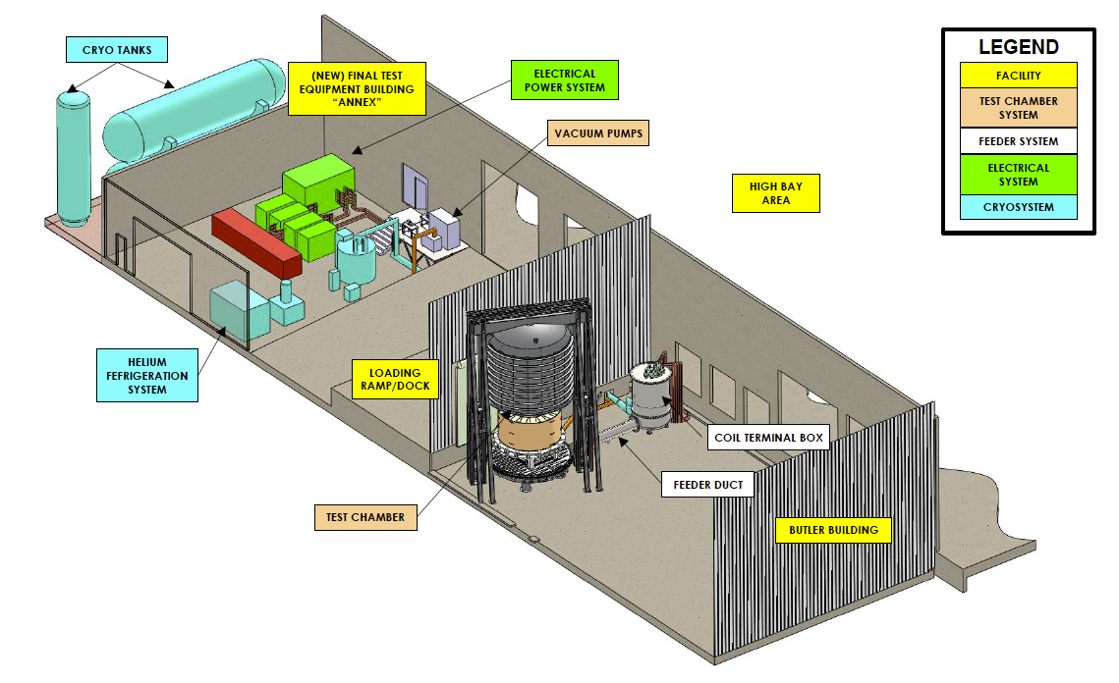
More Than $12M of Test System Infrastructure
Can be Utilized in Operating the DCLL TS

Slide 13
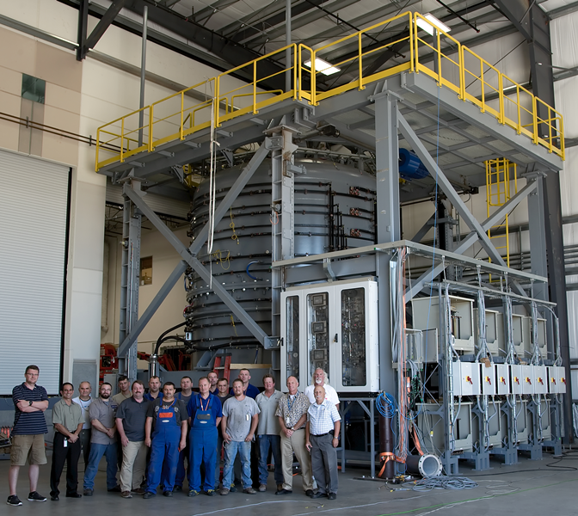
The Size of the ITER CS Coil Heat Reaction Oven Illustrates That a 5T DCLL TS will not be a Small Facility

Slide 14
5 T DCLL TS Magnet System Costs
A cost analysis of a Helmholtz coil based on the ITER CS Coil fabrication tooling has not been performed.
What is known
  Conductor cost $5M per hexa-pancake ($20M)
  Fabrication cost of 1 CS Magnet ~$6M
What needs to be estimated
  Rerouting of Lhe piping
  Support structure for the upper Helmholtz coil
    Is adjustability needed?

