Slide 1
NSTX PFC diagnostic probe development and results
J.P. Allain^{1,2}, C.N. Taylor¹, B. Heim¹,
PPPL Collaborators: C.H. Skinner, H.W. Kugel, R. Kaita, A.L. Roquemore
ORNL Collaborators: P. Krstic
¹School of Nuclear Engineering, Purdue University, West Lafayette, IN 47906
²School of Materials Engineering, Purdue University, West Lafayette, IN 47906
Plasma Facing Components Meeting, UCLA
Los Angeles, CA, August 4-6, 2010

Slide 2
Summary
Review
Lithiated graphite
Influence of D⁺
Deuterium fluence
Atomistic simulations
Porous molybdenum
MAPP: Materials Analysis Particle Probe
Conclusions
Future work

Slide 3
Lithiated graphite – influence of D⁺ irradiation
With lithium
Without lithium
The formation of new peaks or a reproducible peak shift is an indication of a chemical change.

Slide 4
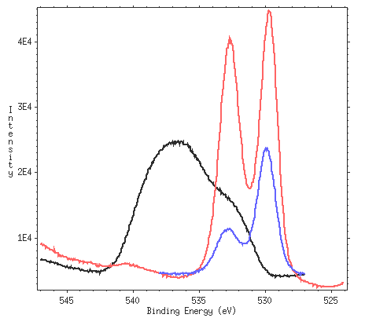
Laboratory experiments consistent with surface chemistry of NSTX tiles
NSTX tile
~ 60 nm Li
Lab sample
~ 800 nm Li
Connecting controlled “single-effect” studies in lab experiments to complex environment in NSTX using PMI modeling
Limited by both modeling and available edge diagnostics; compromise by introducing in-situ PMI diagnostics

Slide 5
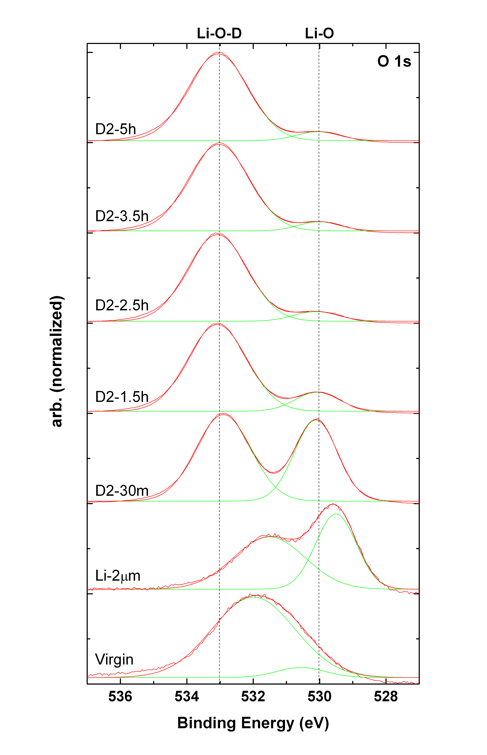
Lithiated graphite – Deuterium fluence
Deuterium irradiation alters the surface chemistry of lithiated graphite.
What happens as larger quantities of deuterium are introduced?
Can lithium-deuterium saturation be observed through XPS?
O1s peaks

Slide 6
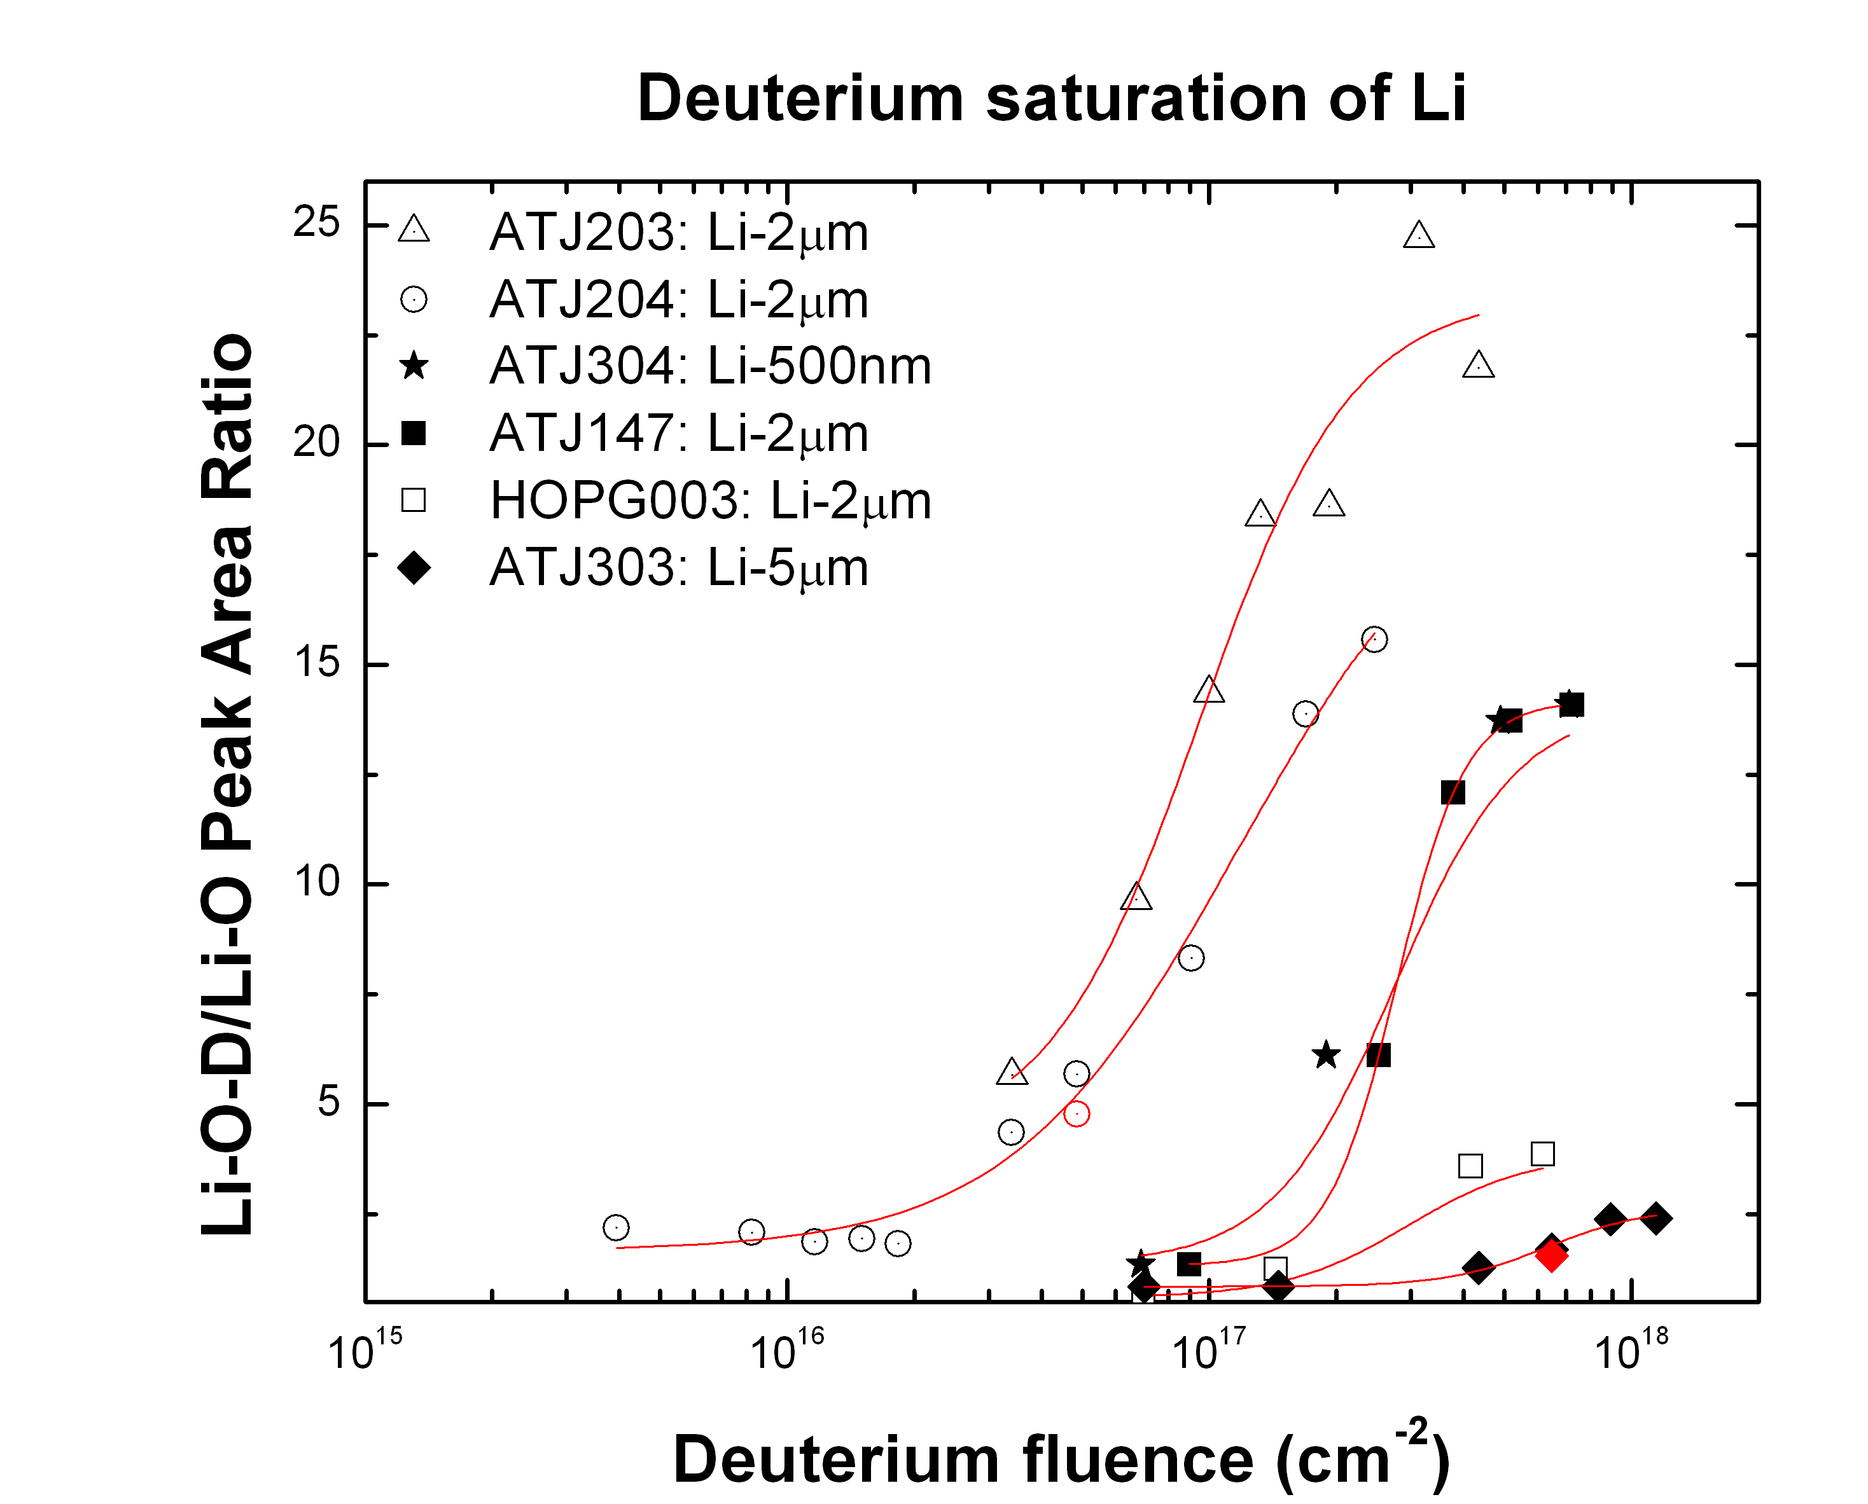
Lithiated graphite – Deuterium fluence
How is saturation calculated?
Area of Li-O-D peak
Area of Li-O peak
Li-O-D
=
=
Ratio
Li-O
No D-irrad
O1s peaks

Slide 7
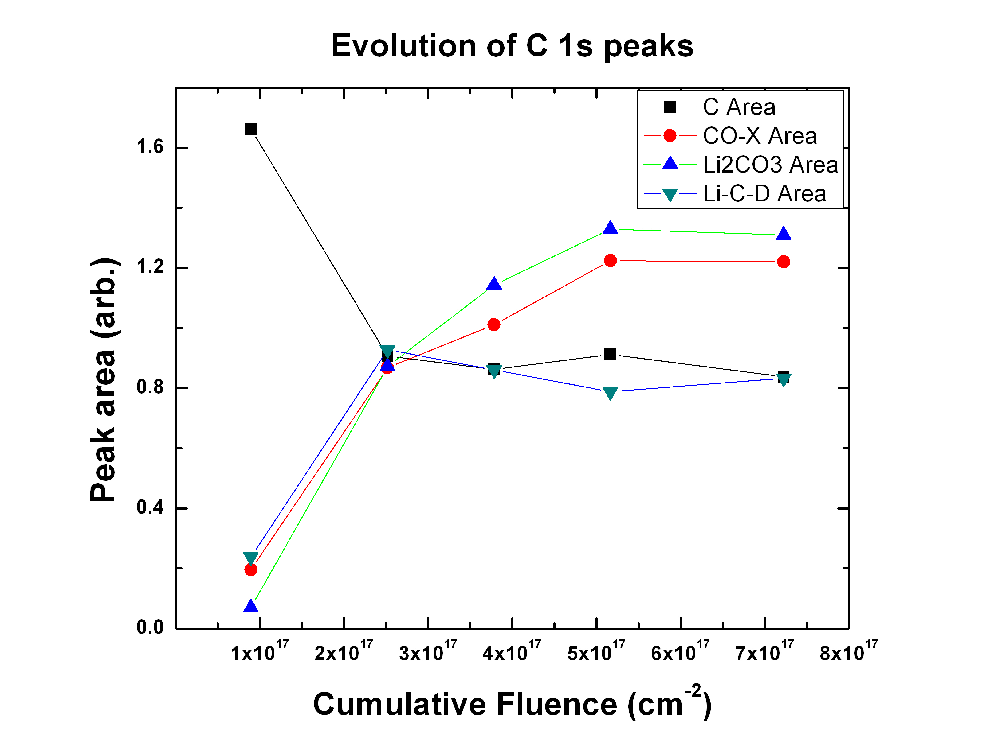
Lithiated graphite – Deuterium fluence
What happens in the C1s spectral range as deuterium fluence increases?
C1s peaks

Slide 8
Deciphering D binding in lithiated graphite – Atomistic simulations
Density functional theory (DFT)
Examines small clusters containing Li, C, O and H
Optimizes cluster geometry
Considers lowest molecular orbitals
Preliminary DFT Results
Computed Li-O-H molecular bonding occurs at BE < 532 eV (for O binding)
Computed Li-C-H molecular bonding occurs at BE < 285 eV (for C binding)
This is CONTRARY to experiments!

Slide 9
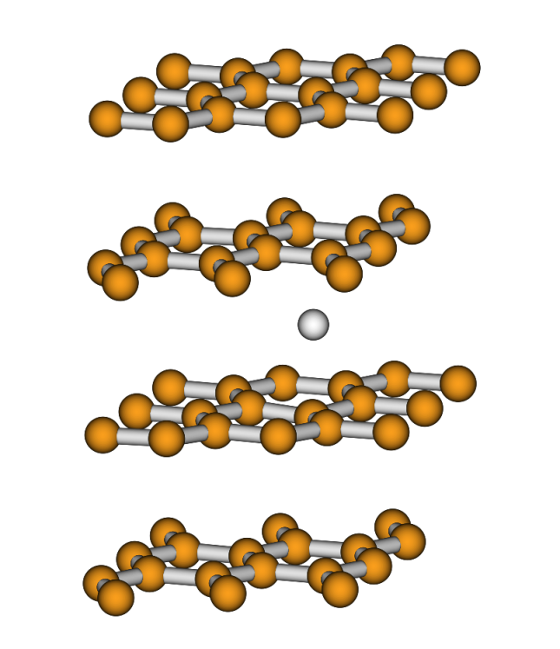
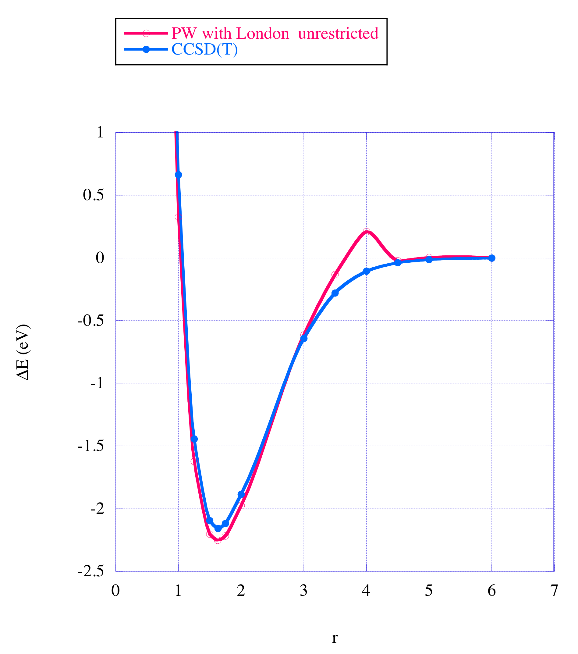
Quantum calculations with Li : Problems!!! Require all-electron calculations!
Li on graphite surface, Adsorption, H co-adsorption, oxidation
Li intercalation in graphite, Adsorption H retention & diffusion
For low-energy scattering, DFT calculations not good: Produces false bumps
DFT calculation with C and O in hydrogenated Li shows qualitative disagreement with XPS data*
Systems involving Li require advanced quantum-computational-chemistry calculation (even for production of the ground MD potential)
9
C.N. Taylor, et al. J. Nucl. Mater. Submitted 2010

Slide 10
Deciphering D binding in lithiated graphite – Atomistic simulations
Implications: The consistency of O and C bonds showing up at binding energy levels lower than experimental results indicates that we may not have molecular bonds!
Hypothesis: Lithium and deuterium do not bind molecularly (LiD is unstable) in the lithium-graphite system. Dipole interactions stimulate deuterium clusters in the vicinity of lithiated graphite. The electronegativity of lithium leads to a strong reaction with carbon and oxygen.
Elemental Electronegativities
Lithium: 0.98
Carbon: 2.55
Hydrogen: 2.20
Oxygen: 3.44

Slide 11
Midpoint summary
Oxygen
On graphite, Li, O, and D interactions are manifest at 533.0 eV. Peak dominates with larger D fluence, indicating that a given lithium thickness has a finite deuterium capacity.
Li and O interactions, on a graphite substrate, are manifest at 530.1 eV in the XPS spectrum. Peak diminishes with larger D fluence, indicating that D⁺ binds/interacts with and consumes the Li-O bonds.
Carbon
Li, D, and C interactions are manifest at 291.4 eV. Relative peak energy increases with increased D fluence.
NSTX relevance
NSTX lithium depositions (10s-100s nm per cycle) likely saturate after a single discharge (10¹⁷ cm⁻²) and therefore “fresh” surfaces are either replenished from re-sputtering/transport of Li atoms or in-situ conditioning sources (e.g. Li powder, LiTER, etc…).
Bonding nature
D and Li interact via dipole interactions rather than molecular bonds.

Slide 12
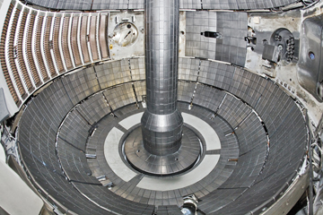
Porous molybdenum
The LLD introduces a new material into NSTX
It cannot be expected that porous Mo will exhibit the same surface chemistry as lithiated graphite.
Surrounding graphite tiles
provides source of C impurity

Slide 13
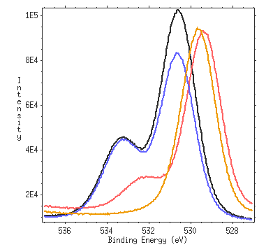
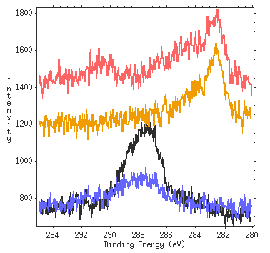
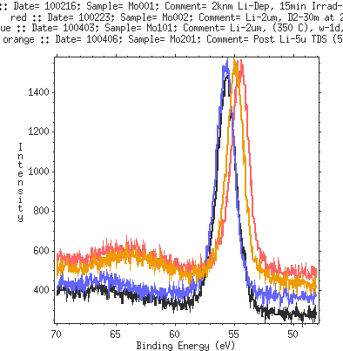
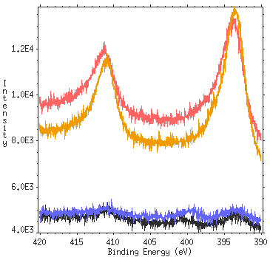
Porous Mo – 4 irradiation scenarios
1) Mo001: D₂ irradiation on cold Li. 2µm Li deposited on cold Mo.
O1s
C1s
Note: Low C presence
Mo001: D2 on solid Li
Mo002: D2 on liquid Li
Mo101: D2 on solid Li after melting Li
Mo201: Melting Li with no D
2) Mo002: D₂ irradiation on liquid Li. 2µm Li deposited on cold Mo.
3) Mo101: D₂ irradiation on cold lithium. 2µm Li deposited on cold Mo, followed by heating, then re-solidified.
Li1s
Mo3p
4) Mo201: No irradiation. 5µm Li deposited on cold Mo and then melted.

Slide 14
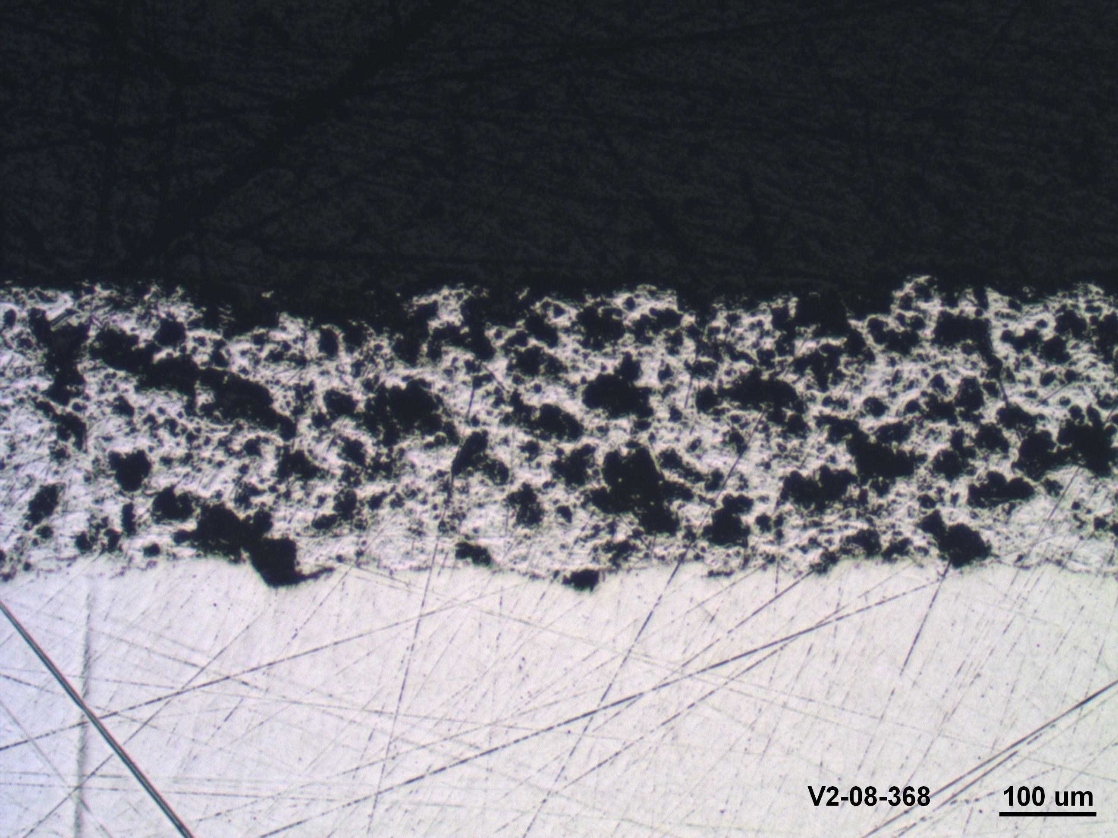
Porous molybdenum – % Concentrations
Metal concentrations (neglecting impurities)
Metal and impurity concentrations
 | % Li | % Mo
Mo001 | 99.033 | 0.967
Mo002 | 98.766 | 1.234
Mo101 | 98.791 | 1.209
 | % Li | % Mo | %C | %O
Mo001 | 85.023 | 0.830 | 2.866 | 11.281
Mo002 | 86.294 | 1.078 | 5.089 | 7.539
Mo101 | 71.669 | 0.877 | 4.593 | 22.860
Li-2µm, T_{room}
Li-2µm, T_{room}
Li-2µm, T_{melt}
*Nominal Li thicknesses
XPS probing depth < 10 nm
Surface lithium is plentiful and dominant after heating.
e⁻
Implication: lithium wets rather than pools.
~10 nm
Target
Notes:
The difference between the two tables is that the metal-only table shows that the lithium coverage is quite comparable for all three samples. The metal+impurity table shows that there are some differences. Regardless, the implications are the same: There is a lot of lihtium that resides on the surface.

Slide 15
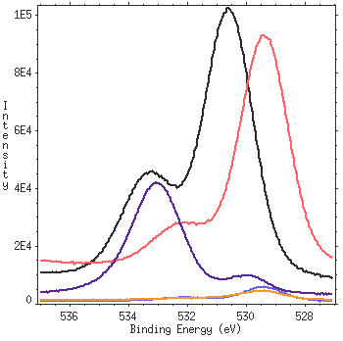
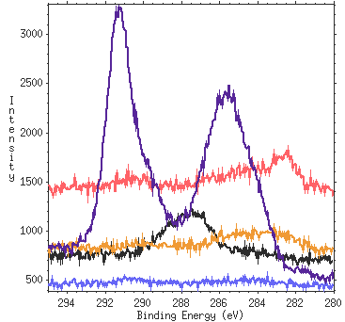
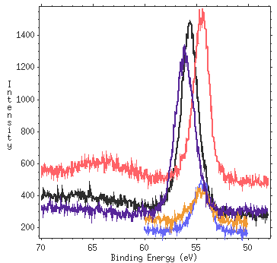
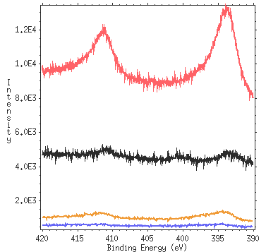
Porous Mo – 5 irradiation scenarios
1) Mo001: 30 min D₂ irradiation on 2µm Li deposited on cold Mo.
O1s
C1s
Note: Low C presence
Mo001: D2 on solid Li
Mo002: D2 on liq. Li deposited cold
Mo202: D2 on liq. Li deposited hot
2) Mo002: 30 min D₂ irradiation on 2µm Li at 255º C. Li deposited on cold Mo.
Mo201: Sputtered C and D2 on liq. Li
ATJ203: D2 on Li on graphite
3) Mo202: 30 min D₂ irradiation on 3µm Li at 200º C. Li deposited on Mo at 250º C.
Li1s
Mo3p
4) Mo203C: Carbon sputtered (via Ar) onto Li-coated Mo. 30 min D₂ irradiation at 200º C.
5) ATJ203: 30 min D₂ irradiation on ATJ graphite with 2µm Li dose.

Slide 16
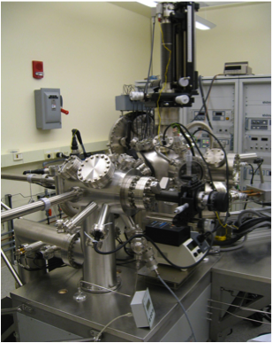
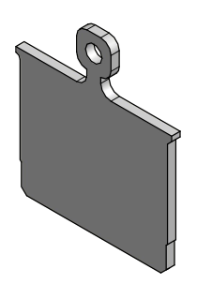

Slide 17
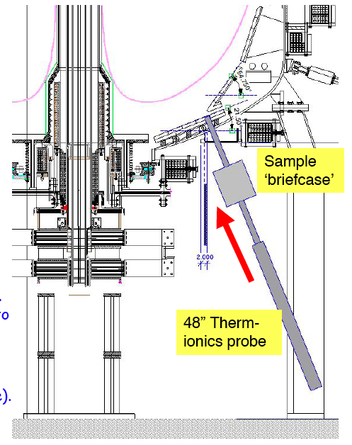
MAPP – Building from experience
Sample analysis probe in NSTX
Enables exposure of samples to NSTX plasma discharges and removal for analysis during NSTX campaign.
Capabilities include:
Button heater for sample heating
Residual gas analyzer (RGA) for thermal desorption spectroscopy (TDS)
Ship to Purdue for XPS and further analysis

Slide 18
MAPP: Materials analysis particle probe

Slide 19
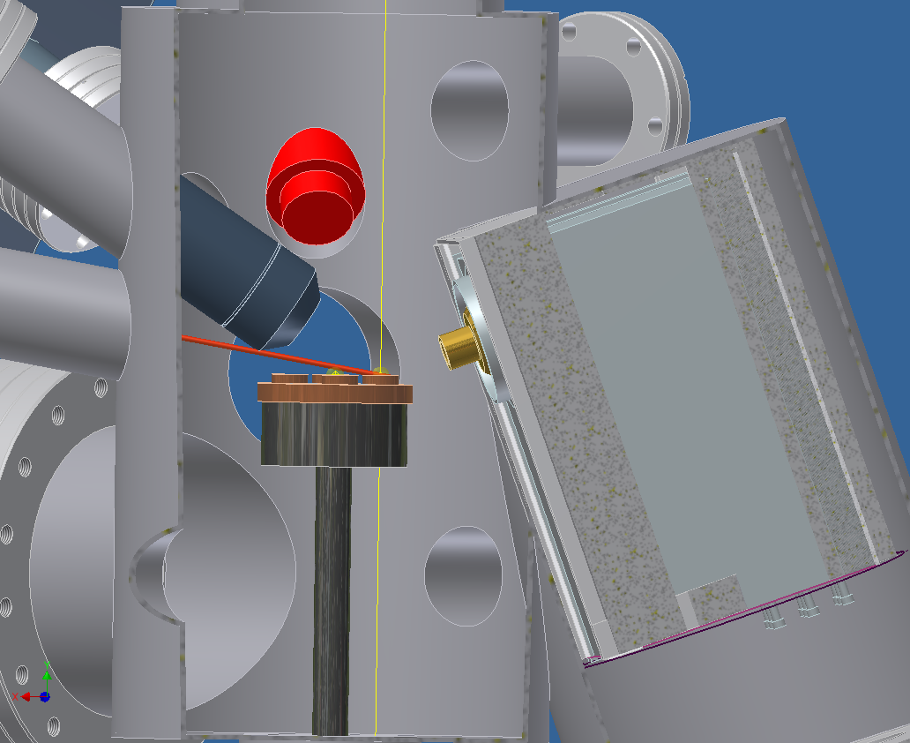
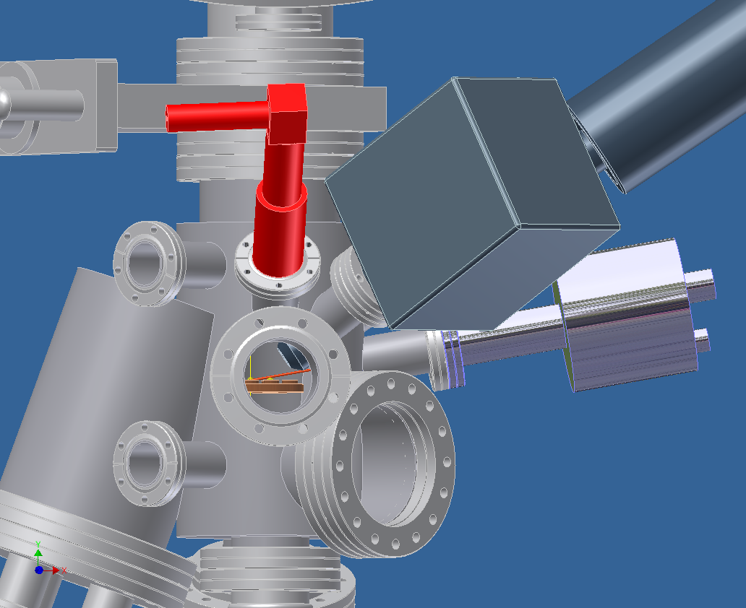
Internal/external layout of MAPP
X-ray source
camera
Ion-beam source
Analyzer chassis
RGA box
Notes:
The red line is the Ion Beam, the X-ray is fully inserted to a 40 mm working distance for max resolution

Slide 20
New Probe Head Design
Compatible design with current probe
Sample fastening design will consult with Lane
Samples flush with divertor floor plane
Will use custom samples
15.24 mm diameter
10 mm diameter
54.0 mm diameter
Notes:
The material will be similar to the Dimes probe by Wampler, current probe heads are made of TZM,
which is a molybdenum alloy, ((Chase is leading the investigation of the probe head material)
Custom samples are going to be made to make each sample flush with surface.
Probe samples involve (ATJ graphite, Moly mesh on SS substrate, thin film semi conductors and metals Si, Pd)
Copper Ring around sample holder will help verify sample location with analyzer and source alignment.
This probe head design is just a fitting which will go over the current probe head design
with no alterations needed to the internal wiring.

Slide 21
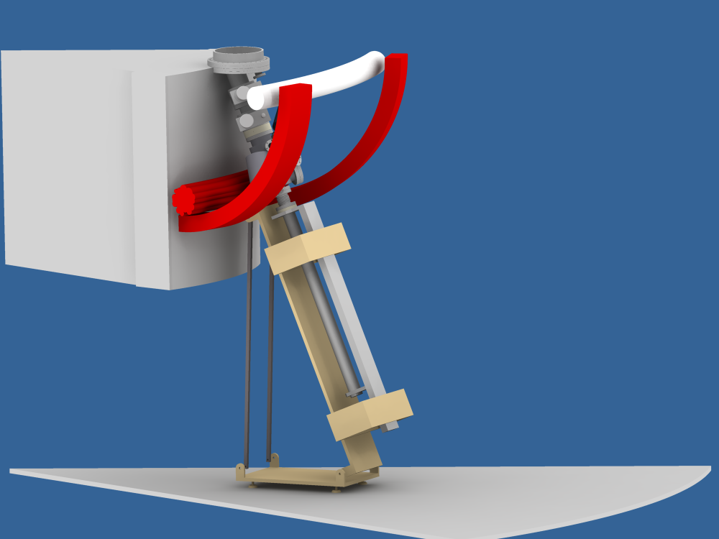
MAPP on NSTX: Logistics
Major engineering design challenge to bring MAPP close to harsh environment
Bay K access has enough space to allow surface diagnostics
Existing platform used to support chamber, diagnostics
Scheduled for assembly at Purdue end of Sept
Delivery to PPPL near end of October

Slide 22
Conclusions
A link between offline laboratory experiments and NSTX wall tiles has been found.
Li-D-O and Li-O interactions can now be identified in the photoelectron spectra.
First step to understand the underlying mechanism that causes lithium to pump deuterium.
Heating a cleaned NSTX tile reveals two peaks that correspond to the Li-D-O and Li-O binding states.
Helps to improve pre-plasma startup operations to have better performance.

Slide 23
Conclusions
The point at which lithiated graphite saturates with deuterium can be observed in XPS spectra by comparing ratios of integrated peak areas.
A nominal lithium thickness of 2μm becomes saturated with D at ~10¹⁷m⁻². Lithium thickness is a fundamental parameter in deuterium retention.
MAPP is scheduled for assembly and testing at Purdue at the end of September and delivery to PPPL end of October
Currently working with C. Skinner on XP related to MAPP

Slide 24
Future work
Repeat experiments with ultraviolet photoelectron spectroscopy (UPS) to interrogate outer valence electrons.
Investigate and distinguish differences between physical and chemical response of irradiations.
Using inert species (He) to isolate chemical effects.
Interrogate sample surface at various depths to determine chemical functionalities throughout specimen.
Study the affect morphology has on lithium depositions and “chemistry density.”
Investigate the source and meaning for consistent subtle shifts in XPS spectra.

