Slide 1
US TBM Activities Update 1- Quick background 2- Recent Activities
Mohamed Abdou
FNST Meeting held at UCLA, August 2-4, 2010

Slide 2
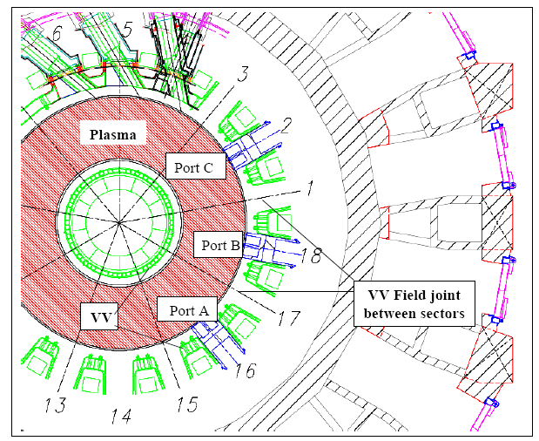
Test Blanket Module (TBM) Program is now an integral part of ITER
ITER provides substantial hardware capabilities for testing FW/Blanket Systems
Other parties have large programs to utilize this valuable testing space: EU (2), JA (1), CH (1), IN (1) half-ports
The 6th half-port is un-assigned, but the US has been asked to serve as the “interface coordinator” with the US DCLL Blanket concept – as representative of LB concepts
3 equatorial ports allocated, Each port can accommodate 2 modules (i.e. 6 TBMs max)
Neutrons, heat sinks, hot cells, etc. already paid for
He pipes to TCWS
Vacuum Vessel
A PbLi loop Transporter located in the Port Cell Area
2.2 m
TBM/Frame
TBM tests the FW/Blanket System (TBM + transport loops + T extraction + purification…)

Slide 3
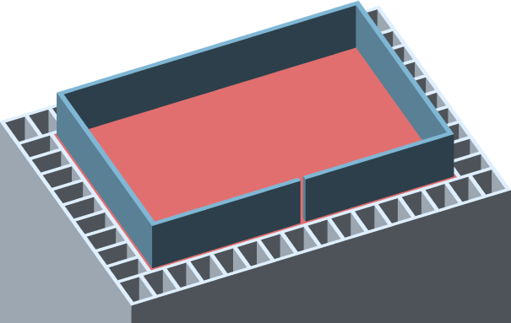
US Planning for ITER-TBM experiments
FNST community spent two years to formulate an ITER TBM technical plan and cost estimate
Focus testing on 2 concepts with substantially different feasibility issues (one LM based, one ceramic breeder based)
Capitalize on international collaboration with other ITER parties (strong interest world-wide in ceramic breeder and Pb-Li based blankets)
The plan was reviewed twice, the Technical review found the planning “complete and credible”
“The committee believes that the TBM effort is essential for the overall development of fusion in the U.S. and strongly recommends that this effort continue,” review committee headed by M. Hechler, August 2006
Programmatic review found that base FNST program needs to be strongly strengthened
“…the fusion technology program must be strengthened if US participation is to be successful. A strong well-funded scientifically based FNT program is necessary… the US needs to make these investments today..,” review committee headed by D. Petti, June 2007
However, DOE has not yet decided whether the US would lead a TBM concept or be only a partner with one or more parties on concepts they lead
Self-cooled Pb-17Li Breeding Zone
SiC FCI
He-cooled steel structure
LM Option - DCLL Typical Unit Cell with SiC flow channel insert

Slide 4
Breakdown of ITER TBM Cost Estimate over 10 years as developed in FNST Community Study
Category | Examples of Activities | Reference Case Cost** | Comment
Basic R&D | Joining technologies for RAFS SiC FCI development LM MHD flow behavior experiments Solid breeder thermomechanics Tritium control and extraction Advanced predictive capabilities | $41M | Basic and applied R&D needed before ANY testing in an integrated environment (ITER-TBM, FNSF, etc.)
Design and Development Activities | TBM design and analysis Safety analysis and support Testing of scaled mockups in non-fusion facilities | $40M
TBM & Ancillary Equipment Fabrication | TBM fabrication & acceptance tests Ancillary coolant loops and support systems fabrication and acceptance tests | $10M | (for FNSF multiply equip cost by number of testing ports) The cost to lead a TBM concept (for FNSF project costs will also be much larger)
“Project” Costs | Administration and management for US share Contingency | $23M
Total Costs (over the next 10 years) |  | $114M | Including escalation and contingency
** Reference Case – Lead DCLL international consortium, support HCCB consortium with US R&D and submodule
Notes:
4

Slide 5
Observations
The US ITER TBM study (2005-2007) to develop a technical plan and cost estimate provided
1-understanding of the detailed R&D requirements (specific tasks, cost, and time) and
2- insights and experience into the practical, complex, time-consuming, and cost aspects involved in preparing to place a test module and conduct experiments in the fusion nuclear environment.
Report is on web site http://www.fusion.ucla.edu/ITER-TBM/
The experience and results from this detailed ITER TBM study provide important input to inform the US current FNS initiative and FNSF activities.

Slide 6
Recent Actions on ITER TBM
The ITER TBM program has been formalized by the ITER Council as an important part of ITER and as essential to ITER achieving its objectives.
A TBM program committee (TBM-PC) has been formed with official participation by the 7 parties. TBM-PC reports directly to the ITER Council.
TBM-PC held 3 meetings (March 2009, September 2009, May 2010). Next meeting is planned for October 2010.
In TBM-PC-1 Korea announced it will not lead a concept. The half port for Korea became vacant. A case was made that this half port should be reserved for “liquid breeders” to maintain balance with “solid breeders”. The US agreed to serve as “interface coordinator” for this half port and to use DCLL as representative of liquid breeder blankets. This was considered a temporary measure to:
Define a representative interface with ITER.
Prevent the TBM half-port to be taken over by non-TBM activity.
This provided an opportunity for the US to keep options open until DOE decides whether the US would lead a concept. However, the US member to TBM-PC made it clear that the US does not have the resources to fulfill the “responsibilities” of interface coordinator and that the US will do only limited effort – often on delayed time schedule. The US also asked that another party share the responsibility. Korea agreed to be the “Interface Co-Coordinator”.

Slide 7
TBM Concepts Port-Sharing
The six TBM Systems to be installed in ITER in the initial ITER H-operation
are the following :
Port No. and PM | TBM Concept | TBM Concept
16 (PM : EU) | 1 - HCLL (TL : EU) | 2 - HCPB (TL : EU)
18 (PM : JA) | 3 - WCCB (TL : JA) | 4 - DCLL (InCo: US (KO))*
2 (PM : CN) | 5 - HCCB (TL : CN) | 6 - LLCB (TL : IN)
*Interfaces Coordinator (US with support from KO)
PM : Port Master, TL : TBM Leader
HCLL : Helium-cooled Lithium Lead
HCPB : He-cooled Pebble Beds (Ceramic/Beryllium)
WCCB : Water-cooled Ceramic Breeder (+Beryllium)
DCLL : Dual-Coolant (LiPb & He) Lithium-Lead
HCCB : He-cooled Ceramic Breeder (+Beryllium)
LLCB : Lithium-Lead Ceramic Breeder (LiPb & He, Dual-Coolant type)

Slide 8
Exploring TBM Partnerships with Other Parties
DOE instructed the US TBM team to explore TBM partnerships with other parties and define possible options and conditions for such partnerships.
Key US team members held a meeting with EU (at F4E) to explore TBM partnerships, April 29-30, 2009.
Key US team members held a meeting with Japan (JAEA and Japanese Universities) to explore TBM partnerships, August 4-5, 2009.
Key US team members held a meeting with Korea to explore TBM partnerships, November 23-24, 2009.
All meetings were productive
Several areas of interest for potential collaborations were identified for each party
Information conveyed to Governments
Further action will depend on how governments wish to proceed
The US intends also to hold exploratory discussions with China and India.
Follow up discussions with EU, Japan, and Korea and other parties need to be planned. This awaits DOE decision.

Slide 9
Key points on US FNST Status
The US FNST research activities continue to focus on the most important technical issues with high scientific content and substantial potential for an improved vision of a fusion energy system.
The US continues to perform fundamental R&D on its preferred blanket concepts: DCLL and PBCB (the much larger part being DCLL). These are the same US options for ITER TBM leadership or partnership.
Such FNST research effort and R&D is needed for ITER TBM, for FNSF, or any DT-related facility in the US. It is also necessary in order 1- for the US to develop (any) meaningful perspective on the most challenging fusion issues that lie ahead, and 2- for the US to gain access to information from the much larger international activities
The US, despite severely limited resources, continues to have leadership in the world program in key technical areas. The US FNST team still has major influence on the strategy, priorities, and activities of the international program.
Resources allocated to FNST in the US must be increased soon!!

Slide 10
Key Research Areas in the US “Base” FNST Program that have been Providing Support to TBM Activities
MHD flow Dynamics for liquid metal blankets (UCLA; Hypercomp)
Interfacial phenomena, MHD Heat and Mass Transfer, Corrosion, Tritium Transport (UCLA; SBIRS: HyPerCom, Ultramet, Hypertherm)
Compatibility, Corrosion experiments (ORNL, SBIRs: Ultramet, Hypertherm)
Tritium permeation and recovery (INL, UCLA)
Safety analysis and modeling (INL)
FCI material/component development & properties (ORNL, PNL; SBIRS: Ultramet, Hypertherm)
Irradiation effects in RAFM steels and SiC (Materials Program )
Integrated modeling / Virtual TBM (UCLA, UW; SBIR: Hypercomp)
Beryllium armor joining to RAF/M steel (UCLA)
Ceramic breeder thermomechanics (UCLA)

Slide 11
US Activities on TBM the Past Year
Technical progress on fundamental FNST R&D
This is essential to building US capabilities for leadership or partnership on ITER TBM. It also strengthens US position in negotiating partnership agreements with other parties.
Actively participated in ITER TBM-PC meetings and activities.
Completed PrSR (Brad Merrill et al), which presents a comprehensive view of a US DCLL Test Blanket System (TBM) safety assessment.
Clement Wong and others from the US participated in meetings of Workshop on TBM Impact on ITER plasma physics and potential countermeasures and Port-Management Group-18 meetings (Port Master Japan) and provided input on DCLL interface.
Explored options for TBM partnerships with EU, Japan, and Korea.

